Slide 1
MOBILE APP
What the Mobile App Offers
DISCOVER
APPLY
TRACK
Find the right job
Submit instantly
Stay informed
PROFILE & RESUME
JOB DISCOVERY
APPLICATIONS & NOTIFICATIONS
Onboarding — personal details
Resume builder — education, experience, skills, certifications, languages
Personalized feed — ranked by matching engine
Search & filter by type, salary, location, arrangement
Favorite jobs to review later
One-tap apply with optional cover letter
Application tracker — real-time status updates
Push notifications (Firebase FCM) + email opt-in
Mobile App
24

Slide 2
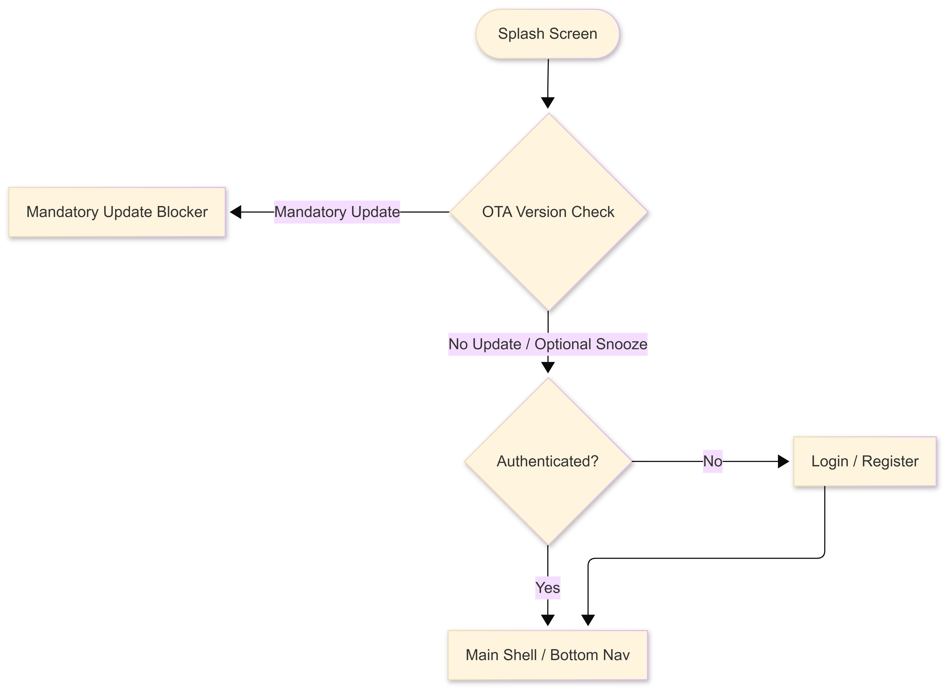
MOBILE APP
Application Architecture & Navigation Flow
BOTTOM NAVIGATION — 4 TABS
Tab 1 — Home
Recommended jobs & Saved jobs (Favorites)
Tab 2 — Jobs
All jobs list, search, filters & work arrangements
Tab 3 — Applied
Applications status tracker
Tab 4 — Profile
Edit profile, resume builder, app settings & info
Startup: OTA version check runs before any screen loads
Mobile App
25

Slide 3
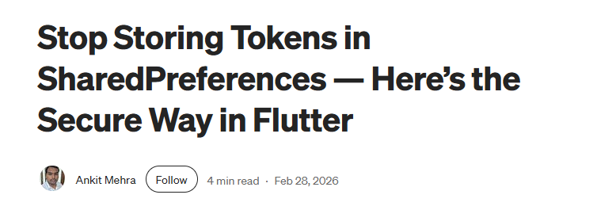
SECURITY
Why We Don't Store JWT in SharedPreferences
SharedPreferences
flutter_secure_storage
Stored as plain XML on disk: /data/data/<package>/
Readable by any process with root access
Not encrypted at the OS level
Cloud backup by default — token survives app uninstall on some devices
No iOS Keychain equivalent
Android: Android Keystore + EncryptedSharedPreferences
iOS: native Keychain Services API
Keys are hardware-bound on supported devices
Cleared on app uninstall (unlike cloud-backed prefs)
Trade-off: ~1–3 ms read vs ~0.1 ms — negligible in a login flow
Trade-off: wiped on factory reset → user simply re-authenticates
"The performance penalty is negligible.
The security boundary is not optional."
Security
26

Slide 4
SECURITY
Authentication Flow & Dio Interceptor
AuthInterceptor
Global Dio wrapper
Reads JWT from flutter_secure_storage
Appends Authorization: Bearer <token> to every request
Intercepts 401 / 403 → delegates to AuthDialogManager
Token logic never reaches the UI layer
AuthDialogManager — Semaphore
Problem: Profile page fires 4 parallel calls. All 4 return 401 simultaneously → 4 dialogs stack.
Solution — boolean semaphore:
First 401 → raise flag → show dialog
Subsequent 401s → flag is true → silently swallowed
Security
27

Slide 5
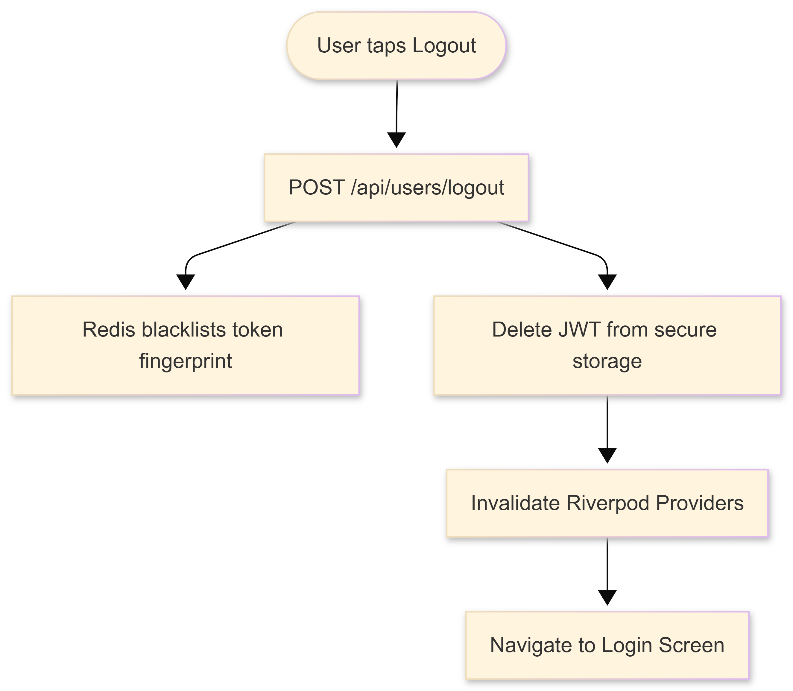
SECURITY
Logout & Multi-Account Cache Isolation
What gets cached — providers:
Profile data — name, photo, role
Resume data — skills, education, experience
Applied jobs list — status per job
Favorite jobs list — bookmarked IDs
Interest tags — field-of-interest chips
Job feed pages — paginated results
Search results — last query + filters
Notifications — unread count + list
Currency setting — selected code
Language setting — AR / EN
Personal info — contact details
Auth state — current principal
"On a shared device, skipping any one of these leaks the previous user's data to the next. Seasonal workers share devices — this is a real scenario."
Security
28

Slide 6
OTA UPDATES
The Play Store Problem — Why We Built Our Own Update System
1
Developer signs APK
2
Uploads to Play Store ($25 one-time fee)
3
Store notifies all installed users
4
User downloads with one tap
Our Constraint
As a graduation project, the Play Store fee is a cost we chose not to commit to before validating the product. We still required: automated APK builds on every push, user update notifications, and frictionless download.
Problem 1 — Build automation
Problem 2 — Update notification
→ GitHub Actions CI/CD — builds and publishes a new APK release on every push
→ Mobile client queries GitHub Releases API directly — no backend relay needed
No intermediary — one fewer network hop — no extra backend code required.
OTA Updates
29

Slide 7
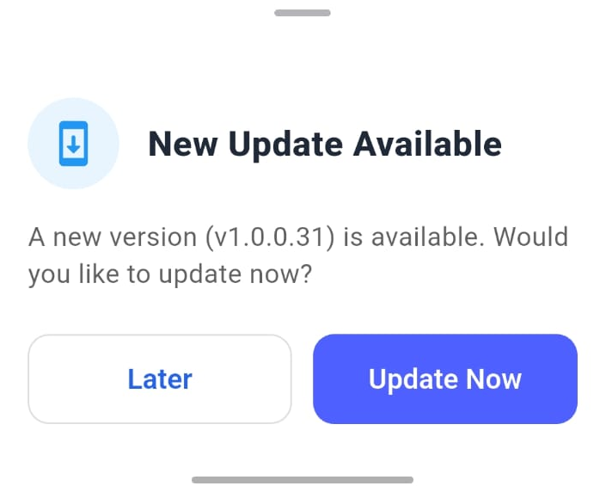
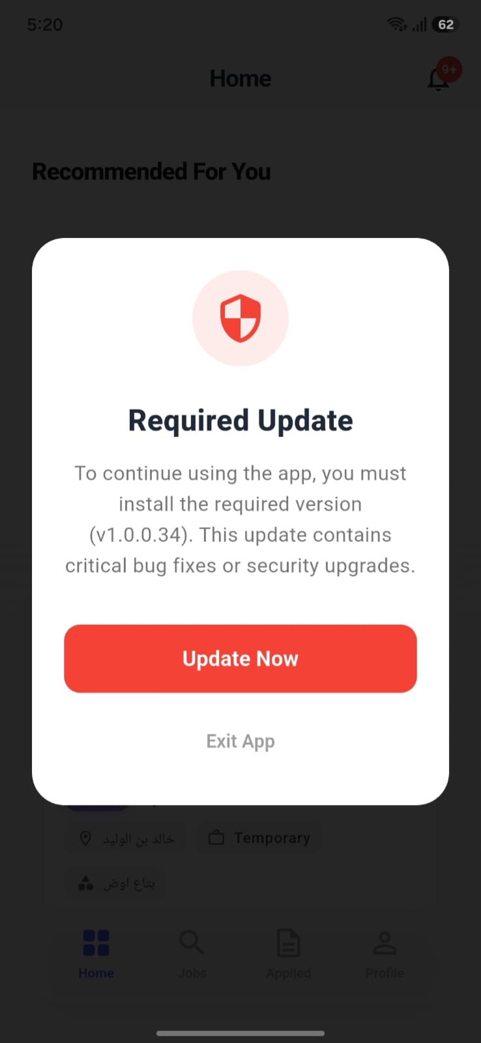
OTA UPDATES
OTA Implementation — Mandatory vs Optional & Snooze Flow
OTA Updates
30

Slide 8
PERFORMANCE
Parallel Aggregation — Eliminating Sequential Round-Trips
The Problem
Solution — Future.wait
Profile page requires 4 API calls:
GET /api/users/{uid}
GET /api/applications/user
GET /api/jobs/favorites
GET /api/users/FOI/{uid}
await Future.wait([
getProfile, getApplications,
getFavorites, getInterests
]);
Sequential → TTI ≈ ~800ms
TTI = max(t1, t2, t3, t4) ≈ 200ms → ~75% reduction
Trade-off: Future.wait throws immediately if any call fails. Mitigation: error boundary wraps the profile notifier — sections show skeleton loaders on partial failure.
Performance
32

Slide 9
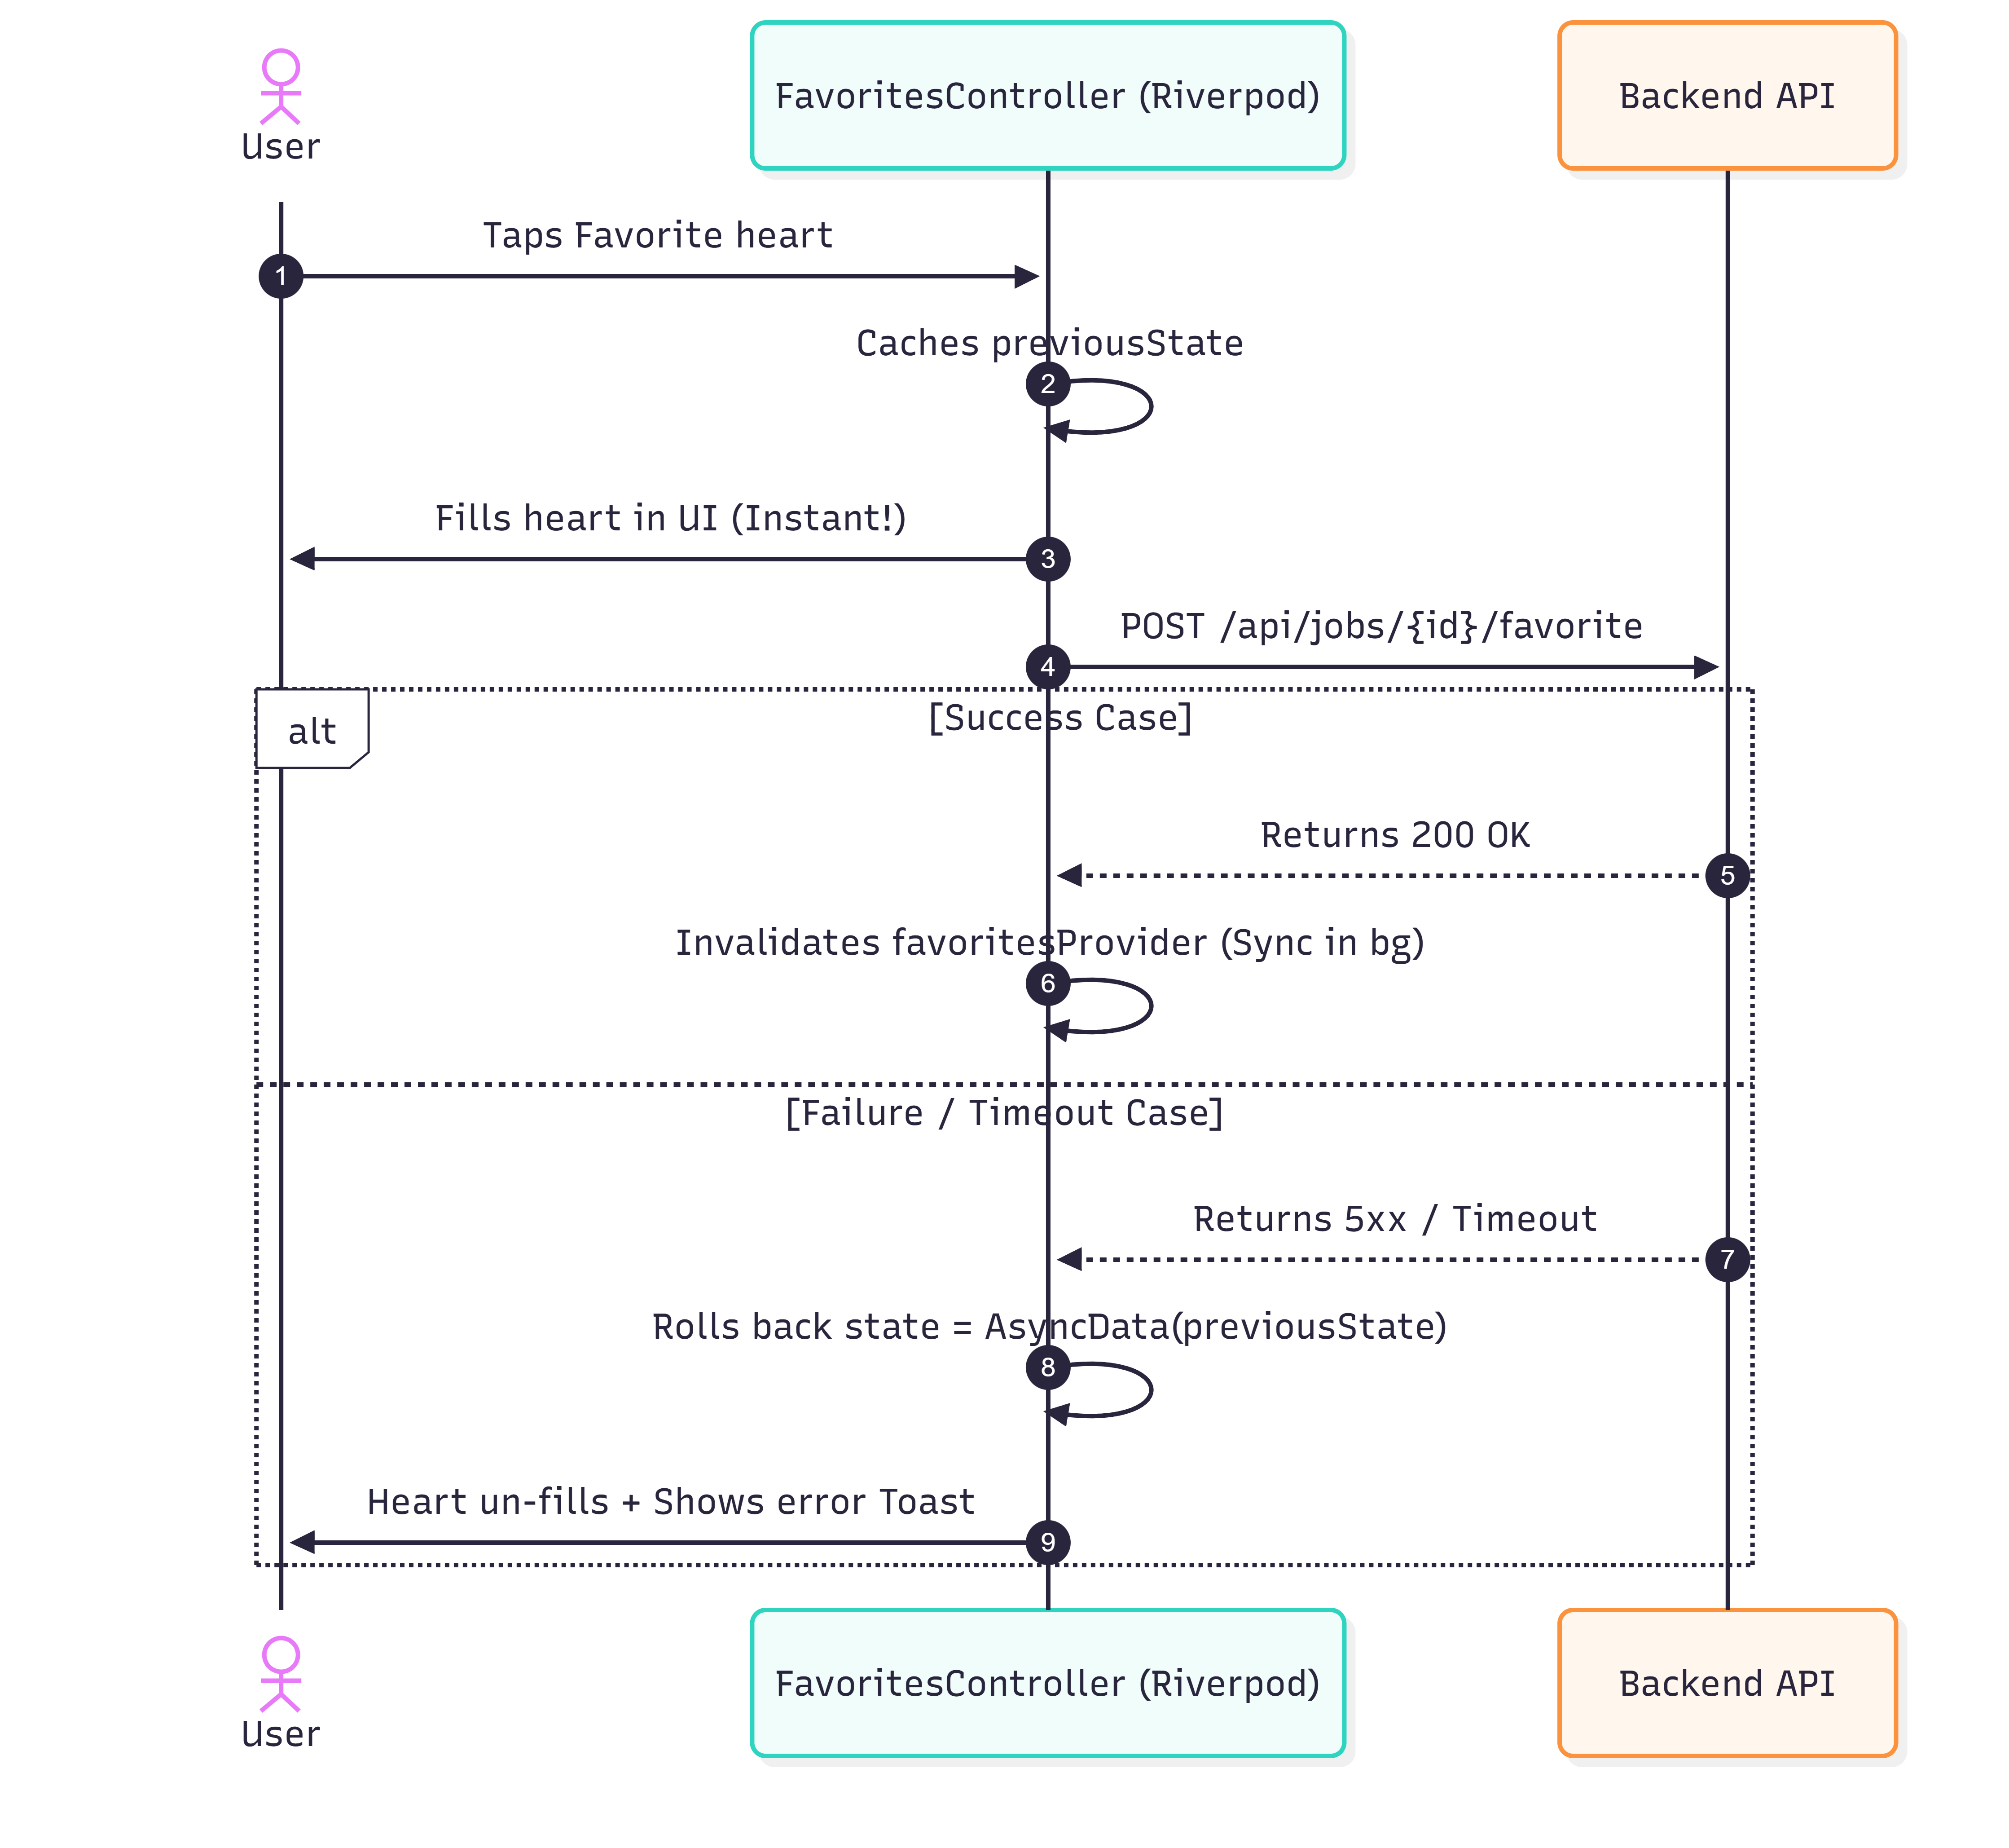
PERFORMANCE
Optimistic UI Updates & Automatic Rollback
FavoritesController Pattern
1. Cache current state
final previousState = state.value;
2. Update UI immediately
state = AsyncData(updatedList);
3. Fire async HTTP request
4a. On success
ref.invalidate(favoriteJobsProvider);
4b. On failure → rollback
state = AsyncData(previousState);
Trade-off: brief inconsistency on server rejection → mitigated by immediate rollback + visible error toast.
Performance
33

Slide 10
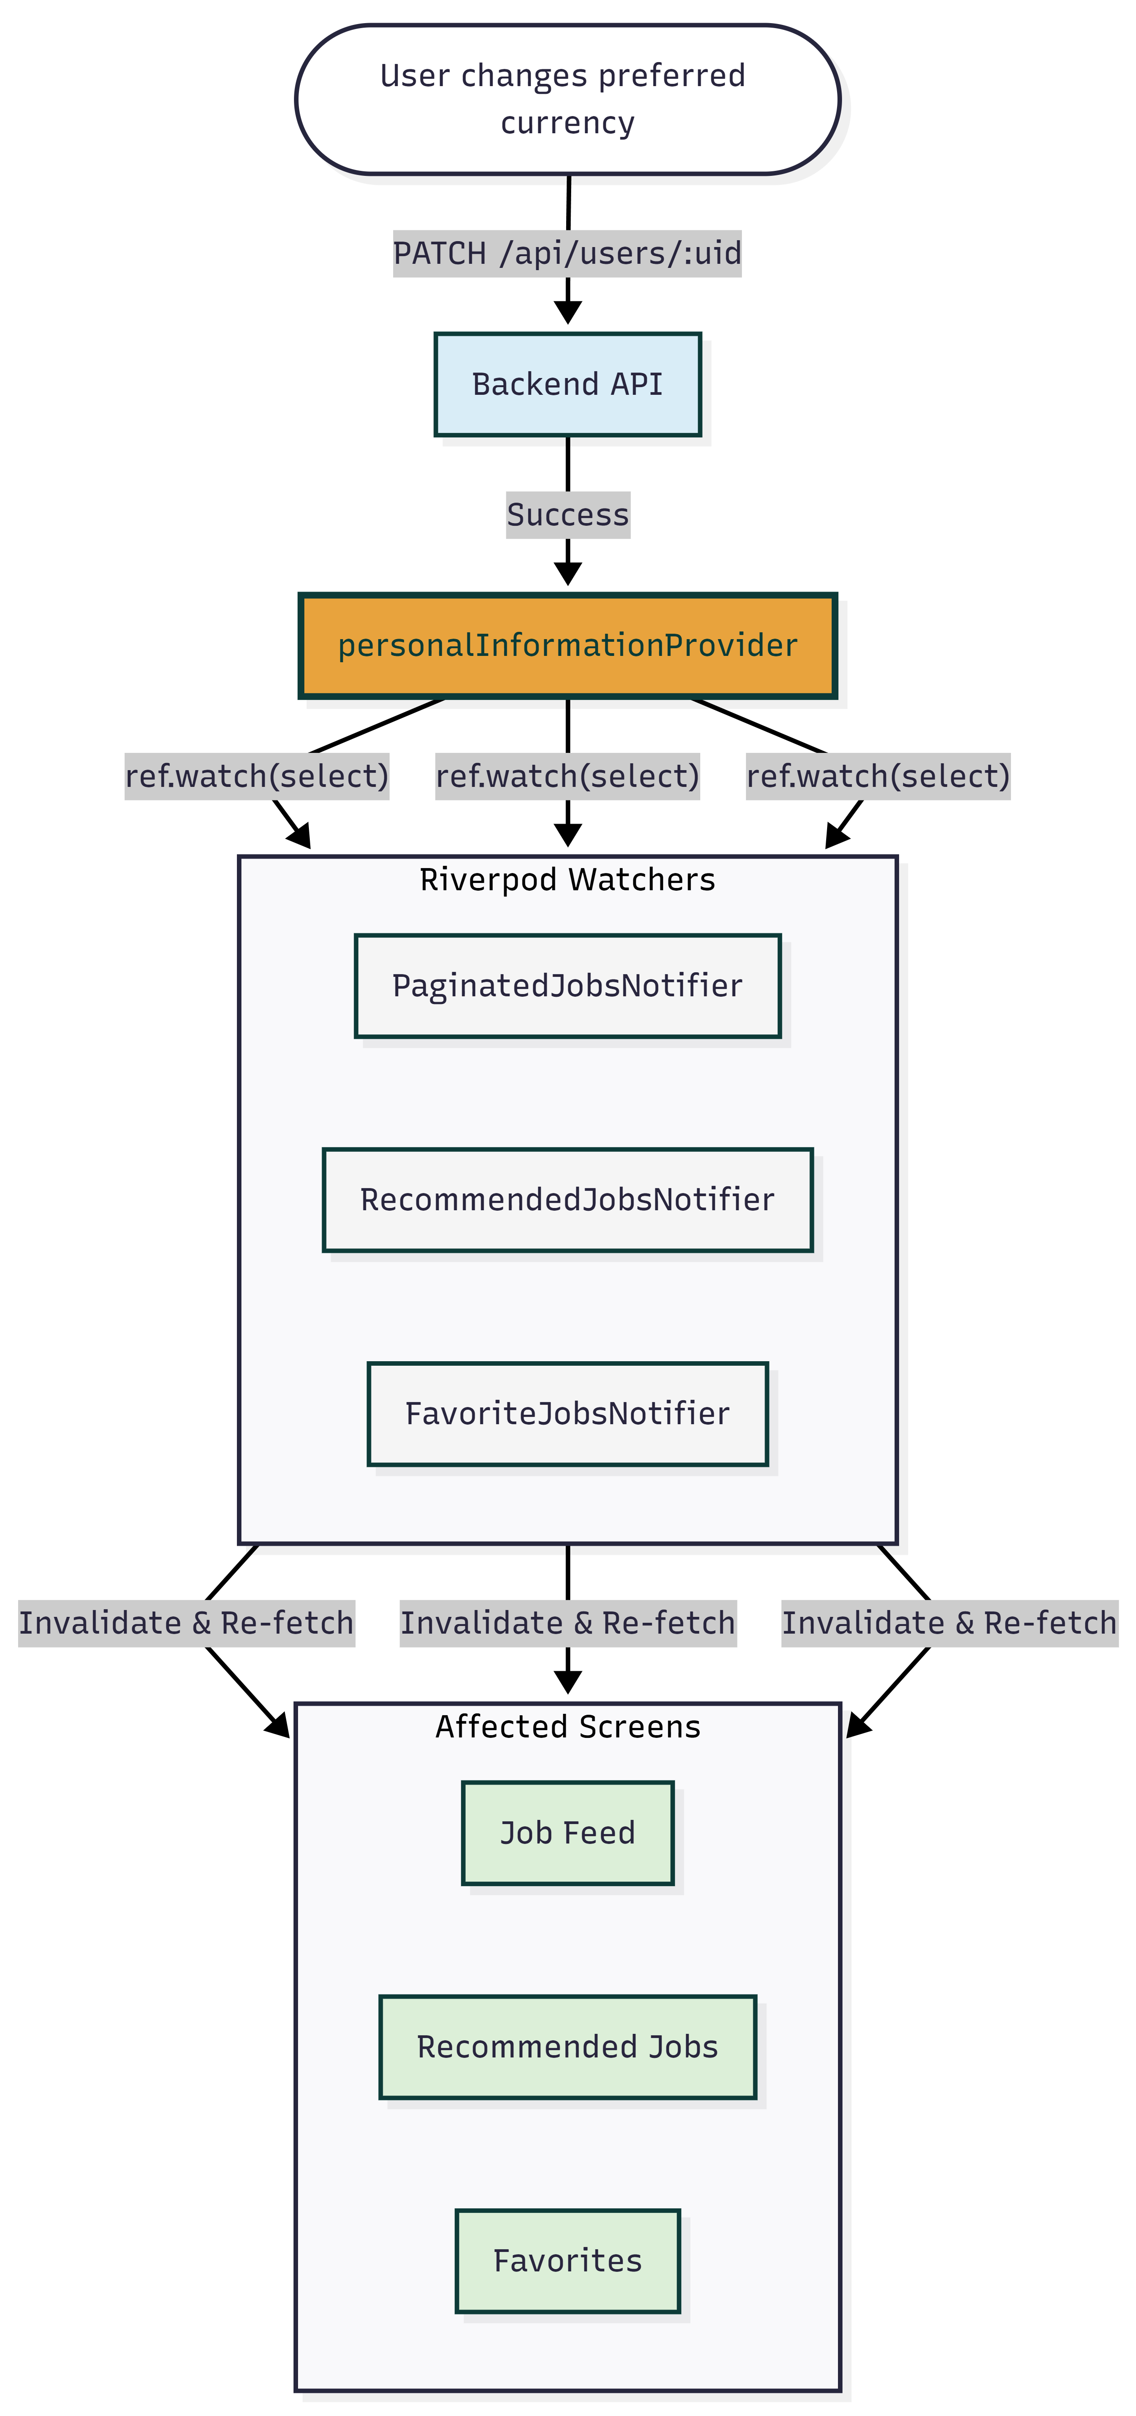
STATE MANAGEMENT
Multi-Currency — Reactive State Propagation
Supported Currencies
EGP (default) • USD • SAR • extensible to any ISO 4217 code
How it works
1. User selects currency in Settings
2. PATCH /api/users/{uid} — backend sync
3. personalInformationProvider updated
4. Job feed providers watch:
ref.watch(personalInformationProvider
.select((u) => u.value?.currency));
5. Currency change → auto-invalidates → feed reloads
6. intl.simpleCurrency() formats: $1,200 / EGP 15,000
No event bus. No refresh button. No imperative callbacks.
State Management
34

Slide 11
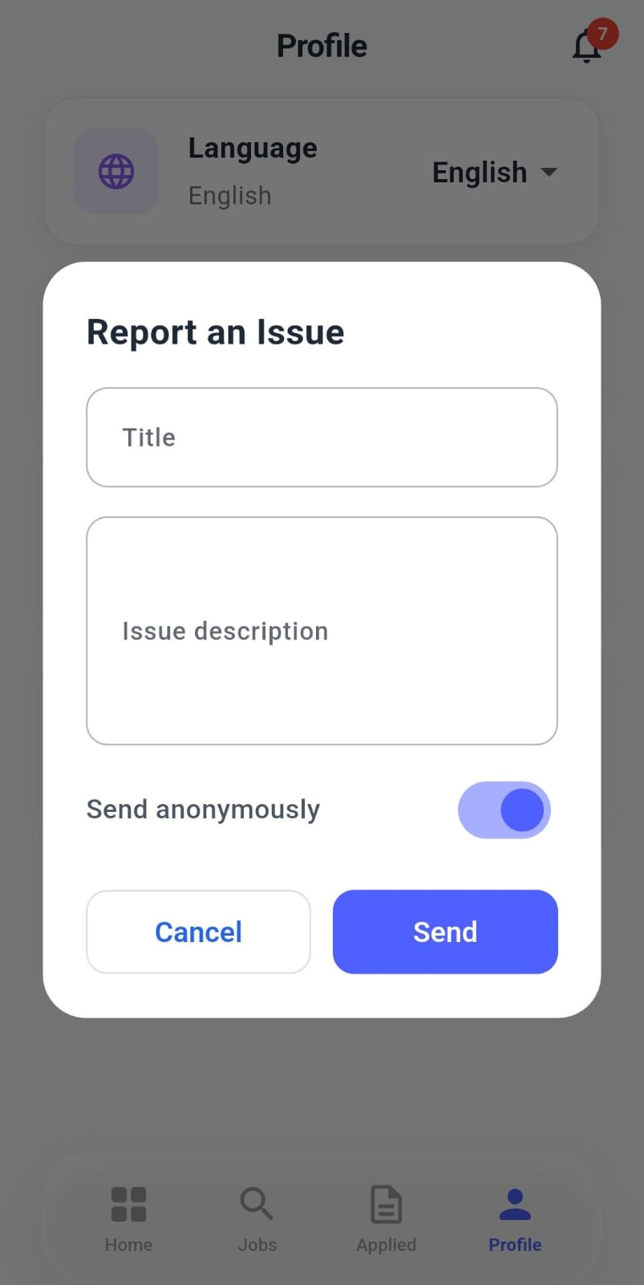
UX & QUALITY
In-App Feedback & Anonymous Submission
Why it exists
Every shipped app has bugs that survive testing. Users need a low-friction channel to report issues directly from the device.
Benefit:
Enables workers to report employer misconduct, payment issues, or safety hazards safely without disclosing their identity, preventing retaliation.
UX & Quality
35

Slide 12
PERFORMANCE
Benchmarks — State Engine vs UI Rendering
Data Scale | CPU Execution Latency | Status
100 Jobs | ~0.15 ms | Excellent
1,000 Jobs | ~1.25 ms | Excellent
10,000 Jobs | ~8.10 ms | Good
100,000 Jobs | ~14.50 ms | Safe (< 16.6 ms)
Jobs in Heap | Est. Memory Usage | Status
100 Jobs | ~150 KB | Negligible
1,000 Jobs | ~1.5 MB | Safe
30,000+ Jobs | ~45.0 MB+ | OOM Risk
Engineering Justification
The Riverpod state engine is computationally efficient at any scale. The bottleneck is Flutter's widget inflation — rendering 1,000+ job cards consumes significant RAM and causes frame jank on low-end Android hardware (the dominant device class in our target market). Hybrid Pagination: auto-scroll pauses at 200 items in the widget tree → user taps "Load More" to continue. The 14.5ms benchmark proves the limit is device rendering — not state management.
Performance
36

Slide 13
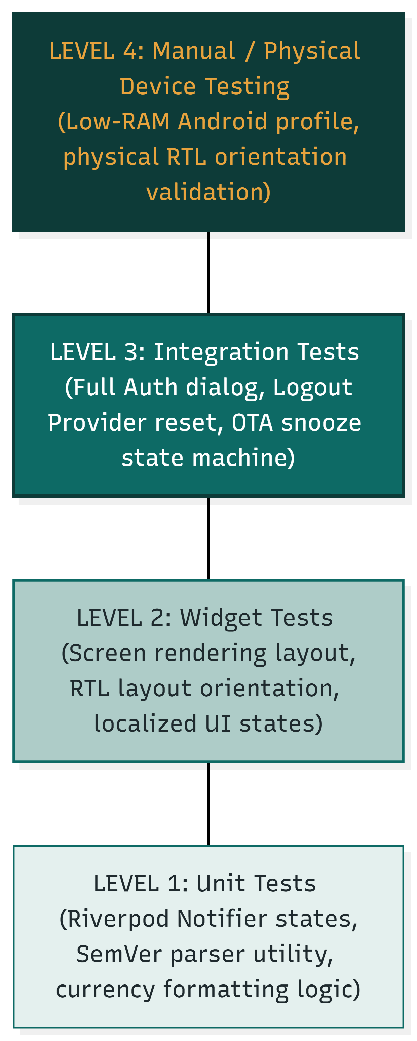
TESTING
Testing Hierarchy & Key Validation Scenarios
Testing
37

Slide 14
SUMMARY
What Was Built — What Comes Next
COMPLETED
ROADMAP
Full onboarding — personal details
Resume builder — education, experience, skills, certifications, languages
Personalized job feed (matching engine integration)
Search & filter by type, location, salary, arrangement
One-tap apply with optional cover letter
Application status tracker (real-time)
Push notifications (Firebase FCM) + email opt-in
Favorite jobs — optimistic UI + rollback
Secure JWT storage (flutter_secure_storage)
Dio AuthInterceptor + AuthDialogManager semaphore
Multi-account cache isolation (12 providers on logout)
OTA update system — mandatory + optional + 24-hr snooze
Arabic / English localisation + full RTL support
Multi-currency display (EGP, USD, SAR) — reactive state
Parallel aggregation on profile page (Future.wait)
In-app feedback with anonymous submission
Performance benchmarks + hybrid pagination (200-item limit)
In-app messaging (employer ↔ job seeker) — requires WebSocket server
Employer rating & review system
Interview scheduling in-app (calendar integration)
Offline mode — cached feed for low-connectivity areas
Semantic job search (NLP / vector similarity)
Play Store publication (post-pilot validation)
iOS build + App Store submission
Summary
38

