Slide 1
ATRIUM
The AltoLumo solo operator sales console
One console runs both inbound and outbound lead generation over an AI sales crew inside Claude Code.
You manage the crew, the crew works the leads.
Version 5.0 Project code ATR Kenneth Benavides July 5, 2026

Slide 2
THE PROBLEM
One operator, two full-time jobs
Generating leads and working leads are each a full-time job, and a solo operation has one person for both. Manual outbound research does not scale, and inbound cannot wait, so one stream always gets neglected.
1
2
3
Outbound is slow
Inbound cannot wait
Context switching
Hours of company research per account before a single message goes out.
A generic contact box yields cold, delayed first replies and lost interest.
Two streams, one person, and only so many hours in a day.
The fix. One console drives an AI crew across both lead streams. The crew does the research and qualification so the operator only shows up to close.

Slide 3
THE SHAPE OF THE SOLUTION
Two lead streams, one crew, one console
1
Inbound
2
Outbound
3
One pipeline
A consultation funnel on the AltoLumo site captures visitors who raise a hand, one tappable question at a time.
The crew sources and qualifies target companies you point it at, returning a scored, contact-mapped prospect.
Both streams land in Supabase, where the crew researches, qualifies, scores, and drafts outreach for every lead.
Inbound arrives through the funnel, outbound is sourced by the crew, and both are managed from a single console that shows the pipeline and launches every crew command.

Slide 4
SYSTEM ARCHITECTURE, HOW IT WORKS
Four layers over one engine
Inbound funnel
Next.js on Vercel, public
Operator console
Next.js, local
Local launcher
Node helper
Claude Code crew
The engine
Orchestrator + crew
13 sub-skills, 5 parallel agents, 4 scripts, 6 templates
Supabase
Leads, targets, runs, artifacts . single source of truth
The funnel and console read and write Supabase. The console calls the launcher, the launcher drives the crew, and the crew writes its scores and artifacts back to Supabase for the console to render.
Inbound / structural
Crew engine
Source of truth

Slide 5
STREAM ONE, INBOUND
The consultation funnel, an elicitation flow
Built on the elicitation-widget: five focused steps, one tappable question at a time, then a real Cal.com booking. Built for a phone.
1.
Company
2.
Challenge
3.
Timeline
4.
Budget
5.
Book
Write lead
One row to Supabase
Confirm + alert
Resend to customer and operator
Onto pipeline
Appears on the console board
Under 3 minutes to a confirmed slot. The booking writes one lead, confirms the customer, alerts you, and drops the lead onto the same pipeline as your outbound prospects.

Slide 6
INSIDE /ATRIUM PROSPECT
Discovery, five parallel agents, one score
atrium-company Company Fit
25%
atrium-contacts Contact Access
Discovery
Fetch + brief
20%
Synthesis
Weighted avg
0-100
composite
+ grade
atrium-opportunity Opportunity Quality
20%
atrium-competitive Competitive Position
15%
atrium-strategy Outreach Readiness
20%
Weights live in qualify.config.json and sum to one, so a new agent is a data change plus one file. The run writes PROSPECT-ANALYSIS.md and persists the composite, the grade, and each category score.

Slide 7
THE TWO SHARED SKILLS, INCORPORATED
Where kajiro and elicitation sit
kajiro-prompt-optimizer-pro . the prompt-quality layer
Console run
Operator triggers
Orchestrator
/atrium routes
Kajiro optimize
Auto mode, 14-pt rubric, silent
Dispatch
Skill or 5 agents run
elicitation-widget . the intake layer, one engine, three surfaces
Question inventory
Declared per surface
Intake engine
Batched tappable
Funnel
Target add
ICP editor
Both are configuration, not new logic. Kajiro optimization is a data-driven step before dispatch, and every operator intake reuses one engine, so the funnel, target add, and ICP editor behave identically.

Slide 8
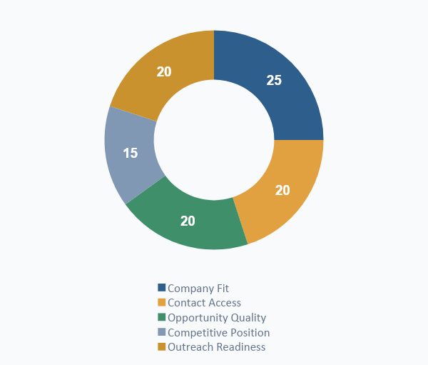
THE SCORING ENGINE
A weighted score, zero to one hundred
A+
90-100
Hot lead, prioritize now
A
75-89
Strong, worth real effort
B
60-74
Qualified, standard approach
C
40-59
Nurture, do not hard sell
D
0-39
Poor fit, deprioritize
The five categories compose into one number. Qualification feeds Opportunity Quality through BANT and MEDDIC, each dimension scored zero to twenty five with recorded evidence.

Slide 9
THE WALKTHROUGH
Both streams, one pipeline, six steps
1
Enter
2
Prospect
3
Qualify
Inbound books, or you add an outbound target
Crew runs discovery and the five agents
BANT and MEDDIC set Opportunity Quality
4
Score
5
Prep
6
Work
Composite 0-100 and a grade
Contacts mapped, brief and outreach drafted
You review in the console and close
Steps two through five are the crew running on its own. You only join at step six.

Slide 10
FAITHFUL INCORPORATION, VERIFIED AGAINST THE REPO
What comes straight from the reference build
Orchestrator
14 commands
/sales becomes /atrium, same routing
prospect, quick, research, qualify, and 10 more
5 agents
Weights
company, contacts, opportunity, competitive, strategy
25 / 20 / 20 / 15 / 20, exact
4 scripts
6 templates
analyze_prospect, lead_scorer, contact_finder, generate_pdf_report
cold, warm, referral, meeting-prep, proposal, objection
Scoring
BANT + MEDDIC
0-100 composite, A+ to D grade bands
each dimension 0-25, with evidence and strength
Atrium adds only what the repo lacks for this product: an inbound intake bridge, three database bridge scripts, the elicitation intake layer, the kajiro optimization layer, and the console and launcher above the crew.

Slide 11
THE BUILD
Stack, aligned to your standard
Next.js + TypeScript
Tailwind + React 19
Vercel
Supabase Postgres
Funnel and console, strict mode
UI layer
Funnel hosting
Source of truth
Node 22 launcher
Anthropic API
Python scripts
pnpm
Drives the crew
Crew reasoning in Claude Code
reportlab, beautifulsoup4, requests
Package manager, no npm or yarn
The crew and the two shared skills install under the Claude configuration directory. The funnel deploys to Vercel; the console, launcher, and crew run locally on your workstation.

Slide 12
DELIVERY
Three phases, hours favor Claude Code
1
Phase 1 Foundation
2
Phase 2 Core
3
Phase 3 Polish
Elicitation engine, funnel, console board, crew install, kajiro wiring, five agents, launcher, scoring, write-back
Outreach, follow-up, prep, proposal, reports and PDF, runs and artifact views, ICP editor
Objections, ICP, competitors, quick snapshot, accessibility, error hardening, deployment lockdown
77
219
142
Claude Code hours
Solo dev hours
Hour delta saved
Phase 1 stands up a working two-stream engine. Estimated launch, early to mid September 2026 at ten hours per week.

Slide 13
READY TO BUILD WITH CLAUDE CODE
PRD v5 is complete and Claude Code ready
Faithful to the reference crew, deepened to a build-ready spec, with the elicitation intake layer and kajiro optimization layer incorporated.
1
Install and adapt the crew, wire the launcher and kajiro
2
Build the elicitation funnel and the console board
3
Add a target, run /atrium prospect, watch the score write back
Atrium v5 Project code ATR Kenneth Benavides

