Slide 1
MODULE 1
Understanding
Coding Agents
> fix the build reason → act → observe → repeat $ dotnet build Build FAILED. reading Program.cs... applying fix... Build succeeded.
Building a mental model for MiniCode — the agent harness we’ll build in C# on Microsoft Agent Framework.
MiniCode Course · Phase 1

Slide 2


CORE CONCEPT
Chatbots vs. Agents
Chatbot
Agent
Answers a message and stops.
You send text, it sends text back — the interaction ends until you send the next message.
Everything it needs is already in the conversation you gave it.
“Why is the build failing?” → it can only guess from what you paste in.
Can act on the world, observe, and decide what’s next.
It runs the build itself, reads the error output, opens the offending file.
It works through several rounds of investigation you never had to script.
Same question, no guessing — it goes and finds out.
MODULE 1 — UNDERSTANDING CODING AGENTS
2

Slide 3

CORE CONCEPT
The Agentic Execution Loop
The mechanical heart of every agent, including MiniCode.
1
2
3
4
REASON
ACT
OBSERVE
REPEAT
Model decides what to do
Requests a tool call
Reads the tool result
Loops until answer is final
...until the model returns a final answer instead of another tool request
The takeaway: the loop, not the model, is what makes multi-step autonomous work possible. Every Module between now and Module 12 gives that loop something useful to do.
MODULE 1 — UNDERSTANDING CODING AGENTS
3

Slide 4


CORE CONCEPT
Autonomy Is a Spectrum, Not a Switch
SUGGEST ONE EDIT, STOP
WORK UNSUPERVISED UNTIL DONE
MiniCode sits here
Given "find out why the solution isn’t compiling and fix it," MiniCode chains file discovery, reading, editing, building, and testing on its own — but full autonomy over a real codebase needs limits.
Runs on its own
Needs human approval
• Reading a file
• Searching the repository
• Running dotnet build / test
• Deleting a file
• Running git commit
• Installing a package
MODULE 1 — UNDERSTANDING CODING AGENTS
4

Slide 5

CORE CONCEPT
Most of the Capability Is the Harness
It’s tempting to think a tool like Claude Code is "just a really good model." In practice:
THE HARNESS
Tool definitions
Workspace boundaries
Approval policy
Context management strategy
The loop that keeps it going
The model supplies reasoning. The harness supplies structure, safety, and persistence.
THE MODEL
MODULE 1 — UNDERSTANDING CODING AGENTS
5

Slide 6
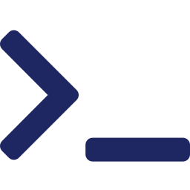




LAB — ARCHITECTURE
The MiniCode Architecture
Developer
MiniCode CLI
MAF Coding Agent
Workspace
Shell
Git
Read · Search · Edit
Build · Test
Status · Diff · Log
.NET Repository
One agent, no exceptions: no manager, planner, or reviewer agents — the CodingAgent never touches the filesystem directly.

Slide 7
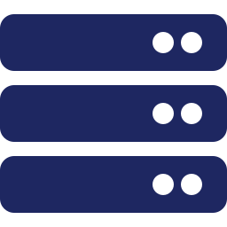

LAB — ARCHITECTURE
Component Responsibilities
MiniCode CLI
MAF Coding Agent
Tool Invocation
MiniCode.Cli
MiniCode.Agent
MiniCode.Tools
Terminal interface — accepts requests, streams activity, prompts for approvals.
Owns instructions, reasoning, tool selection, and the execution loop.
Defines each capability as a tool and shapes results into text.
Workspace
Shell + Git
Tests
MiniCode.Workspace
MiniCode.Infrastructure
MiniCode.Tests
Sandbox boundary — path validation, read/search/edit primitives, ignore rules.
Runs allowlisted commands and supplies Git status/diff/log, plus approval policy.
Covers everything above — not part of the runtime path, so absent from the diagram.
MODULE 1 — UNDERSTANDING CODING AGENTS
7

Slide 8
EXPECTED OUTPUT
What You Should Walk Away With
1
4
6
AGENT
CORE BEATS
PROJECTS
No multi-agent orchestration anywhere in this course
Reason → Act → Observe → Repeat
Map directly onto the architecture diagram
Articulate the chatbot-vs-agent difference, grounded in the reason–act–observe–repeat loop.
Redraw the MiniCode architecture diagram from memory, with correct component responsibilities.
Explain why MiniCode is a single-agent harness — and why that stays true for the whole course.
No code runs this Module — Module 2 starts implementing this architecture as the first MAF console app.

