Slide 1
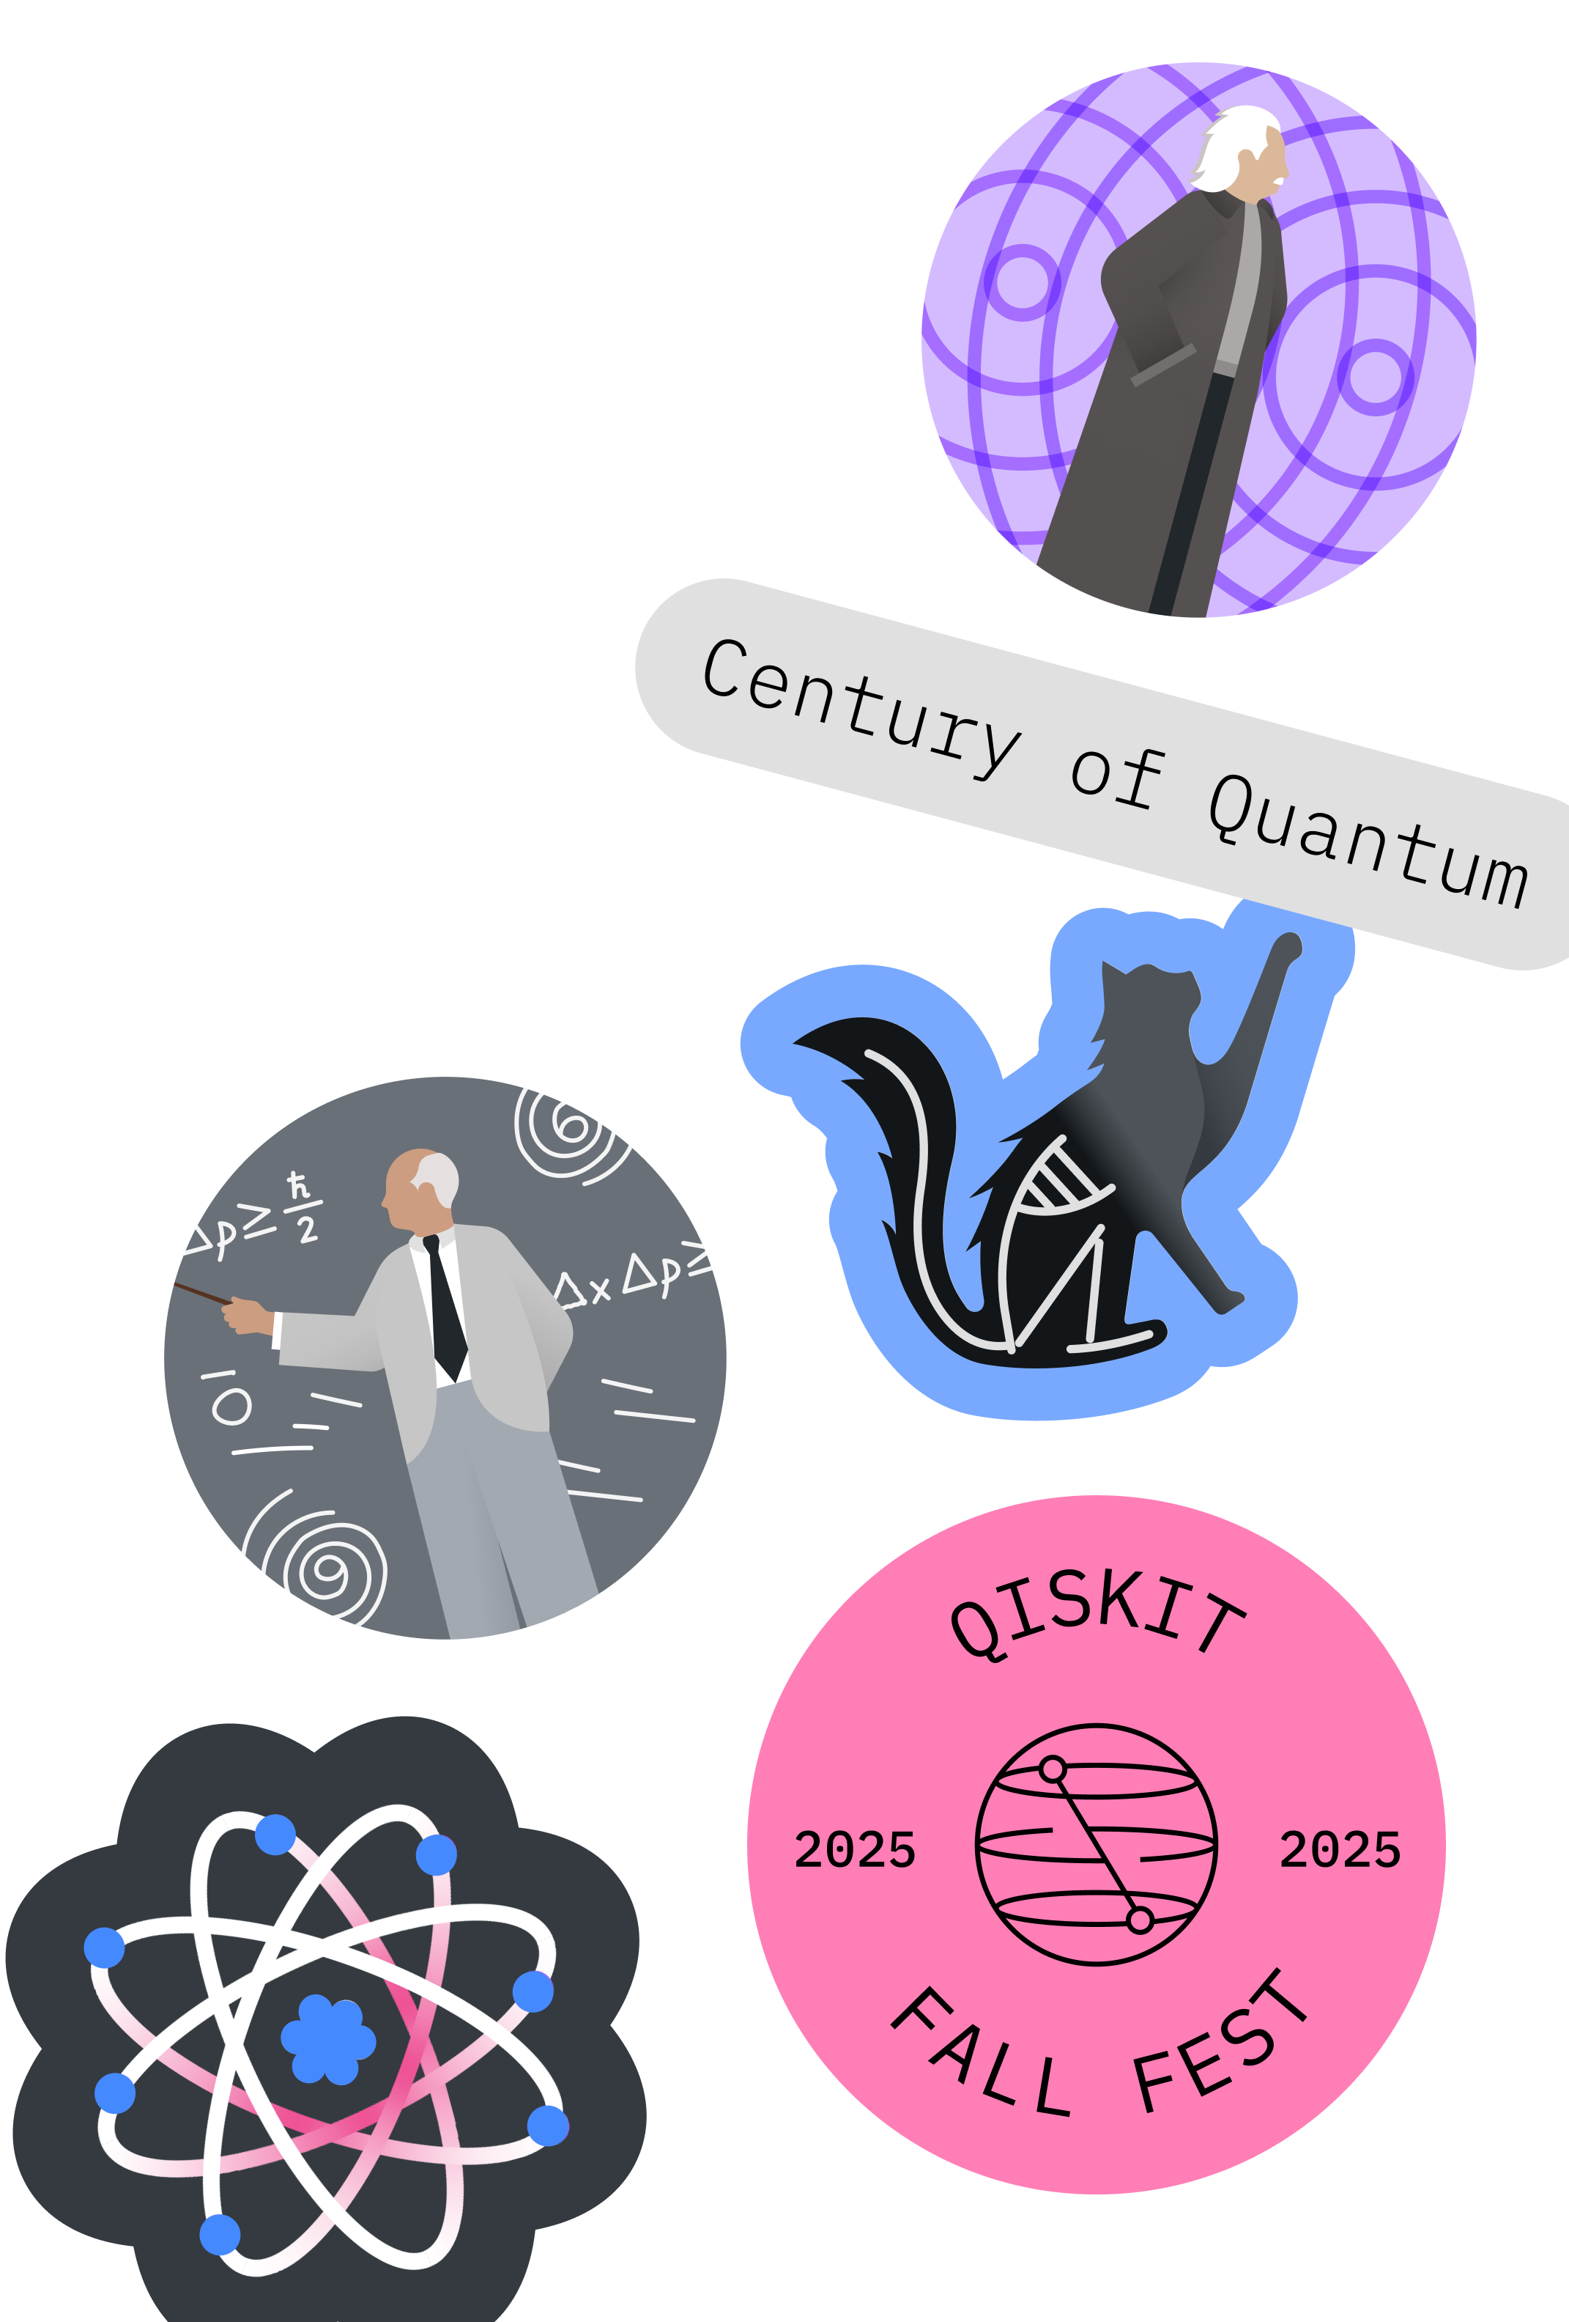
Fall Fest 2025, Halfway There!
Qiskit Fall Fest 2025
Natalie Hawkins Qiskit Advocate, Tier 1
Seattle Quantum Computing Meetup, Founder

Slide 2

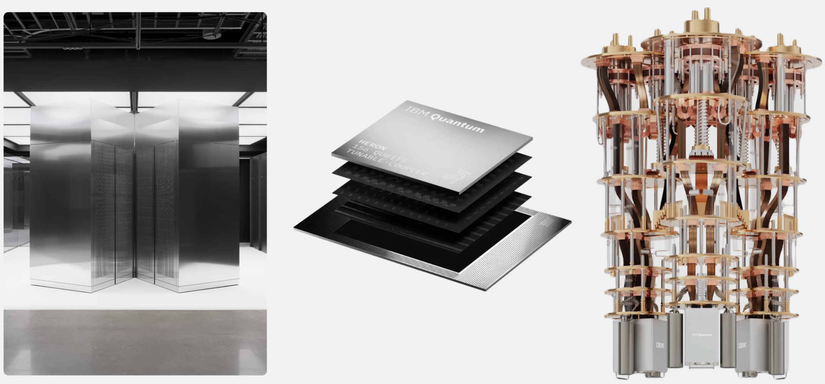
Qiskit Fall Fest 2025
Today’s Agenda
SQCM’s FF25 Materials
https://github.com/SeattleQuantumComputingMeetup/qiskit_fall_fest_2025/tree/main
Who else is hosting?
https://www.ibm.com/quantum/events/fall-fest-2025
What is the International Year of Quantum Science and Technology (IYQ)?
Why does this Year's Nobel Prize in Physics Matter for Quantum Computing?
Real world interactions: HowTo with Qiskit and Quantum Computers

Slide 3
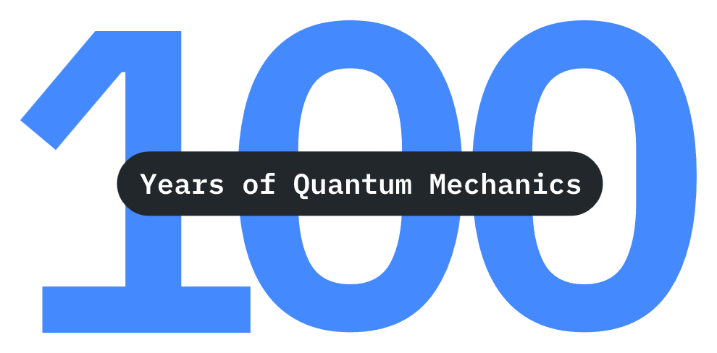
International Year of Quantum Science and Technology, IYQ
Declared by the UN
year-long, world-wide initiative
will “be observed through activities at all levels aimed at increasing public awareness of the importance of quantum science and applications”.
1925: significant progress was made in quantum mechanics, with Wolfgang Pauli announcing the exclusion principle and Werner Heisenberg developing matrix mechanics (Google AI Overview)
https://quantum2025.org/

Slide 4

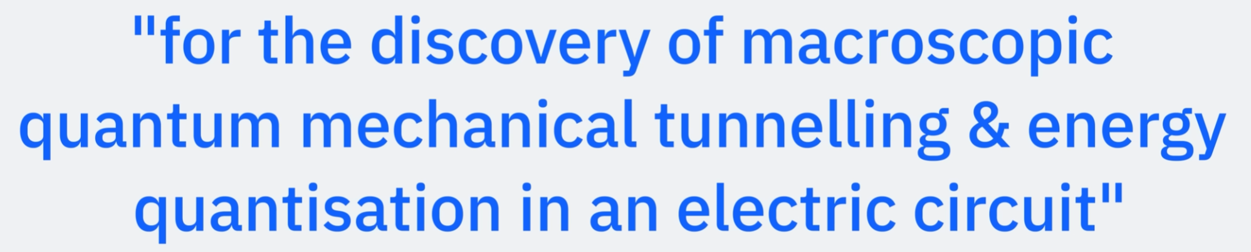
Nobel Prize in Physics, 2025 Clarke, Devoret, Martinis
Why This Year's Nobel Prize Matters for Quantum Computing,
Qiskit Channel, Christopher Porter
https://www.youtube.com/watch?v=N4zxJ5iJRhg

Slide 5
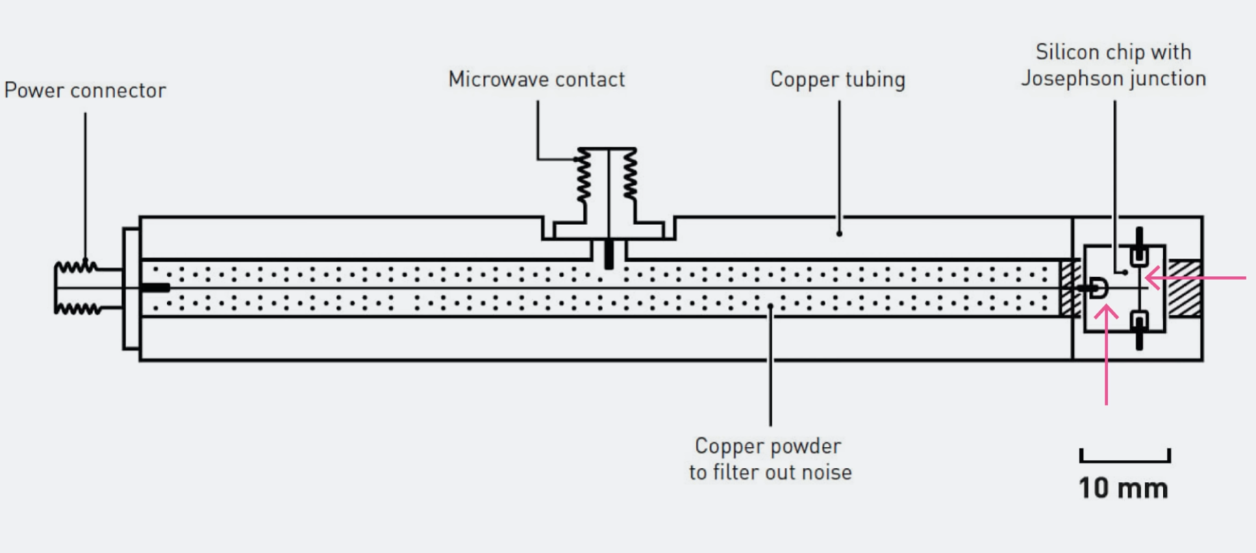
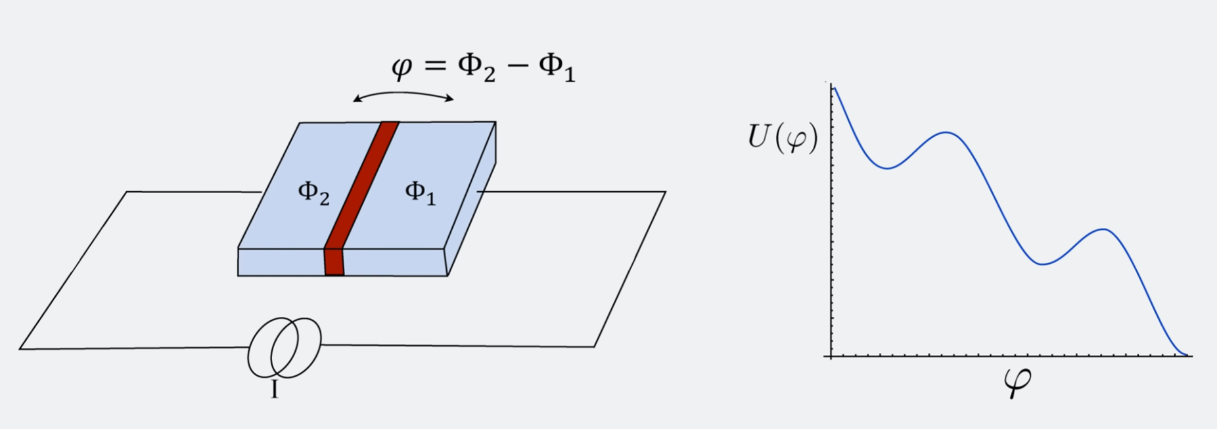
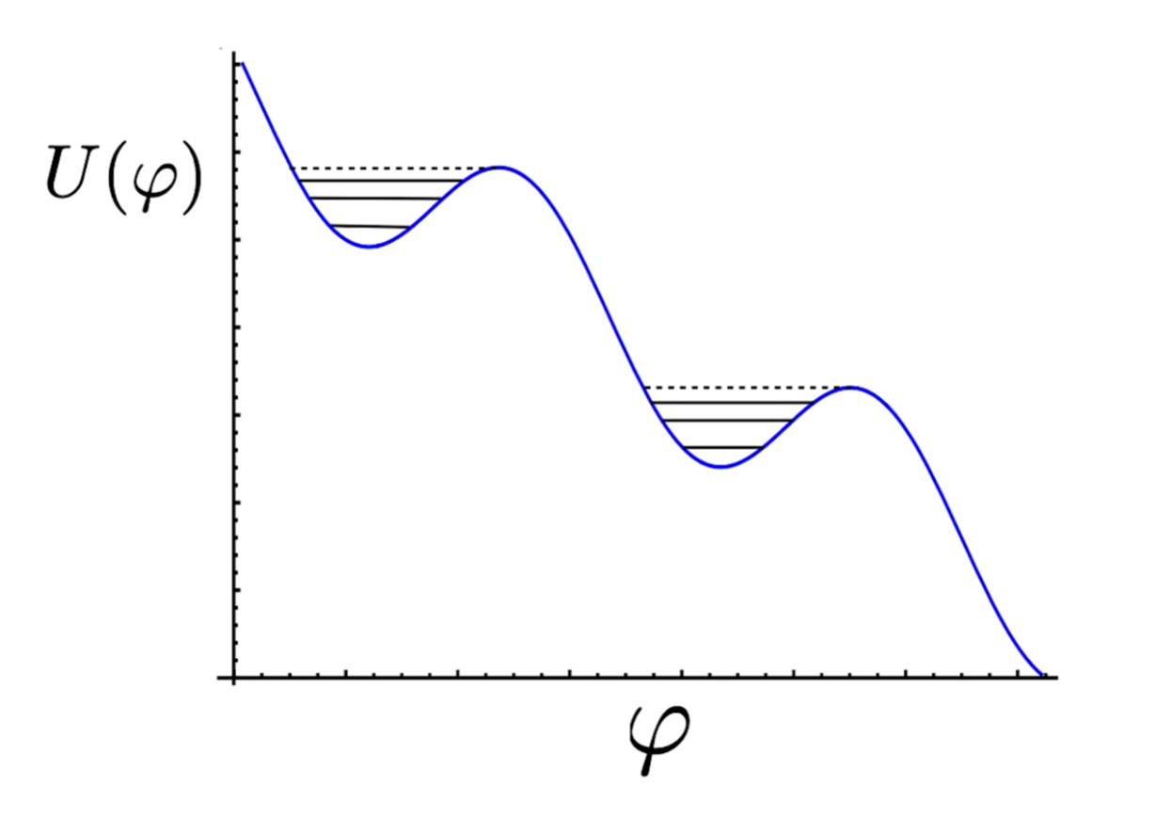
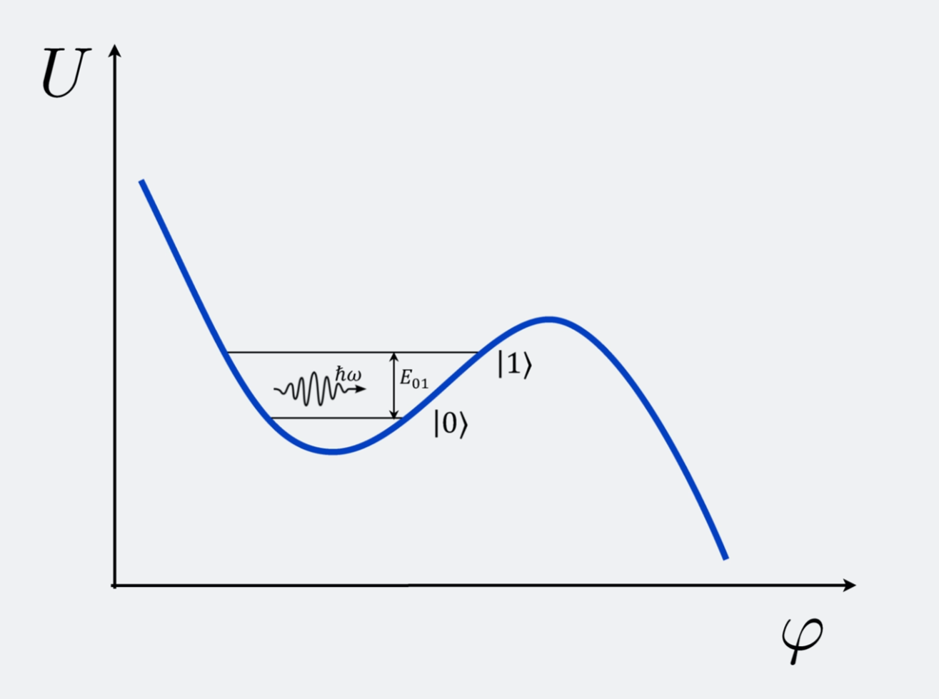
Macroscopic Tunnelling, Energy Quantization in an Electric Circuit
Place imagery here
Josephson Junction = 2 superconductors separated by a thin barrier (red), and the current going through it can be controlled; i.e. biased; each superconductor is a macroscopic superfluid (of Cooper pair electrons)
Energy – curve of the junction is a function of the phase difference, phi, of the phases of the two superconductors
Valley – of the energy curve represents a qubit; when the bias current is below a critical value and at zero temp, the system sits in a valley; energy quantization of electrical circuits is observed in the valley, and energy can tunnel out of the valley
Application = superconducting qubits, which are engineered to maximize coherence, minimize noise, and allow precise control, such as the ones used by IBM Quantum
We can design the energy gap between |0> and |1>, and use microwaves to control their quantum state on demand
Why This Year's Nobel Prize Matters for Quantum Computing https://www.youtube.com/watch?v=N4zxJ5iJRhg

Slide 6
Real World Interactions w/Quantum Computing
Qiskit Fall Fest 2025
Open Source Software Development
Extend the Power of Qiskit - the Qiskit ecosystem is a collection of tools created by researchers and developers who use Qiskit every day.
https://www.ibm.com/quantum/ecosystem
Tools for heterogeneous orchestration
Qiskit quantum hardware plugins, backend-agnostic
QRMI: Quantum resource management interface
Slurm workload manager
Qiskit Serverless for multi-cloud and supercomputer use cases
Parts of Qiskit
https://www.ibm.com/quantum/qiskit#ecosystem
Tools for algorithm development
Qiskit Addons – combine to build algorithms; exist for mapping, optimizing and post-processing steps
Qiskit Function templates – realistic code examples utilizing Qiskit and Qiskit Addons
Use Cases
Optimization: combinatorial problems
Simulate complex systems in nature across physics and chemistry domains
Quantum Machine Learning, leverage quantum kernels
Partial differential equations, simulate nonlinear dynamical systems

Slide 7
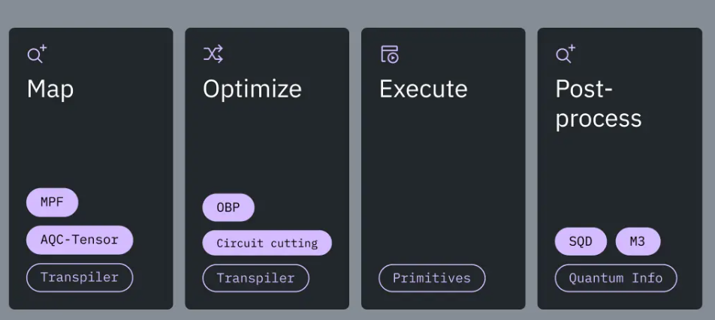
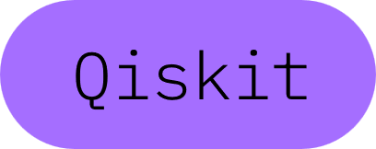
Some Examples
Qiskit Tutorials
https://quantum.cloud.ibm.com/docs/en/tutorials
1
Combine addons to build an algorithm – as in the graphic above for a Hamiltonian simulation. The addons used are: MPF (multi-product formulas), AQC-Tensor, OBP, Circuit cutting, SQD, and M3.
2
Create your own addon. One example, could be an addon for loading classical data into the quantum computer.
3
Create a game.
Examples:
Qpong, https://kirais.itch.io/qpong
DOOM, https://github.com/Lumorti/Quandoom
4
Use the QAOA algorithm to solve an optimization problem.

Slide 8
Thanks for coming!!
Qiskit Fall Fest 2025
Submissions Due: Nov 3, 10 am, PT
Next Event(s):
Possibly a Zoom
Possibly a Speaker on the UW Campus

