Slide 1
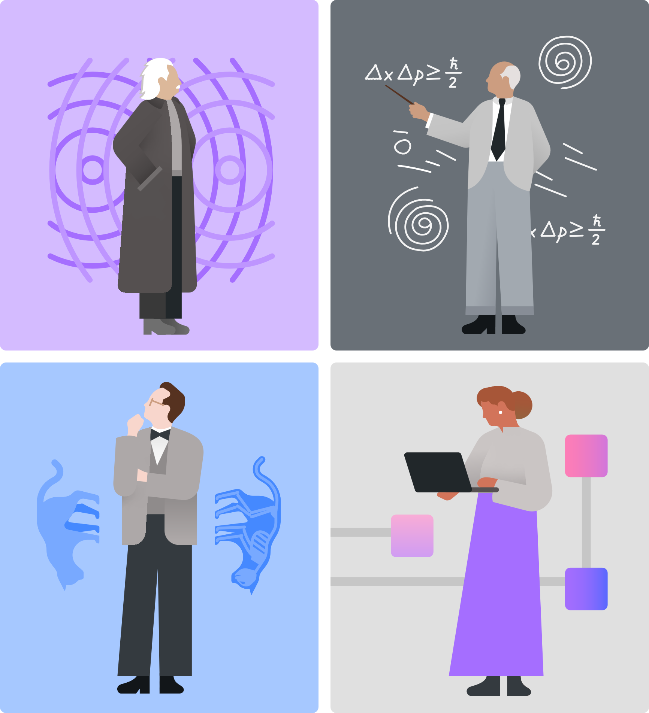
Qiskit Fall Fest 2025
Qiskit Beginner Challenge, on Zoom
Natalie Hawkins
Qiskit Advocate, Tier 1 Seattle Quantum Computing Meetup, Founder

Slide 2

Agenda
Announcements + Explain Fall Fest
Qiskit Learning Resources
Qiskit Hello World Notebook
Qiskit Challenge Beginner Notebook

Slide 3

Announcements + What is the Fall Fest?
https://github.com/SeattleQuantumComputingMeetup/qiskit_fall_fest_2025
1
Submissions Deadline for earning a Winning Certificate is Extended to Monday, Nov 24!!!
The non-coding and Hackathon options can be starts on projects; they don’t have to be fully worked out.
2
Project Idea: (1-2 pgs max total)
Short answers on questions:
How will QC affect our futures?
How will QC and AI affect our futures?
What are the pro’s and con’s of each type of qubit?
How many qubits are required for Shor’s alg?
3
Our last in-person FF25 Meetup will be next Saturday, Nov 1, 2-4 pm, at the Montlake Branch of the SPL.
Topics TBD:
DiVincenzo Intermediate Notebook
Working in QC, Getting a job, Where are the jobs?
4
Upcoming Summit:
TechAlliance Policy Matters Summit | The Quantum Frontier
https://luma.com/sxwd8icd

Slide 4
Qiskit Learning Resources
Software Development
IBM Quantum Platform
Learning: courses
Tutorials: Qiskit
Guides: Documentation
API Reference: Qiskit
Qiskit Channel on YouTube
https://www.youtube.com/qiskit
IBM Quantum Challenges and Qiskit Developer Certification
QGSS: Qiskit Global Summer School
Maybe a Spring Challenge?
Study for the Qiskit Developer Certification exam
Qiskit Community
Slack Channel
Unitary Foundation’s unitaryHACK
Other Hackathons and Industry Challenges
Books

Slide 5
Qiskit Jupyter Notebooks
Fall Fest 2025
Hello World
https://quantum.cloud.ibm.com/docs/en/tutorials/hello-world
Beginner Notebook
Qiskit Fundamentals
https://github.com/SeattleQuantumComputingMeetup/qiskit_fall_fest_2025/tree/main/coding_challenges
Intermediate Notebook
- DiVincenzo Criteria
https://github.com/SeattleQuantumComputingMeetup/qiskit_fall_fest_2025/tree/main/coding_challenges
Hackathon Prompts
No Notebooks associated with these
https://github.com/SeattleQuantumComputingMeetup/qiskit_fall_fest_2025/tree/main/hackathon_prompts

Slide 6
Qiskit Beginner Challenge Notebook
1
Software Setup
2
Circuits and Visualization
3
Optimize, then Run on Simulator or Fake Backend
4
Run on Real Quantum HW

Slide 7
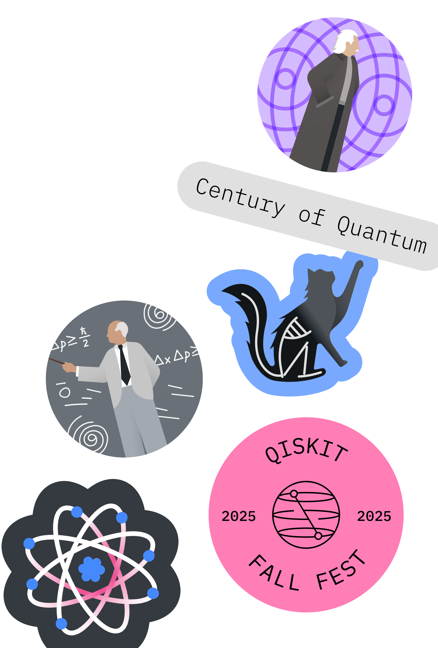
Qiskit Fall Fest 2025
Thanks for Coming!!!
Deadline for Submissions: Monday Nov 24, 10 am PT
Next IRL Meetup: Saturday Nov 1, 2 pm PT
Upcoming Event: TechAlliance, Nov 19, South Seattle
Upcoming Meetup: Date? in December w/Holiday Party

