Slide 1
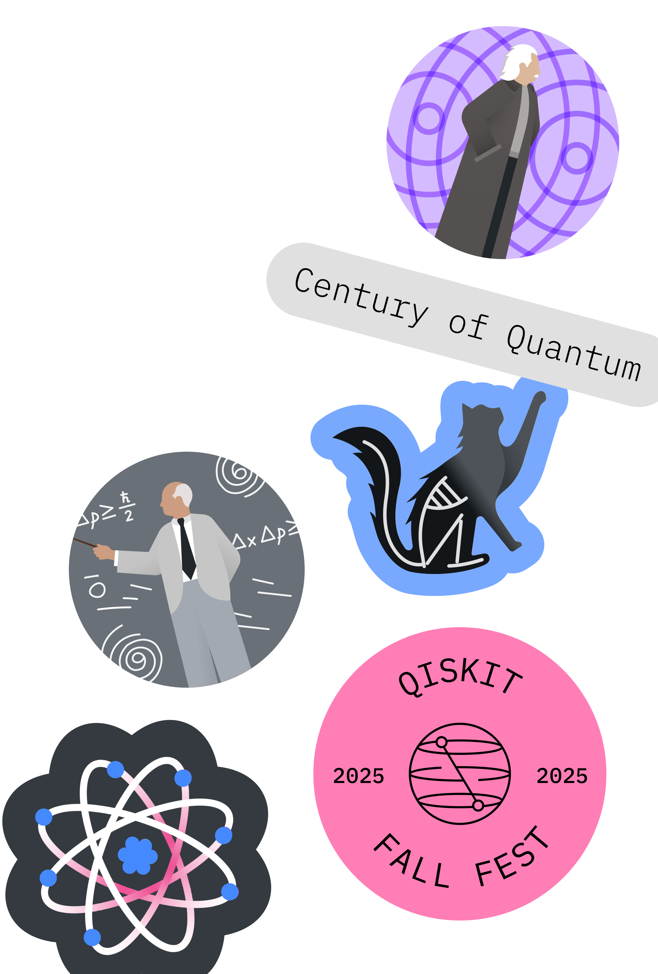
Fall Fest 2025, Halfway There!
Qiskit Fall Fest 2025
Natalie Hawkins Qiskit Advocate, Tier 1
Seattle Quantum Computing Meetup, Founder

Slide 2

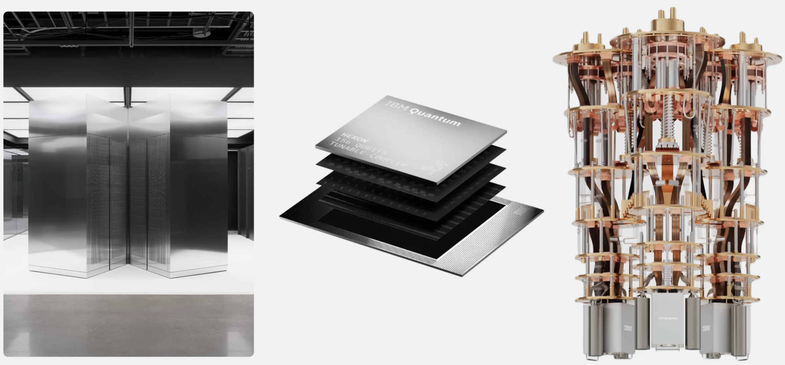
Qiskit Fall Fest 2025
Today’s Agenda
SQCM’s FF25 Materials
https://github.com/SeattleQuantumComputingMeetup/qiskit_fall_fest_2025/tree/main
Who else is hosting?
https://www.ibm.com/quantum/events/fall-fest-2025
What is the International Year of Quantum Science and Technology (IYQ)?
Why does this Year's Nobel Prize in Physics Matter for Quantum Computing?
Real world interactions: HowTo with Qiskit and Quantum Computers

Slide 3

International Year of Quantum Science and Technology, IYQ
Declared by the UN
year-long, world-wide initiative
will “be observed through activities at all levels aimed at increasing public awareness of the importance of quantum science and applications”.
1925: significant progress was made in quantum mechanics, with Wolfgang Pauli announcing the exclusion principle and Werner Heisenberg developing matrix mechanics (Google AI Overview)
https://quantum2025.org/

Slide 4

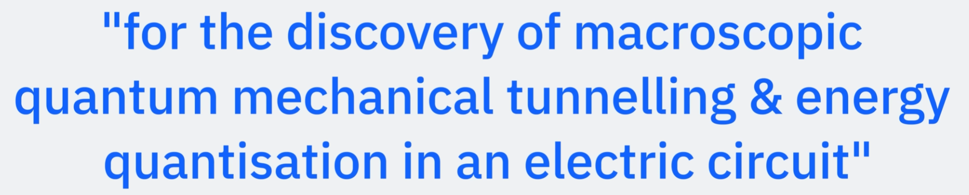
Nobel Prize in Physics, 2025 Clarke, Devoret, Martinis
Why This Year's Nobel Prize Matters for Quantum Computing,
Qiskit Channel, Christopher Porter
https://www.youtube.com/watch?v=N4zxJ5iJRhg

Slide 5
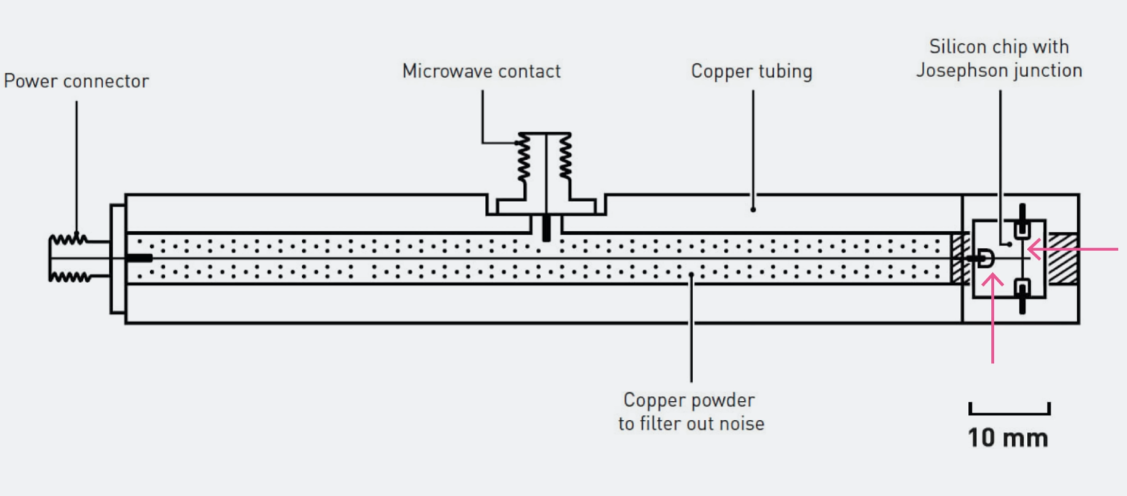
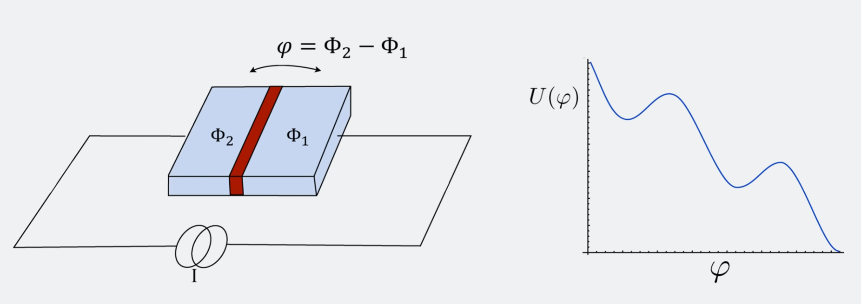
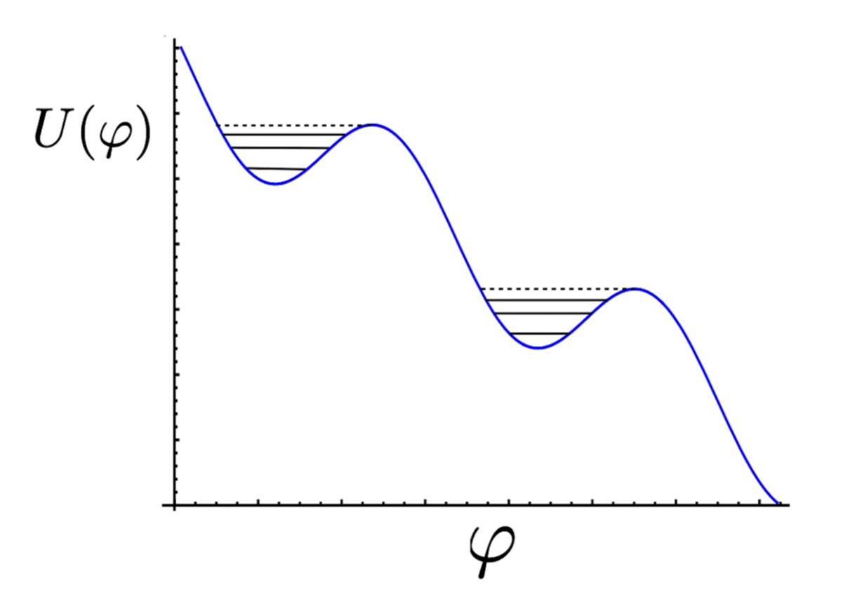
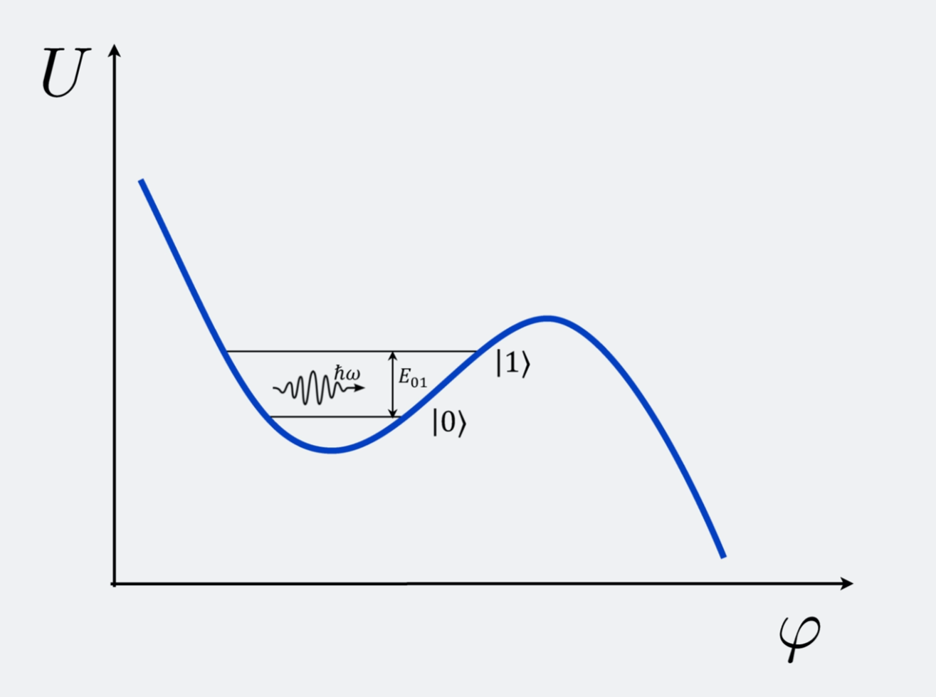
Macroscopic Tunnelling, Energy Quantization in an Electric Circuit
Place imagery here
Josephson Junction = 2 superconductors separated by a thin barrier (red), and the current going through it can be controlled; i.e. biased; each superconductor is a macroscopic superfluid (of Cooper pair electrons)
Energy – curve of the junction is a function of the phase difference, phi, of the phases of the two superconductors
Valley – of the energy curve represents a qubit; when the bias current is below a critical value and at zero temp, the system sits in a valley; energy quantization of electrical circuits is observed in the valley, and energy can tunnel out of the valley
Application = superconducting qubits, which are engineered to maximize coherence, minimize noise, and allow precise control, such as the ones used by IBM Quantum
We can design the energy gap between |0> and |1>, and use microwaves to control their quantum state on demand
Why This Year's Nobel Prize Matters for Quantum Computing https://www.youtube.com/watch?v=N4zxJ5iJRhg

Slide 6
Nobel Prize in Physics, 2025 Clarke, Devoret, Martinis
How Tunneling is used:
- Josephson junctions:
Superconducting qubits are built with Josephson junctions, which consist of two superconductors separated by a very thin insulating layer.
- Cooper pair tunneling:
Quantum tunneling allows pairs of electrons (Cooper pairs) to tunnel across this insulating barrier, creating a supercurrent.
- Qubit control:
This tunneling creates a nonlinear inductance, which is essential for creating an anharmonic oscillator. This ensures that the energy levels are not equally spaced, allowing the qubit to be controlled to operate between just the lowest two levels
Resource: Google AI Overview
Josephson Junctions
use tunneling to create the non-linear inductance needed to make the qubit's energy levels quantized and distinct, allowing it to hold quantum information in a superposition of states.
tunneling is also a source of problems, as unwanted quasiparticle tunneling and tunneling two-level systems (TLS) can cause decoherence and errors.

Slide 7
Nobel Prize in Physics, 2025 Clarke, Devoret, Martinis
How tunneling is a challenge
Quasiparticle tunneling:
Unwanted quasiparticles (individual electrons with broken pairs) can tunnel across the junction, leading to qubit decay and dephasing.
Tunneling two-level systems (TLS):
Defects in the insulating layers or other parts of the qubit can act as TLS, where particles can tunnel between different energy states. This can introduce noise and cause the qubit to lose its quantum state.
Decoherence:
Both quasiparticle tunneling and TLS are major sources of decoherence, which limits the performance and coherence time of the qubit.
Mitigation efforts:
Researchers are actively working to reduce these detrimental tunneling effects by engineering the materials and the qubit structure itself to suppress unwanted tunneling.

Slide 8
Quantum Computing Hardware Resources
Book:
Building Quantum Computers, A Practical Introduction by Shayan Majidy, Christopher Wilson, Raymond Laflamme
Company Websites:
have articles explaining their hardware
YouTube:
The Evolution and the Future of IBM Quantum Hardware: Holger Haas | QGSS 2025
Qiskit Channel: https://www.youtube.com/watch?v=0eTmqj5nf7c

Slide 9
Real World Interactions w/Quantum Computing
Qiskit Fall Fest 2025
Open Source Software Development
Extend the Power of Qiskit - the Qiskit ecosystem is a collection of tools created by researchers and developers who use Qiskit every day.
https://www.ibm.com/quantum/ecosystem
Tools for heterogeneous orchestration
Qiskit quantum hardware plugins, backend-agnostic
QRMI: Quantum resource management interface
Slurm workload manager
Qiskit Serverless for multi-cloud and supercomputer use cases
Parts of Qiskit
https://www.ibm.com/quantum/qiskit#ecosystem
Tools for algorithm development
Qiskit Addons – combine to build algorithms; exist for mapping, optimizing and post-processing steps
Qiskit Function templates – realistic code examples utilizing Qiskit and Qiskit Addons
Use Cases
Optimization: combinatorial problems
Simulate complex systems in nature across physics and chemistry domains
Quantum Machine Learning, leverage quantum kernels
Partial differential equations, simulate nonlinear dynamical systems

Slide 10
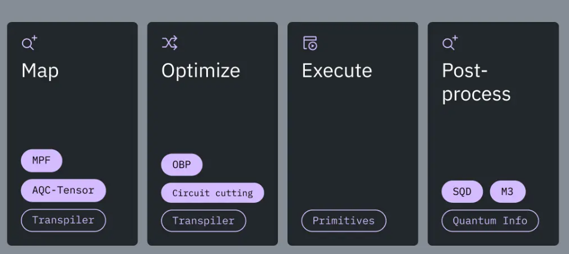
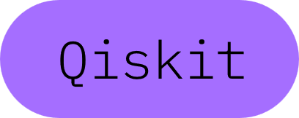
Some Examples
Qiskit Tutorials
https://quantum.cloud.ibm.com/docs/en/tutorials
1
Combine addons to build an algorithm – as in the graphic above for a Hamiltonian simulation. The addons used are: MPF (multi-product formulas), AQC-Tensor, OBP, Circuit cutting, SQD, and M3.
2
Create your own addon. One example, could be an addon for loading classical data into the quantum computer.
3
Create a game.
Examples:
Qpong, https://kirais.itch.io/qpong
DOOM, https://github.com/Lumorti/Quandoom
4
Use the QAOA algorithm to solve an optimization problem.

Slide 11
Thanks for coming!!
Qiskit Fall Fest 2025
Join the Discord: invite link is under the About tab on the Seattle Quantum Computing Meetup page
Submissions Due: Nov 3, 10 am, PT
Next Event(s):
Possibly a Zoom
Possibly a Speaker on the UW Campus

