Slide 1
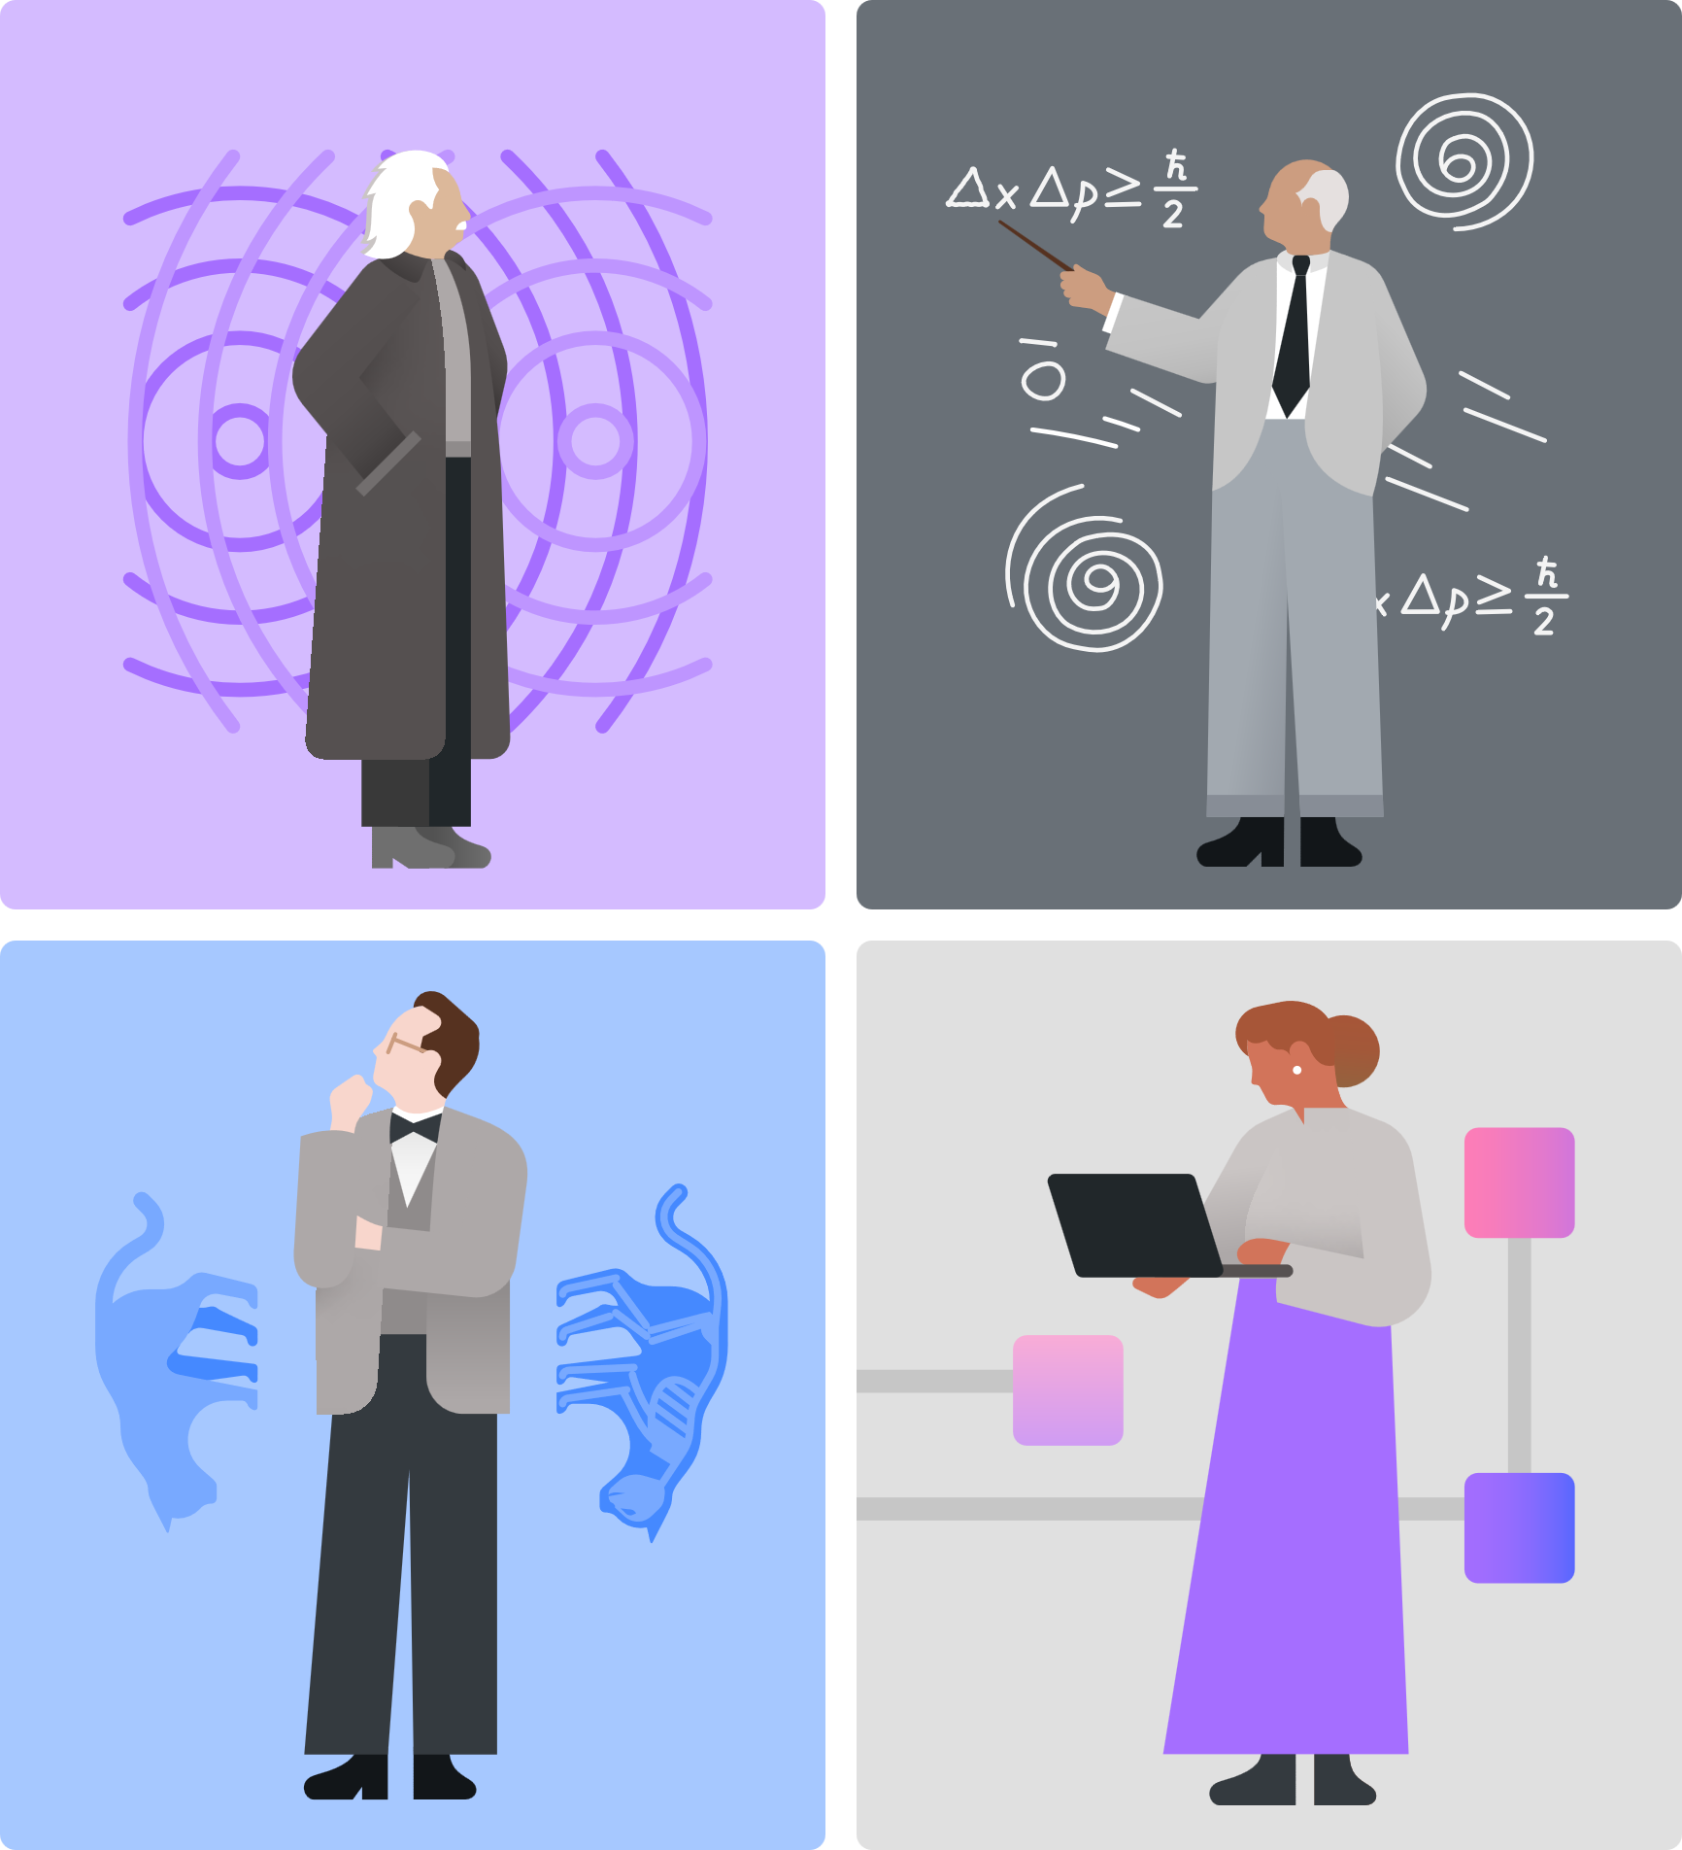
Qiskit Fall Fest 2025
Last Fall Fest IRL Meetup – Intro to DiVincenzo Criteria + revisit previous questions
Natalie Hawkins
Qiskit Advocate, Tier 1 Seattle Quantum Computing Meetup, Founder

Slide 2

Agenda
Announcements
Intro to DiVincenzo Criteria
Q News – Industry & Academia
Revisit Previous Questions
Talk about the next Meetup
Mingle

Slide 3

Announcements
1
Submissions Deadline for earning a Winning Certificate is Extended to Monday, Nov 24!!!
The non-coding and Hackathon options can be starts on projects; they don’t have to be fully worked out.
2
Project Idea: (1-2 pgs max total)
Short answers on questions:
How will QC affect our futures?
How will QC and AI affect our futures?
What are the pro’s and con’s of each type of qubit?
How many qubits are required for Shor’s alg?
3
Our last in-person FF25 Meetup will be next Saturday, Nov 1, 2-4 pm, at the Montlake Branch of the SPL.
Topics TBD:
DiVincenzo Intermediate Notebook
Working in QC, Getting a job, Where are the jobs?
4
Upcoming Summit:
TechAlliance Policy Matters Summit | The Quantum Frontier
https://luma.com/sxwd8icd

Slide 4

TechAlliance Policy Matters Summit | The Quantum Frontier
Summit Agenda
Wed, Nov 19, 2025
​​Overview -
Washington has what it takes to lead in quantum top-tier research, major tech players, and a growing innovation ecosystem. What’s missing is a coordinated strategy. The 2025 Policy Matters Summit will bring together policymakers, educators, industry, and startups to launch a shared vision for Washington’s quantum future.
​Summit Goals -
​Position Washington as a hub for quantum R&D, talent, and commercialization
​Spark collaboration and follow-on action statewide
​Why Now -
States like Texas, Illinois, and Maryland are moving fast - passing laws, building hubs, and attracting funding. Washington has the assets. This Summit is our chance to catch up - and take the lead.
​
​
​8:30 Breakfast/Networking
​9:00 Opening remarks by Lieutenant Governor Denny Heck
​9:20 Quantum Basics - A beginner-friendly overview of quantum concepts, technologies, and real-world applications
​11:00 Q-Day 101 - What is Q-Day and why does it matter? Learn how quantum will impact cybersecurity, infrastructure, and the economy.
​12:00 Networking lunch
​1:00 The Quantum Landscape – National and Global Initiatives - Explore how other states and countries around the world are advancing quantum
​2:00 Building a Quantum Ecosystem in WA

Slide 5
Others Are Moving Fast - passing laws - building hubs - attracting funding
IL
Chicago Quantum Summit, Nov 3-4
https://chicagoquantum.org/summit2025
MD
In 2025, Maryland's quantum ecosystem is experiencing significant growth, fueled by major investments, partnerships with technology leaders like Microsoft and DARPA, and the continued expansion of homegrown companies such as IonQ. (Google)
Look at IEEE Quantum Week Locations:
2022 Broomfield, CO
2023 Seattle
2024 Montreal
2025 Albuquerque
2026 Toronto
https://qce.quantum.ieee.org/2025/
TX
Texas is solidifying its position as a major hub for quantum technology through the recently passed Texas Quantum Initiative, which aims to boost state investment and coordinate research and development. The effort involves collaborations between academic institutions, industry leaders, and state government. (Google) (Abilene, Texas: The first and flagship site is a massive AI data center $500B Stargate Project.)

Slide 6
What is Q-Day?
The quantum computing meaning of Q-Day
What it is:
Q-Day is the day a powerful enough quantum computer can use algorithms like Shor's algorithm to crack asymmetric encryption that protects data like online banking, email, and other secure communications.
Why it's a concern:
It would create a "cryptographic apocalypse," where sensitive data could be easily decrypted by attackers, impacting everything from financial transactions to secure messaging.
Current status:
Experts debate the exact timeline, but they agree that organizations need to prepare by transitioning to post-quantum cryptography (PQC) to stay secure.
Preparing for Q-Day:
The race is on to develop and implement new quantum-resistant encryption methods before a powerful quantum computer arrives.
The historical meaning of Q-Day
What it is: In 1945, "Q-Day" was the name of the dress rehearsal for the Trinity atomic bomb test, the first detonation of a nuclear weapon.
5 Misconceptions about Q-Day
By Werner Coomans
24 May 2025
https://www.nokia.com/quantum/5-misconceptions-about-q-day/#:~:text=There%20are%20two%20families%20of,which%20are%20currently%20undergoing%20standardization.

Slide 7
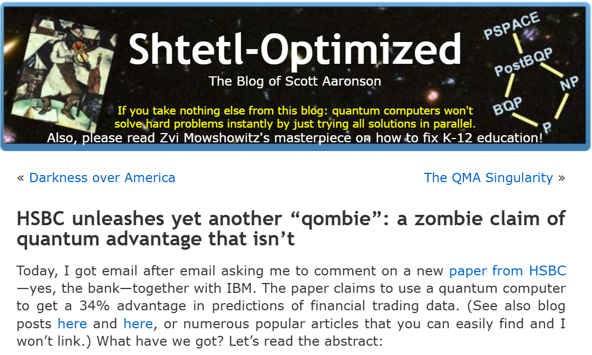
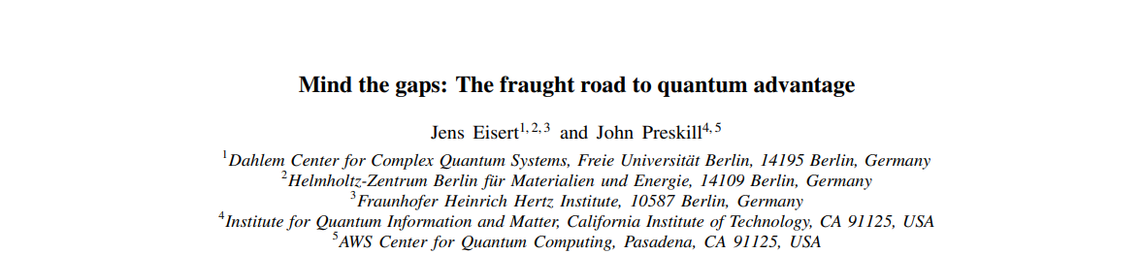
Q News
Claims
“When and how will quantum computing broadly benefit humanity? Despite exhilarating recent progress, we still don’t know. Here my friend Jens Eisert and I assess the current status and the challenges ahead. We are optimistic about the quantum future, but there’s a lot of work to do.”
John Preskill, Caltech.
https://lnkd.in/gxuzxhj3
2510.19928
What’s Needed
“Gaps that we still have to cross in order to reach broadly useful technology. An important take-away: 𝘁𝗵𝗲 𝗯𝗶𝗴𝗴𝗲𝘀𝘁 𝗴𝗮𝗽 𝗶𝘀 𝗻𝗼𝘁 𝗶𝗻 𝗵𝗮𝗿𝗱𝘄𝗮𝗿𝗲, 𝗯𝘂𝘁 𝗶𝗻 𝗱𝗲𝘃𝗲𝗹𝗼𝗽𝗶𝗻𝗴 𝘁𝗵𝗲 𝗿𝗶𝗴𝗵𝘁 𝗾𝘂𝗮𝗻𝘁𝘂𝗺 𝗮𝗹𝗴𝗼𝗿𝗶𝘁𝗵𝗺𝘀.”
Koen Groenland, QuSoft.

Slide 8
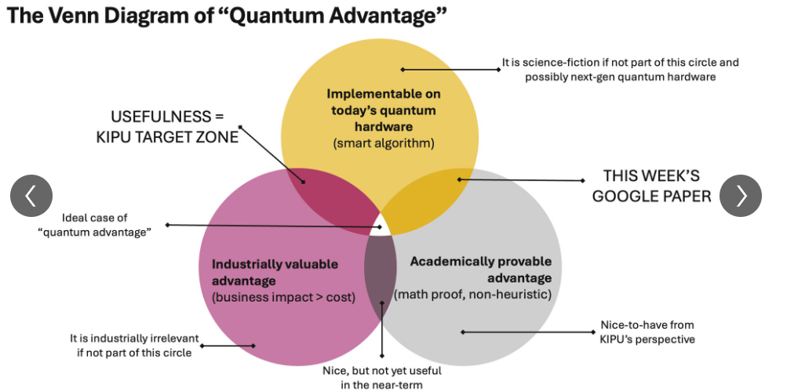
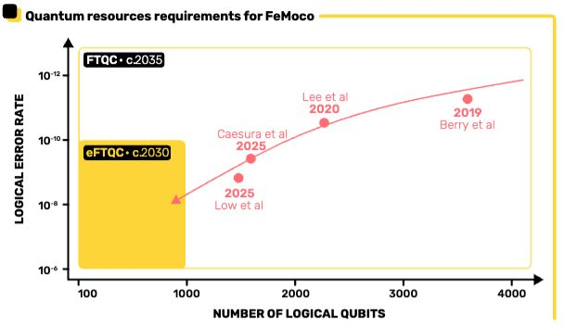
Q News
Sweet Spot for Q Advantage
Error Rates Needed
Koen Groenland, QuSoft, Amsterdam

Slide 9
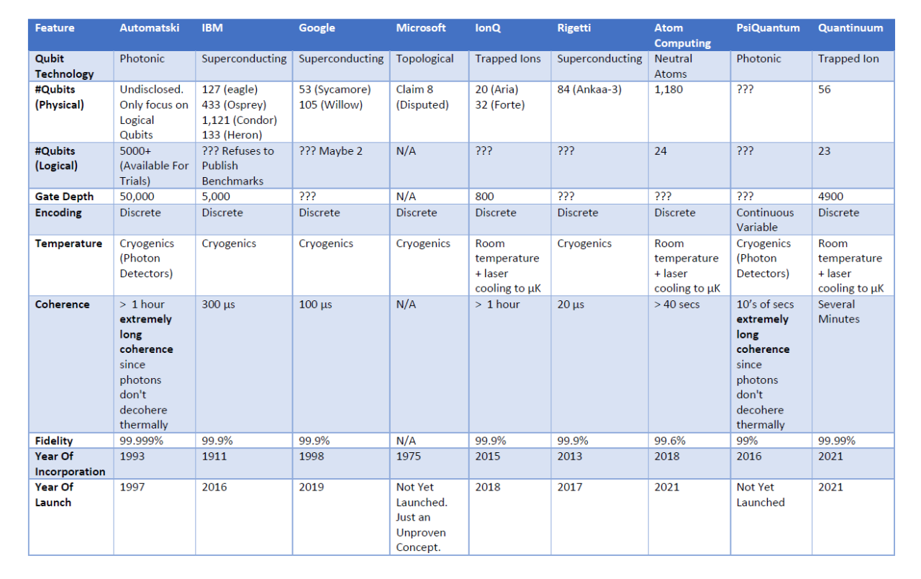
Q News
Qubit Technology Comparison
Table compiled by Automatski, in India

Slide 10
DiVincenzo Criteria
Qiskit Coding Challenge Intermediate Notebook
Qiskit Global Summer School (QGSS25) Lecture by David DiVincenzo
The Physical Realization of Qubits (~ an hour)
https://www.youtube.com/watch?v=H4VnP1uL-eU
Physicist David DiVincenzo outlined five key requirements for any physical implementation of a quantum computer, plus two additional criteria for quantum communication. In this notebook, we will experience each DiVincenzo criterion through practical Qiskit demonstrations. Rather than going deep into theory, each section briefly explains one criterion and then provides code exercises using Qiskit 2. You will get to run circuits on simulators and real IBM Quantum devices to explore each principle hands-on.
Five Criteria for Quantum Computation:
A scalable physical system with well-characterized qubits.
2. Ability to initialize qubits to a simple reference state (e.g. |00…0〉).
3. Long decoherence times (qubit coherence much longer than gate operation time).
4. A universal set of quantum gates (able to perform arbitrary unitary operations).
5. Qubit-specific measurement capability (read out the state of each qubit).
(DiVincenzo also described two criteria for quantum communication: the ability to interconvert stationary and “flying” qubits, and to faithfully transmit flying qubits between locations. We include these in a recommended activity at the end of this notebook.)

Slide 11
Revisit Previous Questions
1
Greek Alphabet
2
Data and Quantum Computers
Data Loading Project
Watch out for Bad Articles, written by AI or humans
Small Data, Big Solution Space (Medium: J Krupansky)
Now-ish vs. Later-ish (FTQC, qRAM)
3
AI + Quantum, Quantum + AI
Qiskit Code Assistant
AI Software Survey (TensorFlow?)
Quantum Software Survey (TensorFlow Quantum?)
4
Computer Chips
How SC qubits work,
Qiskit Channel, Zlatko’s talk,
Parts 1 and 2,
Lectures 16-21, (~6 hrs)
How QPUs and CPUs are made

Slide 12
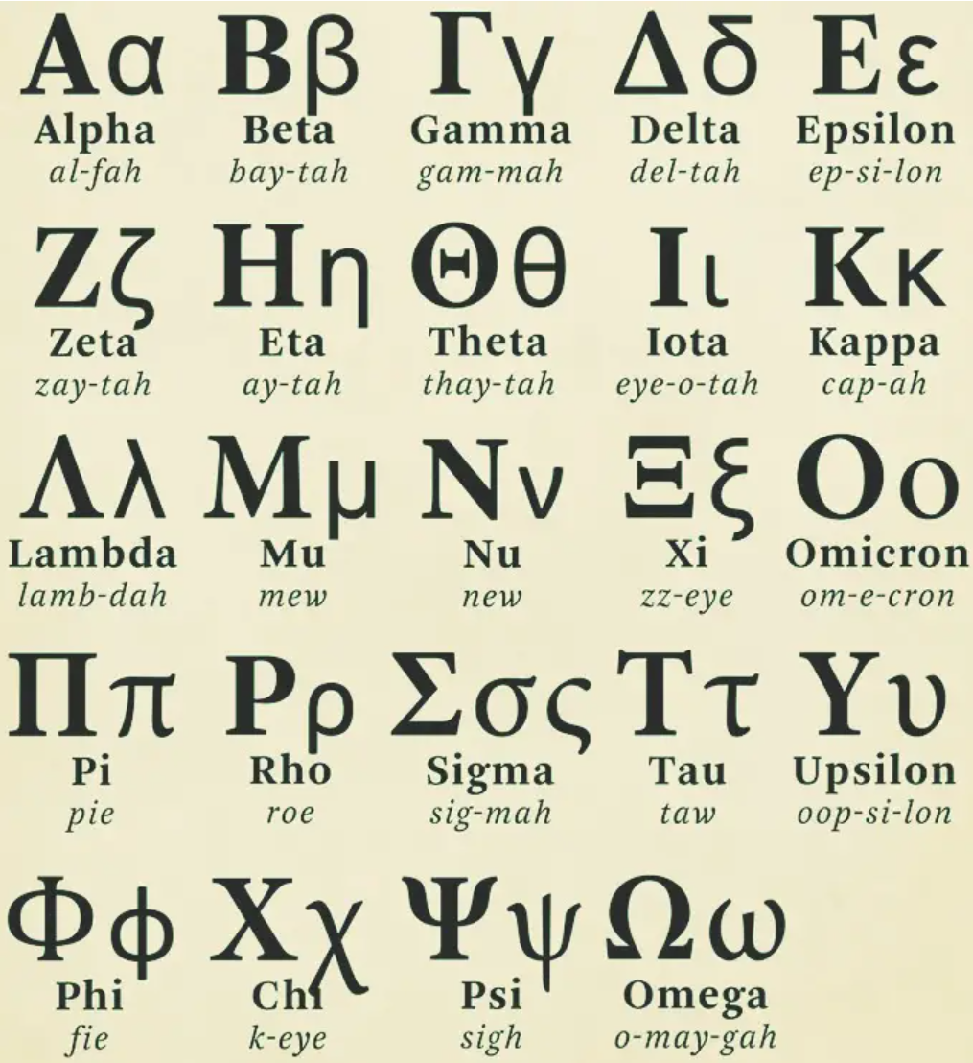
Greek Alphabet
Place imagery here
Phi and Psi are used a lot, also Alpha, Beta, Pi, and Theta, and, well, the others too!
https://en.wikipedia.org/wiki/Greek_alphabet
.

Slide 13
AI and Quantum Computers
Software Development
Qiskit Code Assistant
IBM Quantum has one
Available via a Premium Plan
Designed to create Qiskit 2 code
https://quantum.cloud.ibm.com/docs/en/guides/qiskit-code-assistant
AI Software Survey
O’Reilly Tech Trends Report (from Jan 6 ‘25: based on ‘24, ‘23)
Look for TensorFlow
https://www.oreilly.com/pub/pr/3465
Quantum Open-Source Software Survey
See the Unitary Foundation’s annual survey
https://unitaryfoundation.github.io/survey-2024/
Look for TensorFlow Quantum in the results
Look for CUDA-Q
AI + Q, Q + AI
AI helping Quantum
Quantum helping AI
Conference Q+AI
Company: e.g. Sandbox AQ
IEEE Quantum Week 2025, can still register for on-demand content (~$200)
https://web.cvent.com/event/3f8c3754-761c-4db5-a3f5-20003fcc785c/summary

Slide 14
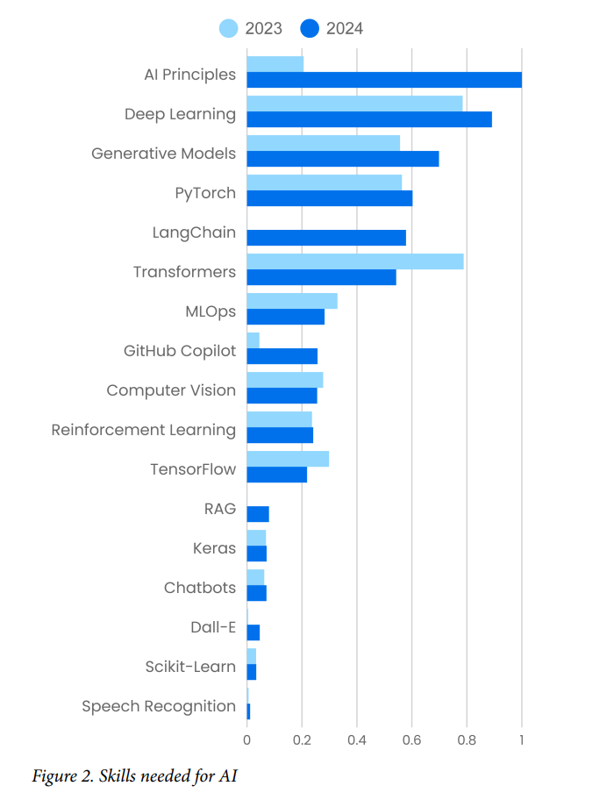
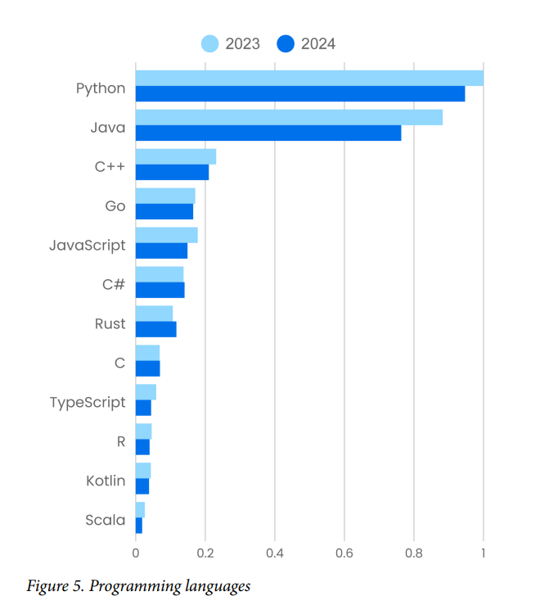
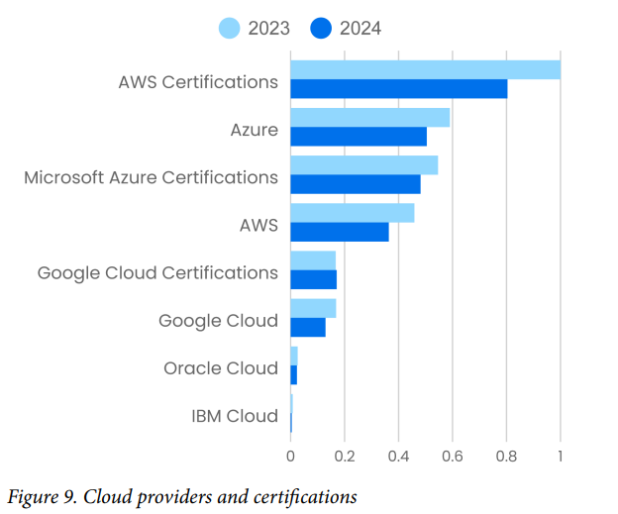
AI Tool Trends
Technology Trends for 2025
Report by O’Reilly, Jan 6 2025
https://www.niso.org/niso-io/2025/01/oreilly-offers-insights-tech-trends-2025#:~:text=Usage%20of%20material%20about%20Software,a%20bearing%20on%20software%20architecture.
How to Choose Between TensorFlow vs PyTorch in 2025
“PyTorch is easier to use and better for research, while TensorFlow is better for production and scalability.”
http://youtube.com/watch?v=yOGi4vmtNaY

Slide 15
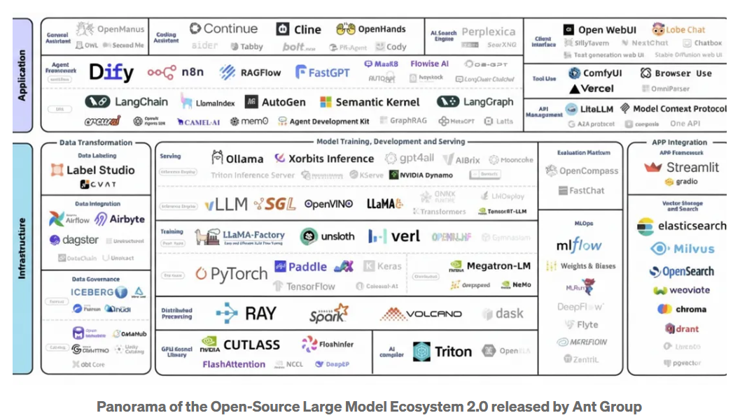
Panorama of the Open-Source Large Model Ecosystem 2.0
In Ant Group’s newly released Panorama of the Open-Source Large Model Ecosystem 2.0, TensorFlow has been officially removed.
Medium article, TensorFlow Is Dead. PyTorch Won., Pan Xinghan, Sep 15, 2025
How Industry: Cracks in TensorFlow’s Fortress
“In industry, TensorFlow still hangs on, thanks to its early enterprise adoption. Big companies with legacy models — think Google Translate, some cloud pipelines, some banks — still run it. But the cool kids aren’t choosing it anymore.
OpenAI trained GPT-3 and DALL·E on PyTorch. Tesla’s Autopilot runs on PyTorch. Meta, Microsoft, and Amazon have rallied behind it. NVIDIA and Intel are optimizing PyTorch first. Even Google Cloud now openly supports PyTorch and quietly shifts research toward JAX instead of TensorFlow.
Yes, TensorFlow has stars on GitHub. But stars don’t equal momentum. Forks, contributors, and new repos overwhelmingly lean PyTorch. The trend lines are clear: TensorFlow is legacy, PyTorch is future.”

Slide 16
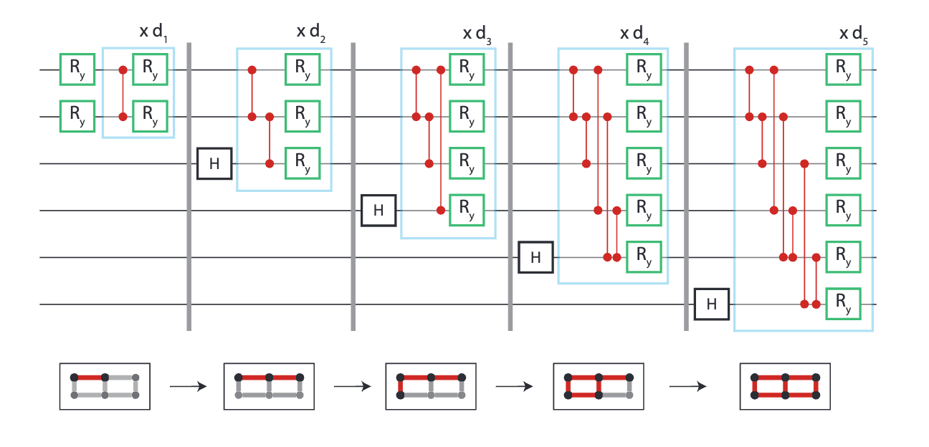
Data and Quantum Computers
Quantum Applications
Quantum State Preparation
Quantum Resource Estimation for Data Loading or State Preparation in Quantum Computers
Phys. Rev. Lett. 129, 230504 – Published 30 November, 2022
“Quantum state preparation is an important subroutine for quantum computing. We show that any 𝑛-qubit quantum state can be prepared with a Θ⁡(𝑛)-depth circuit using only single- and two-qubit gates, although with a cost of an exponential amount of ancillary qubits.”
Google AI Overview
“Resource estimation for data loading and state preparation is a critical aspect of analyzing the overall cost of a quantum algorithm. The resources required often scale exponentially with the number of qubits for preparing a generic quantum state. However, tailored approaches can offer substantial reductions in circuit depth and qubit requirements for specific problems.
Key resource metrics include the number of qubits, quantum gates, and execution time. This process is particularly challenging because it involves translating classical data into a quantum format.
Encoded classical data: In quantum machine learning (QML) and other data-driven algorithms, classical data must be loaded into a quantum state. The efficiency of this process is a major bottleneck.”
Little Data with Big Solution Space
“No, quantum computers are not appropriate for big data problems. Rather, they are best for problems with a fairly small amount of data which has a very large solution space — so called combinatorial explosions. So, rather than call it Big Data, I call it Little Data with a Big Solution Space. This informal paper introduces the notions of Little Data with a Big Solution Space.”
https://jackkrupansky.medium.com/little-data-with-a-big-solution-space-the-sweet-spot-for-quantum-computing-b6c6d76ada6d
Blue Qubit, 2311.12929 https://www.bluequbit.io/quantum-data-loading
Figure 1: A circuit ansatz with hierarchical architecture on 6 qubits laid out on a grid. Vertical gray lines on the circuit indicate a partial circuit which is variationally learned before using it as input to the next sub-circuit.

Slide 17
Data and Quantum Computers
Quantum Applications
Qiskit Functions
https://quantum.cloud.ibm.com/functions
Quantum Resource Estimation
Quantum Computing Report, article,
Update on the GQI Quantum Resource Estimator Playbook
https://quantumcomputingreport.com/update-on-the-gqi-quantum-resource-estimator-playbook/
Resource Estimation Tools, Google AI Overview
Tools for quantum resource estimation include Azure Quantum Resource Estimator, QREChem, TopQAD, and PsiQuantum's QREF and Bartiq. These tools help estimate the logical and physical qubits, runtime, and other resources needed for a quantum program on a fault-tolerant quantum computer by taking into account various parameters like hardware specifications and error correction codes.
What is QRE and why is it hard?
https://www.mustythoughts.com/perfect-qre-sw
Multiverse Computing
Singularity Machine Learning Function
“With the Singularity Machine Learning function, you can solve real-world classification problems on quantum hardware without requiring quantum expertise. This function, based on ensemble methods, is a hybrid classifier which combines classical methods like boosting for ensemble training with quantum methods like quantum approximate optimization (QAOA) for optimizing the trained ensemble for maximum diversity, and generalization. Unlike other quantum machine learning solutions, this function is capable of handling large-scale datasets with millions of examples and features without being limited by the number of qubits. It is also highly flexible, and can be used to solve classification problems across a wide range of domains, including finance, healthcare, and cybersecurity.”
https://quantum.cloud.ibm.com/functions

Slide 18
Superconducting Qubits
Quantum Hardware
How are QPUs Fabricated?
Inside Quantum Chip Manufacturing: From Qubits to Fabrication, SpinQ Blog
https://www.spinquanta.com/news-detail/inside-quantum-chip-manufacturing-from-qubits-to-fabrication
How To Build A Quantum Computer
YT Channel: Lukas’s Lab (9 min)
https://www.youtube.com/watch?v=N06hC1GL1ns&t=421s
Superconducting Qubits I: Quantizing a Harmonic Oscillator, Josephson Junctions - Part 1, Lecture 16, by Zlatko Minev, IBM Quantum (now at Google)
https://www.youtube.com/watch?v=kV0RsKXSqRg
Also, see Lectures 17-21, approx. 6 hours in total
Intel’s Big Bet: Inside the Chipmaker’s Make-or-Break Factory
https://www.nytimes.com/2025/10/09/technology/intel-chip-factory-fab52.html?searchResultPosition=1
How Semiconductors Are Fabricated
https://www.nytimes.com/2022/04/08/technology/intel-chip-shortage.html
Zlatko has several presentations on noise too. One example,
https://www.zlatko-minev.com/blog/quantum-error-mitigation-bss23

Slide 19
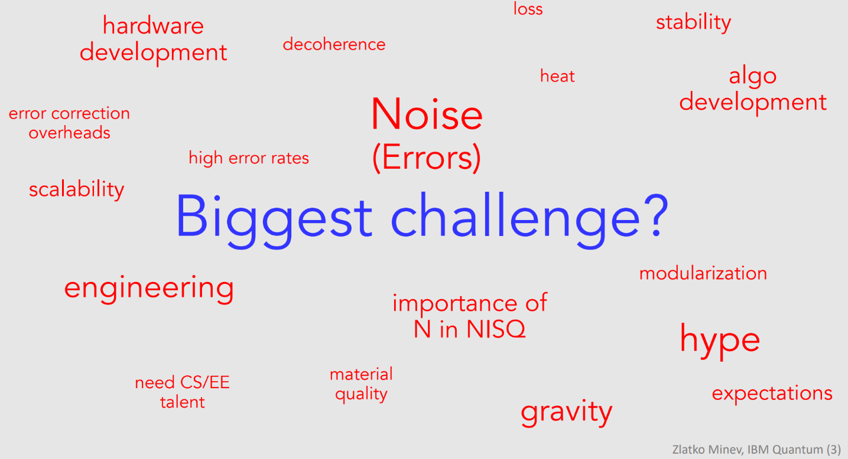
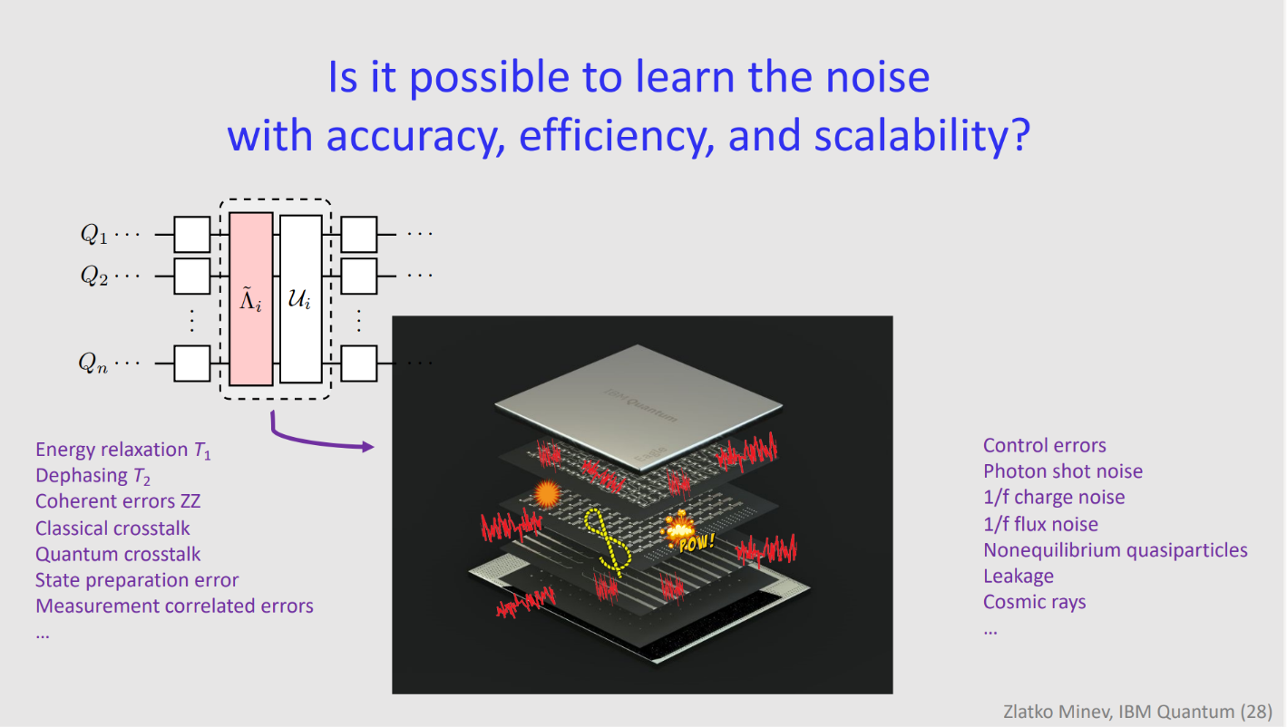
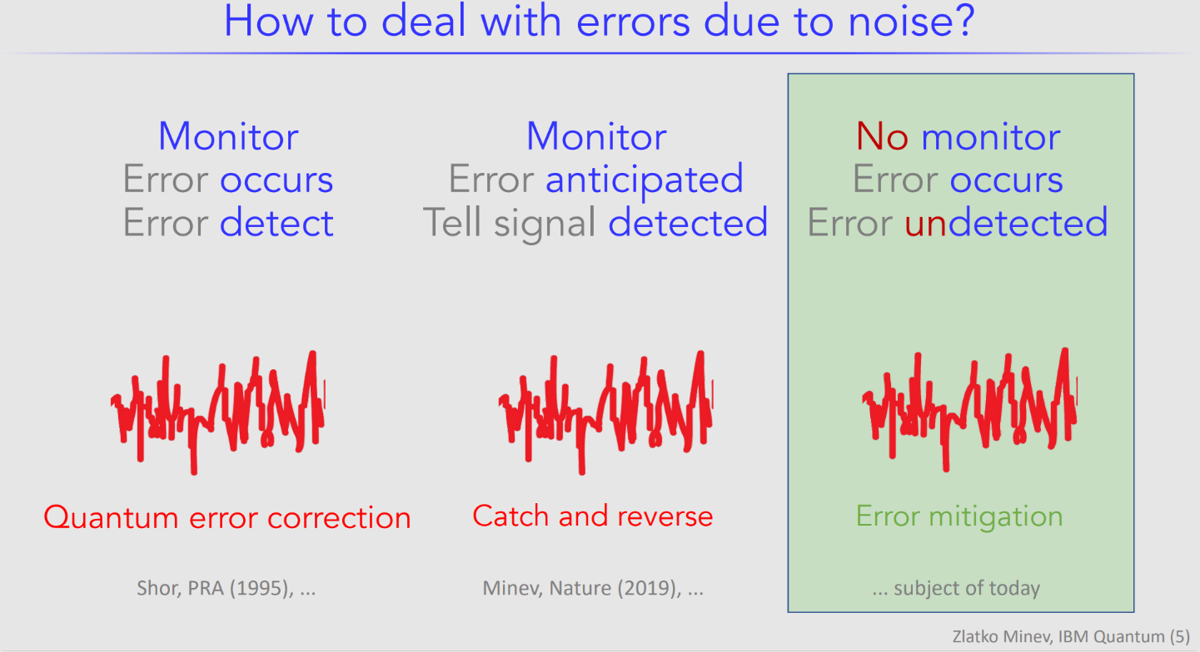
QC Biggest Challenge?
Zlatko says, “Noise.” (2022)
https://www.zlatko-minev.com/blog/pec-talk
How Deal with Noise?
Depends on the type of noise.

Slide 20
Qiskit Beginner Challenge Notebook
1
Software Setup
2
Circuits and Visualization
3
Optimize, then Run on Simulator or Fake Backend
4
Run on Real Quantum HW

Slide 21
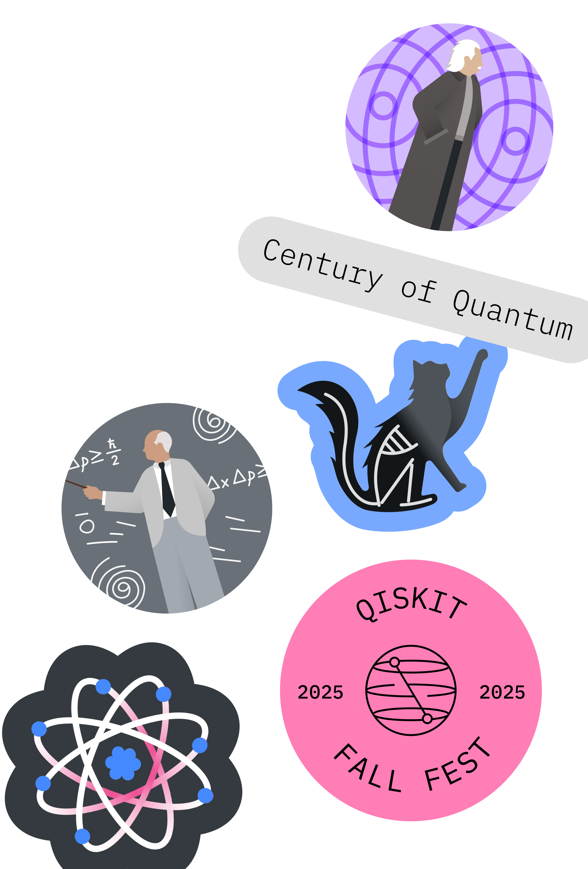
Qiskit Fall Fest 2025
Thanks for Coming!!!
Deadline for Submissions: Monday Nov 24, 10 am PT
Upcoming Event: TechAlliance, Nov 19, South Seattle
Upcoming Meetup: Date? in December w/Holiday Party

