Slide 1
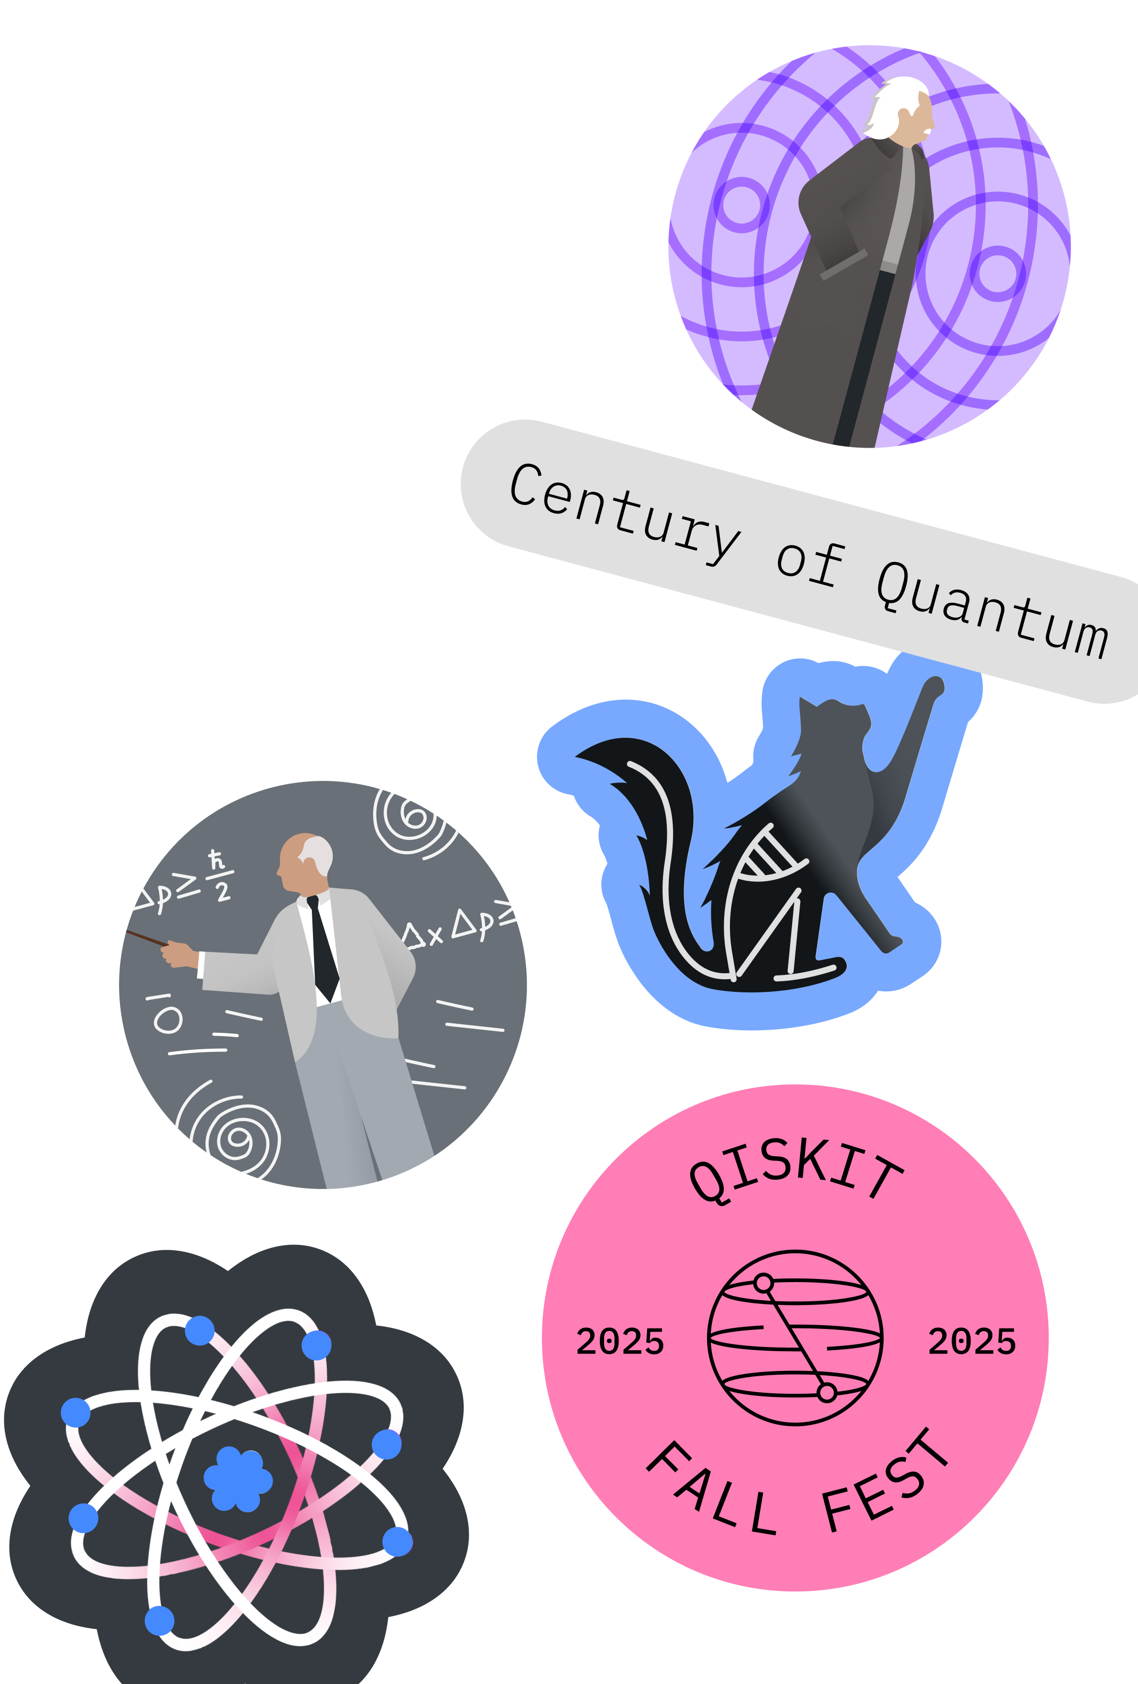
Qiskit Fall Fest 2025 Event and Outcomes
QAP Seminar May 2026
Natalie Hawkins Founder, QFF Lead Organizer
Seattle Quantum Computing Meetup (2022-present)

Slide 2
Qiskit Fall Fest 2025, a Seattle Community Event
Summary of Event and Outcomes
The Numbers
Winning Certificates: 4
Participant Certificates: 18
Total Number of Registrants over 9 Events: 94
Stimulated: sharing by the participants of their learning (Python talk, article, mentor, LI)
The Events
Qiskit and QC 101
Kickoff
Happy Hour
Work Party
Physics Nobel Prize 2025
Beginner Notebook Walkthrough
Zoom Kickoff
Follow-up on Questions
Schedule and materials:
https://github.com/SeattleQuantumComputingMeetup/qiskit_fall_fest_2025
The Participants
Software Engineers
Project Managers
Quantum Curious
Community Mentor
Former IBMer
Event Locations
Seattle Public Library (5)
Community Center (1)
Local Brew House (1)
Meeting Space (1)
Zoom (1)

Slide 3
Why?
1
I am all-in on Quantum Computing.
2
I would like to attend something like this to learn more about QC and to meet other interested people.
3
It didn’t exist.
4
It’s a win-win-…-win -> for me, for the participants (near and far), for Seattle, for Quantum Computing, …, for IBM.

Slide 4
What?
What made it successful?
What next ?
The Seattle Quantum Computing Meetup group on meetup.com attracts eyes.
Flexibility was allowed on the type of participation, and the participants chose different paths to the Winning Certificate:
coding
article writing
project proposal
Each event allowed newcomers to join at any point, and, so, did not depend on attending any previous events.
Participants liked being able to get a certificate from IBMQ.
-Fun, friendly, caring environment
-Interesting presentation content
-Followed-up on questions asked
-IBMQFF-branded slides look nice
-IBMQFF Coding Challenges provided nice coverage of Qiskit
-An IBMQ-like Attendee Guide was helpful
-Zoom catches additional audience
People are interested in:
QC skills related to jobs
Working on a project together – so maybe I could focus more on the hackathon topics and make those easier for participants
Thoughts:
Narrow focus with #1 and #2 above in mind
“Practice Makes Perfect” – with experience, I feel that I improve, and will automatically adjust when hosting future events
“Courage to Start” – with #2 in mind, it’s good to just get started!
https://www.meetup.com/seattle-quantum-computing-meetup/
https://github.com/SeattleQuantumComputingMeetup/qiskit_fall_fest_2025

Slide 5
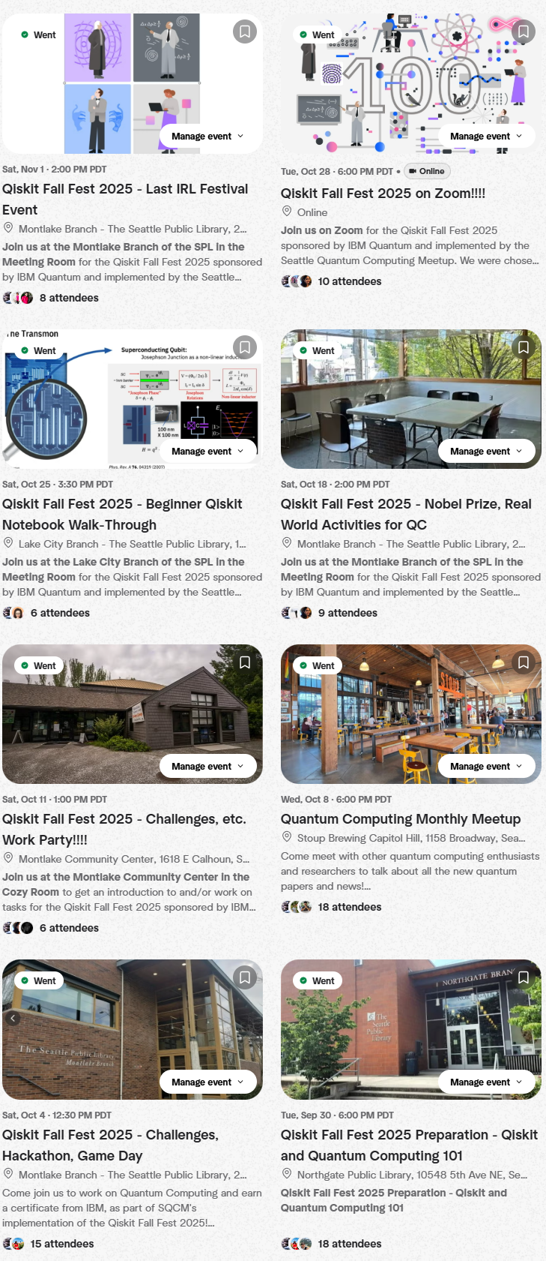
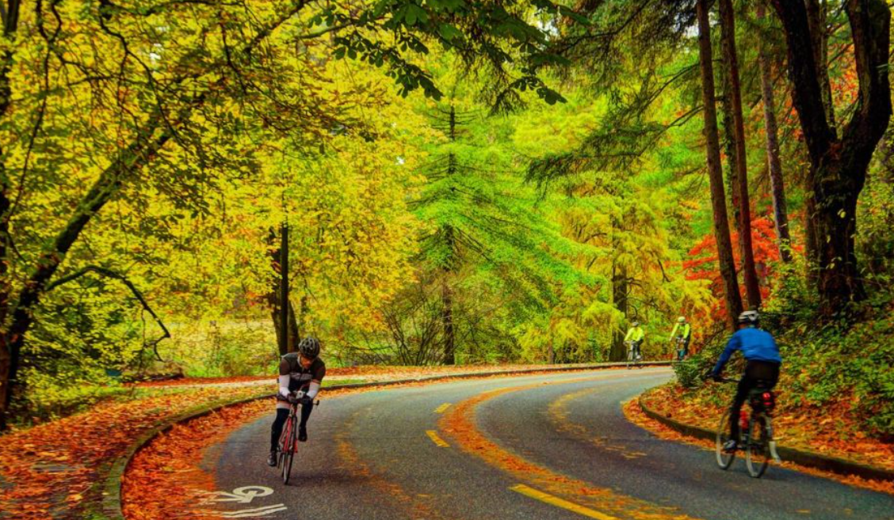
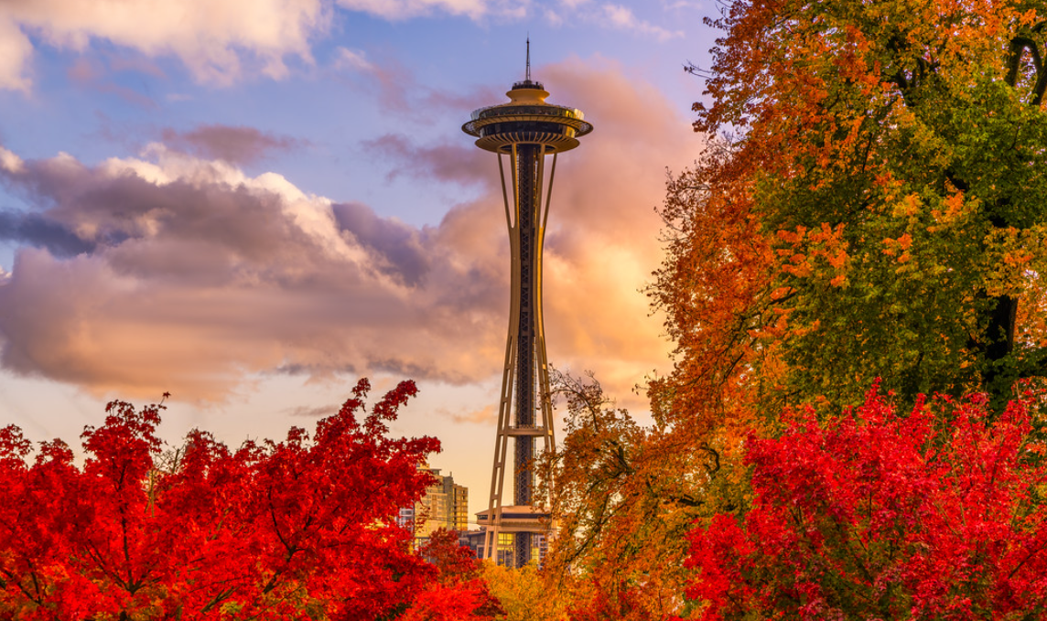
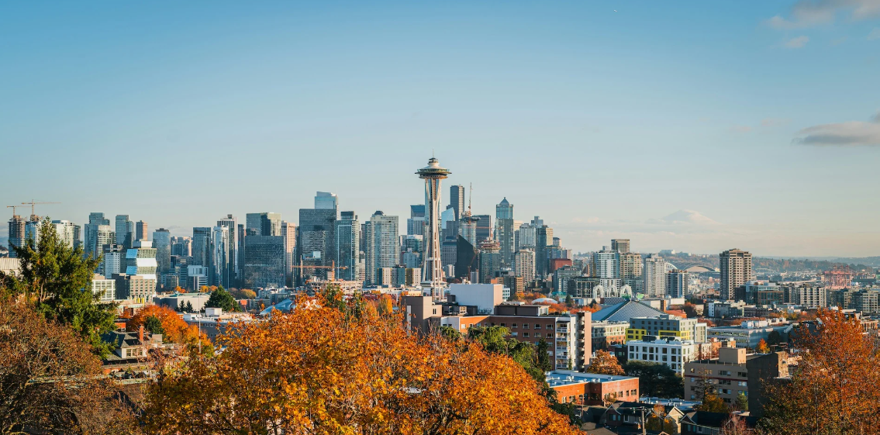
Photos
Events ran from:
Sep. 30 – Nov. 14, 2025
Most events were exclusively in-person in Seattle, WA.
One event was exclusively on Zoom.
Most of the participants live in the Seattle metro area.
Two events were ancillary quantum events in the community which occurred during the QFF window.
Our QFF was hosted on github on the Seattle Quantum Computing Meetup org page, and advertised at: https://www.meetup.com/seattle-quantum-computing-meetup/

