Slide 1


Decade in the Cloud
Welcome!
Qiskit Fall Fest 2026
Natalie Hawkins
Lead Organizer, QFF26
Tier 2 Qiskit Advocate
Seattle Quantum Computing Meetup

Slide 2

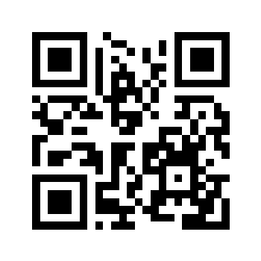
QFF26 Kickoff Agenda
- What is Qiskit Fall Fest? What is Qiskit?
- What are we going to do? → Have Fun!
- How can I earn an IBM Quantum Certificate?
- What’s next event-wise?
- How can I learn more?
Please scan this QR code to register with IBM Quantum:

Slide 3
QFF26 – Global Event
4000+ Applications, IBMQ Selected 200 Hosts
Oct 5 – Nov 30, 2026
https://www.ibm.com/quantum/events/fall-fest-2026
SQCM bird = Kookaburra -> https://www.ibm.com/quantum/hardware#roadmap

Slide 4
What’s in it for you?
From IBM Quantum:
-Participant Certificate ✓
-Winning Certificate
-Learning Opportunity and Badge(s)
From SQCM:
-A chance to present?
-Community, Collaborators, Learning Opportunity
From Packt Publishing:
-a copy of Quantum Chemistry and Computing for the Curious?

Slide 5
What are we going to do?
Oct 6 – Nov 30
Qiskit
Is an open-source software development kit (SDK) used to program, optimize, and execute quantum programs on real quantum hardware or classical simulators.
Applications, Algorithms
We have Qiskit coding exercises to help you see how quantum computers can be applied to a real world problem, such as finding ground state energy, using the Sample-based quantum diagonalization (SQD) algorithm.
Schedule of Events:
https://github.com/SeattleQuantumComputingMeetup/qiskit_fallfest_2026
Real Quantum Hardware
IBM Quantum offers 10 mins of free QPU use per month.
You can create an account on the IBM Quantum Platform and run jobs on real quantum hardware.
Presentations
We are aiming to have short talks by people working on quantum problems in industry and academia, and by you, participants of the Qiskit Fall Fest 2026!
Target:
Software devs, researchers, students

Slide 6
Highlights from the SQCM github page for QFF26:
https://github.com/SeattleQuantumComputingMeetup/qiskit_fallfest_2026
What to do:
Register here so that we have your name when awarding an IBM Quantum Certificate
If you haven't previously, join the SQCM Discord to engage with others during the fall fest
Join the Qiskit Fall Fest 2026 Kickoff zoom on Tu, Oct 6, at 12noon, 4pm, or 6pm PT
Schedule of Events:
Date | Time | Activity | Location
Oct 6 | 12noon, 4pm, or 6pm | Qiskit Fall Fest 2026 Zoom Kickoff | Zoom
Oct 8 | 4pm-6pm | Quantum Computing Happy Hour, RSVP | Seattle TBD
Oct 13 | 5pm-7pm | Quantum Computing Happy Hour, RSVP | Forum Social House, Lincoln Square, Bellevue, WA
Oct 20, 21, or 22? | 4pm?, 5pm?, or 6pm? | Industry Presentations related to Quantum Computing Research, Programming, Jobs, and Qiskit | TBD
Nov 3 | 12:00 - 1:00 pm | IBM Quantum Presentation, Alex Choquette, Global Strategic Research Development, IBM Quantum | online, RSVP here
Nov 24 or Dec 1 or later | TBD | Participant Qiskit Project Presentations | TBD
Nov 30 | 10:00 am | Deadline for Winning Certificate work | submit online
Dec 8 | 6:30 am | Closing Ceremony, by Serena Godwin, Qiskit Fall Fest Lead at IBM Quantum | On24
Up to Early Dec | -- | Participation and Winner Certificates Will Be Awarded | delivered online

Slide 7
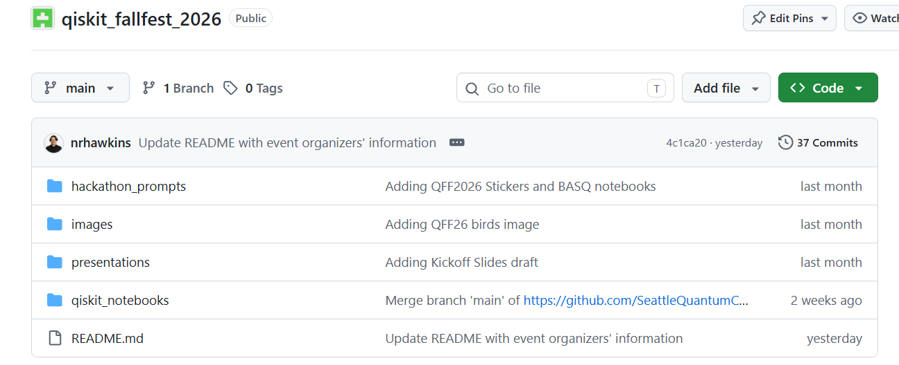
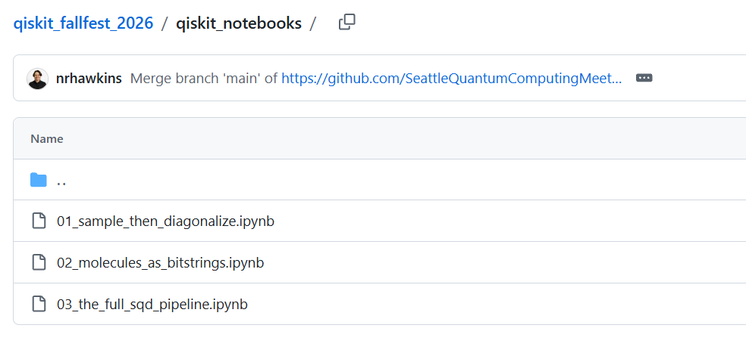
Highlights from the SQCM github page for QFF26:
https://github.com/SeattleQuantumComputingMeetup/qiskit_fallfest_2026
Use the SQD Algorithm to find ground state energy
Lab 1: string of magnets
Lab 2: H2 electron orbitals
Lab 3: stretched-N2 and H2O

Slide 8
Highlights from the SQCM github page for QFF26:
https://github.com/SeattleQuantumComputingMeetup/qiskit_fallfest_2026
How can I earn a Winning Certificate? (it’s completely flexible - pick one, or design one of your own)
Complete one or more of the Qiskit Jupyter Notebooks on the SQD Algorithm
Complete one or more classes on the IBM Quantum Learning platform, https://quantum.cloud.ibm.com/learning/en/courses
Complete a tutorial on the IBM Quantum platform, https://quantum.cloud.ibm.com/docs/en/tutorials
Work on a hackathon prompt from the SQCM QFF26 directory: https://github.com/SeattleQuantumComputingMeetup/qiskit_fallfest_2026/tree/main/hackathon_prompts
Write a proposal for a start-up related to quantum technologies, something like, https://dorahacks.io/hackathon/564/businesschallenge
Write an article, say, for Medium or Substack, or just for yourself, related to quantum computing, could be a report on a Qiskit Quantum Seminar that you watched on the Qiskit YouTube channel, or on the QPU Roadmap
Vibe code a research paper, take the Qiskit Developer Certification exam, join the Qiskit Advocate Program
Create a piece of art or music related to quantum technologies

Slide 9

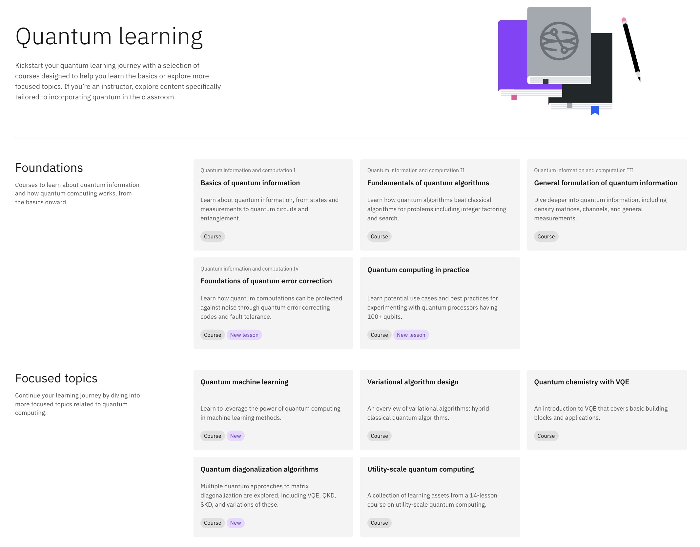

IBM Quantum Learning
Learn the basics of quantum computing and how to solve real-world problems with IBM Quantum services and systems
Courses, tutorials, and educational resources by leading quantum experts.
© 2026 IBM Corporation

Slide 10
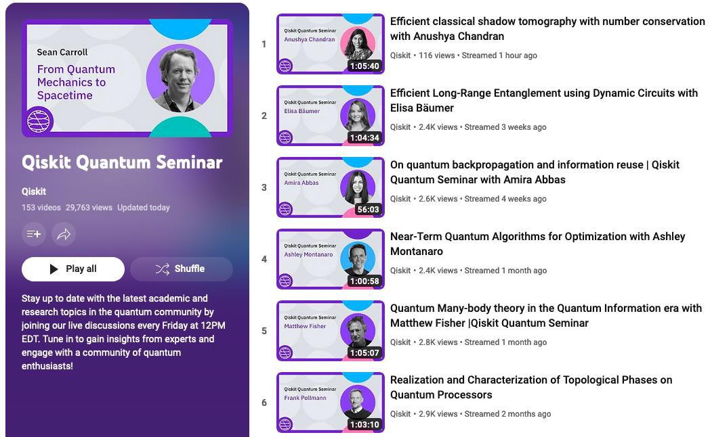
© 2025 IBM Corporation

Slide 11
Highlights from the SQCM github page for QFF26:
https://github.com/SeattleQuantumComputingMeetup/qiskit_fallfest_2026
Comments on the “group project” idea:
I am working on reviewing your backgrounds
I have a few projects in mind
IBM Quantum runs a program called QAMP = Qiskit Advocate Mentorship Program, in which small groups work on a research project; I was a mentor on a project last year.
We can discuss at a future Happy Hour, or schedule a zoom, or on the SQCM Discord’s Category: Qiskit Fall Fest 2026, etc.

Slide 12
Qiskit
Qiskit is an open-source, Python-based software development kit (SDK) used to program quantum computers. There is some Rust underneath, and a C/C++-interface exists.
Developed by IBM in 2017, Qiskit lets developers and researchers build quantum circuits, run simulations, and execute code on real quantum hardware or using simulators.
Pronounced "kiss-kit", it serves as a leading industry tool for quantum information science.
(Google Gemini, AI Overview, w/a few mods)
© 2026 IBM Corporation
14

Slide 13

Where is everybody on their Quantum journey?
0
Beginner - Intermediate
5
10
What’s
Quantum?
Reading, Videos,
Science, math or hands-on coding
Papers Active Research and development
Qiskit Fall Fest 2026

Slide 14



Qiskit Pattern:
The anatomy of a quantum algorithm
01
Map problem instance to quantum circuits and operators
02
Optimize for target hardware execution
03
Execute via
IBM Quantum Compute
04
Result processing
Map
Optimize
Execute
Post-Process
© 2026 IBM Corporation

Slide 15
Qiskit SDK sets the foundation
Qiskit SDK gives us a base layer of building blocks for building and running quantum algorithms
Qiskit Circuit Library
Transpiler
Primitives
Quantum Info
Input:
Domain inputs
Input:
Circuits, observable
Input:
ISA circuit, observable
Input:
Expectation value/samples
Output:
Circuits, observable
Output:
ISA circuit, observable
Output:
Expectation value/samples
Output:
Data objects/visualizations
Map
Optimize
Execute
Post-Process
© 2026 IBM Corporation

Slide 16

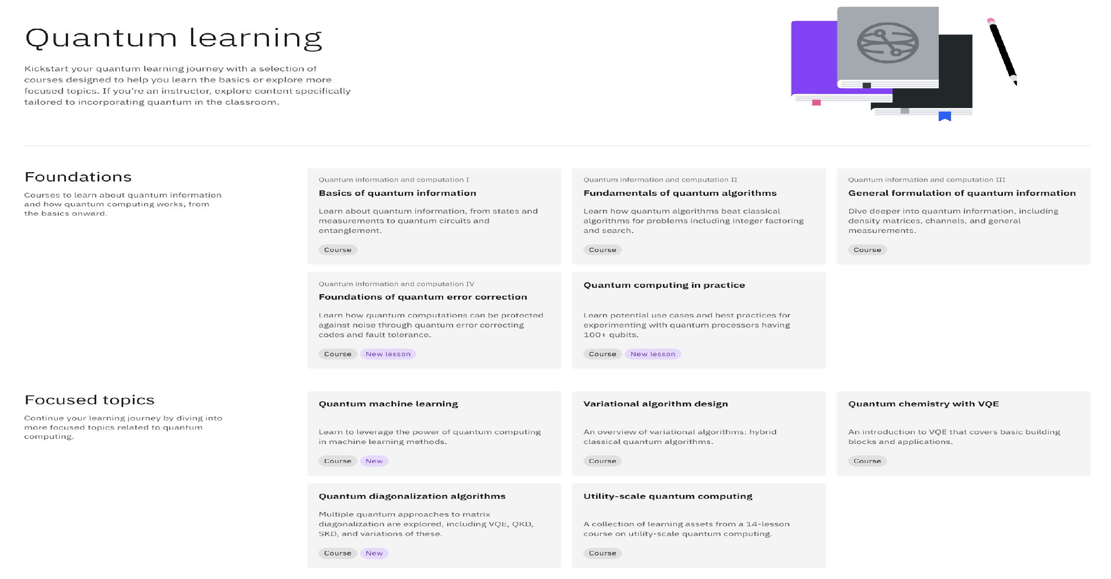
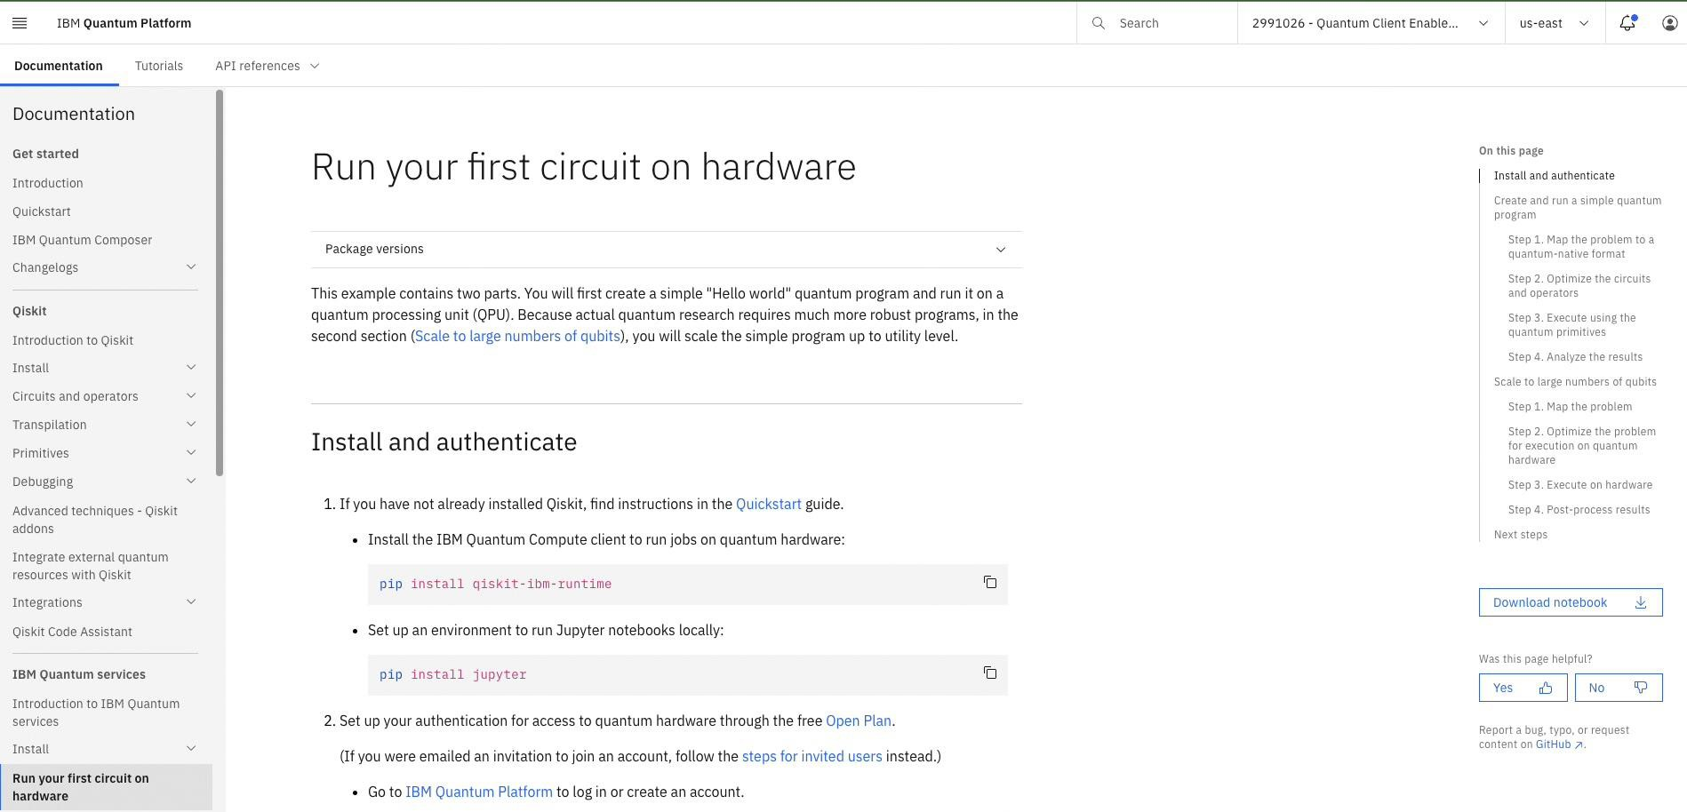
IBM Quantum Platform
Hello World: A quick hands on introduction to running circuits on Qiskit and IBM Quantum platform
Link: https://quantum.cloud.ibm.com
/docs/en/tutorials/hello-world
© 2026 IBM Corporation

Slide 17
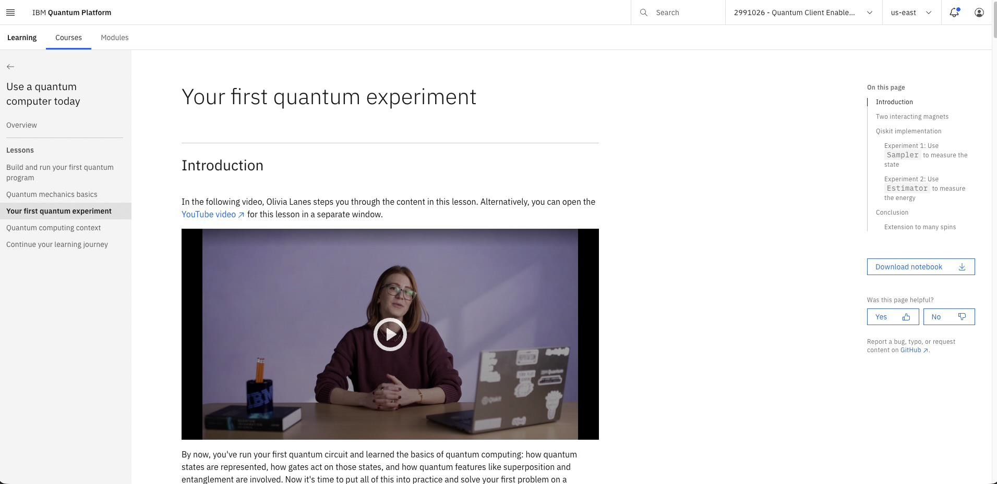

IBM Quantum Platform
Your First Quantum Experiment: A quick hands on introduction to running circuits on Qiskit and IBM Quantum platform
https://quantum.cloud.ibm.com
/learning/en/courses/use-a-qc-today/your-first-quantum-
experiment
© 2026 IBM Corporation

Slide 18
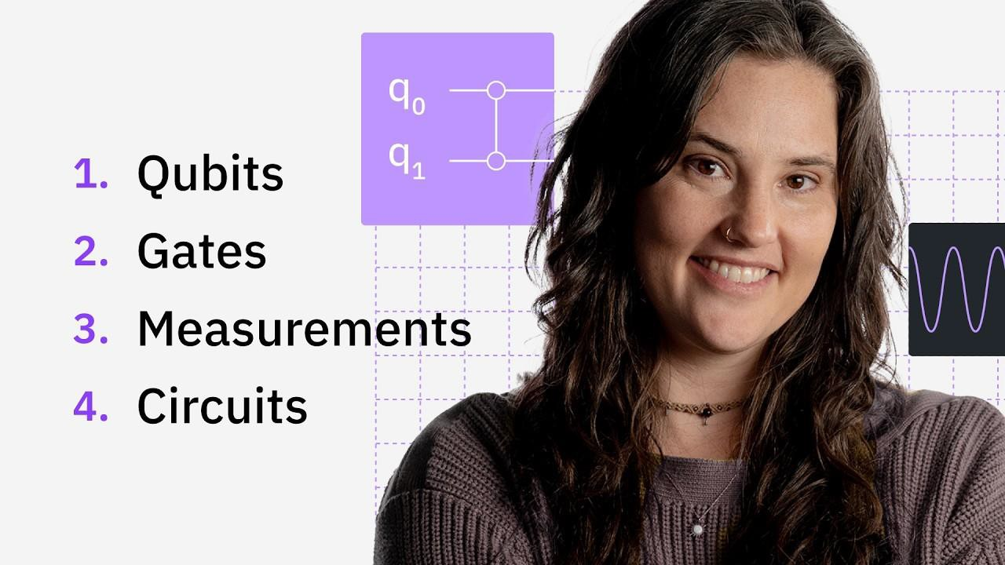
IBM Quantum Platform
Quantum Computing 101: How to Get Started
Link: https://www.youtube.com/watch
?v=l5I9M3C2wzg
© 2025 IBM Corporation

Slide 19
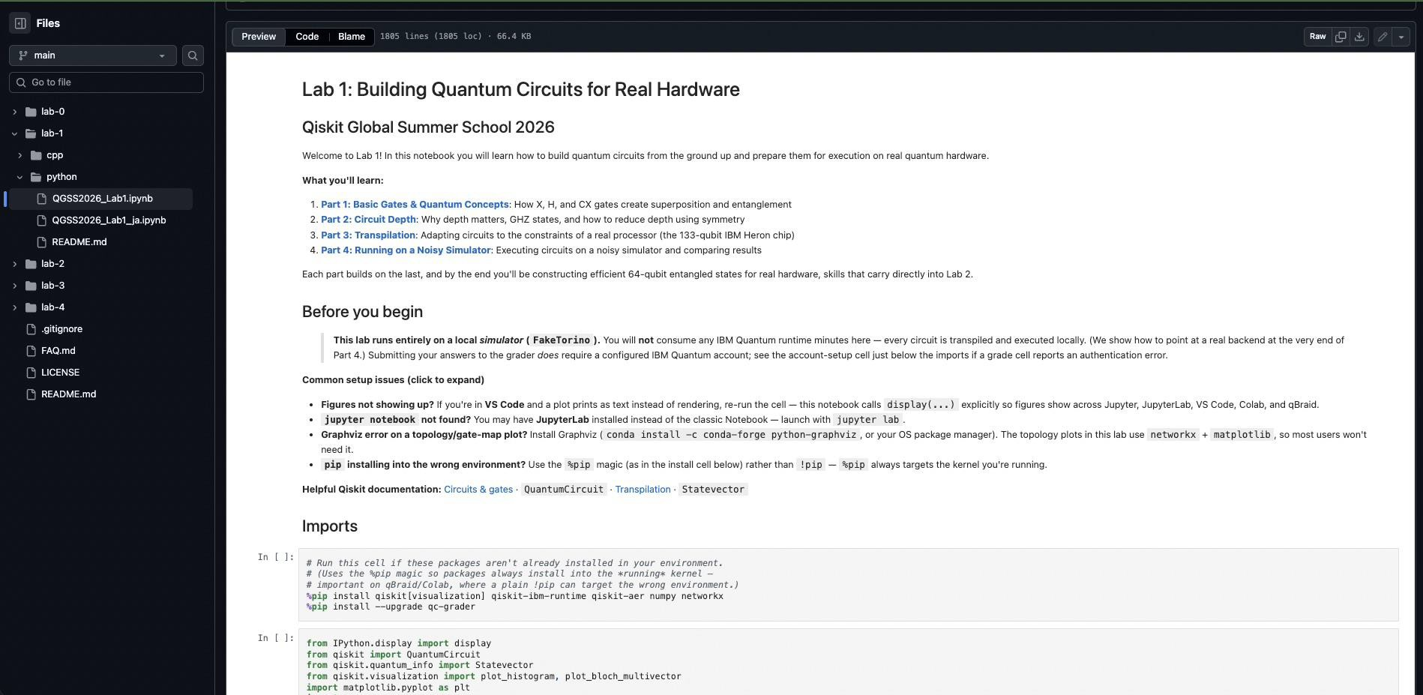
IBM Quantum Platform
Qiskit Global Summer School 2026: Lab 0
Notebook: https://github.com/qiskit-community/qgss-2026/blob/main/lab-0/QGSS2026_Lab0.ipynb
© 2026 IBM Corporation

Slide 20
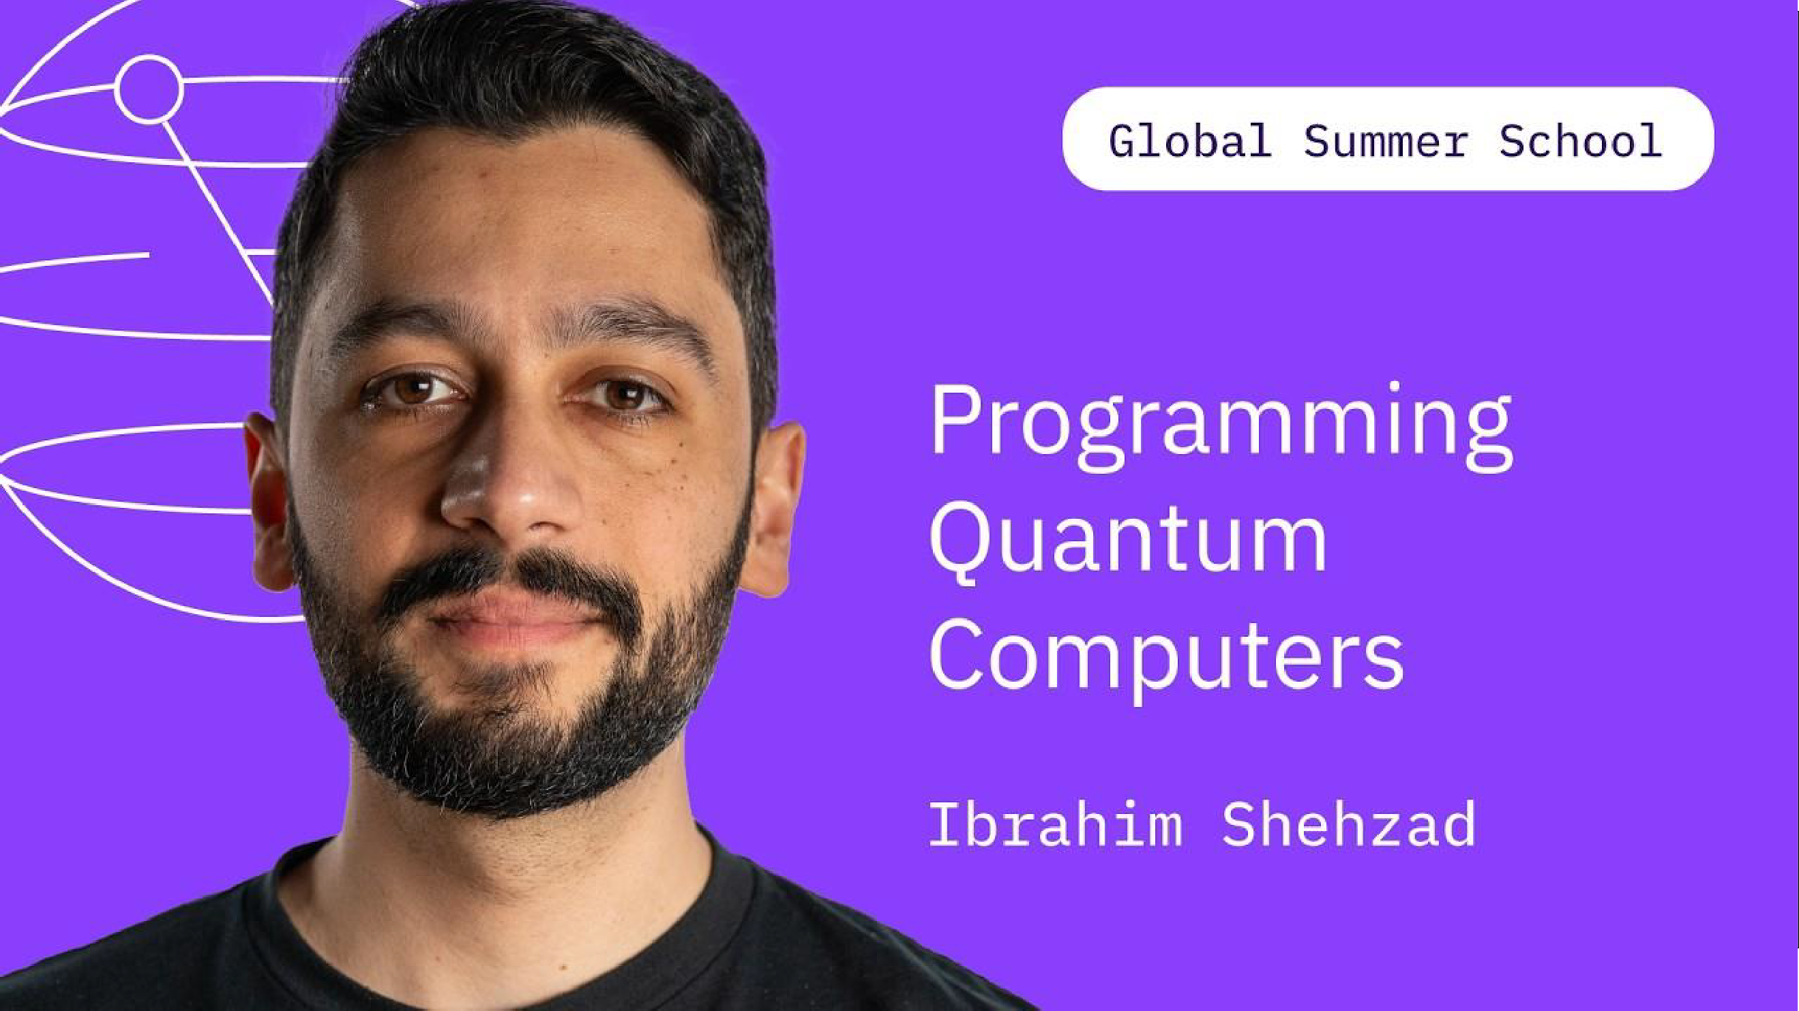
IBM Quantum Platform
Programming QuantumComputers | Ibrahim Shehzad | QGSS26
https://www.youtube.com/watc h?v=47loAu08F2w&list=PLcYB0 kKPI4a8&index=5
© 2026 IBM Corporation

Slide 21
Example workflows
© 2026 IBM Corporation

Slide 22
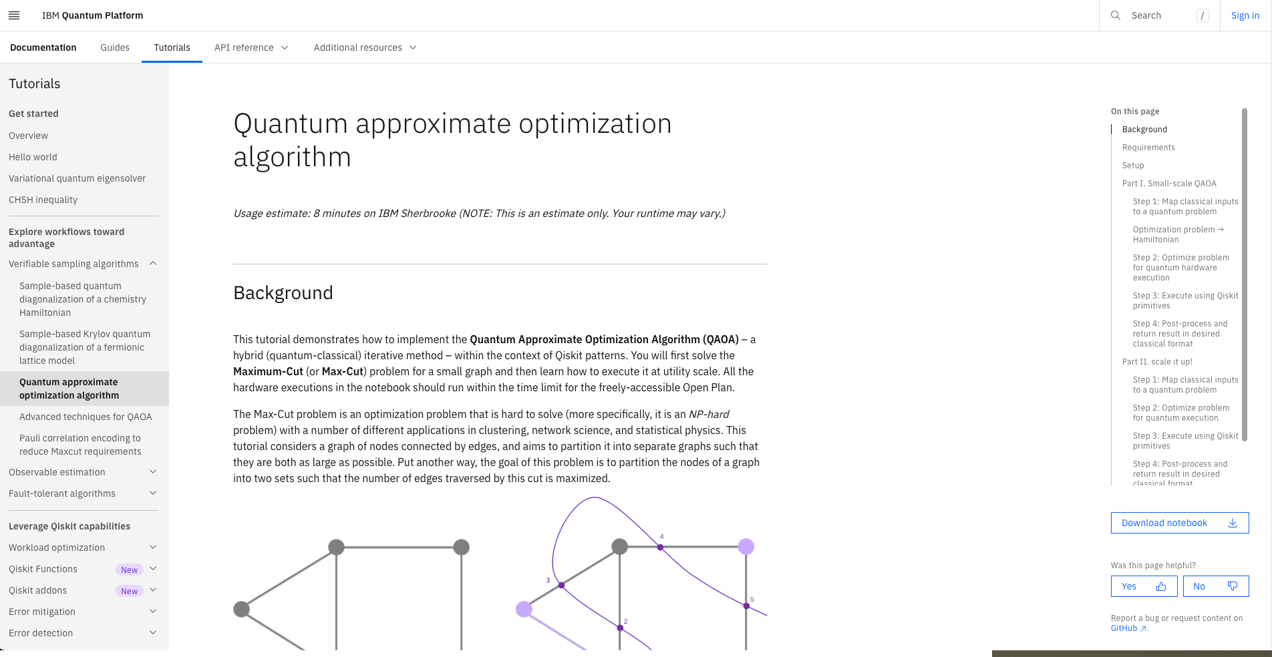
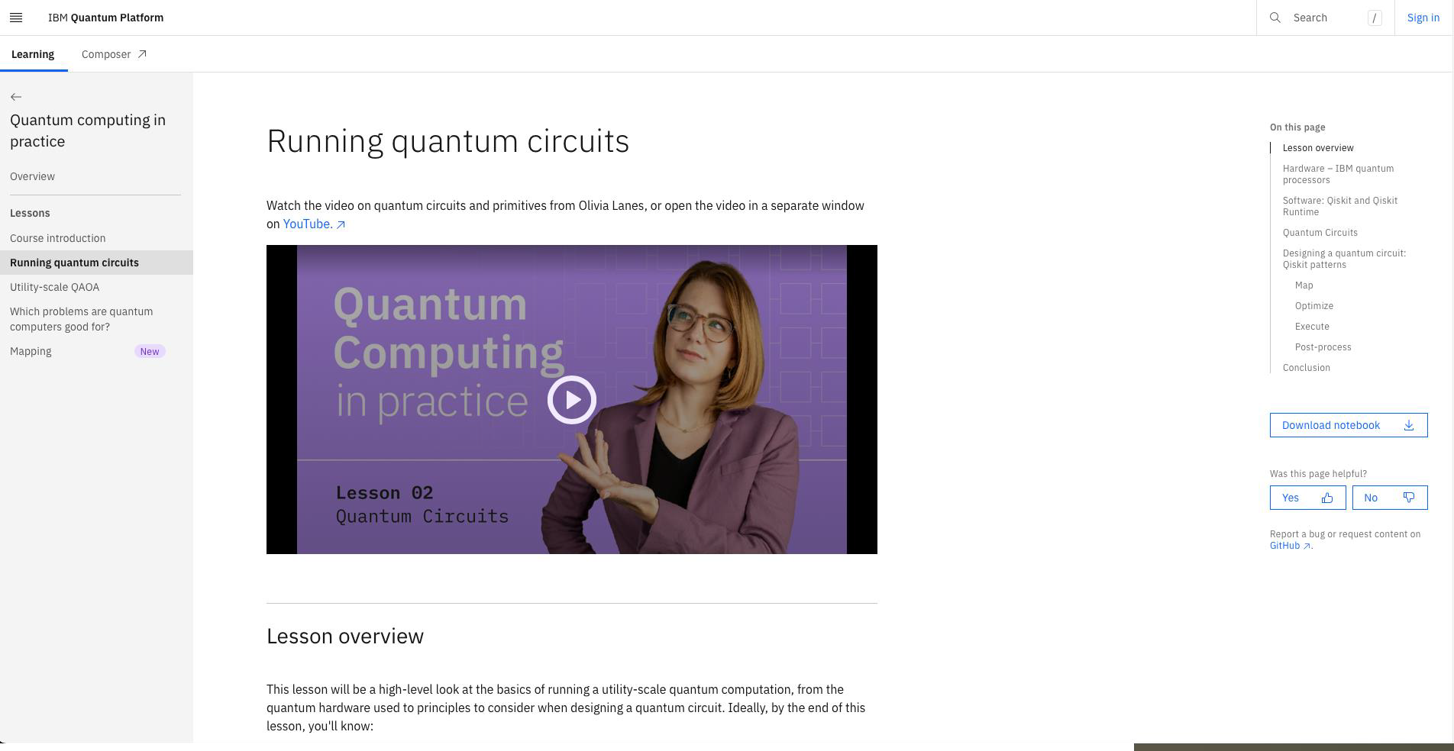
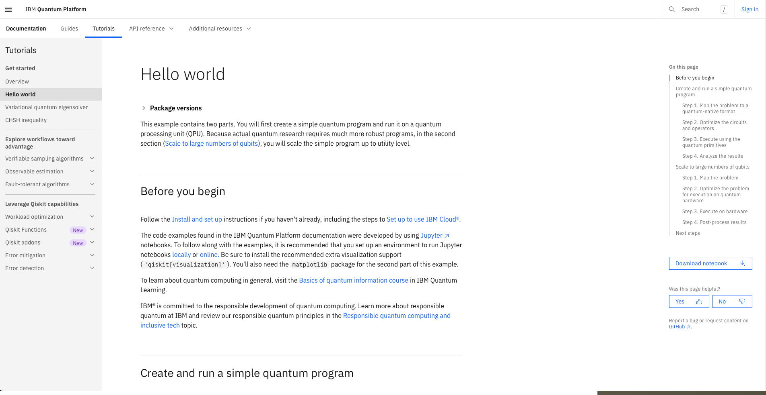
IBM Quantum Platform
Quantum Approximate optimization Algorithm (QAOA) Workflow
Link: https://quantum.cloud.ibm.com
/docs/en/tutorials/quantum-approximate-optimization-algorithm
© 2026 IBM Corporation

Slide 23
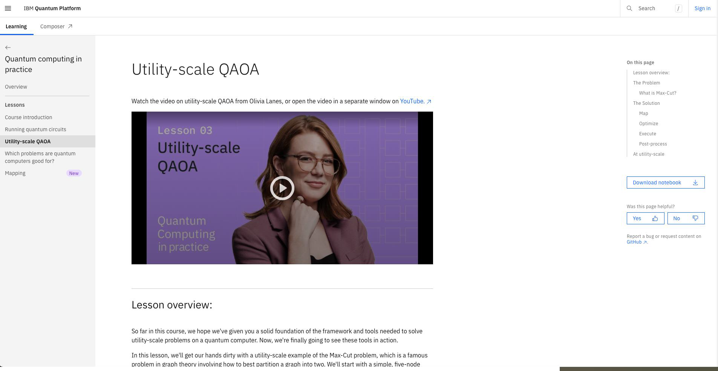
IBM Quantum Platform
Quantum Approximate optimization Algorithm (QAOA) Workflow walkthrough
Link: https://quantum.cloud.ibm.com
/learning/en/courses/quantum-computing-in-practice/utility-scale-qaoa
© 2026 IBM Corporation

Slide 24
Error Mitigation (optional – at Beginner stage)
© 2026 IBM Corporation

Slide 25
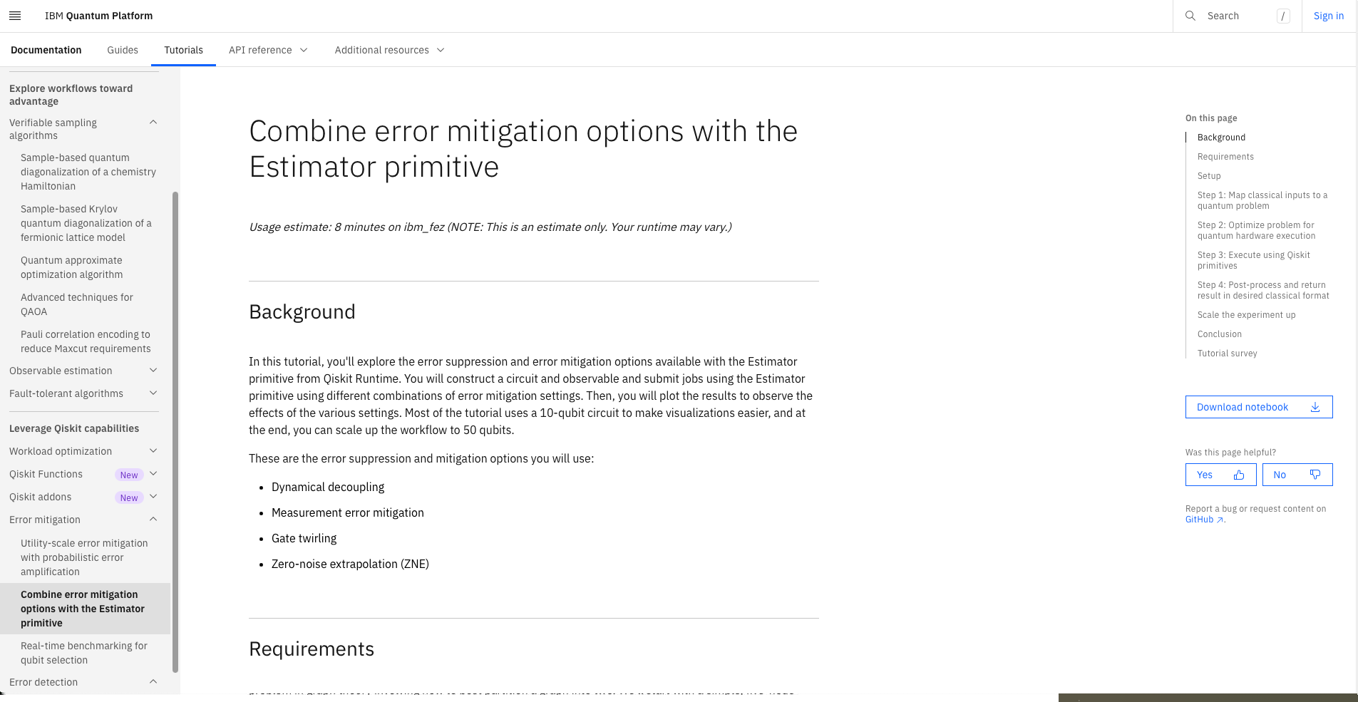
IBM Quantum Platform
Notebook: Combine error mitigation options with the Estimator Primitive
Link: https://quantum.cloud.ibm.com
/docs/en/tutorials/combine-error-mitigation-techniques
© 2026 IBM Corporation

Slide 26
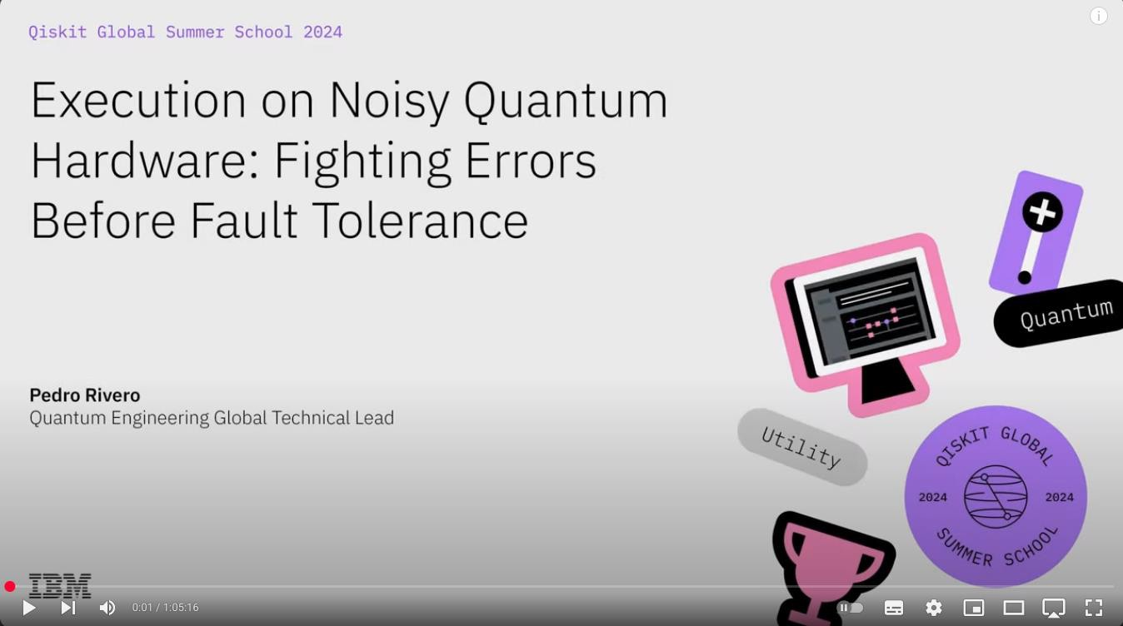
IBM Quantum Platform
Video: Execution on Noisy Quantum Hardware: Fighting errors before Fault Tolerance
Link: https://www.youtube.com/watch
?v=l5V8J_yMEis
© 2026 IBM Corporation

Slide 27
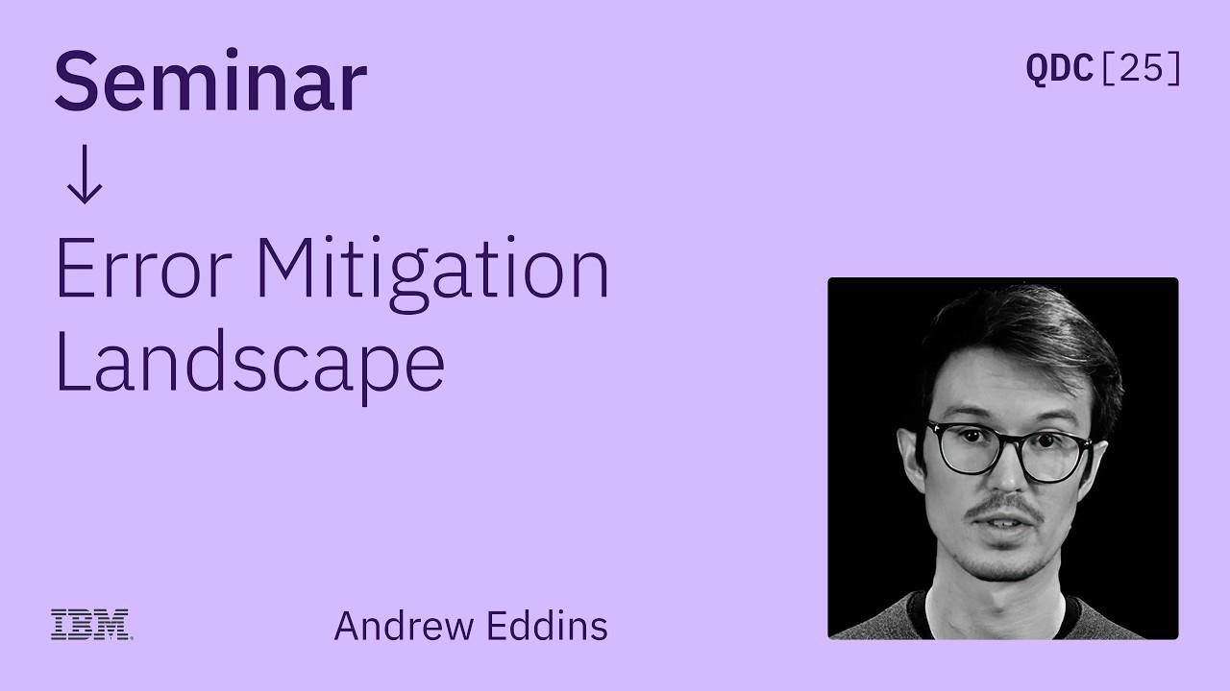
IBM Quantum Platform
Video:
Andrew Eddins | Error Mitigation Landscape | QDC 2025
Link: http://youtube.com/watch?v=ix5 2wx4_zek
© 2026 IBM Corporation

Slide 28
Where are your participants on their Quantum journey?
0
5
Intermediate - Advanced
10
What’s Quantum?
Reading, Videos,
Science, math or hands-on coding
Papers Active Research and development
IBM Quantum / © 2026 IBM Corporation

Slide 29
Qiskit Pattern:
The anatomy of a quantum algorithm
01
Map problem instance to quantum circuits and operators
02
Optimize for target hardware execution
03
Execute via Qiskit Runtime
04
Result processing
Map
Optimize
Execute
Post-Process
© 2026 IBM Corporation

Slide 30
Example workflows
© 2026 IBM Corporation

Slide 31
Qiskit addons build on the Qiskit SDK
A collection of research capabilities developed as modular tools that can plug into a workflow to design new algorithms at the utility scale
Starting with multi-product formulas (MPF), approximate quantum compilation (AQC-Tensor), operator backpropagation (OBP), and sample-based quantum diagonalization (SQD).
AQC-Tensor
OBP
SQD
MPF
Circuit cutting
M3
Qiskit Circuit Library
Transpiler
Primitives
Quantum Info
Input:
Domain inputs
Input:
Circuits, observable
Input:
ISA circuit, observable
Input:
Expectation value/samples
Output:
Circuits, observable
Output:
ISA circuit, observable
Output:
Expectation value/samples
Output:
Data objects/visualizations
Map
Optimize Execute
Link: https://quantum.cloud.ibm.com/docs/en/guides/addons
Post-Process
© 2026 IBM Corporation
Lecture notes: Link
41

Slide 32


Executor and Samplomatic enable advanced classical error mitigation
Propagated Noise Absorption
Shaded Lightcones
OBP
Circuit Cutting Noise Learner Samplomatic
https://quantum.cloud.ibm.com/d
ocs/en/guides/get-started-with-executor
PEC
AQC-Tensor
SQD
MPF
Executor
M3
Qiskit Circuit Library
Transpiler
Primitives
Quantum Info
Input:
Domain inputs
Input:
Circuits, observable
Input:
ISA circuit, observable, samplex
Input:
Expectation value/samples
Output:
Circuits, observable
Output:
ISA circuit, observable
Output:
Expectation value/samples
Output:
Data objects/visualizations
Map
Classical compute
Optimize
Classical/Quantum Compute
Execute
Quantum Compute
Post-Process
Classical Compute
© 2026 IBM Corporation

Slide 33
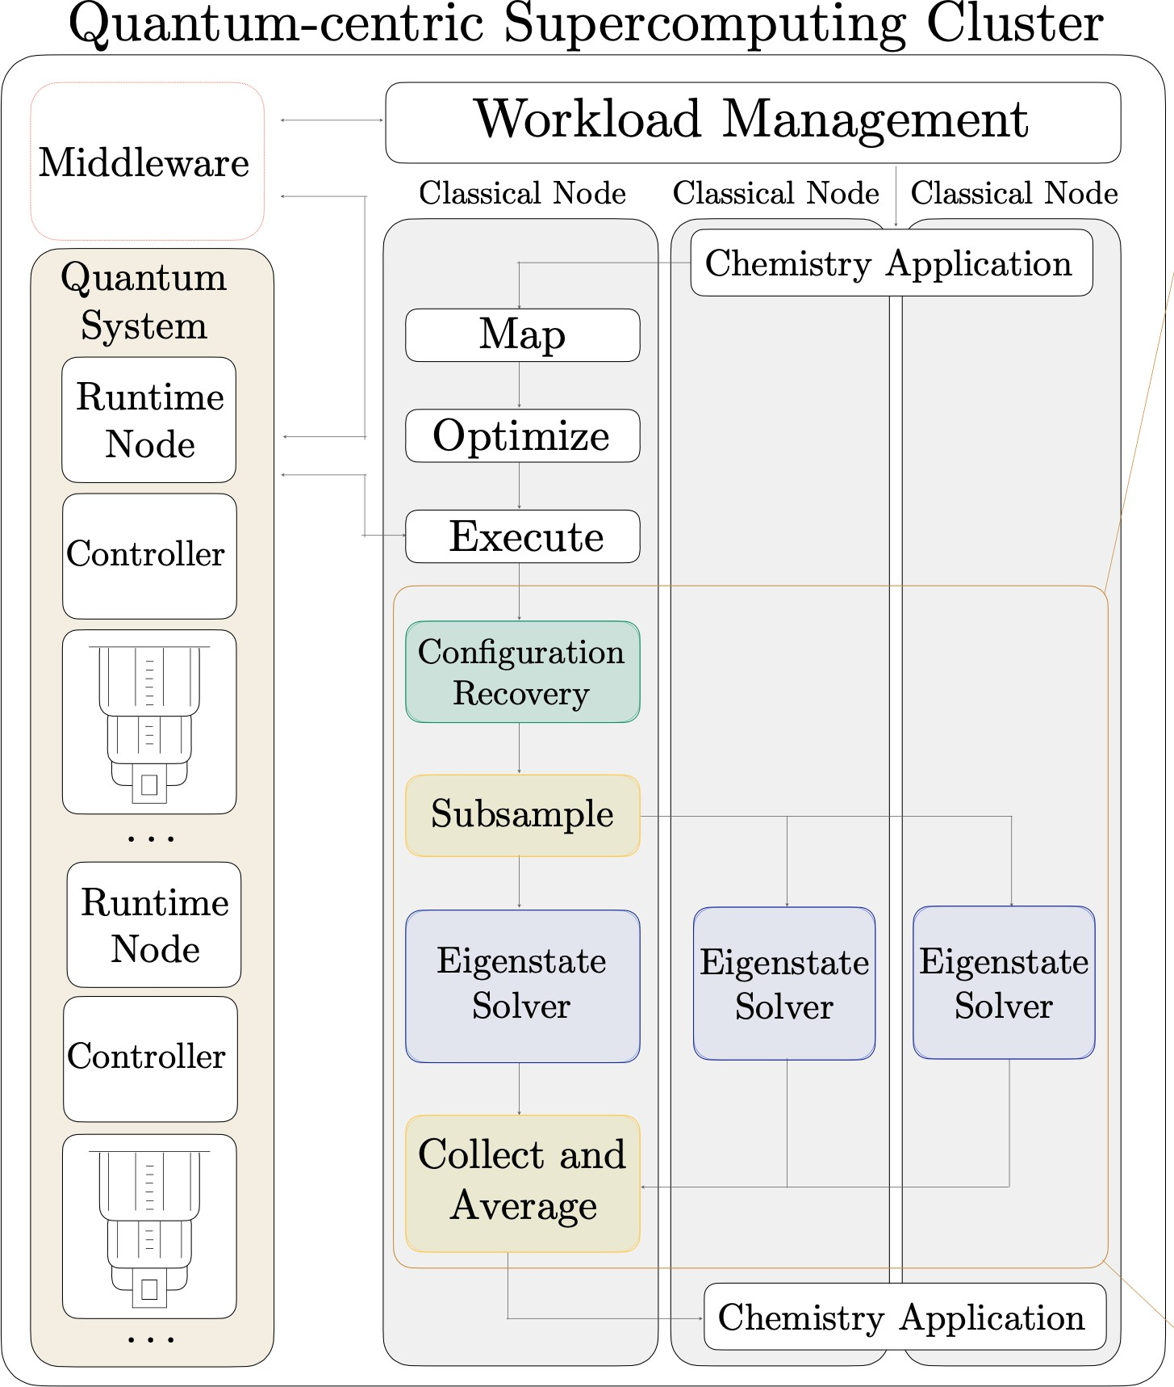
Qiskit Addon: Sampling-based quantum diagonalization
Domain
inputs
Create circuit, observable
SQD classically post-processes noisy samples from a quantum processor to produce more accurate energy estimations
Map
Circuits
SQD
Transpile circuit
Sample-based Quantum
Diagonalization (SQD)
Optimize
ISA circuit, observable
Quantum Info
Sampler primitive
Result processing
Samples
Execute
SQD
Energy
estimation
Post-process
RIKEN
IBM Quantum
University of Colorado Boulder
Research
Science Advances vol. 11, no. 25 (2025)
Development
https://github.com/Qiskit/qiskit-addon-sqd
© 2026 IBM Corporation

Slide 34

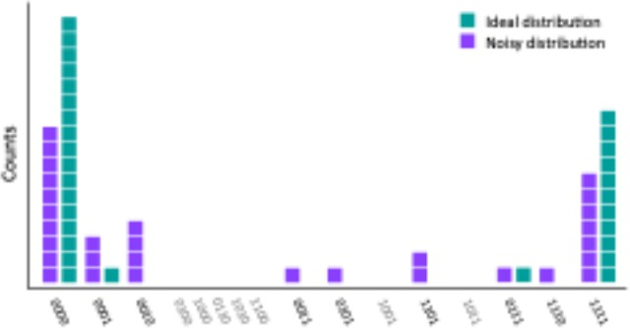
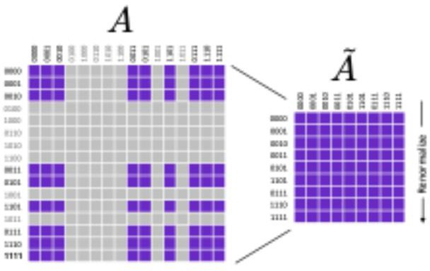
Qiskit Addon: Matrix-free Measurement Mitigation (M3)
Scalable readout error mitigation via sub-space reduction and iterative matrix-free techniques.
Create circuit, observable
Circuit, observable
Map
Transpile circuit
Mapped ISA circuit
M3
Mitigation
M3: calibration
Calibrate readout errors over full device
Optimize
Mitigate readout errors for sampling and expectation values
Sampler primitive
Counts
Execute
M3: post-process
Research
PRX Quantum 2, 040326 (2021)
225+ citations
Development
https://github.com/Qiskit-Extensions/mthree
Post-process
Quasi-distribution
IBM Quantum
© 2026 IBM Corporation
44

Slide 35
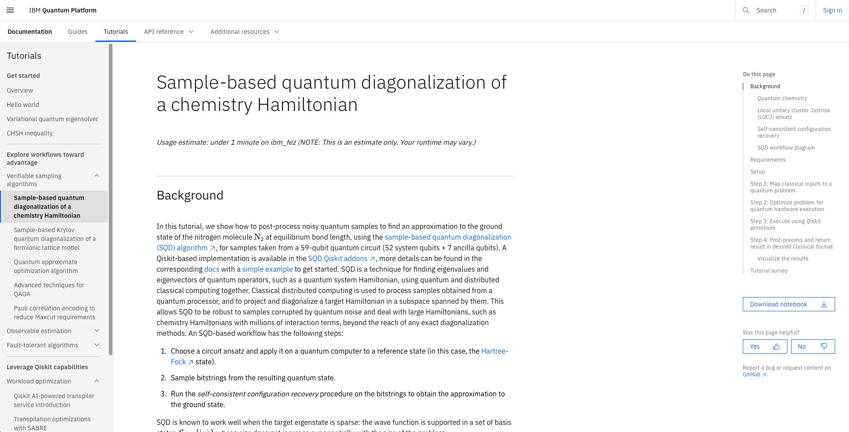
IBM Quantum Platform
Qiskit Addons workflow: Sample based quantum diagonalization of a chemistry Hamiltonian
Link: https://quantum.cloud.ibm.com
/docs/en/tutorials/sample-based-quantum-diagonalization
Lecture notes from QGSS: https://github.com/qiskit-community/qgss-2025-lecture-notes/blob/main/Day%205%20-
%20Practical%20Quantum%20Algorithms%2 0by%20Joana%20Fraxanet%20Morales.pdf
© 2026 IBM Corporation

Slide 36
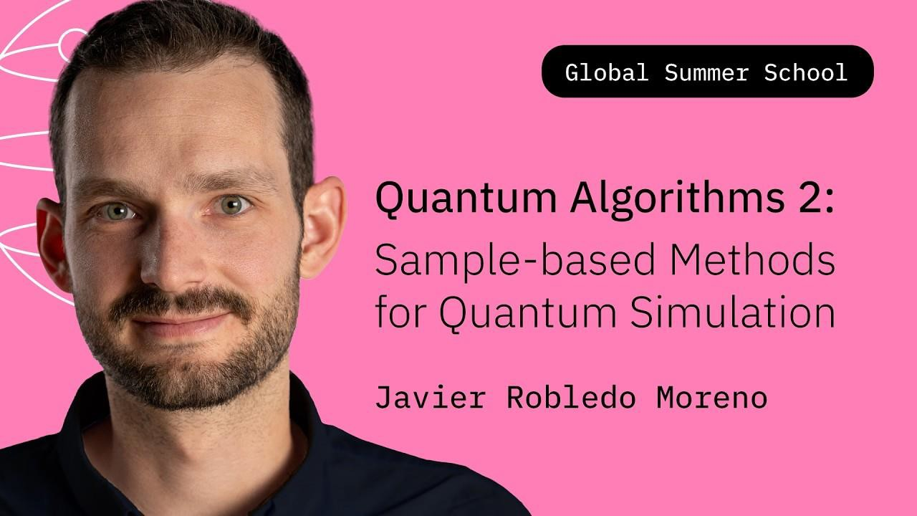
IBM Quantum Platform
Quantum Algorithms Pt.2 Sample-based Methods for Quantum Simulation Javier Robledo Moreno | QGSS26
Link: https://youtube.com/watch?v= WuaoaknYDrk
© 2026 IBM Corporation

Slide 37
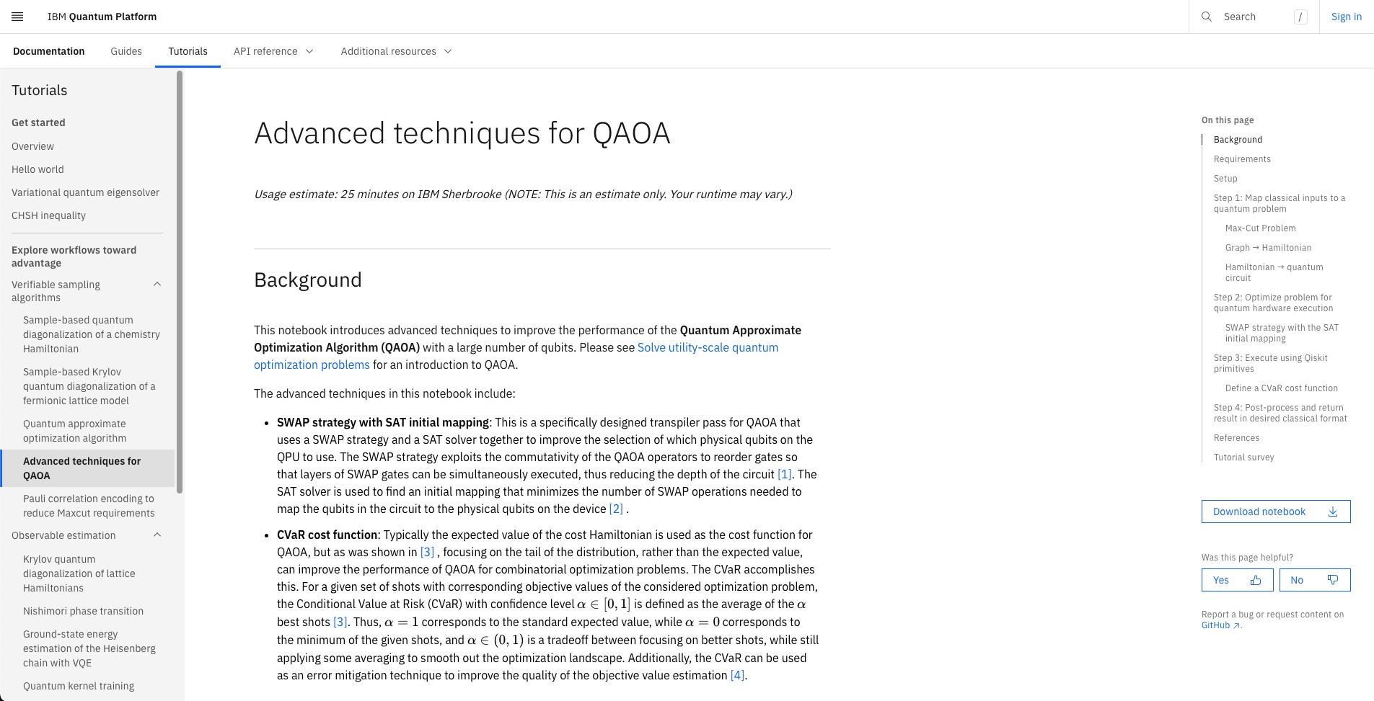
IBM Quantum Platform
Advanced Techniques for QAOA
Link: https://quantum.cloud.ibm.com
/docs/en/tutorials/advanced-techniques-for-qaoa
© 2026 IBM Corporation

Slide 38
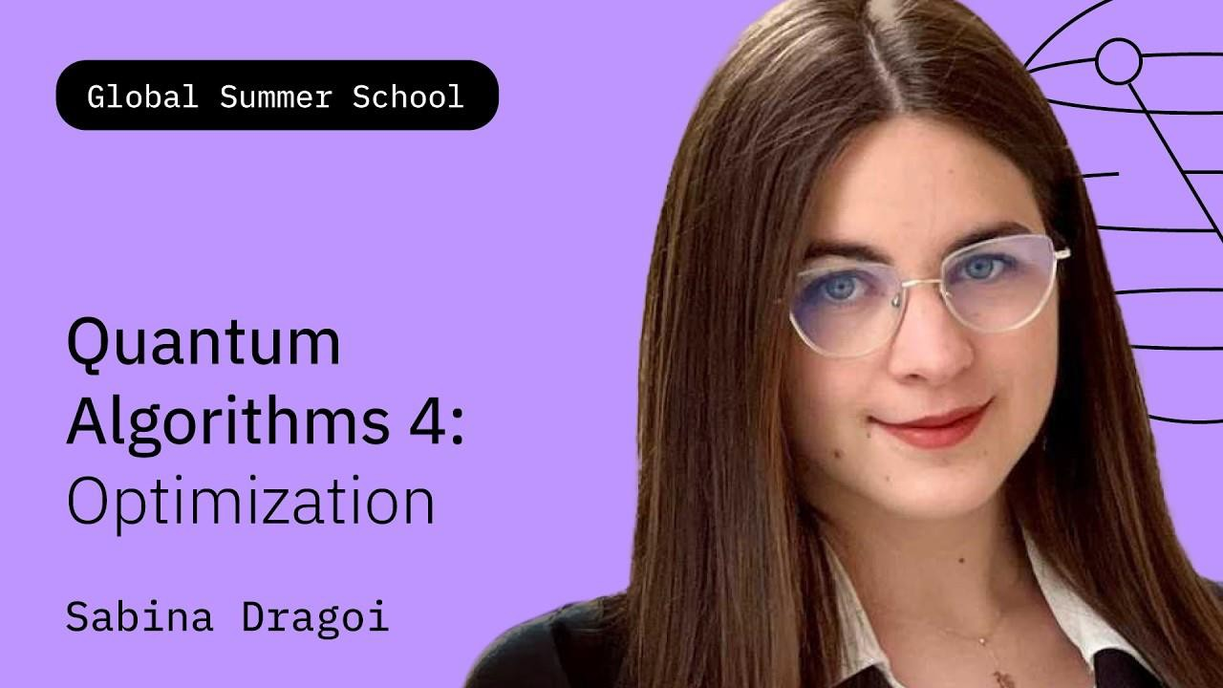
IBM Quantum Platform
Quantum Approximate optimization Algorithm (QAOA) walkthrough
Link: https://www.youtube.com/watc h?v=D5cAo5O6xZM
© 2026 IBM Corporation

Slide 39
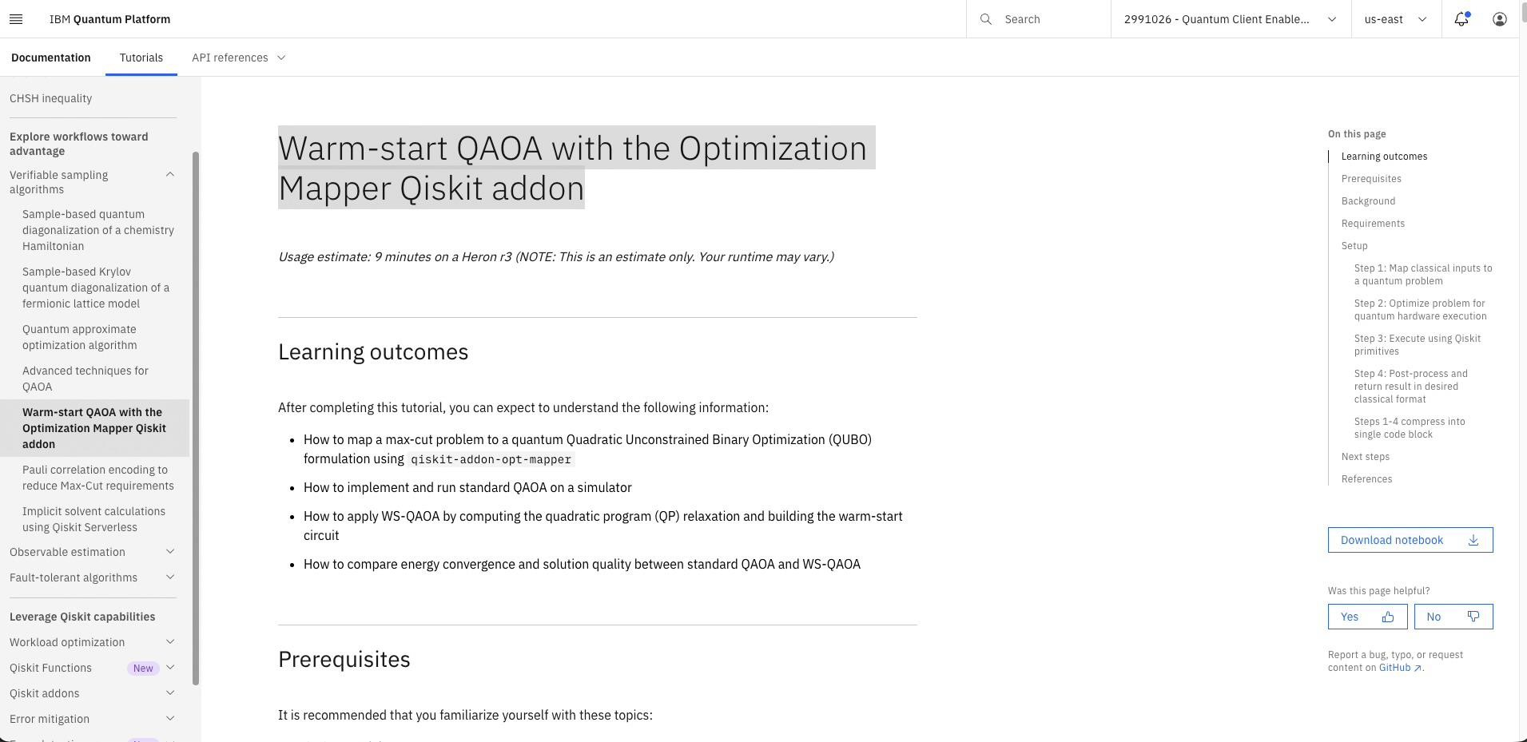
IBM Quantum Platform
Warm-start QAOA with the Optimization Mapper Qiskit addon
Link: https://quantum.cloud.ibm.com/ docs/en/tutorials/warm-start-qaoa
© 2026 IBM Corporation

Slide 40
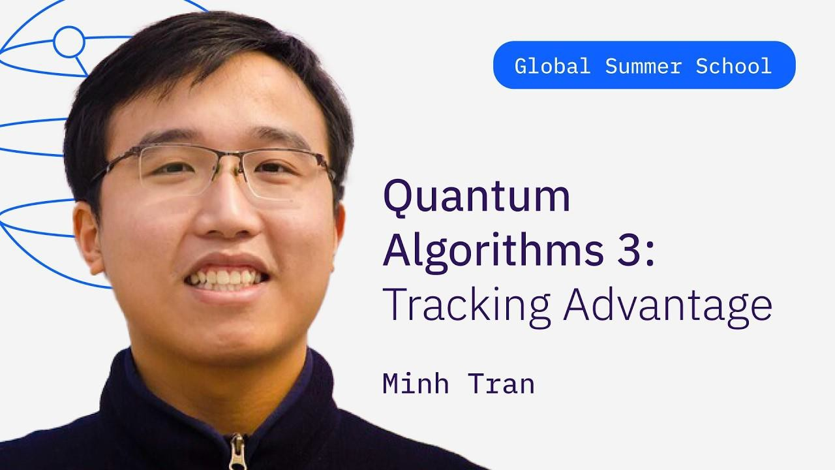
IBM Quantum Platform
Video:
Quantum Algorithms Pt.3 Tracking Advantage | Minh Tran | QGSS26
Link: https://www.youtube.com/watc h?v=aBlZlTWWjuE
QGSS Notebook: https://github.com/qiskit-community/qgss-2026/blob/main/lab-4/QGSS2026_Lab4a.ipynb
The Quantum Advantage Tracker:
https://quantum-advantage-tracker.github.io/
© 2026 IBM Corporation

Slide 41
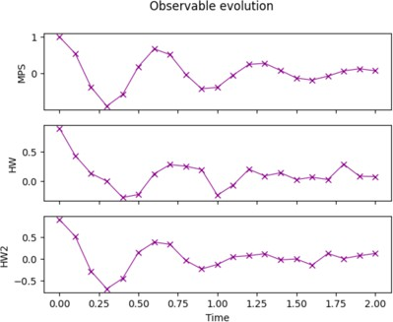
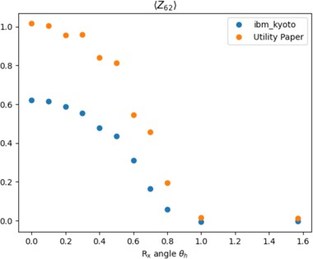
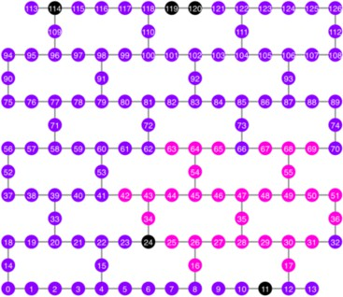
Utility Scale Modules
1D Transverse Ising Model (70 qubits x 80 ent. gates)
Nature Paper Simulation (127 qubits x 60 ent. gates)
Long-entanglement with GHZ State (127 qubits)
Utility I
Utility II
Utility III
This module explores Quantum simulation of a 1D transverse Ising model on linear lattices.
Performs time-evolution simulation using Statevector and MPS simulators first with N=20, then scales to N=70 on a real hardware to compare with the N=20 simulator results.
Focuses on teaching the workflow (Map>Optimize>Run>Post-process) in the process.
.
This module walks learners through reproducing the Nature paper with a focus on implementation of the problem without any error mitigation applied at first.
This module can be utilized as a group project or an in-class challenge. The goal is to build a GHZ circuit with 20 qubits or more that meets a certain fidelity criteria (i.e., GHZ state fidelity > 0.5)
Learners will compare results to that of the Nature paper that applied error mitigation techniques.
Several ideas are presented as an example such as finding the best qubit chain based on 2 gate errors, finding a balanced tree of qubits, applying error mitigation options in Sampler V2.
Finally, students can explore an option to try PEA (Probabilistic Error Amplification) to run their circuits and apply error mitigation in post-processing.
The module encourages students to produce their own ideas while exploring the suggested options first.
IBM Quantum

Slide 42

A note on

Slide 43

Qiskit MCP servers
An MCP Server (Model Context Protocol Server) is a lightweight helper program that gives AI models a secure, standardized way to connect to external data sources, databases, and tools
qiskit-docs-mcp-server
Live docs search into any assistant. Tool for every participant to attach.
INSTALL
pip install "qiskit-mcp-servers[all]"
CONFIG — CLAUDE CODE (.MCP.JSON) · CLAUDE DESKTOP · CURSOR
qiskit-mcp-server
Build, transpile & serialize circuits (QASM3/QPY) as agent tools.
{ "mcpServers" : {
"qiskit-docs" : {
"command": "uvx" ,
"args": ["qiskit-docs-mcp-server" ]
},
qiskit-ibm-runtime-mcp-server
Real hardware: list backends, submit & monitor jobs. Needs QISKIT_IBM_TOKEN.
qiskit-ibm-transpiler-mcp-server
AI transpiler passes (routing & synthesis) on demand.
"qiskit-runtime" : {
"command": "uvx" ,
"args": ["qiskit-ibm-runtime-mcp-server" ],
"env": { "QISKIT_IBM_TOKEN": "<token>" }
qiskit-gym-mcp-server
RL circuit synthesis (community).
} }
}
Try Docs first. Use Runtime only when ready to use real-hardware.
© 2026 IBM Corporation

Slide 44

Common Pitfall – Deprecated code
vanilla_llm_output.py
# what a frontier model happily writes in 2026: from qiskit import QuantumCircuit, execute from qiskit import IBMQ
IBMQ.load_account()
backend = provider.get_backend( 'ibmq_qasm_simulator')
job = execute(qc, backend, shots=1024)
# execute(): removed in Qiskit 1.0 (2024)
# IBMQ provider: gone. That backend: retired.
ImportError: cannot import name 'execute'
Trained on the 2023 internet
Most public Qiskit code predates 1.0 — models learned APIs that no
longer exist.
Prompting isn't enough
Saying “use Qiskit 2.x” in the prompt is often ignored (QUANTUM-API-
DRIFT benchmark, Jul 2026).
Hardware code is worst
One study found LLM-generated hardware-access code failed 100% of the time on current platforms.
This is the single most common failure that will hit.

Slide 45
The two-prompt test — vanilla
CAN TRY THIS · PART 1
PROMPT “Write Qiskit code that creates a Bell state and runs it on IBM hardware.”
1
Plain frontier assistant, no grounding.
Paste the output into a pinned Qiskit 2.5 environment and run it.
$ python bell_vanilla.py
Traceback (most recent call last):
ImportError: cannot import name 'execute' from 'qiskit'
✗ dead API from 2023
Deprecated code: needs newer info than trained on to improve the context.

Slide 46

Same prompt — grounded with the Qiskit Docs MCP
CAN TRY THIS · PART 2
2
Same assistant, one change:
the official Qiskit Docs MCP server is attached (Claude Code / Cursor / any MCP client). It consults live documentation before writing a line.
bell_grounded.py
# grounded output (abridged)
from qiskit import QuantumCircuit from qiskit.transpiler import
generate_preset_pass_manager
from qiskit_ibm_runtime import ( QiskitRuntimeService, SamplerV2)
qc = QuantumCircuit(2) qc.h(0); qc.cx(0, 1) qc.measure_all()
# ...ISA transpile → sampler.run()
runs clean on Qiskit 2.5
pip install "qiskit-mcp-servers[all]"
Current APIs, ISA transpilation, SamplerV2 — first try. The fix wasn't a smarter model. It was giving the model today's docs.

Slide 47
The grounding ladder — six rungs, all free
HANDY STEPS SHEET
Attach the Docs MCP
pip install "qiskit-mcp-servers[all]" — assistants read live docs before
writing code
Feed LLM-friendly docs
quantum.cloud.ibm.com/llms.txt — or append .md to any docs URL for a
clean-markdown twin
1
2
Paste the migration guide
when stuck on old code, give the model the official 1.0/2.0 migration notes
as context
Pin and declare versions
pip install "qiskit==2.5.*" — and tell the assistant which version it's writing
for
3
4
Run everything
simulators are free and instant — hallucinated APIs die loudly on first execution
5
Qiskit Fall Fest 2026 · © 2026 IBM Corporation
32

Slide 48
A note on Q +

Slide 49
What is possible with Q + AI?
This would be a good topic for a Winning Certificate essay
1
5 Year Outlook
2
The Players
-Known and unknown
3
The Algorithms
-Where Q helps AI
-Where AI helps Q
4
The Applications
-What can you imagine?
-What are the challenges?

Slide 50
How can I learn more about Quantum Computing and Qiskit?
Quantum Computing
Qiskit v2.5+
IBM Quantum Platform
-free online classes
Qiskit YouTube Channel
Books
-Nielsen and Chuang – the original text
-Robert Hundt – QC for Programmers
-Olivier Ezratty – free online, comprehensive, Understanding Quantum Technologies
-Dalzell – free online, resource estimation
-Nielsen – free online
-Thomas Wong – Intro to Classical and Quantum Computing
QC Lecture Notes
-Scott Aaronson
-Lin Lin
-John Preskill
Conferences
-IEEE Quantum Week, QCE26, on-demand
(can register thru Nov 1, 2026)
Talk to your favorite AI
Stay-tuned for SQCM events
Qiskit Documentation:API and more
Qiskit YouTube Channel
Explore Circuits:
Quirk – https://algassert.com/quirk
Grokking the Bloch Sphere -
IBMQuantum Composer –
Study for the Qiskit Developer Certification exam
Qiskit Tutorials
Sign-up for the free open-plan on the IBM Quantum Platform (10 free mins of QPU time per month)
Consider joining the Qiskit Advocate Program
Talk to your favorite AI

Slide 51
What should I do next?
-Complete the registration form, so that we have your name for the IBM Quantum Certificate: https://forms.gle/bRnicddwZMJeXm8G6
-Visit the SQCM QFF26 github to checkout the Qiskit coding exercises and schedule
-Join the SQCM Discord
-Learn more about Quantum Computing and Qiskit
-Plan to attend future sessions!
Questions?
Please scan this QR code to register with IBM Quantum:

Slide 52
Thanks for coming!
Qeep on Qeeping On!

