Slide 1
Introduction to Reinforcement Learning
A simple and visual explanation

Slide 2
What is Reinforcement Learning?
Reinforcement Learning (RL) is a type of machine learning where an agent learns to make decisions by performing actions and receiving feedback in the form of rewards or penalties.
Notes:
เป็นการเรียนรู้ที่ Agent จะทำการตัดสินใจในสภาพแวดล้อมด้วยการลองผิดลองถูก โดยได้รับรางวัล (Reward) หรือบทลงโทษ (Penalty) เพื่อปรับปรุงการตัดสินใจในอนาคต

Slide 3
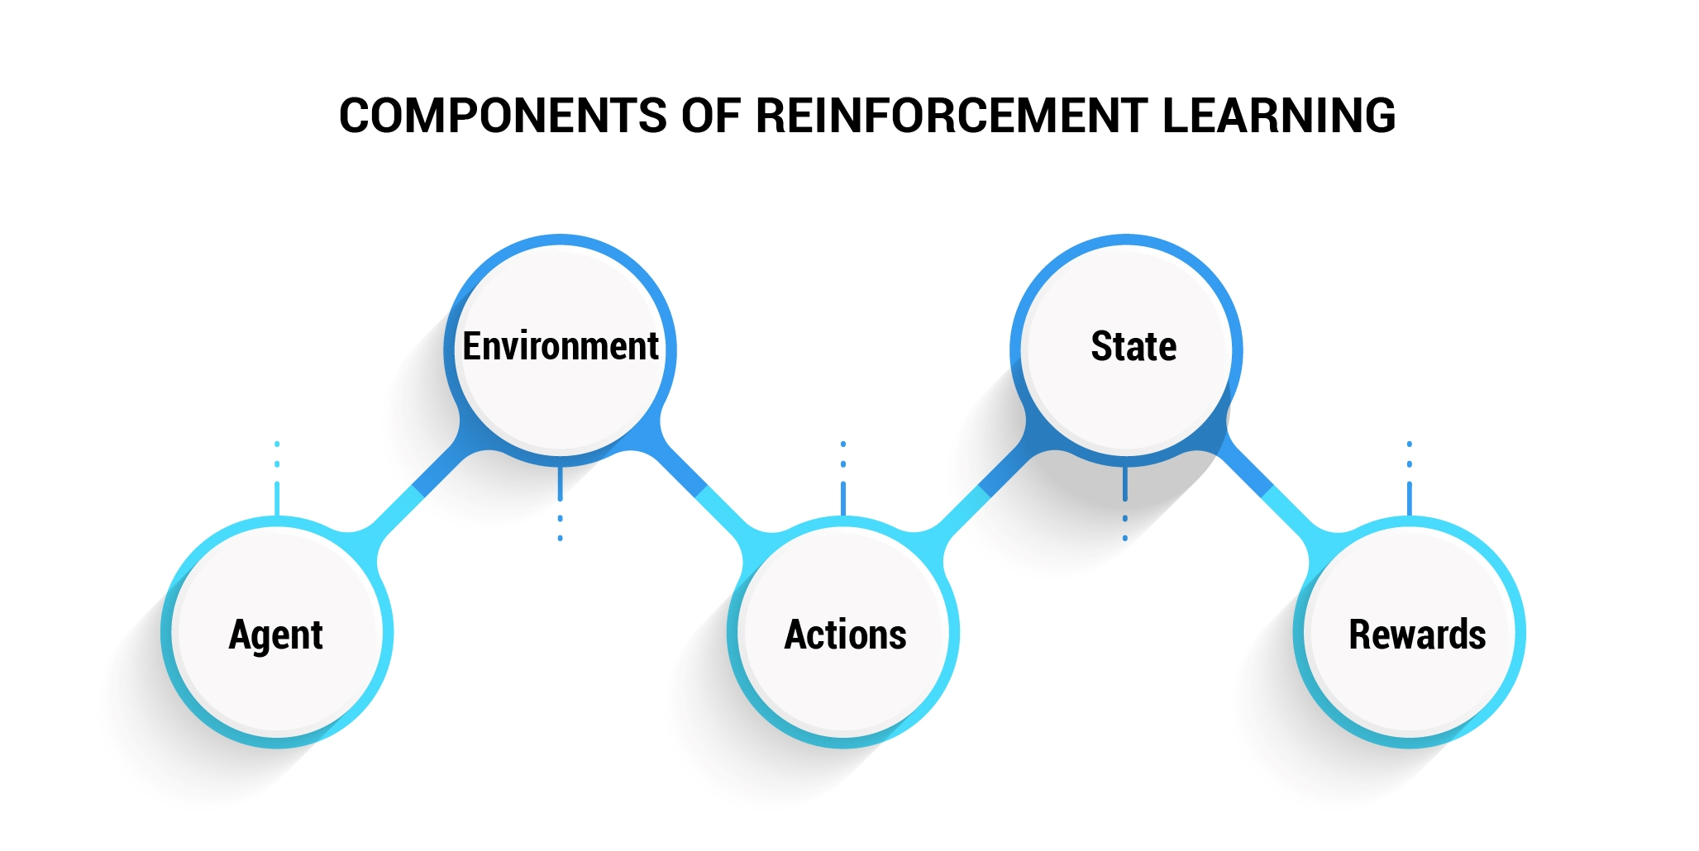
Key Concepts in RL

Slide 4
Key Concepts in RL
Agent: The learner or decision maker
Environment: The external system the agent interacts with
Action: Choices made by the agent
State: Current situation of the agent
Reward: Feedback from the environment

Slide 5
How Reinforcement Learning Works
The agent observes the state, takes an action, receives a reward, and updates its strategy to maximize future rewards.

Slide 6


Example: Baby and fireplace
Imagine a baby crawling around a room and discovering a fireplace.
- Agent: The baby
- Environment: The room with the fireplace
- Action: Crawling toward or away from the fireplace
- Reward: Warmth (positive) or pain (negative)
The baby learns through trial and error to avoid pain and seek comfort, just like an RL agent learning from interactions with its environment.

Slide 7
Applications of Reinforcement Learning
- Robotics
- Game AI
- Autonomous Vehicles
- Personalized Recommendations
- Finance and Trading

Slide 8
References
1. UCLA Course Catalog - COM SCI 260R: click
2. Grinnell College - Reinforcement Learning: An Introduction (PDF): click
3. ResearchGate - DRL vs RAG for Spectrum Allocation: click
4.มาทำความรู้จักกับ Reinforcement Learning แบบเบาๆกันเถอะ click

