Slide 1
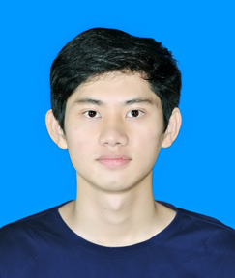




OBJECTIVES
Have the opportunity to develop the necessary skills and work in a professional enviroment.
My goal is to become an Official staff devote to development with a long-term of the company.
EDUCATION
CAO HOÀNG ANH KHA
School: HCMC University of Technology and Education
Education program: High Quality
Faculty: Faculty of Electrical and Electronics Engineering
Major: Electrical - Electronics.
GPA: 7.01/10
Nhân viên IT
PERSONAL INFORMATION
28-07-2000
WORK EXPERIENCE
NEXTWAY SERVICE CO.,LTD
Position: Intern
Description: Check for product defects Electronic circuit, LCD screen,...
Clean circuit board, solder circuit.
037 995 2299
anhkha2872@gmail.com
Ho Chi Minh, VietNam
WORK EXPERIENCE
SKILLS
Gradution thesis
Design and construction of fruit classification model using Raspberry and Adruino.
Wireless communication via wifi between PC and Raspberry.
UART,SPI,I2C communication between Raspberry, Adruino, camera Pi, LCD.
Written by C language to write program to control system.
Technical skills
Have a basic knowledge microcontrollers 8 bit 16F887, working with C/C++.
Soft skills
Ability to work independently and work in group.
Effective time managing.
FOREIGN LANGUAGE
Communicate on basic English topic.
Able to read and understand English documents.
ACTIVITIES
Member of volleyball club.
Certificate of participation "Trò chơi ánh sáng" 2020.
Has been participated in the Programming contest " Automatic guided vehicles applying digital image processing and AI " in 2022.

