Slide 1

ARIZONA

Slide 2
What about Arizona ?
Arizona is a state in the western United States. Its capital and largest city is Phoenix.
it is the sixth largest US state.
Crossed by the Colorado River, the state includes spectacular geological formations.
In 1848, at the end of the American-Mexican war, the United States annexed Arizona, then enlarged its territory in 1853 during the Gadsden purchase. It joined the Union late, on February 14, 1912, and became its 48th state.
It is divided into fifteen counties, and nearly a quarter of its territory is made up of twenty-one Indian reserves. The Navajo and other Apache peoples are in the majority.
Much of the state is made up of desert landscapes, in which many westerns were filmed. Arizona is a very touristy state, comprising three national parks and several American national monuments like Sunset Crater Volcano, Rainbow Bridge and Montezuma Castle.

Slide 3
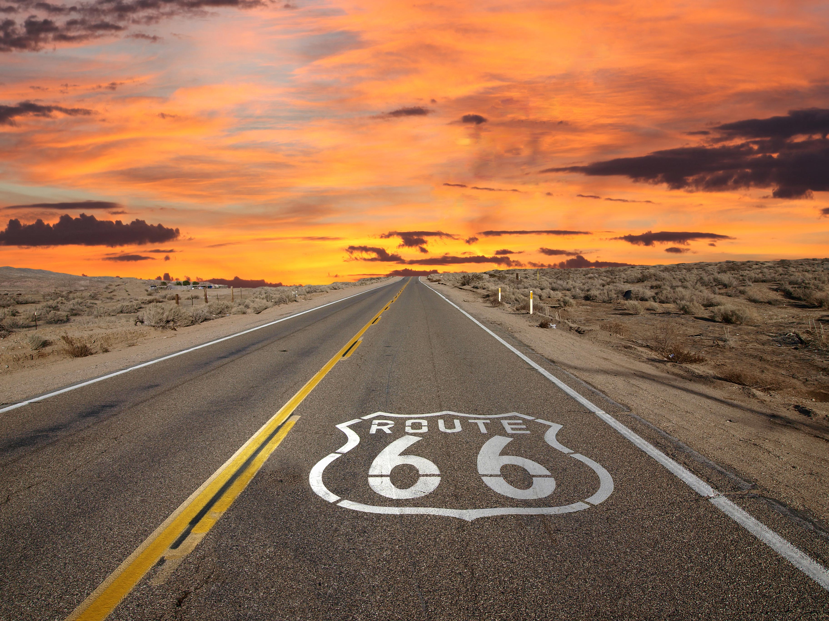
Tourism in Arizona

Slide 4
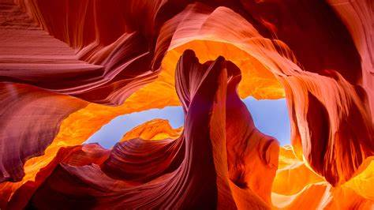
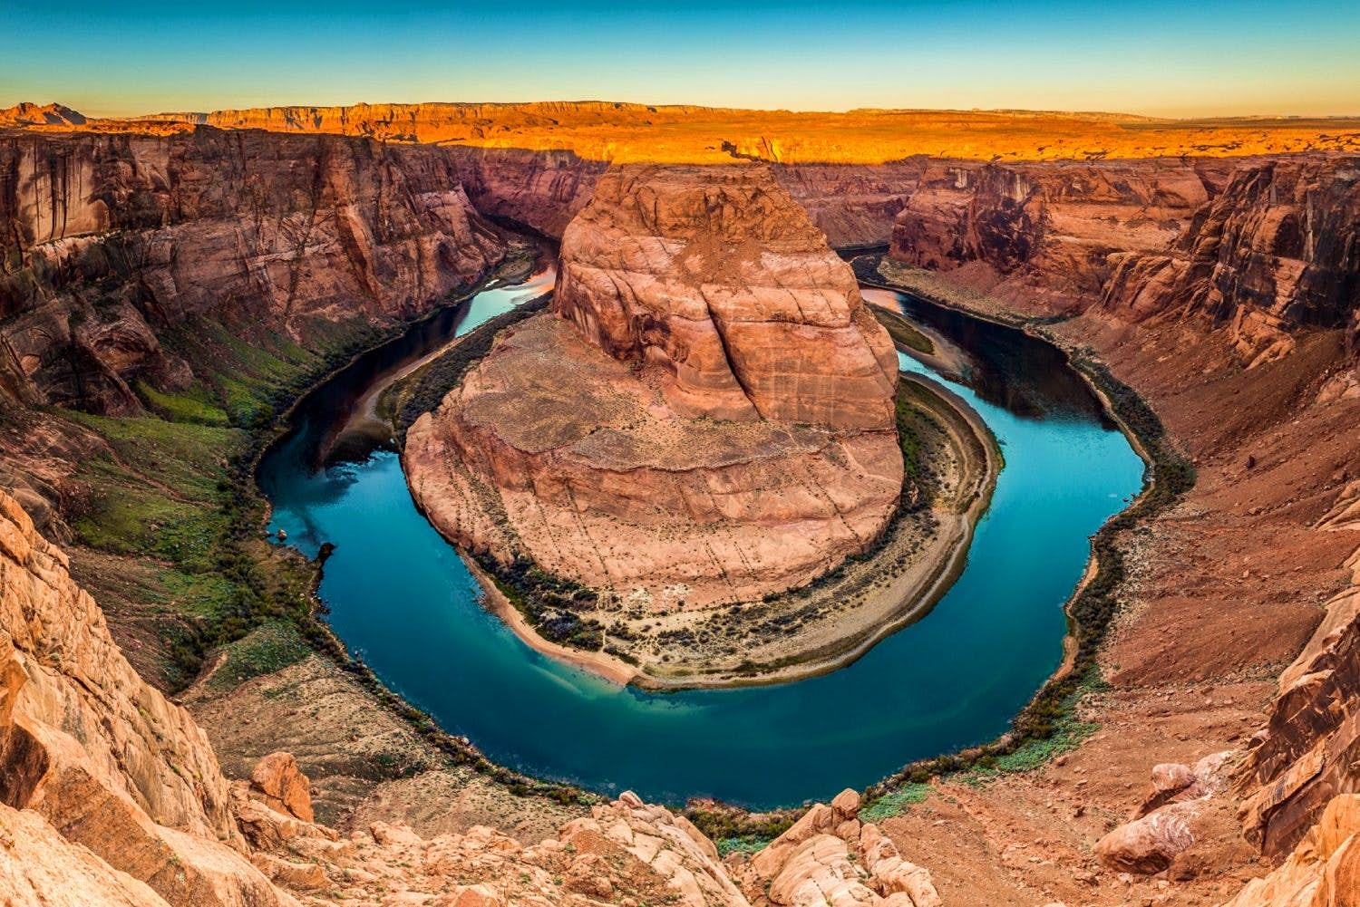
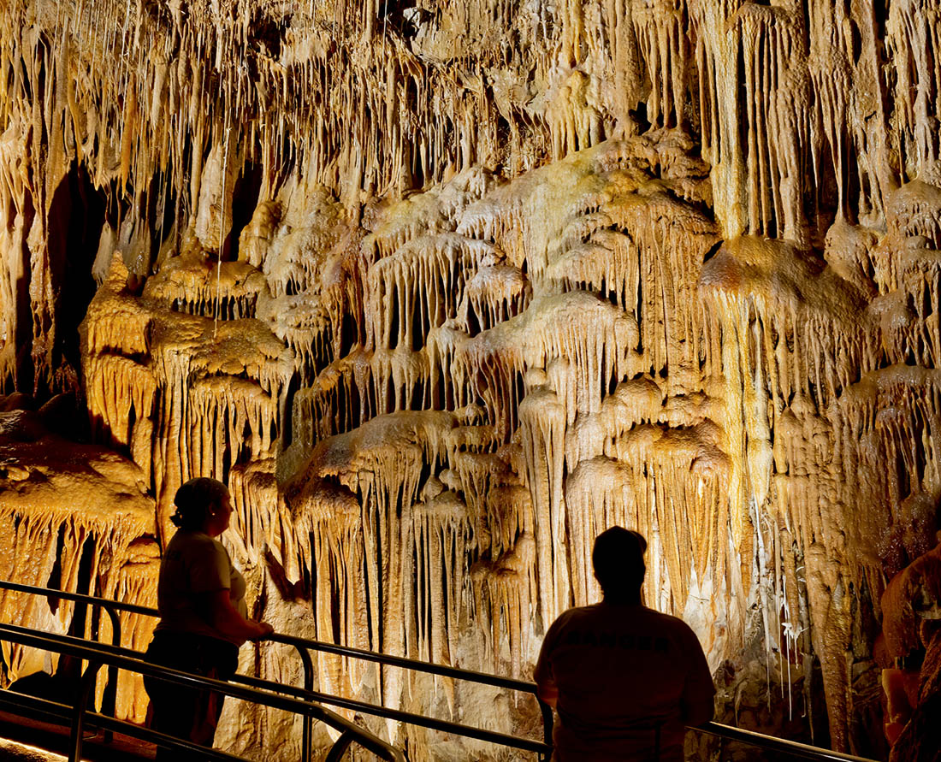
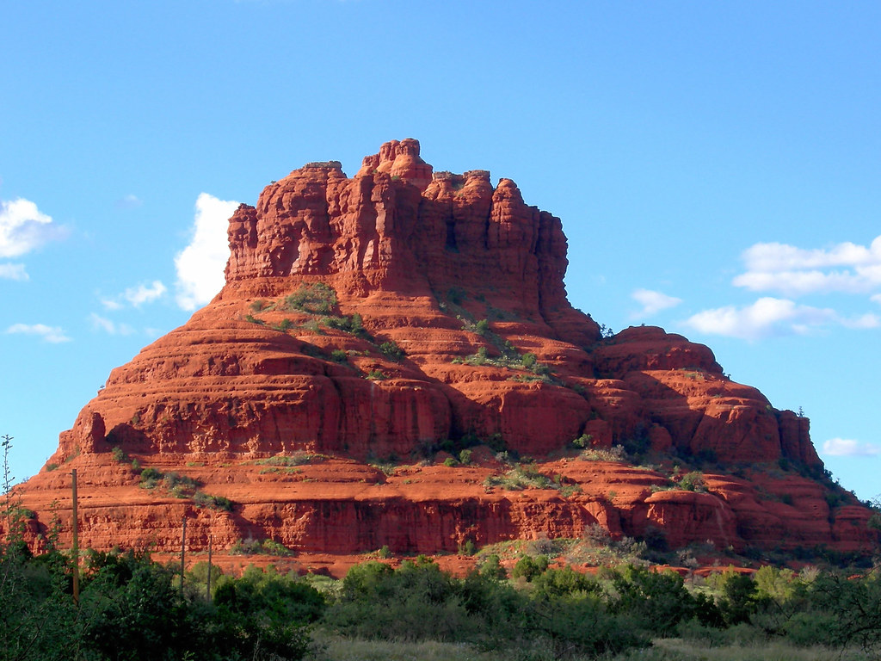
Geological formations
Everybody know grand canyon, but we can also talk about Antelope canyon, horseshoes bend (a bend in the Colorado River located 6 km south of the town of Page), kartchner caverns state park (caves discovered in 1974 with magnificent colored concretions), bell rock and many others,
Antelope Canyon
Horseshoes bend
kartchner caverns state park
Bell rock

Slide 5
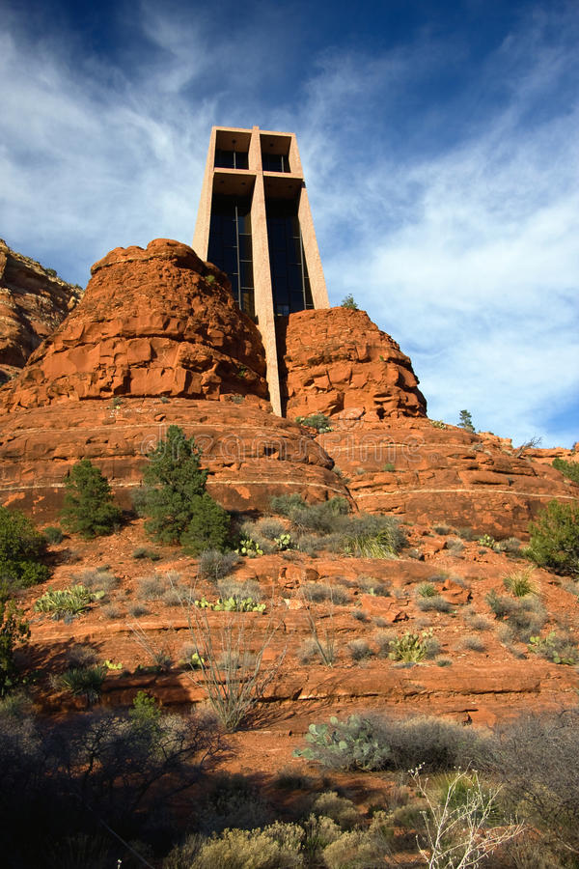
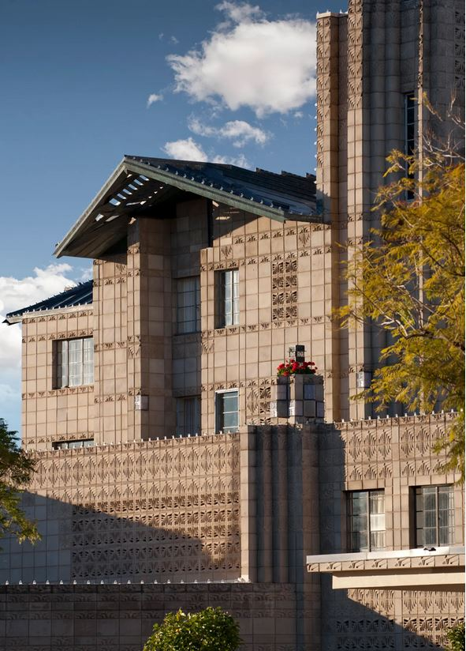
Architectural
For some of you who should prefer architectural tourism, you could be surprise by the chapel of holy cross (completed in 1956) , by Talesin West (Now considered a National Historic Landmark, this building embodies Wright's well-known design philosophy and was maintained by himself and his apprentices) or by Arizona Biltmore Hotel, Phoenix (opened in 1929) to name but a few.

Slide 6
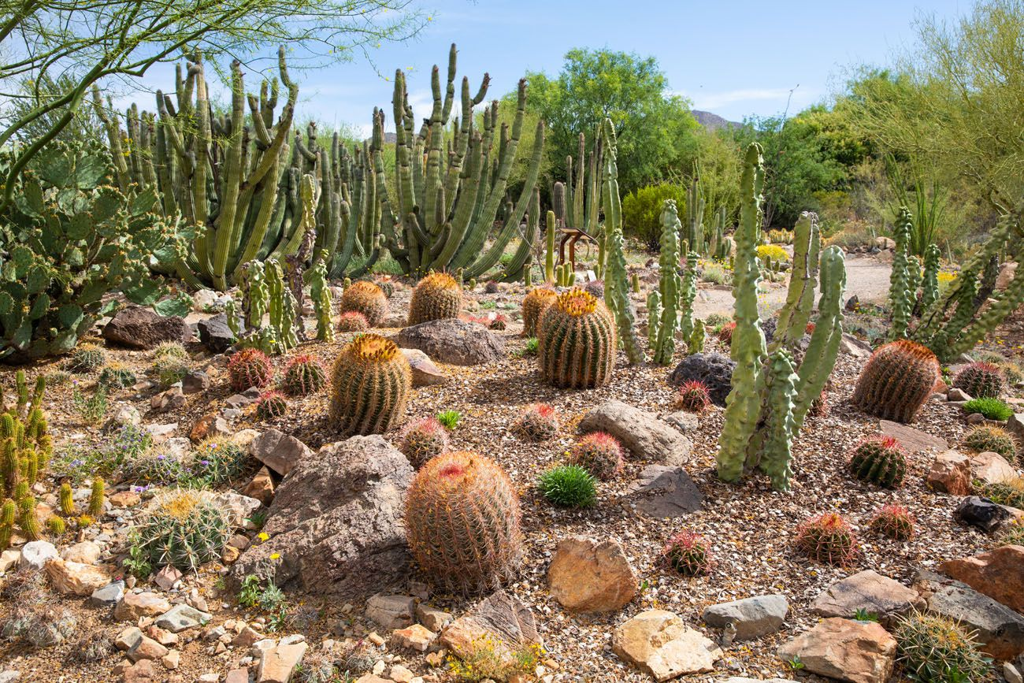
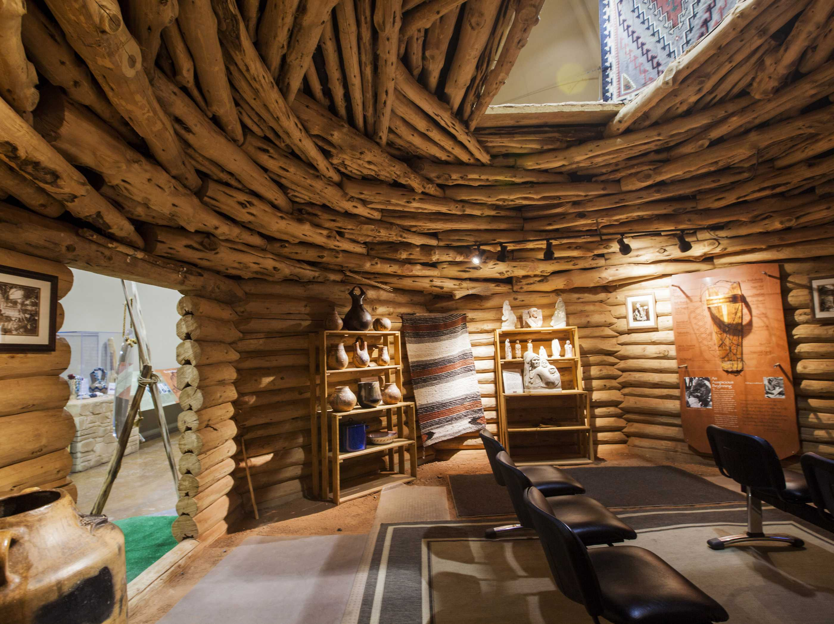
Culture
For peoples who love visit some museum, you want to find your happiness in Arizona.
Let’s start with Arizona-Sonora desert museum in wich you will discover the plants and animals of the Sonoran Desert in their natural settings on the western edge of Tucson.
To continue, you could interest in Navajo interactive Museum where you will be able to learn a lot about this tribe through various exhibits about its sacred land, language, history and traditions.

Slide 7
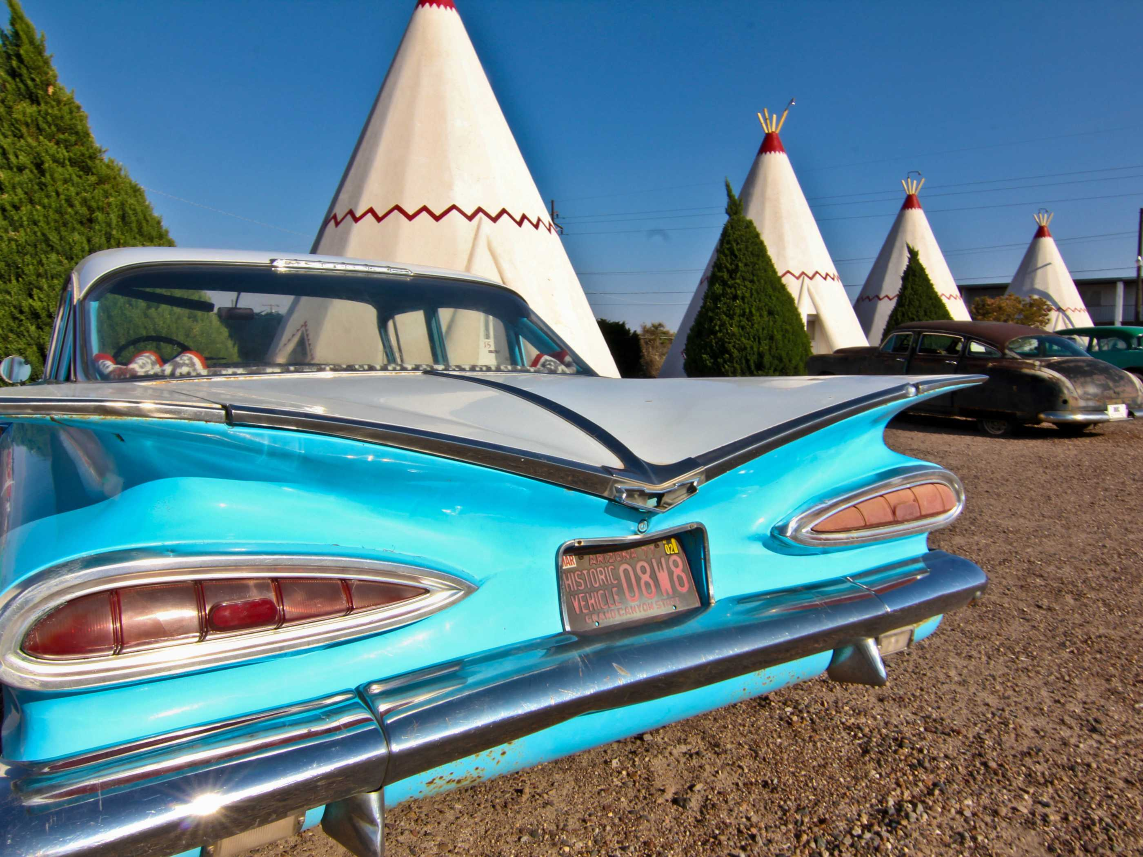
And much More...
we can cite pell-mell :
* The mythic road 66
* The wine regions of arizona
* Gastronomy in TUCSON elevated to the title of creative city of gastronomy by UNESCO
* The city of Phoenix

Slide 8
HAVE GOOD HOLIDAYS IN ARIZONA STATE
See you soon...

