Slide 1

Debunking Design Flaws in PHP Code using Static Call Graphs
  FrOSCon 2007
  Falko Menge
  25.08.2007

Slide 2
Agenda
Motivation
PHPCallGraph
Reflection for Static Analysis?
Results
3D Exploration with the CGA framework

Slide 3
Motivation
When working with large software systems:
  Hard to get an overview of the system
  High number of dependencies
  Reading complete source code takes too much time
  Even harder if its not your own code
Automatic visualization of dependencies could help to handle the complexity

Slide 4
PHPCallGraph: First Prototype
Static call graph generator for PHP
50 lines of PHP code
Source code parsing with regular expressions
  Lead to several bugs
Graph rendering with DOT
  Part of open source GraphViz framework for visualization of directed and undirected graphs

Slide 5
PHPCallGraph: Improvements
DOT generation through PEAR package Image_GraphViz by Sebastian Bergmann
Output driver for the STR format of the CGA framework for 3D exploration of call graphs
Examination of Greg Beaver's PHP_Parser PEAR package
Parsing of method bodies with PHP's Tokenizer
Idea to use InstantSVC CodeAnalyzer

Slide 6
Reflection for Static Analysis?
CodeAnalyzer: static code analysis using an extended version of PHP's Reflection API
Reflection usually concept for dynamic analysis at runtime => also in PHP
Special properties of the language utilized:
  Interpreted language
  Dynamic code weaving and execution
  Declarations at any place in the code
  Exceptions

Slide 7
Reflection for Static Analysis?
$file = 'malicious-code.php';
$maliciousCode = file_get_contents($file);
$protectionCode = "return;?>";
eval($protectionCode . $maliciousCode);
$r = new ReflectionClass('MaliciousClass');
What are the problems with this code?

Slide 8
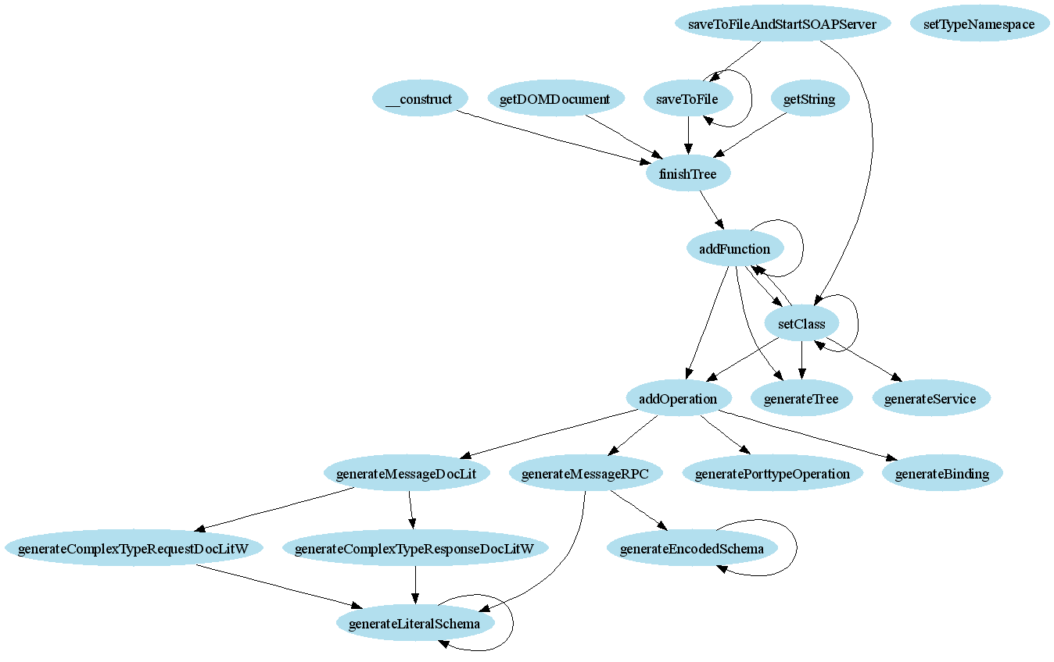
Results

Slide 9
Results
Design flaws which can be detected
  Cyclic dependencies
  Dead code
  Candidates for refactoring
    Subclasses
    Separation of concerns
    Introduction of visibilities

Slide 10
Identifying Candidates for Refactoring
Real world example:
  Function library of 55 functions
  Nearly 2000 lines of code (90KB)
Call graph shows lots of dependencies
=> Introduction of several classes

Slide 11
Identifying Candidates for Refactoring
Real world example:
  One single class containing 130 methods
  Over 5000 lines of code (190KB)
Call graph shows clearly separated clusters
=> Separation into different classes

Slide 12
3D Exploration with CGA
Framework for analyzing complex software systems
Focus on various aspects of system dynamics
Provides elaborate visualization techniques
Analysis of function level dynamics and long-term system evolution
Developed by Computer Graphics System group of the Hasso Plattner Institute

Slide 13
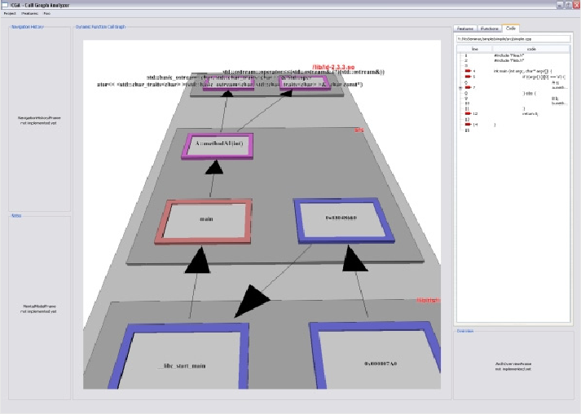
3D Exploration with CGA

Slide 14
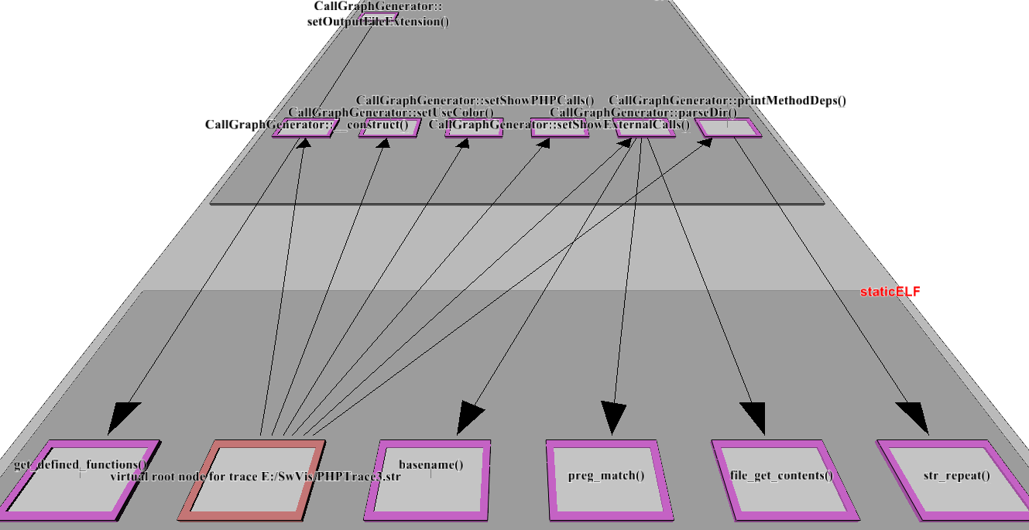
3D Exploration with CGA

Slide 15
Conclusion
Static call graphs can be leveraged to gain a better understanding of large systems
Various design flaws can be detected
Reflection can be used for static analysis
Source Forge project just registered
http://phpcallgraph.sourceforge.net
http://cgs.hpi.uni-potsdam.de/trac/cga/

Slide 16
Debunking Design Flaws in PHP Code using Static Call Graphs
  FrOSCon 2007
  Falko Menge
  25.08.2007

