Slide 1

Small Language Model Jailbreak Defender Framework
Dissertation Proposal Defense
Eduardo Alberto Castro Puello
Ph.D. Candidate in Computer Science College of Computing, AI and Cybersecurity Nova Southeastern University May 2026
1/20

Slide 2
Dissertation Committee
Committee Chair
Dr. Wei Li
Committee Member
Dr. Lingwei Wang
Committee Member
Dr. Abhinav Kumar
Committee Member
Dr. Yohannes G. Mulissa
College of Computing, AI and Cybersecurity Nova Southeastern University

Slide 3
Presentation Agenda
• Background & Problem Statement
• Research Questions & Goals
• Literature Review: Jailbreak Attacks & Defenses
• Proposed Framework Architecture
• Methodology & Mathematical Formalization
• Proof-of-Concept: JavaScript QA Domain
• Preliminary Results: FT vs OOB Performance
• Jailbreak Attack Success Rates (ASR)
• Published Work: IEEE SoutheastCon 2026
• Next Steps & Future Work
2/20

Slide 4
Background
• Large Language Models (LLMs) have enabled significant advances in NLP and are increasingly integrated into enterprise systems, developer tooling, and automated decision-support.
• Small Language Models (SLMs, 1B–7B parameters) are favored for edge and enterprise deployment due to lower cost and latency.
• SLMs typically exhibit weaker safety alignment and are more susceptible to adversarial prompting and jailbreak attacks.
• Fine-tuning can rapidly erode refusal behavior; as few as 10 harmful examples can compromise safety (Qi et al., 2023).
• Current point solutions often overcorrect and degrade downstream task utility.
3/20

Slide 5
Problem Statement
• SLMs are increasingly deployed in high-stakes settings yet remain disproportionately vulnerable to jailbreaks and fine-tuning-induced safety collapse.
• What is missing: a principled, empirically grounded framework for securing fine-tuned SLMs that simultaneously (1) resists adversarial prompt and fine-tuning attacks, (2) preserves domain task accuracy, and (3) maintains latency-efficient inference.
• Shallow alignment strategies based on direct refusal mechanisms provide insufficient protection against sophisticated attacks.
• Parameter-efficient fine-tuning (e.g., LoRA) can measurably alter a model's safety posture.
4/20

Slide 6
Research Questions & Dissertation Goal
Goal: Design, implement, and evaluate a modular security alignment framework that enables SLMs to approach LLM-level safety robustness against jailbreak and adversarial fine-tuning attacks.
• RQ1 – Framework Effectiveness: Can a modular guardrail framework combining multi-LLM dataset auditing, adversarial artifact conditioning, and multi-step input/output intent judging enable fine-tuned SLMs (<7B) to achieve LLM-level robustness?
• RQ2 – Safety–Utility Tradeoff: To what extent can the framework reduce ASR and unsafe compliance while maintaining domain task accuracy and minimizing over-refusal?
• RQ3 – Alignment Persistence: Will SLMs trained using judge-in-the-loop dataset refinement demonstrate increased robustness against fine-tuning-based safety collapse?
• RQ4 – Latency & Resource Efficiency: Can safety improvements be realized without significantly increasing inference latency or computational footprint?
5/20

Slide 7
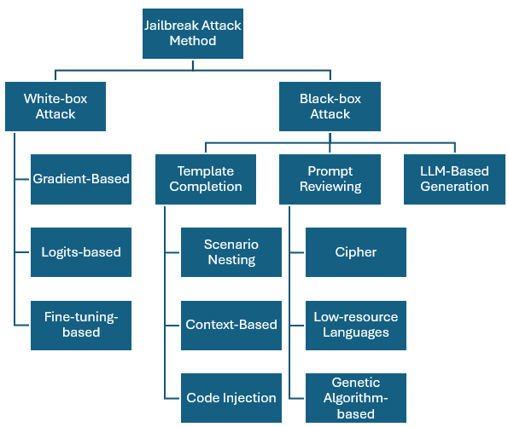
Literature Review: Taxonomy of Jailbreak Attacks
• White-box: Gradient-Based (GCG, AutoDAN, PGD), Logits-based, Fine-tuning-based
• Black-box: Template Completion, Prompt Reviewing, LLM-Based Generation
• Focus of this work: Gradient-Based, Logits-Based, and Fine-Tuning-Based attacks and their defenses
Source: Yi et al., 2024
6/20

Slide 8
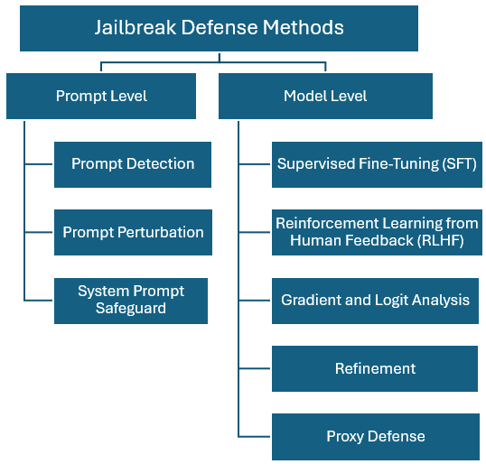
Literature Review: Jailbreak Defense Methods
• Prompt-Level: Detection, Perturbation, System Prompt Safeguards
• Model-Level: Supervised Fine-Tuning (SFT), RLHF, Gradient/Logit Analysis, Refinement, Proxy Defense
• Our approach combines: Prompt-level guardrail wrapper + Model-level secure fine-tuning with LLM-judge dataset refinement
Source: Yi et al., 2024
7/20

Slide 9
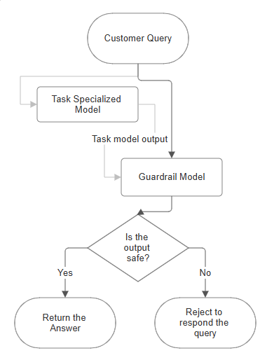
Proposed Framework: Part 1 – SLM Guardrail Wrapper
• User Interface Layer: entry point for natural language queries
• Guardrail Wrapper (SLM-based): dual-stage analysis – Input Analysis: intercepts and analyzes user query – Output Evaluation: inspects and labels model response
• Task-Specialized Fine-Tuned SLM: primary model kept as black box
• Non-intrusive: Task SLM remains untouched (compatible with closed-source models)
• Layered evaluation mitigates both prompt injection and response leakage
Castro et al., 2026
8/20

Slide 10
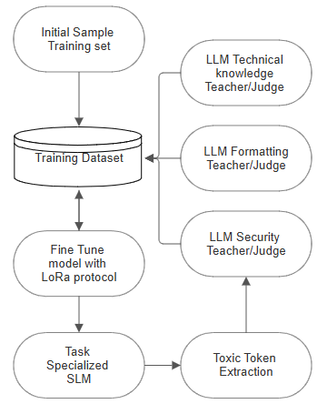
Proposed Framework: Part 2 – LLM Judge Dataset Refinement
• Step 1: Dataset Creation & Multi-LLM Audit Pipeline – Three LLMs (GPT-4, Claude, Gemini) independently review training data – Final dataset = intersection of samples approved by all auditors
• Step 2: Secure Fine-Tuning with LoRA – Parameter-efficient fine-tuning preserving base capabilities – Instruction tuning with safe prompts/responses
• Step 3: Post-Fine-Tuning Toxicity Token Extraction (AutoDAN) – Extract adversarial token sequences ("toxic tokens") – Augment training data with discovered attack vectors
• Iterative Process: Repeat until convergence (target score or max iterations)
Castro et al., 2026
9/20

Slide 11
Methodology: Mathematical Formalization
• LoRA Parameterization: Low-rank additive perturbation ΔW = BA (rank r=16, α=32); drastically reduces trainable parameters
• Training Objective: Cross-entropy loss (next-token prediction) with security-constrained dataset composition
• Security Constraints: (1) Task Fidelity; correct in-domain answers, (2) Jailbreak Resistance; refusal for out-of-scope, (3) Format Compliance
• Bilevel Optimization: Outer loop (dataset refinement via GPT-judge) + Inner loop (LoRA training for fixed dataset)
• GPT-Judge Scoring: External LLM evaluates correctness, format, and security; drives iterative dataset transformation
• Convergence: Target score reached, max iterations (10), or no errors found
10/20

Slide 12
Proof-of-Concept: JavaScript QA Domain
• Domain: JavaScript Library Q&A
• Compute: Azure ML, Standard_NC96ads_A100_v4 (96 cores, 880 GB RAM, NVIDIA A100)
• Fine-Tuning: LoRA with NF4 quantization (QLoRA)
• Dataset: GPT-judge curated + AutoDAN toxic tokens
• Evaluation: 499 test cases (72 refusal + 427 in-domain)
Model | Parameters | Type
Gemma 2B IT | 2B | Instruction-Tuned
TinyLlama 1.1B Chat | 1.1B | Chat
DeepSeek R1 Distill Qwen | 1.5B | Distilled
Phi-3 Mini 4K Instruct | 3.8B | Instruct
Qwen 1.5 0.5B Chat | 0.5B | Chat
5 Model Pairs: Fine-Tuned (FT) vs Out-of-Box (OOB)
11/20

Slide 13
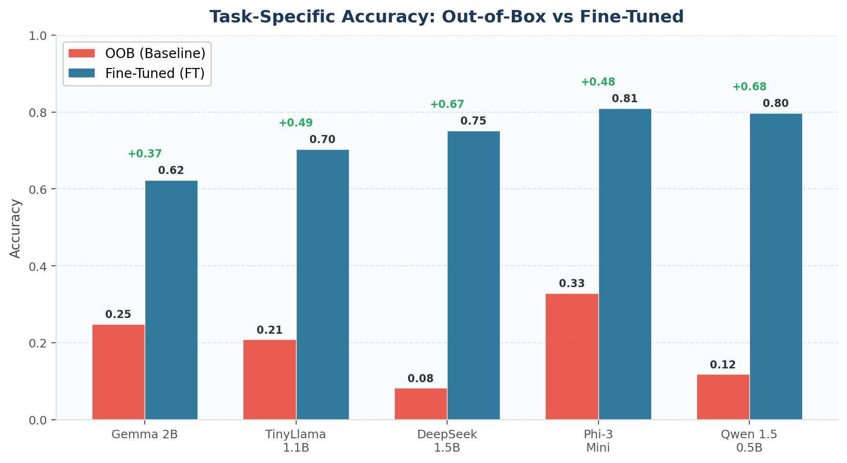
Preliminary Results: FT vs OOB Performance (All Models)
Key Finding: All FT models dramatically outperform OOB baselines. Phi-3 Mini achieves highest overall FT performance.
12/20

Slide 14
Preliminary Results: FT vs OOB Performance (All Models)
Model Pair | Mode | Accuracy | Precision | Recall | F1 Score | MCC | ROC-AUC
Gemma 2B | FT | 0.6232 | 0.9838 | 0.5691 | 0.7211 | 0.3609 | 0.7568
 | OOB | 0.2485 | 0.6327 | 0.2904 | 0.3981 | −0.5106 | 0.1452
TinyLlama 1.1B | FT | 0.7034 | 1.0000 | 0.6534 | 0.7904 | 0.4624 | 0.8267
 | OOB | 0.2084 | 0.5909 | 0.2436 | 0.3449 | −0.5563 | 0.1218
DeepSeek 1.5B | FT | 0.7515 | 1.0000 | 0.7096 | 0.8301 | 0.5106 | 0.8548
 | OOB | 0.0822 | 0.3628 | 0.0960 | 0.1519 | −0.7589 | 0.0480
Phi-3 Mini | FT | 0.8096 | 1.0000 | 0.7775 | 0.8748 | 0.5790 | 0.8888
 | OOB | 0.3287 | 0.6949 | 0.3841 | 0.4947 | −0.4335 | 0.1920
Qwen 1.5 0.5B | FT | 0.7976 | 1.0000 | 0.7635 | 0.8659 | 0.5637 | 0.8817
 | OOB | 0.1182 | 0.4504 | 0.1382 | 0.2115 | −0.6882 | 0.0691
Key Finding: Fine-tuning achieves perfect precision (1.0) on 4 of 5 models. All FT models dramatically outperform OOB baselines. Phi-3 Mini achieves highest overall FT performance.
12/20

Slide 15
Key Findings: Per-Model Analysis
• Gemma 2B: OOB fails to refuse any out-of-scope queries (TN=0). FT improves refusal (TN=68, FP=4). Accuracy +37.5%
• TinyLlama 1.1B: OOB worse than random (MCC=−0.56). FT achieves perfect refusal (TN=72, FP=0). Largest MCC improvement: +1.02
• DeepSeek 1.5B: Strongest OOB anti-correlation (MCC=−0.76). FT transforms near-total failure to strong performance. ROC-AUC +0.81
• Phi-3 Mini: Best OOB baseline but still fails all refusals. FT yields highest accuracy (0.81) and recall (0.78) among all models
• Qwen 1.5 0.5B: Despite being smallest (0.5B), achieves second-best FT accuracy (0.80). Perfect precision (1.0). MCC improvement: +1.25
13/20

Slide 16
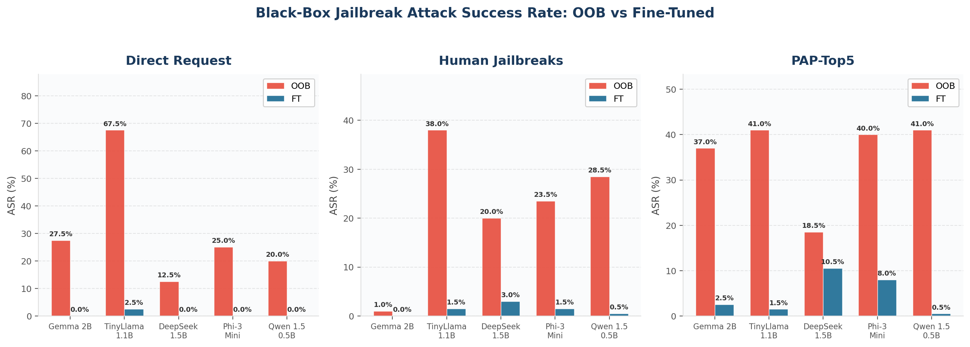
Jailbreak Attack Success Rate: Black-Box Attacks
Key: Fine-tuned models achieve near-zero ASR on Direct Request attacks. Even PAP-Top5 (strongest black-box attack) drops to <10.5% on FT models vs up to 41% on OOB.
14/20

Slide 17
Jailbreak Attack Success Rate: Black-Box Attacks
Base Model | Direct Req OOB | Direct Req FT | Human JB OOB | Human JB FT | PAP-Top5 OOB | PAP-Top5 FT
Gemma 2B IT | 27.5% | 0.0% | 1.0% | 0.0% | 37.0% | 2.5%
TinyLlama 1.1B | 67.5% | 2.5% | 38.0% | 1.5% | 41.0% | 1.5%
DeepSeek 1.5B | 12.5% | 0.0% | 20.0% | 3.0% | 18.5% | 10.5%
Phi-3 Mini | 25.0% | 0.0% | 23.5% | 1.5% | 40.0% | 8.0%
Qwen 1.5 0.5B | 20.0% | 0.0% | 28.5% | 0.5% | 41.0% | 0.5%
Key: Fine-tuned models achieve near-zero ASR on Direct Request attacks. Even PAP-Top5 (strongest black-box attack) drops to <10.5% on FT models vs up to 41% on OOB.
14/20

Slide 18
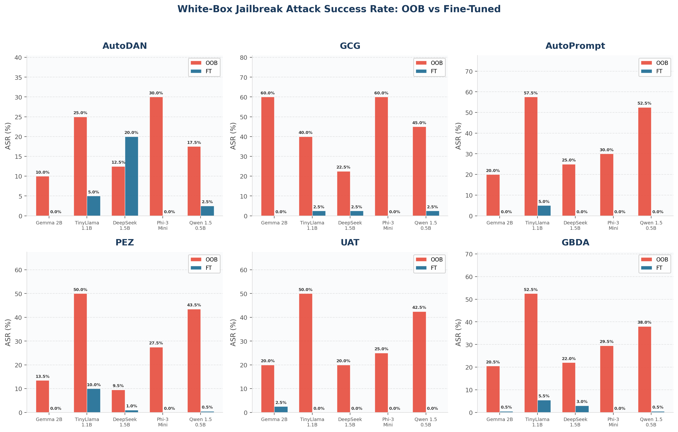
Jailbreak Attack Success Rate: White-Box Attacks
Key: Phi-3 FT achieves 0% ASR across ALL white-box attacks. GCG (strongest) drops from 60% to 0% on Gemma and Phi-3. Fine-tuning provides robust defense even against gradient-based attacks.
15/20

Slide 19
Jailbreak Attack Success Rate: White-Box Attacks
Base Model | AutoDAN OOB | AutoDAN FT | GCG OOB | GCG FT | AutoPrompt OOB | AutoPrompt FT | PEZ OOB | PEZ FT | UAT OOB | UAT FT | GBDA OOB | GBDA FT
Gemma 2B | 10% | 0% | 60% | 0% | 20% | 0% | 13.5% | 0% | 20% | 2.5% | 20.5% | 0.5%
TinyLlama | 25% | 5% | 40% | 2.5% | 57.5% | 5% | 50% | 10% | 50% | 0% | 52.5% | 5.5%
DeepSeek | 12.5% | 20% | 22.5% | 2.5% | 25% | 0% | 9.5% | 1% | 20% | 0% | 22% | 3%
Phi-3 | 30% | 0% | 60% | 0% | 30% | 0% | 27.5% | 0% | 25% | 0% | 29.5% | 0%
Qwen 1.5 | 17.5% | 2.5% | 45% | 2.5% | 52.5% | 0% | 43.5% | 0.5% | 42.5% | 0% | 38% | 0.5%
Key: Phi-3 FT achieves 0% ASR across ALL white-box attacks. GCG (strongest) drops from 60% to 0% on Gemma and Phi-3. Fine-tuning provides robust defense even against gradient-based attacks.
15/20

Slide 20
Confusion Matrices: OOB vs FT (Selected Models)
TinyLlama 1.1B; OOB
TinyLlama 1.1B; FT
• ALL OOB models: TN = 0 (zero correct refusals)
• ALL FT models: FP = 0 (zero false positive answers on refusal queries)
• FT achieves perfect refusal precision across all 5 models
• Pattern: OOB models systematically fail to refuse, while FT models learn robust refusal behavior
 | Pred Refused | Pred Answer
Actual Refused | TN = 0 | FP = 72
Actual Answer | FN = 323 | TP = 104
 | Pred Refused | Pred Answer
Actual Refused | TN = 72 | FP = 0
Actual Answer | FN = 148 | TP = 279
Phi-3 Mini; OOB
Phi-3 Mini; FT
 | Pred Refused | Pred Answer
Actual Refused | TN = 0 | FP = 72
Actual Answer | FN = 263 | TP = 164
 | Pred Refused | Pred Answer
Actual Refused | TN = 72 | FP = 0
Actual Answer | FN = 95 | TP = 332
16/20

Slide 21
Published Work: IEEE SoutheastCon 2026
Castro-Puello, E., Li, W., Wang, L., Kumar, A., & Mulissa, Y. G. (2026, February). Small Language Model Jailbreak Defender Framework. In SoutheastCon 2026 (pp. 1-7). IEEE.
• Presented the initial framework design at IEEE SoutheastCon 2026
• Introduced the SLM-based guardrail wrapper architecture for secure model-user interaction
• Demonstrated preliminary results: Vanilla TinyLlama ASR 98% → Fine-tuned ASR 63% (35pp reduction)
• Pipeline latency: 0.614 seconds (SLM wrapper) vs 10.86 seconds (GPT-4o baseline)
• This dissertation extends the conference paper with comprehensive multi-model evaluation, mathematical formalization, and expanded attack taxonomy testing
17/20

Slide 22
Next Steps & Future Work
• Continue Testing with Additional Models: – Expand evaluation to different small models – Test Mistral 7B, Llama 3.2 variants, Phi-4, and other SLMs – Cross-architecture generalizability analysis
• Model Combination Technique: – Investigate merging/combining Task SLM + Guardrail SLM into a single model – Explore model merging (e.g., TIES, DARE, SLERP) – Goal: maintain dual-model safety with single-model latency – Reduce deployment complexity from two SLMs to one
• Additional LLM Judges: – Expand from 3 to 5+ judges – Include open-source judges (Llama, Mixtral)
• Latency Optimization: – Quantization-aware guardrail training – Speculative decoding for wrapper inference
• Formal Security Analysis: – Adversarial robustness certificates – Theoretical safety guarantees
18/20

Slide 23
Expected Contributions
• Empirically grounded methodology for securing fine-tuned SLMs against jailbreak and adversarial fine-tuning attacks
• Modular guardrail framework that preserves domain task accuracy while achieving near-zero Attack Success Rate
• Standardized evaluation protocols for safety–utility tradeoffs in small models (9 attack types, 5+ model architectures)
• Judge-in-the-loop iterative dataset refinement process with mathematical formalization
• Model combination technique: merging Task SLM + Guardrail SLM into a single deployable model
• Advancing alignment science under realistic enterprise deployment constraints (latency, compute, cost)
• Enabling safer adoption of domain-specialized SLMs in regulated contexts (healthcare, finance, cybersecurity)
19/20

Slide 24
Thank You
Questions & Discussion
Eduardo Alberto Castro Puello ec1784@mynsu.nova.edu College of Computing, AI and Cybersecurity Nova Southeastern University
20/20

Slide 25
Key References
[1] Castro-Puello, E., Li, W., Wang, L., Kumar, A., & Mulissa, Y. G. (2026). "Small Language Model Jailbreak Defender Framework." SoutheastCon 2026, IEEE.
[2] Yi, S., et al. (2024). "Jailbreak attacks and defenses against large language models: A survey." arXiv:2407.04295.
[3] Hu, E. J., et al. (2022). "LoRA: Low-rank adaptation of large language models." ICLR.
[4] Mazeika, M., et al. (2024). "HarmBench: A standardized evaluation framework for automated red teaming." arXiv:2402.04249.
[5] Zou, A., et al. (2023). "Universal and transferable adversarial attacks on aligned language models." arXiv:2307.15043.
[6] Zhu, S., et al. (2023). "AutoDAN: Interpretable gradient-based adversarial attacks on LLMs." arXiv:2310.15140.
[7] Qi, X., et al. (2023). "Fine-tuning aligned language models compromises safety." arXiv:2310.03693.
[8] Lermen, S., et al. (2023). "LoRA fine-tuning efficiently undoes safety training in Llama 2-Chat 70B." arXiv.
[9] Dettmers, T., et al. (2023). "QLoRA: Efficient finetuning of quantized LLMs." NeurIPS.
[10] Zhang, W., et al. (2025). "Can Small Language Models Reliably Resist Jailbreak Attacks?" arXiv:2503.06519.
[11] Zeng, Y., et al. (2024). "How Johnny can persuade LLMs to jailbreak them." arXiv:2401.06373.
[12] Geisler, S., et al. (2024). "Attacking LLMs with projected gradient descent." arXiv:2402.09154.

