Slide 1
UIPATH AGENTHACK 2026 · TRACK 1 — MAESTRO CASE
CaseWeaver
Agentic Mortgage Underwriting Agents
Agents underwrite. Humans decide. UiPath governs.
Built with Claude Code
5 coded agents
durable human-in-the-loop
github.com/SebAustin/mortgage-underwriting-agents

Slide 2
THE PROBLEM
Underwriting is exception-heavy — and a human must own the decision.
Most loans are routine
THE EXCEPTION TAIL
the long tail needs document chasing, re-verification, judgement, and fraud checks.
Missing documents
RPA is too brittle
Low-confidence OCR
rigid scripts snap on the exceptions that actually matter.
Conflicting data
Debt-ratio over policy
A raw LLM is unacceptable
Appraisal gaps
no autonomous model should make a regulated credit decision.
Fraud / AML
Agentic case management: agents reason, robots act, humans hold authority.
CaseWeaver · UiPath AgentHack 2026
2

Slide 3
THE APPROACH
Agentic case management on UiPath Maestro Case
Agents
Robots
Humans
reason, coordinate, and recommend — five coded LangGraph agents.
do the mechanical work — ingest, re-digitise, generate letters.
hold authority — decision support, then the final credit call.
ORCHESTRATED, GOVERNED, AND AUDITED AS ONE MAESTRO CASE
CaseWeaver · UiPath AgentHack 2026
3

Slide 4
ARCHITECTURE
Five agents · six stages · two gates · one swappable port
Intake
Doc Verify
Income
Adjudication
Gate A
Compliance
Gate B
Decision
one PlatformPort interface — the same graph runs locally and on UiPath, selected by RUNTIME_MODE
LocalAdapter — no tenant
UiPathAdapter — cloud
deterministic mocks + SQLite Action Inbox
durable checkpointer (suspend / resume)
runs offline, no API key
⇄
Action Center tasks & escalations
Orchestrator assets · Document Understanding
UiPath LLM Gateway · Maestro durability
CaseWeaver · UiPath AgentHack 2026
4

Slide 5
THE AGENTS — CODED (PYTHON · LANGGRAPH)
What each agent does
IntakeAgent
classify the document set, build the required-docs checklist, triage.
DocVerifyAgent
extract fields, cross-check identity across documents, gate on confidence.
UnderwritingAgent
compute qualifying income (W-2 vs self-employed), reserves, stability.
AdjudicationAgent
DTI / LTV, policy matrix, self-critique — with a CrewAI debate for borderline files.
ExceptionAgent
AML / fraud screen, assemble conditions, route every exception.
Decisions are deterministic and policy-driven — the LLM only narrates.
CaseWeaver · UiPath AgentHack 2026
5

Slide 6
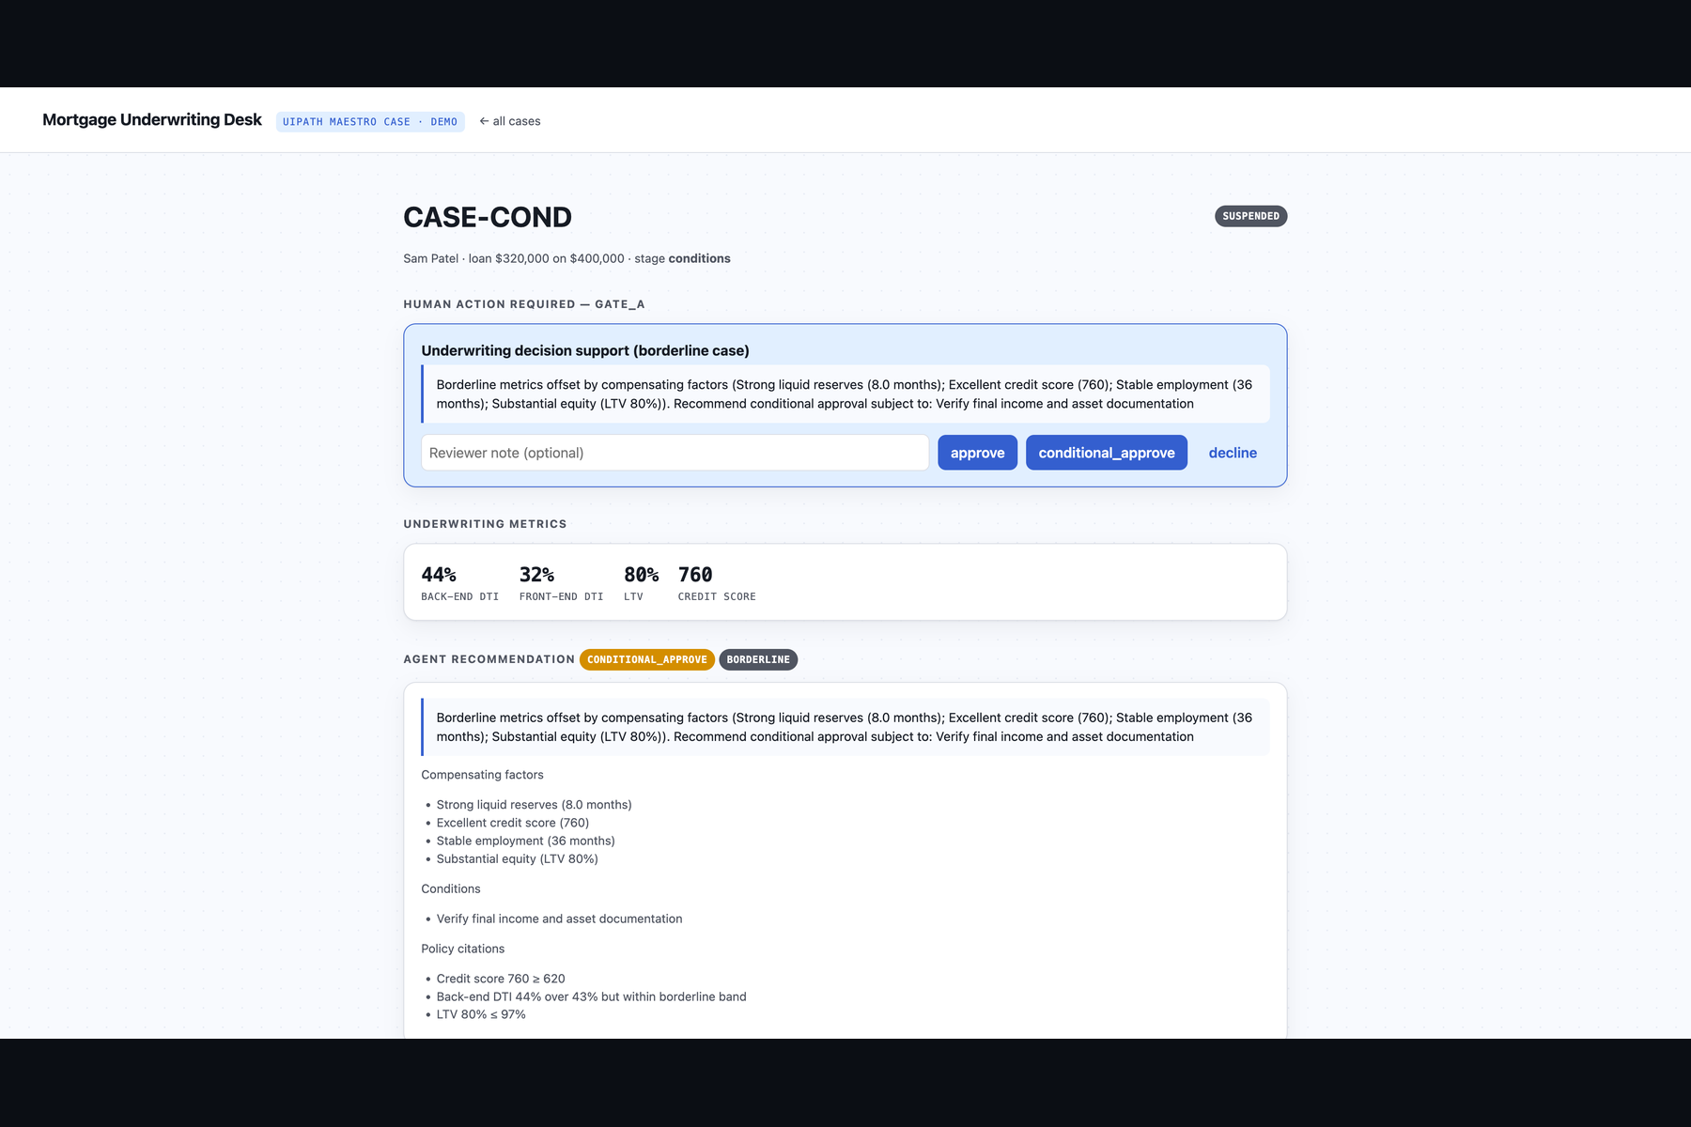
HUMANS IN CHARGE · ACTION CENTER
Two gates: decision support, then final authority
Gate A — decision support
borderline files only; the underwriter sees the agent's metrics, rationale, compensating factors and policy citations.
Gate B — final authority
every approve / decline is signed by a human.
Durable
the case suspends and resumes across processes — like Maestro + Action Center.
CaseWeaver · UiPath AgentHack 2026
The loan-officer desk (real UI)
6

Slide 7
EXCEPTIONS ARE THE PRODUCT
Seven routes, one auditable policy table
Exception | Route
Missing documents | email borrower → suspend (info requested)
Low-confidence OCR | auto re-digitise once → human verify
Conflicting data | re-verify → human resolution
DTI over policy | compensating factors → conditional / decline
Appraisal gap | recompute LTV on lesser value → human review
Fraud / AML hit | hard stop → escalate to compliance
Transient failure | exponential-backoff retry → system escalation
CaseWeaver · UiPath AgentHack 2026
7

Slide 8
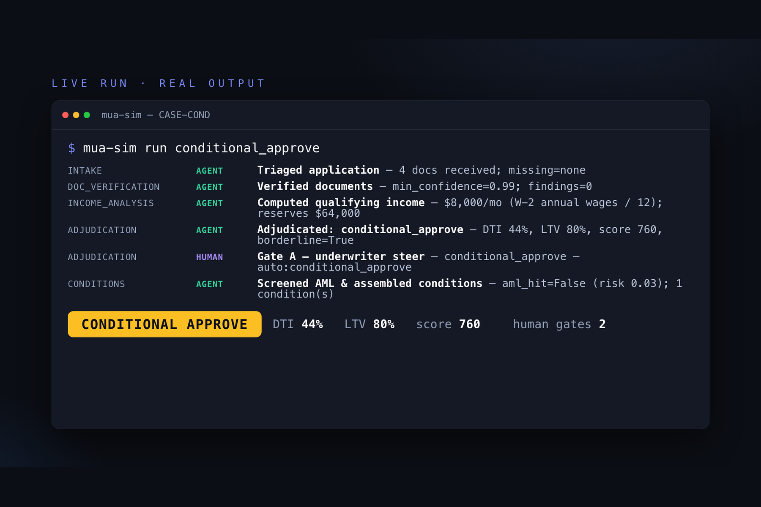
SEE IT RUN
A borderline file, end to end — real output
44% DTI
rescued by reserves & a 760 score
Gate A → underwriter steers
Gate B → final sign-off
→ conditional approve
▶ watch the 3-min demo
CaseWeaver · UiPath AgentHack 2026
8

Slide 9
UIPATH PLATFORM USAGE
Deep, governed platform use
Maestro Case
Coded Agents
Action Center
Document Understanding
Orchestrator
API Workflows
LLM Gateway
CrewAI (governed)
EXTERNAL FRAMEWORK INSIDE A GOVERNED LAYER · BUILT WITH CLAUDE CODE (BONUS)
CaseWeaver · UiPath AgentHack 2026
9

Slide 10
UIPATH FOR CODING AGENTS
The whole solution, built by a coding agent
Designed the dual-mode PlatformPort architecture
Built all five agents, the supervisor graph, and the policy engine
Probed the real LangGraph & UiPath SDK APIs before committing
Validated uipath init / pack → a valid .nupkg, with no tenant
Wrote the tests, the security audit, and the documentation
EVIDENCE
git history — every commit co-authored
evidence/CODING_AGENT_LOG.md
uipath init / pack in the loop
AGENTS.md from the UiPath CLI
CaseWeaver · UiPath AgentHack 2026
10

Slide 11
PRODUCTION-READY
Engineered, not hacked
72
93%
0
✓
tests
coverage
open Critical / High
valid .nupkg, no tenant
ruff + mypy clean · STRIDE security audit · deterministic & reproducible (LLM stubbed)
CaseWeaver · UiPath AgentHack 2026
11

Slide 12
IMPACT & WHAT'S NEXT
From demo to deployment
IMPACT
WHAT'S NEXT
Faster cycle time on routine files
Fewer manual touches; agents handle the tail
Full auditability — every step on the timeline
Humans accountable for every credit decision
Go live on UiPath Labs (publish + Maestro canvas)
Real connectors: credit bureau, AML, Document Understanding
Escalation memory — learn from underwriter decisions
More case templates: disputes, KYC, claims
CaseWeaver · UiPath AgentHack 2026
12

Slide 13
Thank you
Agents underwrite. Humans decide. UiPath governs.
Repo: github.com/SebAustin/mortgage-underwriting-agents
Demo video + this deck linked in the Devpost submission.
Built with Claude Code

