Slide 1
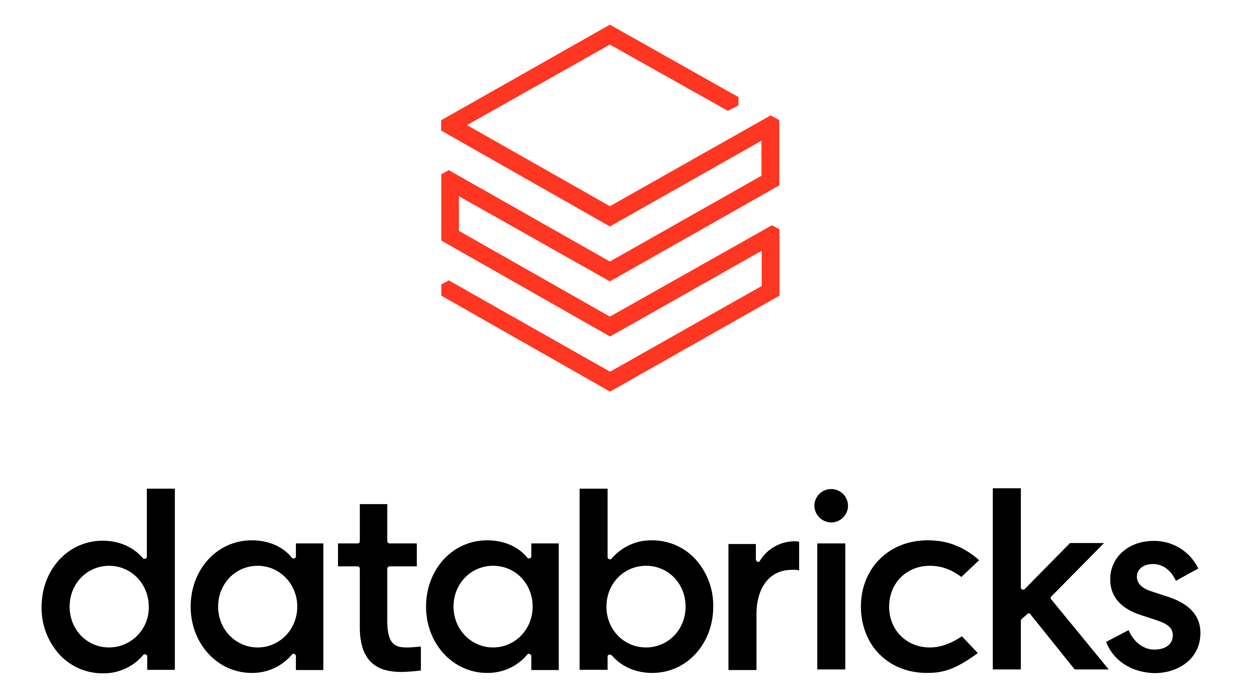
Mock Sales deck

Slide 2
Agenda
How can Databricks capabilities provide a better experience for ICG?
Real-time analytics and streaming
Time-series analytics
Delta sharing
A case study to provide a first-hand account of how effective fully adopting Databricks is for ICG.
Notes:
I thank you for your time today. I currently understand that you currently use Databricks for Etl. However, you have heard good thing about Databricks from you new employee from the LSEG. It is clear that Databricks can improve the speed and governance of your operations at ICG. However today I am going to go though How Databricks capabilities provide a better experience for ICG. In three main areas: Real time analytics and streaming – Time-series analytics – Delta sharing. To finish off today we will go though a case studt to provide evidence that Databricks can make your business more efficient.

Slide 3
Unlocking Value For Your Business Stakeholders.
Richer and more accurate information to allowing better decisions Allows for process streaming +batch data in one unified platform
Manage market reporting at lower cost and greater accuracy
Power intraday dashboards for risk, liquidity, and performance
Faster real time information to allow faster business decisions to outpace competitors
Reduce latency between data arrival and business action
Provide a market changing experience for your customers while driving internal efficiency
Supports time‑sensitive capital‑markets workflows
Notes:
Process streaming - allows for richer data sets and stock exchange data processing in real time giving an advantage over other computers
Batch data – allows for the past stock exchange data and more to be processed in one place, will significantly reduce time for market reports to be created by Benoît Durteste, therefor more time can be spent on other aspects of the business.
The intraday dashboard allows your employees to access the data in a simplified manner this shows the risk, liquidity and performance of trades and potential trade. This allows for faster risk decisions, fewer blind spots and a single source of truth across investment teams. Overall increasing smarter and sharper decisions from all teams.
The Databrick Lakehouse (this is where all different data is stored clean and messy cheaper than having two different systems for organised and unorganised data) is the engine for how quickly the data can be accessed and processed. The Lakehouse can stream: Trade events, Cash movements, Market data and any other piece of data you need. Allowing for live operational and risk reviews with minimal operational lag time.
We do this by what is call the lakeflow instead of the usual overnight ETL, Databricks extracts transforms and loads all of there data into the Lakehouse as soon as they get it.
As a result of the reduced latency we are able to provide you with time-sensitive capital markets, you are able to set up alerts, automated actions and AI agent with your data before anybody has even checked a report.

Slide 4
A Single Governance Layer for All Data, Models And AI
Centralised access control across table, files, dashboards and ML models
Automated lineage for full auditability
Supports secure collaboration across teams
Notes:
Having Databricks being a centralised access control across table, files, dashboards and machine learning models causes a consistent policy that governs who can access, edit, run or export different pieces of data.
Joining Databricks will reduce the following problems of having fragmented access controls: Security risks, Audit friction and operational delays. Security risks are fixed due to consistent permissions across all data, therefor there Is no confusion people can only access the data allowed . Audit friction is solved due to all metrics accessed being located in the Lakehouse therefore being able to trace it all back to a centralised point. And operational delays will be a thing of the past due to the consistent permissions it will provide access if the team is allowed otherwise not therefor, the ad hoc request for data is quick and snappy.
The automated lineage allow you to have an end-to-end map of how every output was produced, overall, this will reduce the blind spots and provides an instant audit ready for any intraday decision. This allows teams to reliably explain how a number is produced while keeping trust with are systems.
If you do decide to expand from only using Databricks for ETL then you are able to have all teams using the same centralized dashboard and data storage system. This allows for teams to easily transfer data, notebooks and more safely and efficiently . This can lead to faster product development and controlled access to sensitive information as previously mentioned. Overall due to secure efficient collaboration across teams it will reducing the time for new market reports and models, fewer data leaks and safer automation for intraday liquidity and margin workflows.

Slide 5
Automate ETL Pipelines In A Meaningful Way and Deliver Projects Faster
Declarative pipelines reduce manual engineering work
Built‑in data quality checks and monitoring
Supports both streaming and batch workloads
Reduces pipeline failures and operational overhead
Notes:
The declarative pipelines that have been engineered allow engineers from different teams to describe how they want the data workflow to be. This cuts out a lot of different steps that your engineers would have previously had to do manually. Due to are systems Operational load will reduce therefor the engineering teams can focus on the business logic
The built-in quality checks allows for all of your data to be able to be transformed into gold standard data this allows for the optimal data for business intelligence, reporting and ML. This allows for more reliable intraday dashboards – cleaner data for risk and performance models – and you are able to have end to end map from how the raw data is transformed by Databricks.
Are systems supporting both streaming and batch workloads has all the benefits previously mentioned however it will also save money. Due to Databricks using one system there will only be one sever one team and one licence. It also includes Auto-scaling this means there is no spare storage which you are paying for.
Due to the a lot of the previous reasons such as built in quality checks there is a reduced risk of pipeline failures. This allows for much less time spent on fixing the pipelines.

Slide 6
LSEG + Databricks — Accelerating AI‑Ready Market Data and Agentic Analytics
Problem: market data was deliver slowly which forced analysts to spend more time integrating the data rather than modelling
Solutions: Delta sharing, Agent Bricks + Databricks AI, Unified platform
Impact on LSEG: Faster data onboarding, Accelerated AI production, lower operational friction
Notes:
Databricks enabled access to London Stock Exchange Groups' AI‑ready market data via Delta Sharing (how the data is transferred safely and quickly e.g. what has been talked about the whole time), cutting integration friction and accelerating production AI/analytics.
We noticed a problem with how quickly LSEG’s market data was delivered and how it was reducing the time analysis had on modelling which increase the strain to meet deadlines.
This is where we decided to implement different tools such as delta sharing, Agent bricks and having a unified platform for LSEG. The delta sharing secured live access to LSEG datasets. Agent bricks and Our AI allowed for LSEG to produce an AI agent that combined market data with firm data causing rapid workflows to form.
Due to our collaboration LSEG it has helped LSEG by having faster onboarding for analysis to access key data points. It has also helped up help you by reducing the time it take to develop an AI agent.

Slide 7
Next steps
Engage your business stakeholder for a business demo
Workshop – todays architecture vs future architecture for ICG
Invite you to our FSI forum in May and Summit in June
Notes:
Some next steps we I think we should take to help you understand Databricks in more detail are Engage your business stakeholder for a business demo and have a workshop of what today's architecture is vs what we think the future architecture for ICG would be. This would be useful to show you more of the applications that Databricks can do the examples of the dashboard and systems we use at data bricks. We would also love to invite you and your business stakeholders to our FST forum in May and summit in June.

