Slide 1
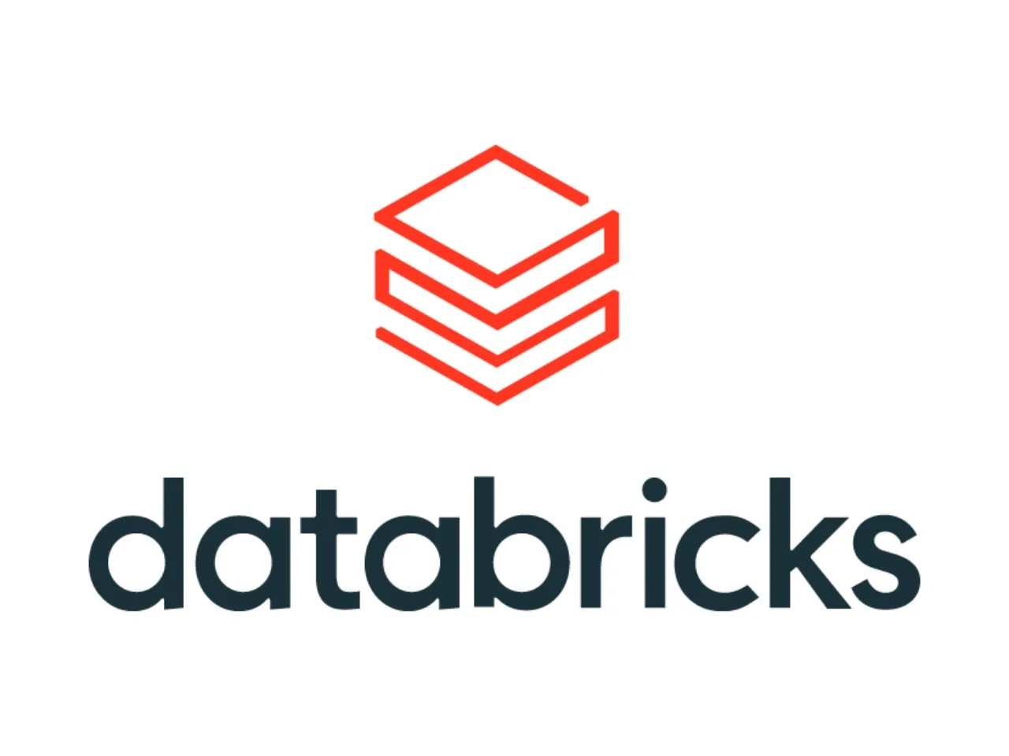
MOCK PITCH · KELLOGG'S CIO
Scaling what's working.
Databricks alongside your PI System.
A conversation about how Kellogg's can get even more out of the data PI is already collecting — starting at Battle Creek, then scaling to all 50 sites.
Mock sales pitch · Databricks · May 2026

Slide 2
Databricks · for Kellogg's
OUR UNDERSTANDING
Here's the Kellogg's landscape as I see it.
Please correct us where we're wrong — this shapes everything that follows.
OPERATIONAL BACKBONE
FOOTPRINT
AVEVA PI System across the estate
~50 manufacturing sites worldwide
The system of record for time-series operational data.
Battle Creek is the proving ground.
PROVEN OUTCOME
PUBLIC COMMITMENTS
$3.3M annual savings, one site
2030 and 2050 sustainability targets
Kellogg's already turns operational data into financial outcomes.
Energy, water and Scope 1–3 emissions, publicly measured.
Databricks
2

Slide 3
Databricks · for Kellogg's
THE OPPORTUNITY
PI proved the model at one site. Databricks scales it across 50.
WHAT PI DELIVERED
WHERE DATABRICKS TAKES IT
$3.3M
Scale that result. Then go beyond it.
annual energy savings at Battle Creek.
Battle Creek is the floor, not the ceiling. Databricks lets Kellogg's apply the same data-driven approach across all 50 sites — and unlock things PI alone wasn't built for: enterprise-wide AI, IT/OT data joined together, and live data sharing with partners and regulators.
A real result from PI doing exactly what it was built for.
Source: AVEVA, Kellogg's case study
Databricks
3

Slide 4
Databricks · for Kellogg's
HOW IT FITS TOGETHER
PI stays where it is. Databricks sits alongside.
Kellogg's keeps PI doing what it's good at. Databricks plugs in next to it and adds the analytics, AI and sharing capabilities PI was never designed for.
OT — PLANT FLOOR
INTEGRATION
DATABRICKS LAKEHOUSE
AVEVA PI System
Databricks Lakehouse
System of record · unchanged
AVEVA CONNECT
Unity Catalog · Delta Lake · governed
PI Data Archive
native Databricks integration
Bronze
Raw PI tags + IT sources
Time-series historian
Streams PI tag values and AF context to the Lakehouse — no rip-and-replace.
PI Asset Framework
Silver
Cleaned, joined, contextualised
Hierarchies & context
PI Vision
Gold
ML features · KPIs · shared
Operator dashboards
Streaming + batch · governed
Sensors · PLCs · MES · energy meters · ~50 sites
→ BI · ML models · Delta Sharing to partners
Databricks
4

Slide 5
Databricks · for Kellogg's
CAPABILITY 1 OF 3
Real-time analytics & streaming
THE CAPABILITY
AT KELLOGG'S
Line-level OEE in real time, not in tomorrow's report.
Streaming and batch in one engine.
Today, PI surfaces what happened on the cereal line. Streaming the same tags into Databricks means a downtime event triggers a model the moment it starts — not after the shift ends.
The same pipeline handles live PI tag data and historical replays — acting on it as it lands, not the next morning.
10–15%
operational efficiency uplift — manufacturing average across Databricks customers
Source: Xorbix industry report, 2025
Databricks
5

Slide 6
Databricks · for Kellogg's
CAPABILITY 2 OF 3
Time-series analytics
THE CAPABILITY
AT KELLOGG'S
Predictive maintenance on extruders, ovens and packaging lines.
From historian to forecaster.
Vibration, temperature and motor-current tags from PI become training data for failure-prediction models — moving Kellogg's from scheduled maintenance to condition-based maintenance.
PI records what happened. Databricks uses that history to predict what's about to happen — energy, yield, equipment failures.
20–30%
maintenance cost reduction — predictive maintenance benchmark, manufacturing
Source: Xorbix industry report, 2025
Databricks
6

Slide 7
Databricks · for Kellogg's
CAPABILITY 3 OF 3
Delta Sharing & Unity Catalogue
THE CAPABILITY
AT KELLOGG'S
Sustainability reporting that doesn't require an army.
Share live data, not file dumps.
Governance.
Share live Scope 1–3 emissions data and energy usage with auditors, retailers (Walmart, Tesco) and regulators directly — no quarterly spreadsheet exports, no version mismatches, no rework.
Partners and regulators read live tables directly — governed at the column level. This is the thing PI alone simply can't do.
Direct line
to 2030 and 2050 sustainability commitments — already public, already measured
Databricks
7

Slide 8
Databricks · for Kellogg's
CASE STUDY
BP unified OT and IT data alongside its existing systems.
THE STARTING POINT
WHAT THEY DID
THE IMPACT
Operational data, fragmented
Built the Unified Data Experience on Databricks
25% productivity boost
BP's data lived across refineries, trading desks and corporate systems — rich, but siloed. Engineers spent more time stitching data together than analysing it.
Kept their existing systems in place. Used Databricks as the platform to unify, govern (Unity Catalog) and serve data to the people who needed it.
Decentralised data ownership, faster discovery, optimised compute costs, consistent quality — and a single portal for the enterprise to find and use data.
Source: Databricks BP customer story, databricks.com/customers
Why it applies to Kellogg's:
BP had refineries, historians and global operations. Kellogg's has plants, PI and 50 sites. Same pattern — keep what works, add intelligence on top.
Databricks
8

Slide 9
Databricks · for Kellogg's
WHERE WE'D LIKE TO GO NEXT
Three concrete steps.
01
02
03
THIS QUARTER
NEXT QUARTER
ONGOING
Engage your business stakeholder for a business demo
Workshop — today's architecture vs future architecture for Kellogg's
Invitation to Databricks Data + AI Summit
A working session with the people who'll actually use this — operations, sustainability and supply chain leads. Real Kellogg's questions, real Databricks answers.
Half-day with your data, OT and plant engineering leads. Current state mapped against target state. Output: a one-page reference architecture for Kellogg's.
Our flagship annual event in San Francisco. Manufacturing track, peer conversations with companies like BP, and hands-on sessions on the capabilities discussed today.
Thank you. Questions welcome.
Databricks
9

