Slide 1
Why the laugh floor is losing efficiency
What is going wrong?
Doors getting lost
Slow response’s with problems
Inefficient handovers
Inaccurate energy predictions
What this is causing!
Security risk
Increase risk for monsters
A decrease in productivity
Supply chain problems

Slide 2

The Aim
A decrease in incidents – Issues spotted earlier
More efferent operations- More automation
Increase in laugh production- Better planning and more accessible data
Controlled shift handovers- Shared dashboards and pipeline
Reduce costs – move to the “cloud”
Fewer incidents because issues are spotted early

Slide 3

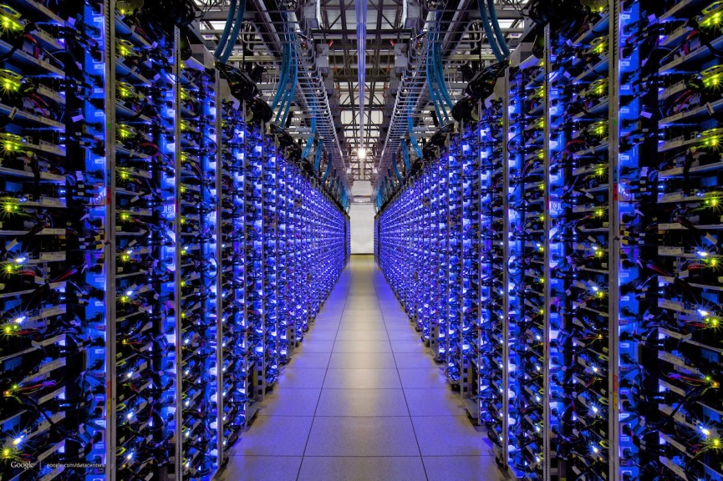
The Fix
Taking data off premise to Microsoft Azure
Introduce the IoT hub- The “eyes an ears” of the factory
Power BI- A clear dashboard for all
Power automate- the online worker who never forgets
Teams + co-pilot- Communication made easy

Slide 4

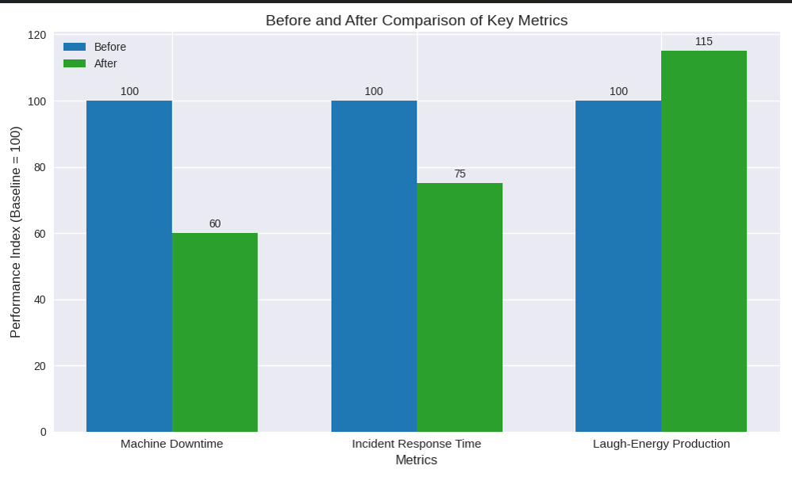
Overall
How the average day might pan out!

Slide 5
Next steps
Set up a meeting demoing all of the tools to get a better understanding
1
Build a simple dashboard to see what it can be like
2
Transfer data to the cloud
3
Make much more laughs
4

