Slide 1

HPP-Cellular Automata
An encryption algorithm in C++ with MPI and OMP
Done by Samuel Orth and Sebastian Roth Master Applied Physics Parallel Computing SS2025 by Prof. Dr. Jens Georg Schmidt

Slide 2
Table of Content
Definition of Cellular Atomata
HPP-Algorithm
Parallelization
Results

Slide 3
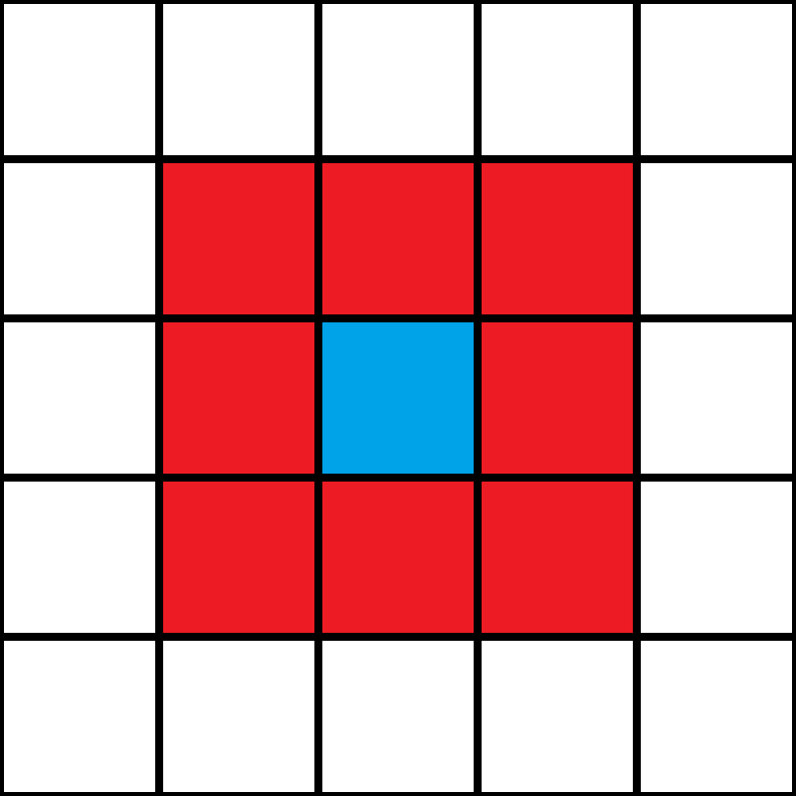
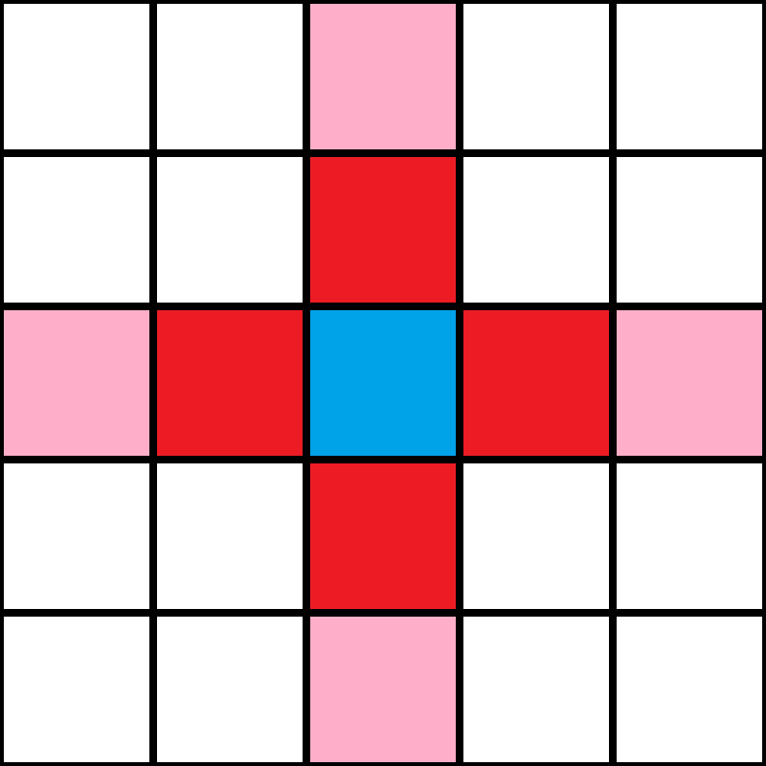
Cellular-Automa Definition
Discrete computational model consisting of a finite grid (lattice) of cells
Each cell has a finite number of states
N dimensional (Typically 1D or 2D)
Well defined neighborhood
Van Neumann or Moor
Hard boundarys or toroidal
Moor and van Neumann neighborhood [3]
Notes:
Hard boundarys = walls that cannot be passed
Toroidal = every edge is coneted to its opposed edge (Donut-Shape)

Slide 4
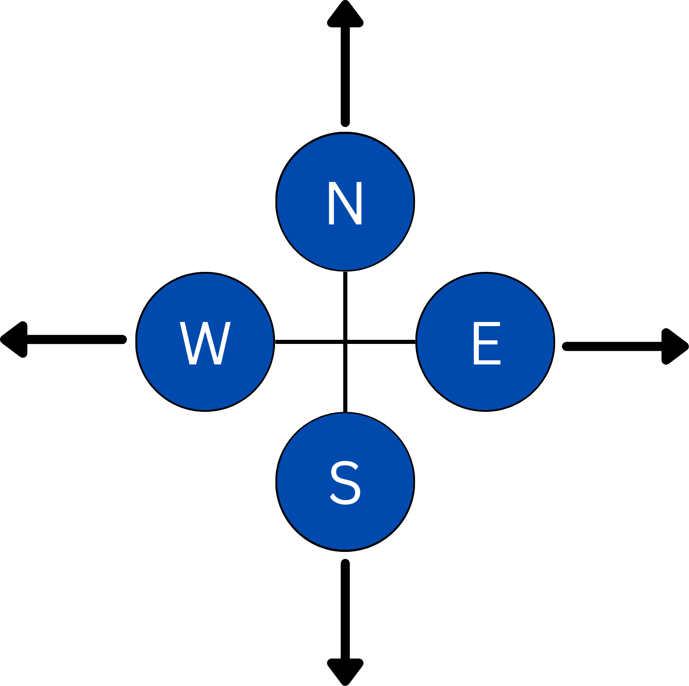
HPP-CA
Lattice-Gas Cellular Automata (LGCA) from Hardy, Pomeau and Pazzis (1973)
Symmetrical behavior: used for cryptography
HPP
2D lattice with van Neumann neighborhood and toroidal character
There are 16 set of states per cell Each cell can hold one of each particle
Fixed set of Rules
Notes:
HPP original was for gas simulation
! PROBLEM: Randomnes in thermodynamics (entropy) --> CA is perfectly invertable
OUR HPP:
North=Up | South=Donw | East=right | West=Left
EACH CELL IS REPRESENTED BY A BYTE/ 8 BITS

Slide 5

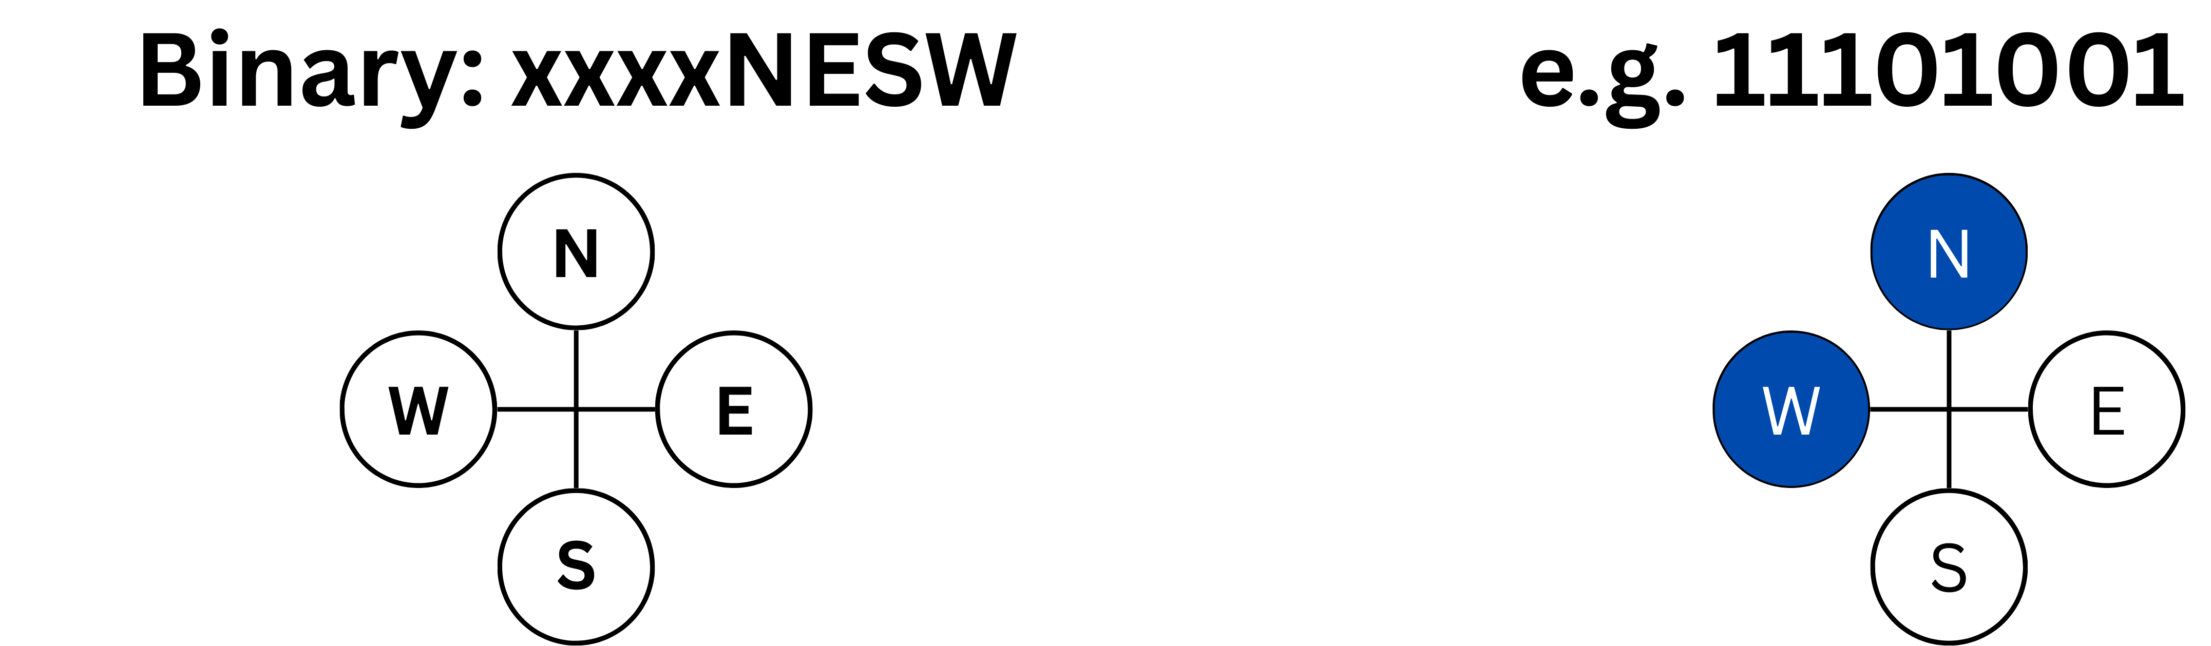
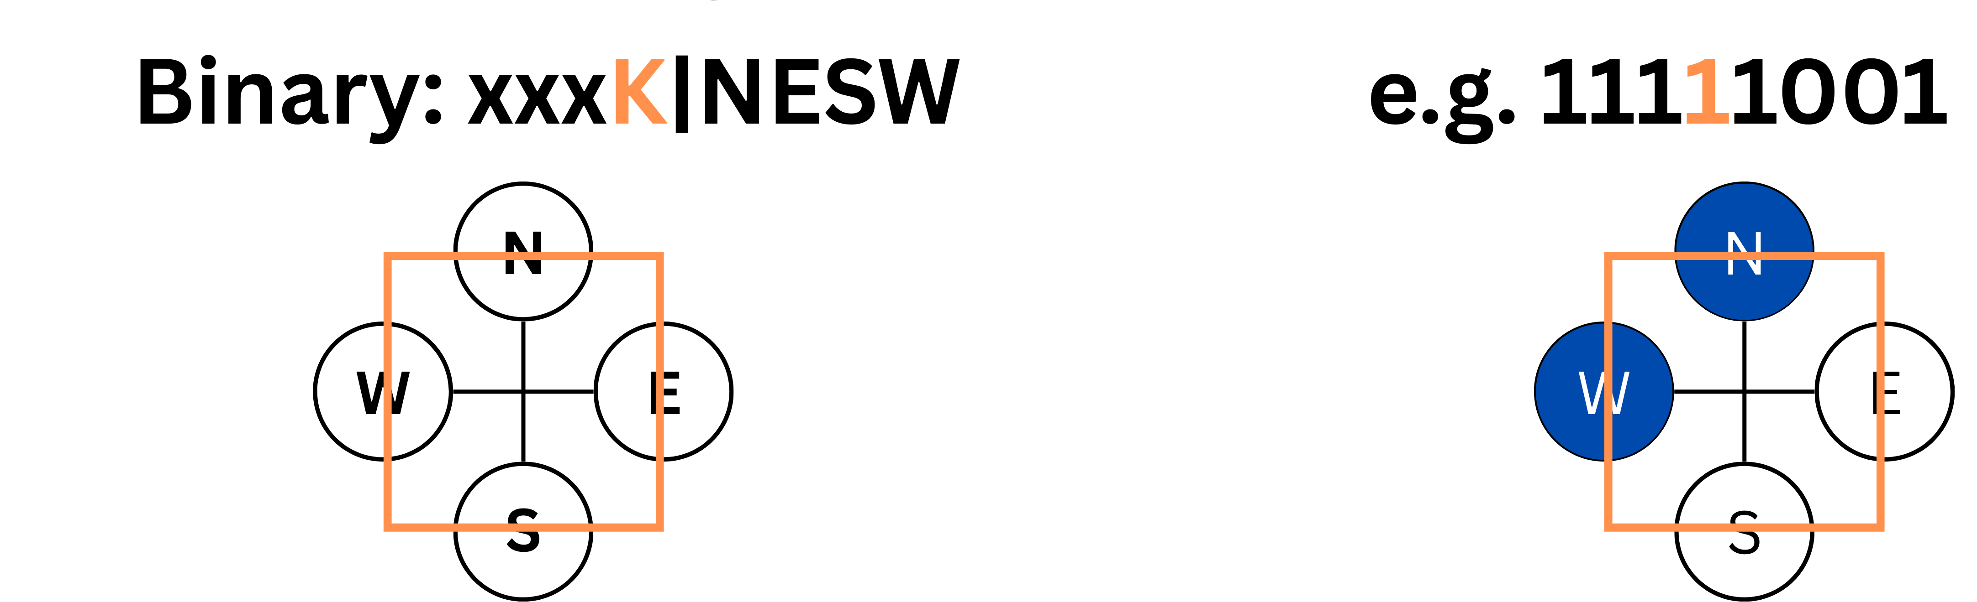
Datatype usage
Data is converted into binary (uint8_t)
Low-Bit is translated to the particles
The K-Bit is the encryption key
ASCII | Integer | Binary | State
A | 65 | 0100|0001 | W particle
a | 97 | 0110|0001 | W particle
b | 98 | 0110|0010 | S particle
c | 99 | 0110|0011 | S & W particle
. | 46 | 0010|1110 | N & E & S particle
! | 33 | 0010|0001 | W particle
? | 63 | 0011|1111 | N & E & S & W particle
[ | 91 | 0101|1011 | N & S & W particle
- | 45 | 0010|1101 | N & E & W particle
„ | 34 | 0010|0010 | South (S) particle
/ | 47 | 0010|1111 | N & E & S & W particle
ä | 228 | 1110|0010 | S particle
Notes:
Data Is loaded as bytes → Each byte is placed in one cell of the automata
LOW BITS REPRESEND THE GAS PARTICLES
High-Bits are not taken into account
K-Bit = KEY/ Wall → Very important for cryptography
AS SHOWN WE WOULD MANIPULATE THE ORIGINAL/ MESSAGE BITS → CREATE SEPARATE BOLEAN MATRIX (MASK)
Table is to give an idea of how an ASCII Character is translated into bytes

Slide 6
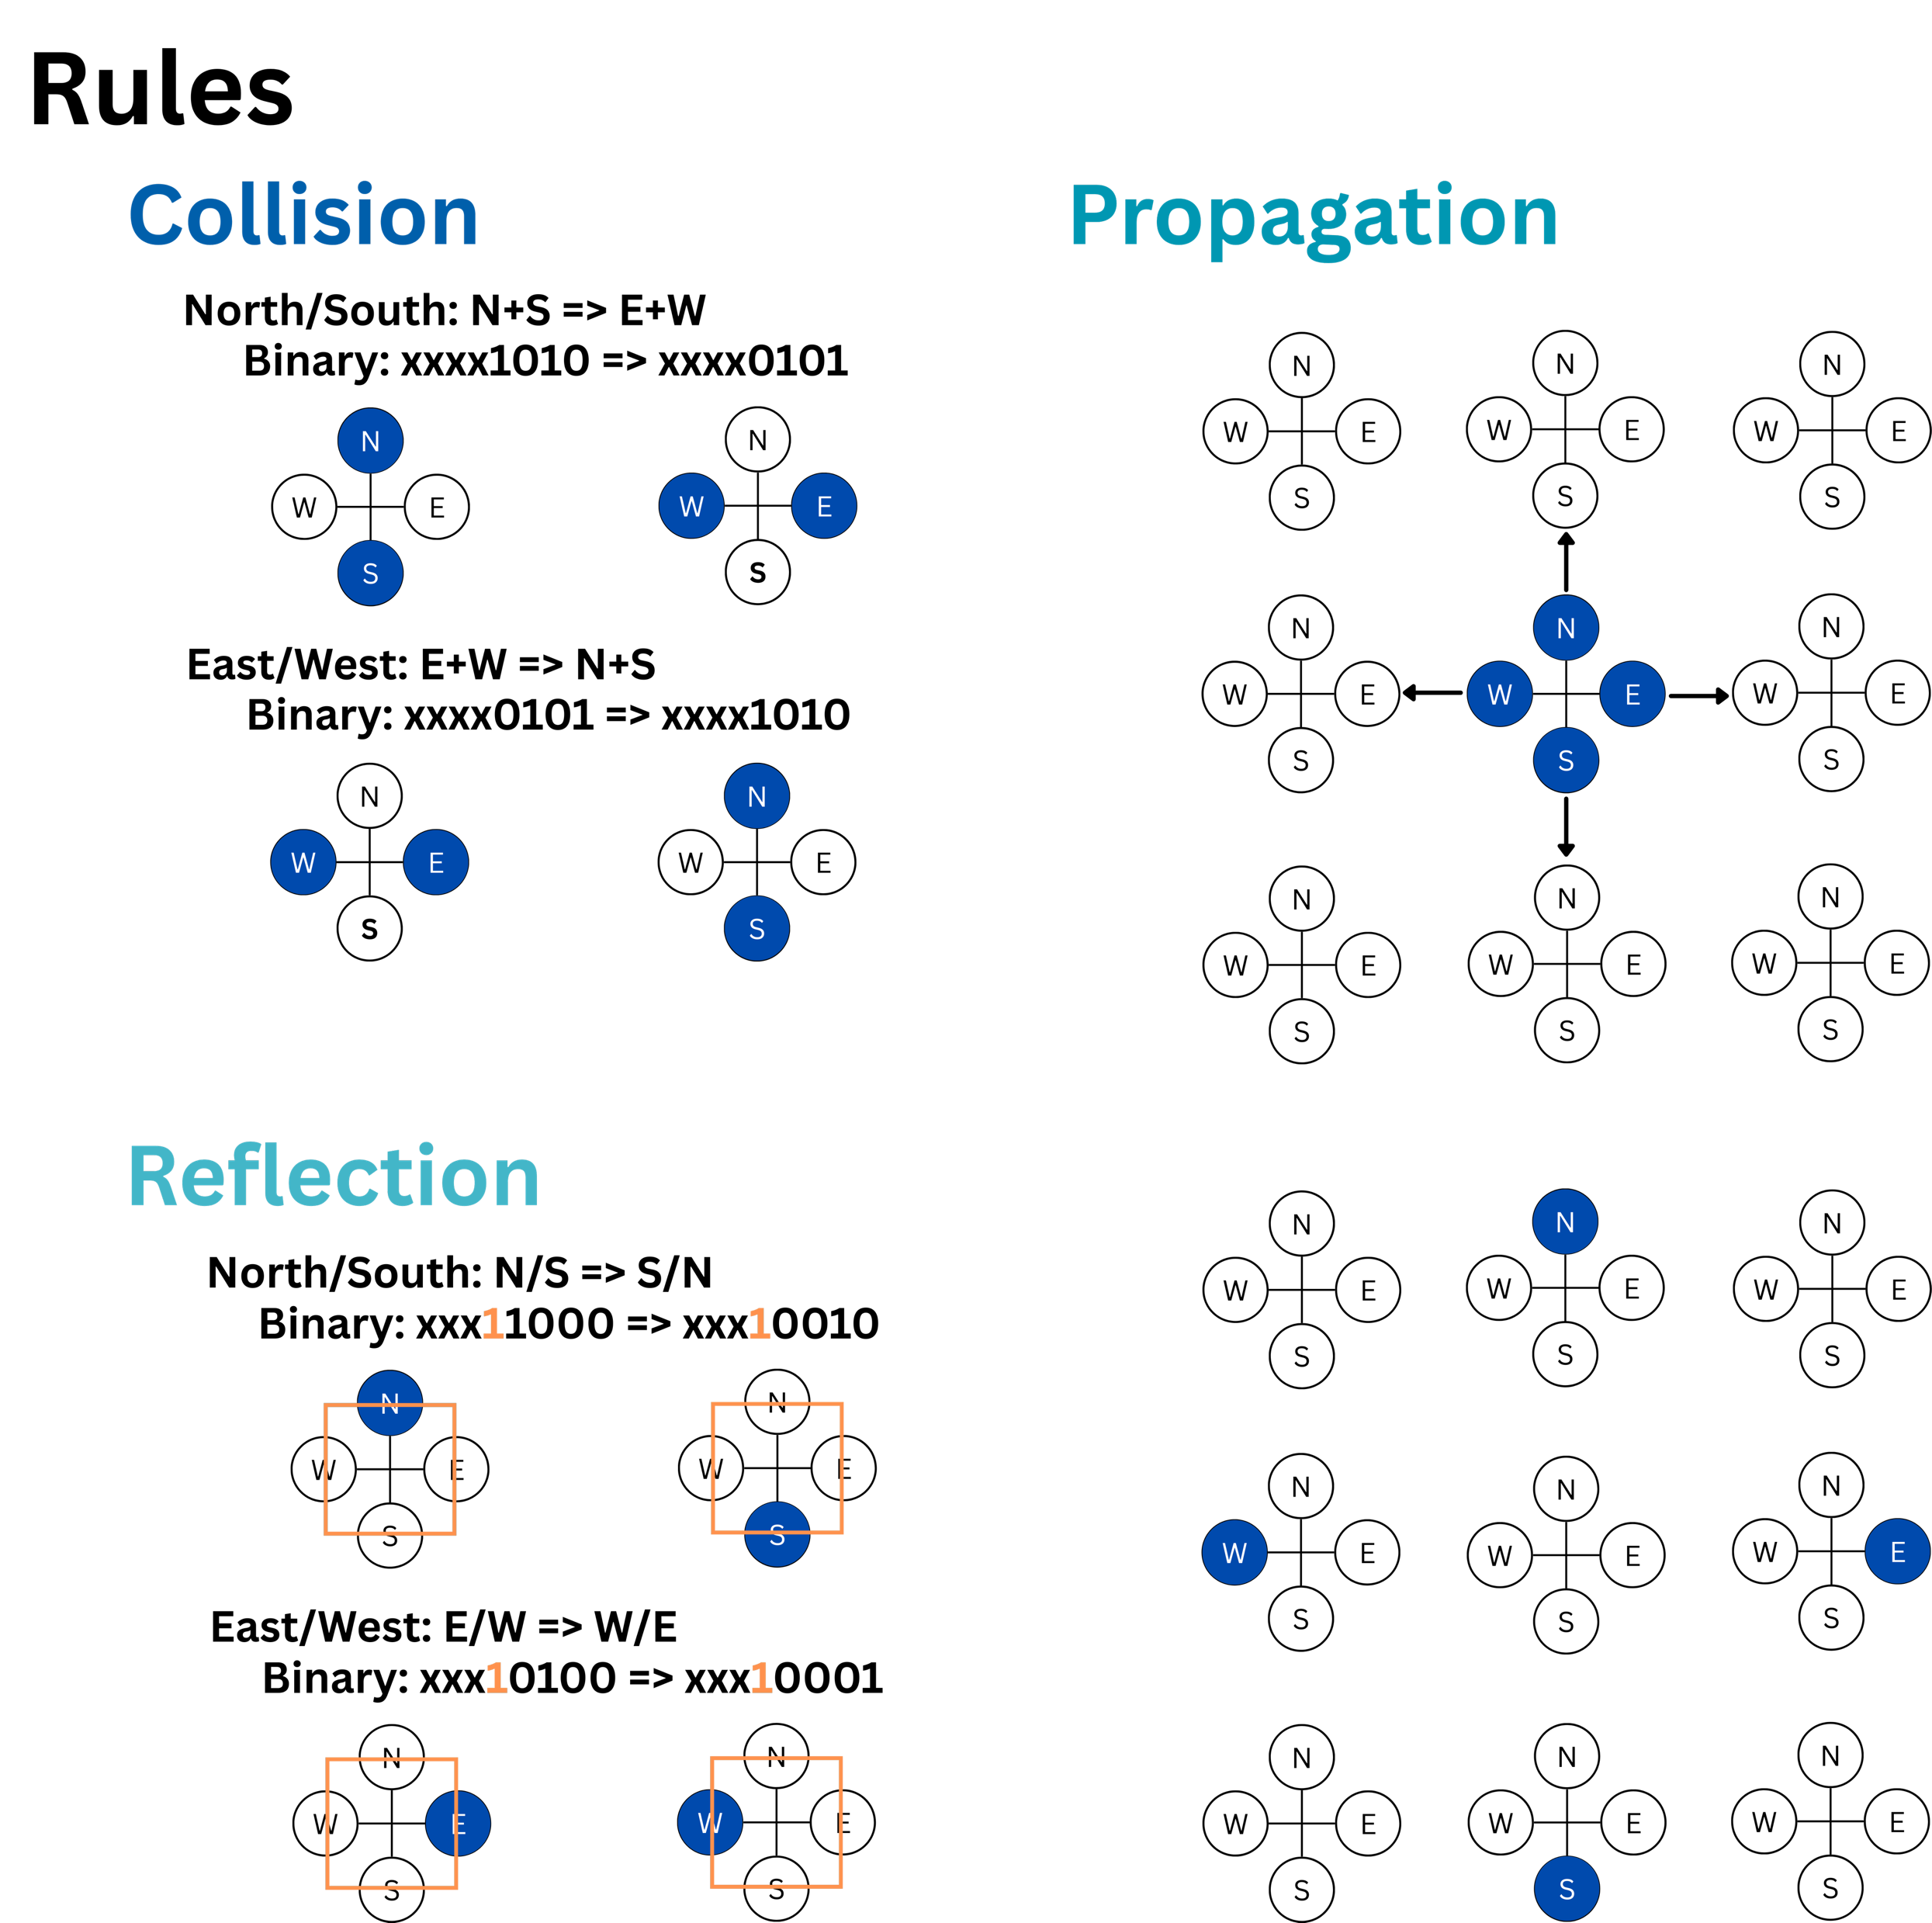
HPP-Rules
Collision
When two particles meet head-on they change directions by 90 degrees
Propagation
Particles move to the adjacent cell in their current direction
Reflection
Particles that hit a wall are reflected by changing directions by 180 degrees
Notes:
The HPP-Rules Consist of 3 different elements 1) COLLISION -> TWO PARTICLES HIT EACHOTHER HEAD-ON → ROTATED BY 90 DEGREES (NORTH HITS SOUTH → BECOMES EAST AND WEST) 2) PROPAGATION -> PARTICLES PROPAGATE TO THE ADJECNT CELL CORRESPONDING TO THEIR DIRECTION (NORTH MOVES UP, SOUTH MOVES DOWN etc.) -! INVERSE PROPAGATION MOVES BACKWARDS → NORTH MOVES DOWN, SOUTH MOVES UP, EAST MOVES LEFT, WEST MOVES RIGHT 3) REFLECTION
-> WHEN THERE IS A WALL IN A CELL A PARTICLE IS ROTEATED BY 180 DEGREES/ REFLECTED (NORTH →SOUTH)

Slide 7
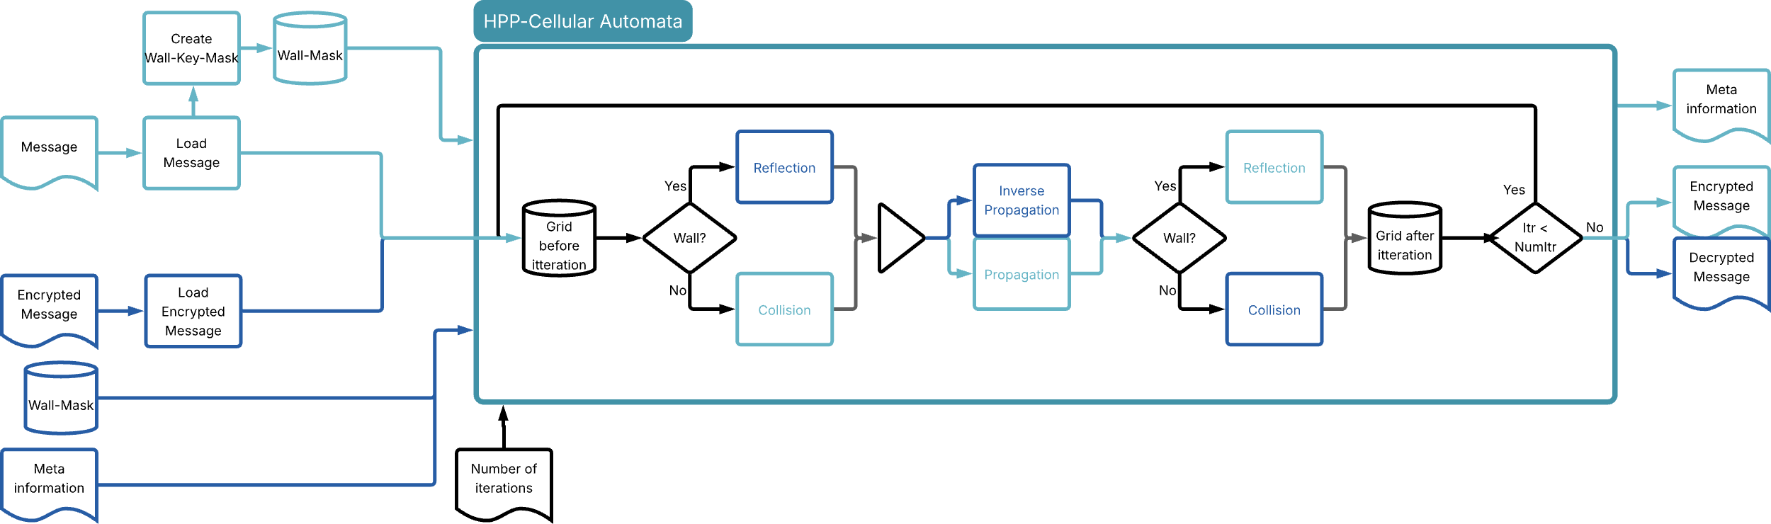
Algorithm (sequential)
Encryptor
Decryptor

Slide 8
Parallelization – What needs to happen?
Preparations:
Read message
Distribute in grid
Create MPI-geometry
(2) Main loop:
Iterate over every cell
Apply the rules
Manage communication
(3) Wrap-up:
Collect and write data
> 98 % of total runtime

Slide 9
Parallelization – How to approach it
Cells are mostly independent → Implies use of Domains (via MPI)
But:
Q: What Geometry?
→ Wanna optimize “volume/edge” ratio
→ MPI_Cart – function family helps
Q: What happens if “particles” migrate?
→ Domains need to share borders
→ Need to send and receive neighbor state
Solution: Introduce Halo-Cells
Halo cells (equal in state to
neighbor domains border cells)
Border cells (transferred to neighbor)
Inner core (independent)
Notes:
So – what to do for the sequential machine we showed earlier?
First realization: Cells are mostly independent

Slide 10
Parallelization – How to approach it
Only border cells need to know about halos
Inner core is independent → can utilize overlap
➔ use non-blocking communication for halo transfer
Specifically:
Process uses MPI_Isend and MPI_Irecv to gather and distribute Halos
Meanwhile: Compute inner cells
Downstream MPI_Waitall for synchronization
Now compute border cells
Notes:
Blocking (MPI_Send, MPI_Recv): the call waits until it’s safe to reuse/read the buffer.
Non-blocking (MPI_Isend, MPI_Irecv): returns right away; you must finish it later with MPI_Wait/MPI_Test. Don’t touch the buffers until it’s done.
Overlap work: non-blocking can let you compute while data moves (latency hiding).
Deadlock: blocking calls can stall each other; non-blocking helps avoid that by letting both sides post then wait.

Slide 11
Parallelization – How to approach it
Compution of next cell states happens in loops
→ Implies use of OpenMP’s #pragma omp parallel for
→ May use #pragma omp simd (one instruction processes multiple elements)
Pitfall:
Need to calculate next state cellwise, but the next state depends on neighboring cells.
Solution:
Use double-buffers: one active grid and one “next state” grid
Notes:
Next important realisation: Compution of next cell states happens in loops.
#pragma omp parallel for schedule(static): runs the loop on multiple threads; iterations are split evenly up-front (fixed chunks). Low overhead; great when each iteration takes about the same time. Make sure iterations don’t write to the same data (use reduction(...) if summing).
#pragma omp simd: makes one core’s vector unit do several iterations at once (no extra threads). Works best if the iterations have strong similarities

Slide 12
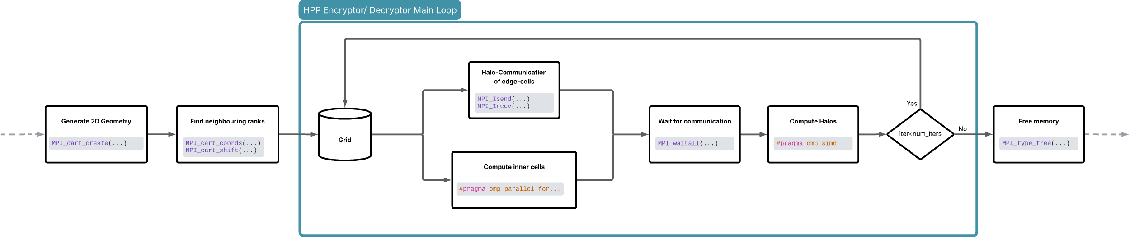
Parallelization structure (MPI+OMP)
Notes:
This is for every rank (every mpi process)

Slide 13
Parallelization - Tips & Tricks
Trim the loop
Set the mode as early as possible
Compiler Flags matter
Don’t copy large-scale, use pointers
Avoid custom made datastructures
Notes:
Trim the loop:
Move anything that doesn’t change each iteration out of the loop to avoid work in the body
Set the mode as early as possible:
Decide the branch before the loop (or split into two separate loops/functions: encrypt-only vs decrypt-only) so the inner loop has no if
Compiler flags matter:
Build with high optimization and CPU tuning (e.g., -O3 -march=native -flto or MSVC /O2 /GL /arch:AVX2) and consider PGO; these enable auto-vectorization, inlining, and better use of your machine’s instructions.
Don’t copy large-scale, use pointers:
Work in place via pointers/references. Avoid creating big temporaries per iteration
Avoid custom made datastructures:
Prefer simple containers so that the compiler does not need to pack and unpack them

Slide 14
Results
Used AI-Cluster of HS-Koblenz (Total of 128 CPUs)
Max. 32 MPI-Processes
Max. 4 OMP-Threads
Grid-Sizes: 2^5, 2^6, …, 2^12
2000 Iterations
O3 optimizer

Slide 15
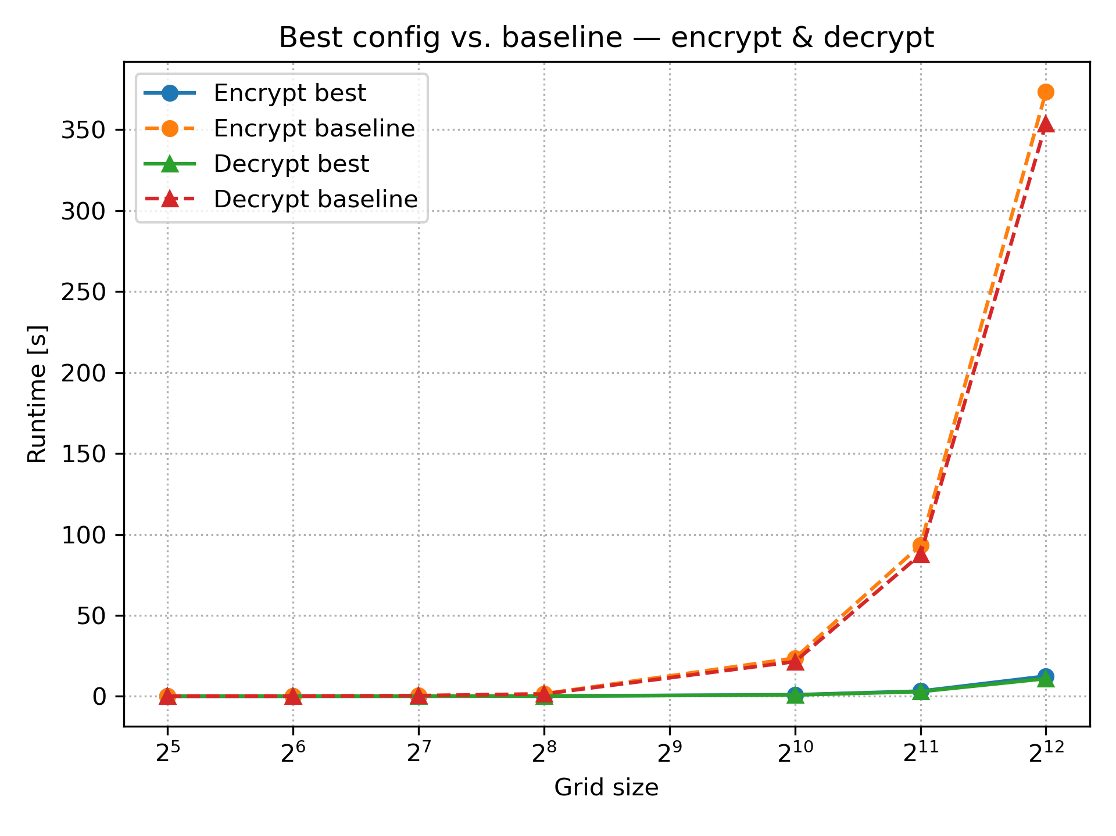
Results - Best configurations
Mode | grid | MPI Processes | OMP Threads | Runtime [s]
Decrypt | 2^5 = 32 | 4 | 1 | 0.0405
Decrypt | 2^6 = 64 | 4 | 2 | 0.0716
Decrypt | 2^7 = 128 | 16 | 2 | 0.1120
Decrypt | 2^8 = 256 | 16 | 2 | 0.1588
Decrypt | 2^10 = 1024 | 32 | 2 | 0.8464
Decrypt | 2^11 = 2048 | 32 | 2 | 2.9029
Decrypt | 2^12 = 4096 | 4 | 2 | 10.9314
Encrypt | 2^5 = 32 | 4 | 1 | 0.0476
Encrypt | 2^6 = 64 | 4 | 1 | 0.0658
Encrypt | 2^7 = 128 | 16 | 2 | 0.1162
Encrypt | 2^8 = 256 | 32 | 2 | 0.1792
Encrypt | 2^10 = 1024 | 32 | 2 | 0.9575
Encrypt | 2^11 = 2048 | 32 | 2 | 3.2018
Encrypt | 2^12 = 4096 | 32 | 4 | 12.4701
Notes:
BASELINE =1 MPI_PROCESS AND OMP THREAD We can see a significant improvement of runtime with greater gridsizes → Parallalisation brouth us an speed up Table shows the best model per mode and grid-size – Increase of MPI-Processes with problemsize - OMP seems not to effect the runtime strongly (maximum of 2 Threads brought best configs)

Slide 16
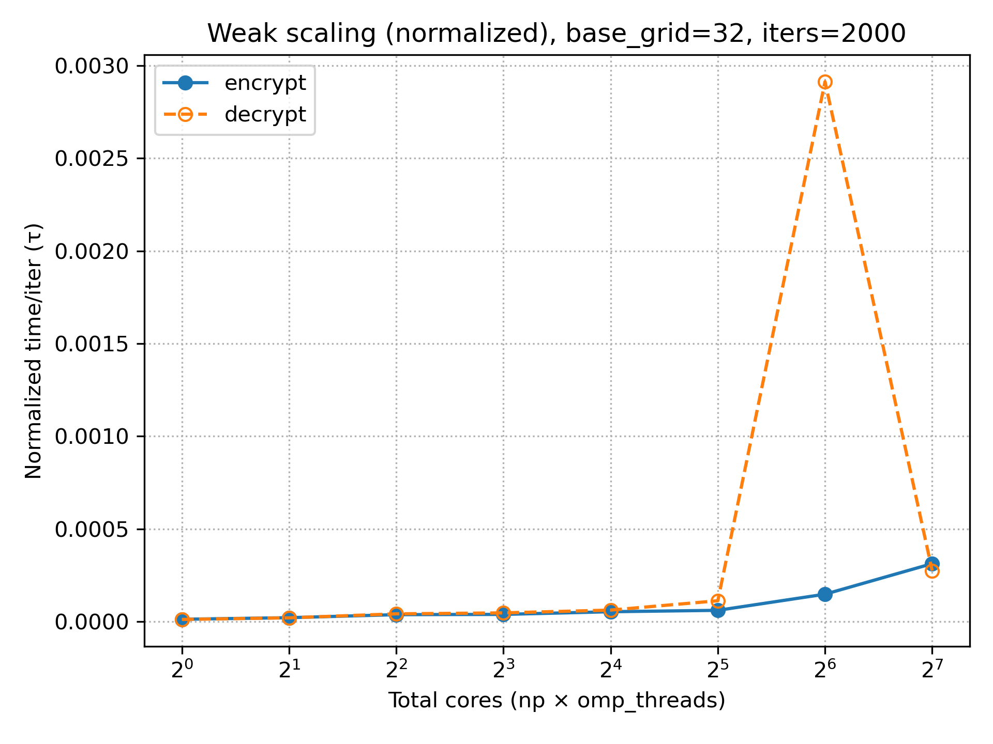
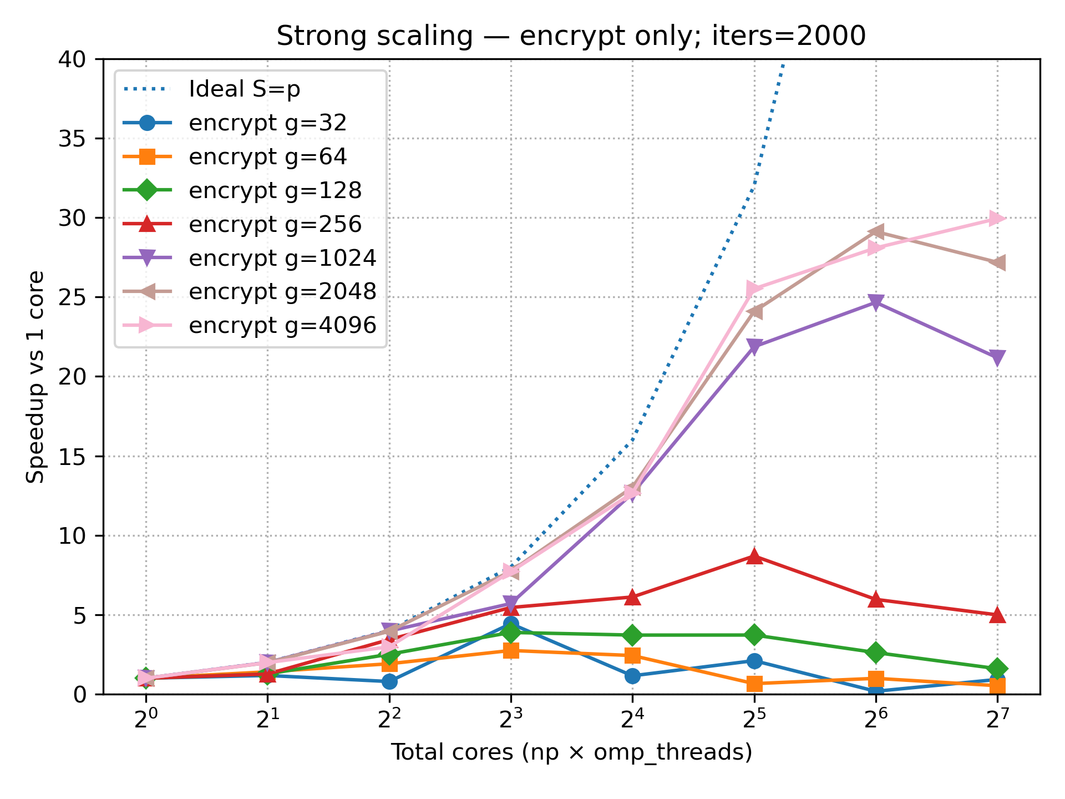
Results - Scaling
Notes:
WAEK-SCALING =^ GUSTAFSONs-LAW - With perfect weak scaling, the normalized time remains constant regardless of how many cores are used. - This means that if each core has the same amount of work and communication were “free,” the curve should be a horizontal line.
=> Both lines increase with more cores Which means that communication between processes/threads takes additional time, which becomes more significant the more cores you have.
=> TAKE-AWAY: Weak scaling is not tobad (time increase is ony in 0.1 ms with a max of 100 cores. Communication takes addiational time STRONG-SCALING =AMDAHLS-LAW
Small Gridsizes (322, 64, 128) =Speed Up up to 1 or 2|
show little up to no speed up → For small problem sizes, communication and parallelization overheads dominate the runtime → the overhead is greater than the computational work.
Medium Girds (256, 1024)=Speed Up up to 9|
Ideal speed up for up to 10 cores, after that not ideal speed up → This shows that parallelization works, but synchronization and communication costs limit the gain.
Large Grids(2048, 4096) =Speed Up up to 10 |
Ideal speed up for up to ca 12 cores → Parallelization is most worthwhile for very large problems, but there is still a significant Amdahl limitation (serial components or communication costs slow things down).
=> TAKE-AWAYS: STRONG-SCALING: Only visible with large grids → small grids are not worthwhile for many cores.
=SUM-UP: Benefit of parallalisation increases with problem size, but is limited by Amdahl's Law and communication overheads.

Slide 17
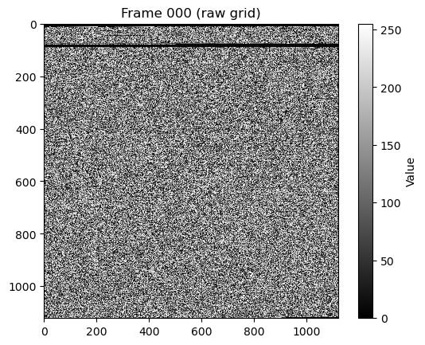
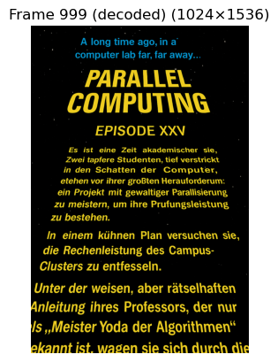
Example – Encrypted/ Decrypted

Slide 18
Tank you for your attention!
Do you have Questions?
Project available at GitHub

Slide 19
sources
[1] Signac, Laurent. (2013). Lattice Gas Symmetric Cryptography
[2] Molekulardynamik und Lattice-Boltzmann Methoden – Dr. Matrin Bernreuther, Universität Stuttgart, SS 2005
[3] Wikipedia: Cellular automaton

Slide 20
Appendix

Slide 21
Condition-Table
Low-Bit | State
|0000 | No particle
|0001 | West (W) particle
|0010 | South (S) particle
|0011 | S & W particle
|0100 | East (E) particle
|0101 | E & S particle
|0110 | E & W particle
|0111 | E & S & W particle
|1000 | North (N) particle
|1001 | N & W particle
|1010 | N & S particle
|1011 | N & S & W particle
|1100 | N & E particle
|1101 | N & E & W particle
|1110 | N & E & S particle
|1111 | N & E & S & W particle
Binary | Integer | State
0000|0000 | 0 | No particle
0000|0001 | 1 | West (W) particle
0000|0010 | 2 | South (S) particle
0000|0011 | 3 | S & W particle
0000|0100 | 4 | East (E) particle
0000|0101 | 5 | E & S particle
0000|0110 | 6 | E & W particle
0000|0111 | 7 | E & S & W particle
0000|1000 | 8 | North (N) particle
0000|1001 | 9 | N & W particle
0000|1010 | 10 | N & S particle
0000|1011 | 11 | N & S & W particle
0000|1100 | 12 | N & E particle
0000|1101 | 13 | N & E & W particle
0000|1110 | 14 | N & E & S particle
0000|1111 | 15 | N & E & S & W particle
Collision
Low-Bit | State
|0110 | E & W particle
|1010 | N & S particle
Reflection
Low-Bit | State
|0001 | West (W) particle
|0010 | South (S) particle
|0100 | East (E) particle
|1000 | North (N) particle

Slide 22
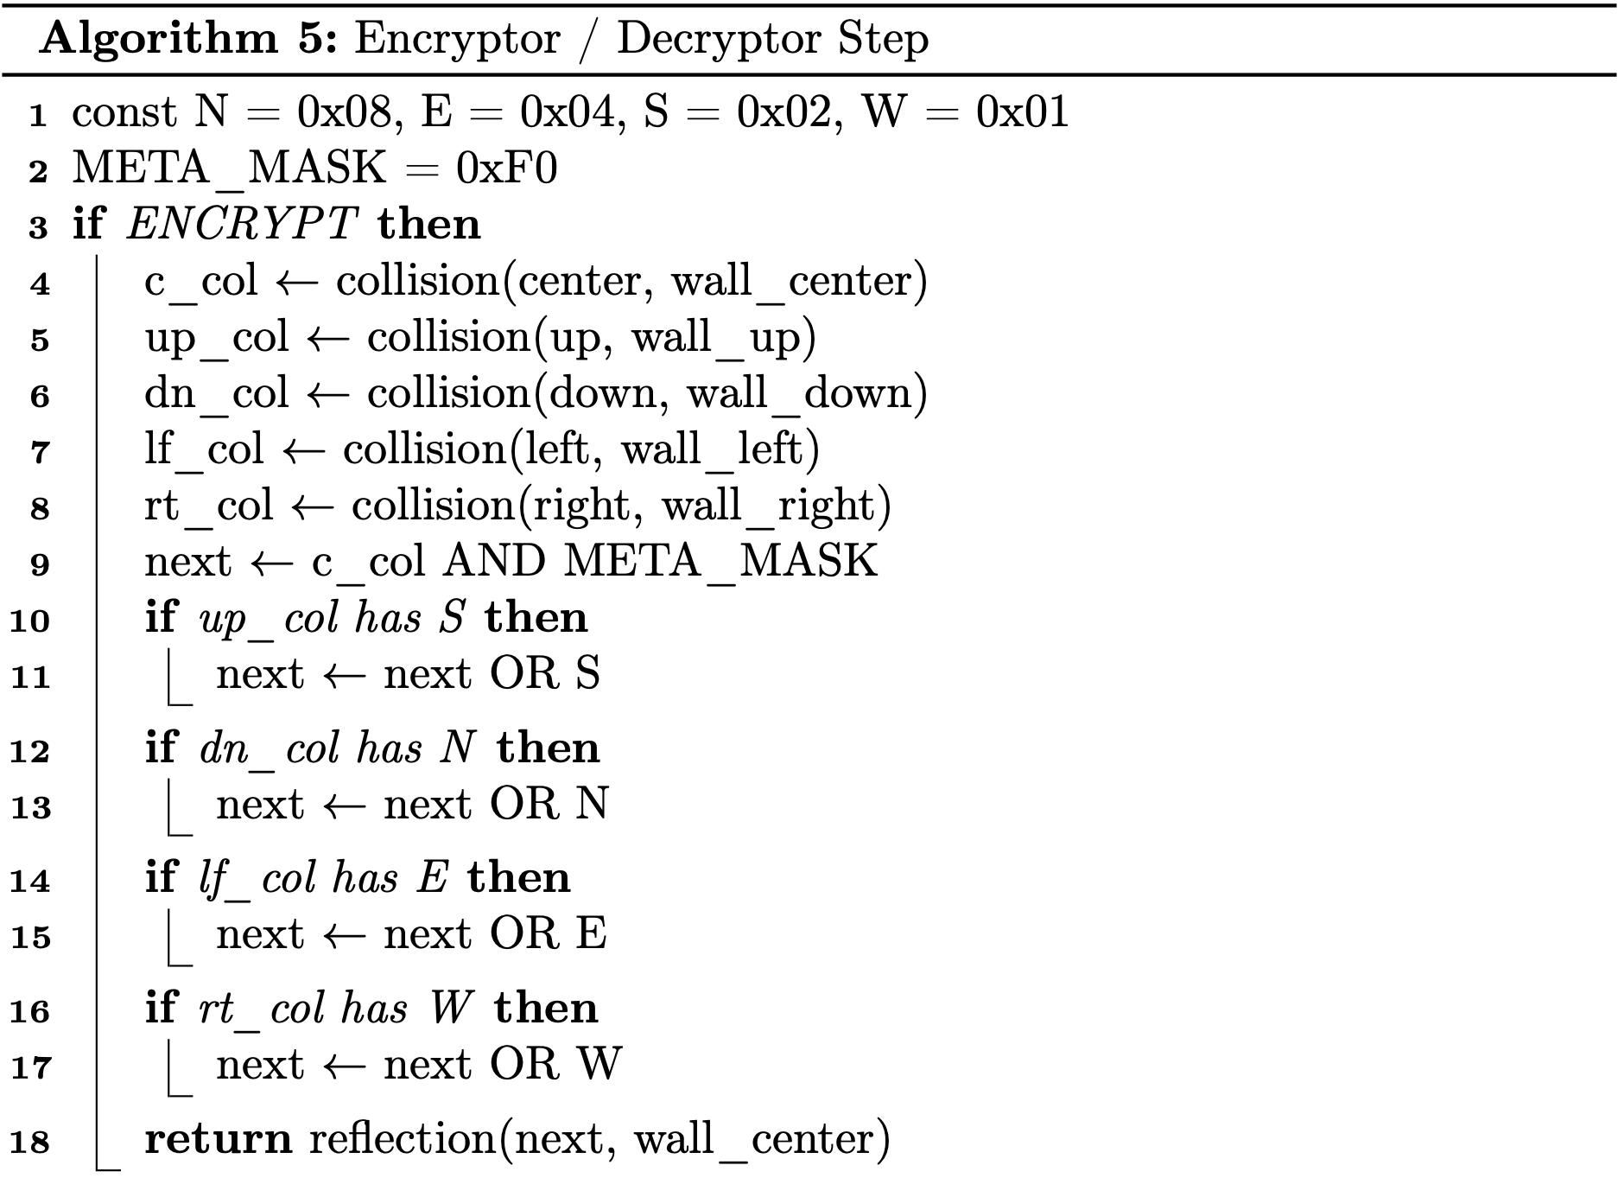
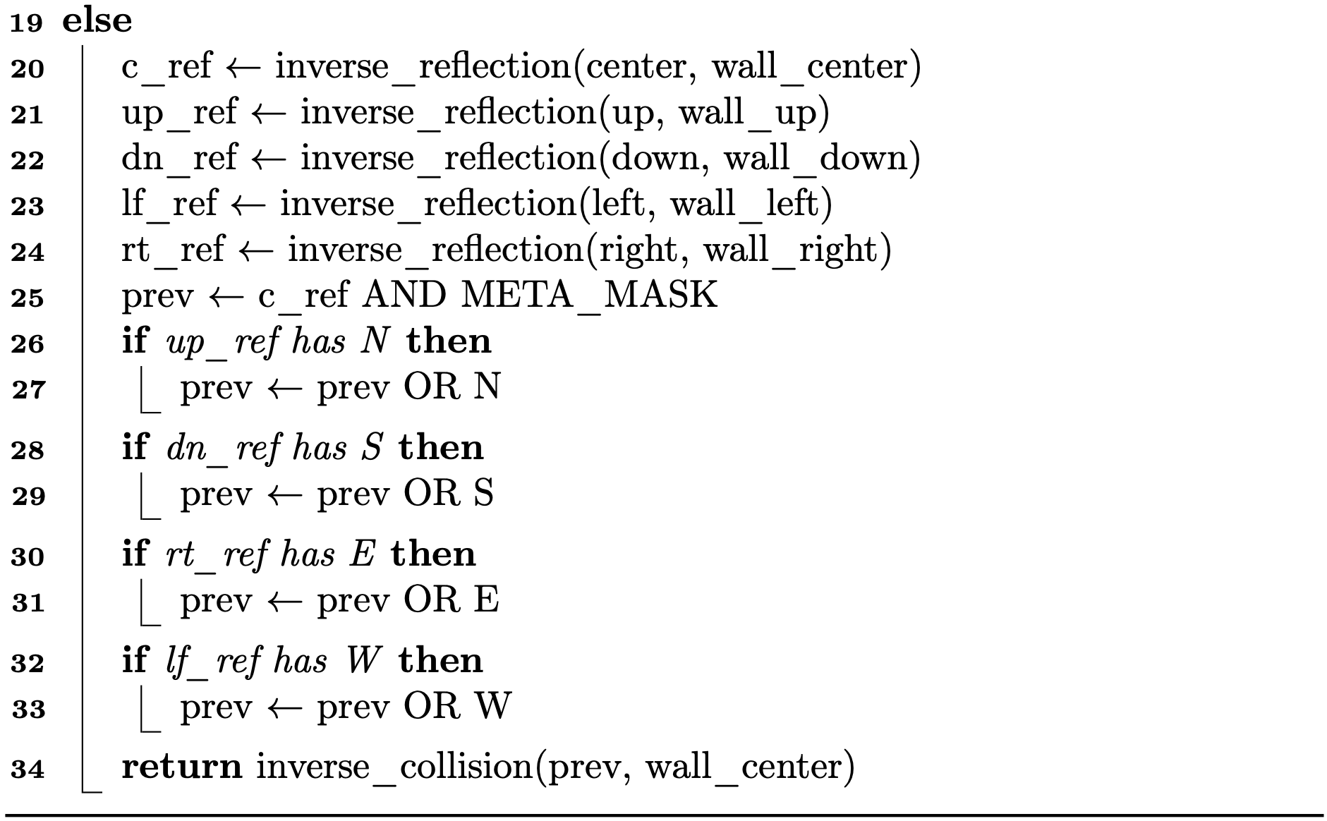
Encryptor/ Decryptor Pseudo-Code

Slide 23
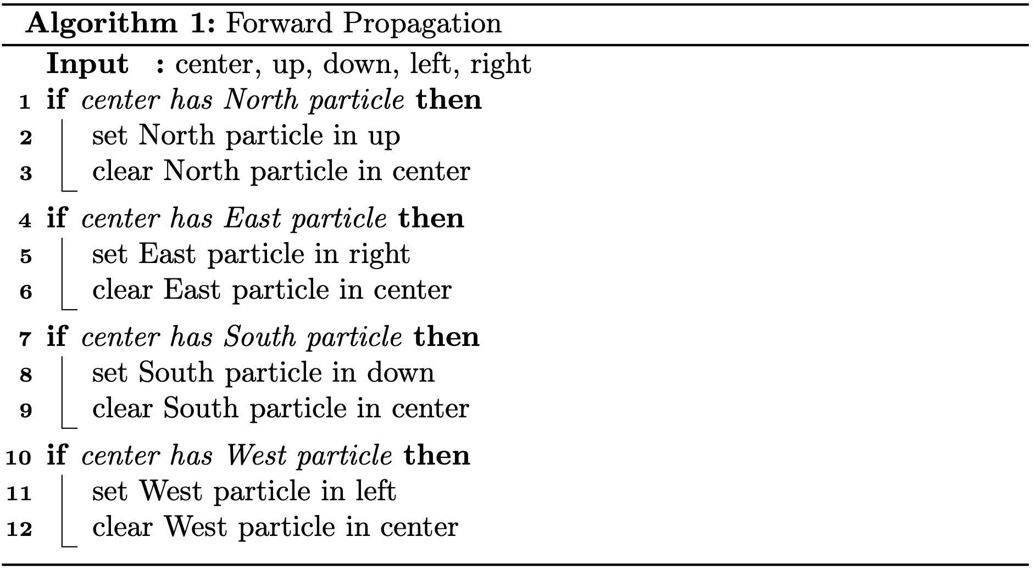
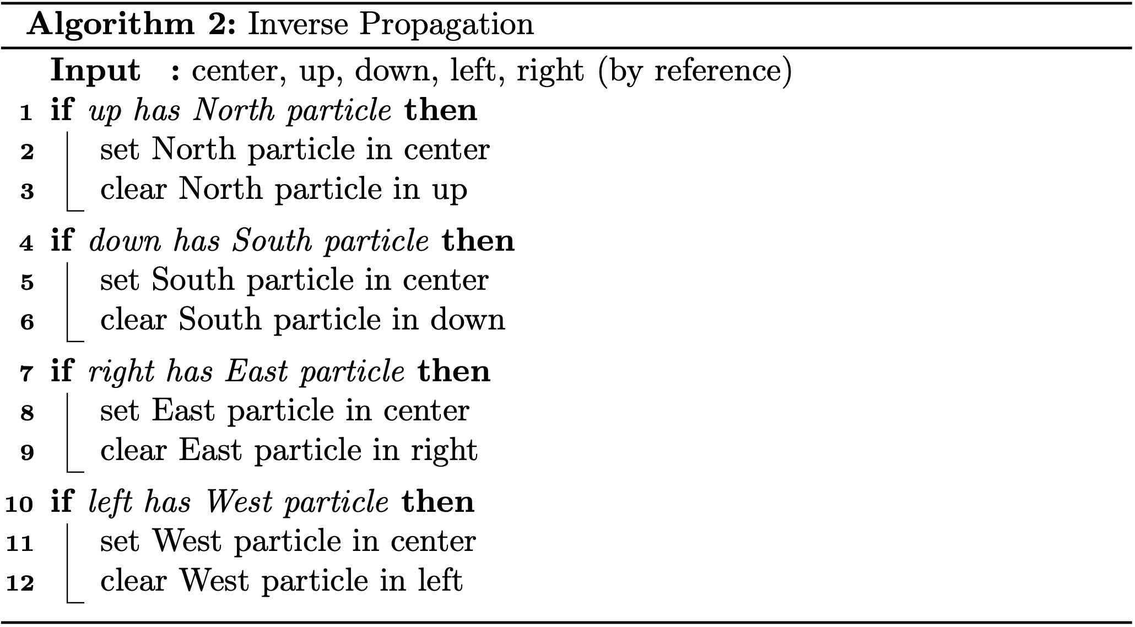
HPP-Rules Pseudo-Code
Propagation
Inverse propagation
Notes:
-! When implementing propagation for inverse run of the HPP (Decryption) → Separate definition of the rules - FORWARD: - Takes a look at the current/ center cell → If there is a North particle set the NORTH-BIT in the up neighbour to 1 → CLEAR the North bit in the center -INVERSE - Takes a look at the up neighbour → IF there is an North particle set the NORTH-BIT in the center to 1 → CLEAR the NORTH-BIT in the Up cell

Slide 24
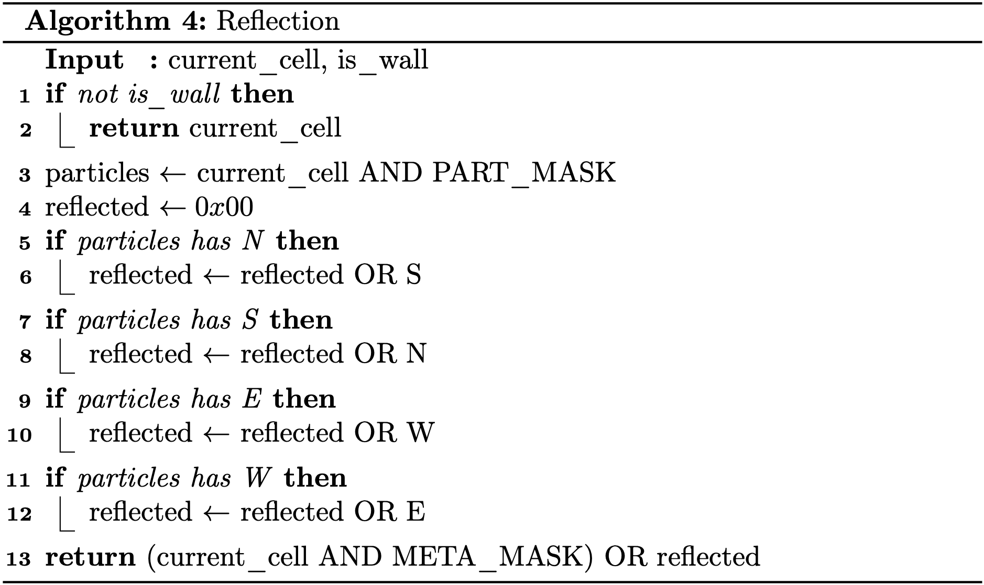
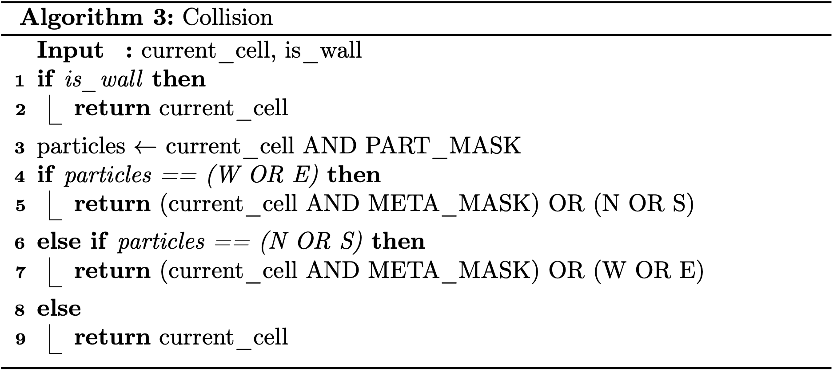
HPP-Rules Pseudo-Code
Reflection
Collision
Notes:
OR ensures that the other information inside the reflected cell (current cell) is not lost! - First North: reflected OR North (0000 OR 1000) = reflected (1000)
- Second South: reflected OR South(1000 OR 0010) = reflected (1010) ! MeTAMASK are the 4 HIGH-BITS → AND METAMASK basicly transfers the High-bits into the collided or reflected new cell) Same goes for Collision W OR E = 0001 OR 0100 => 01010
IF 1101 == (0100 OR 0001) => 1101 == 0101 => FALSE

Slide 25

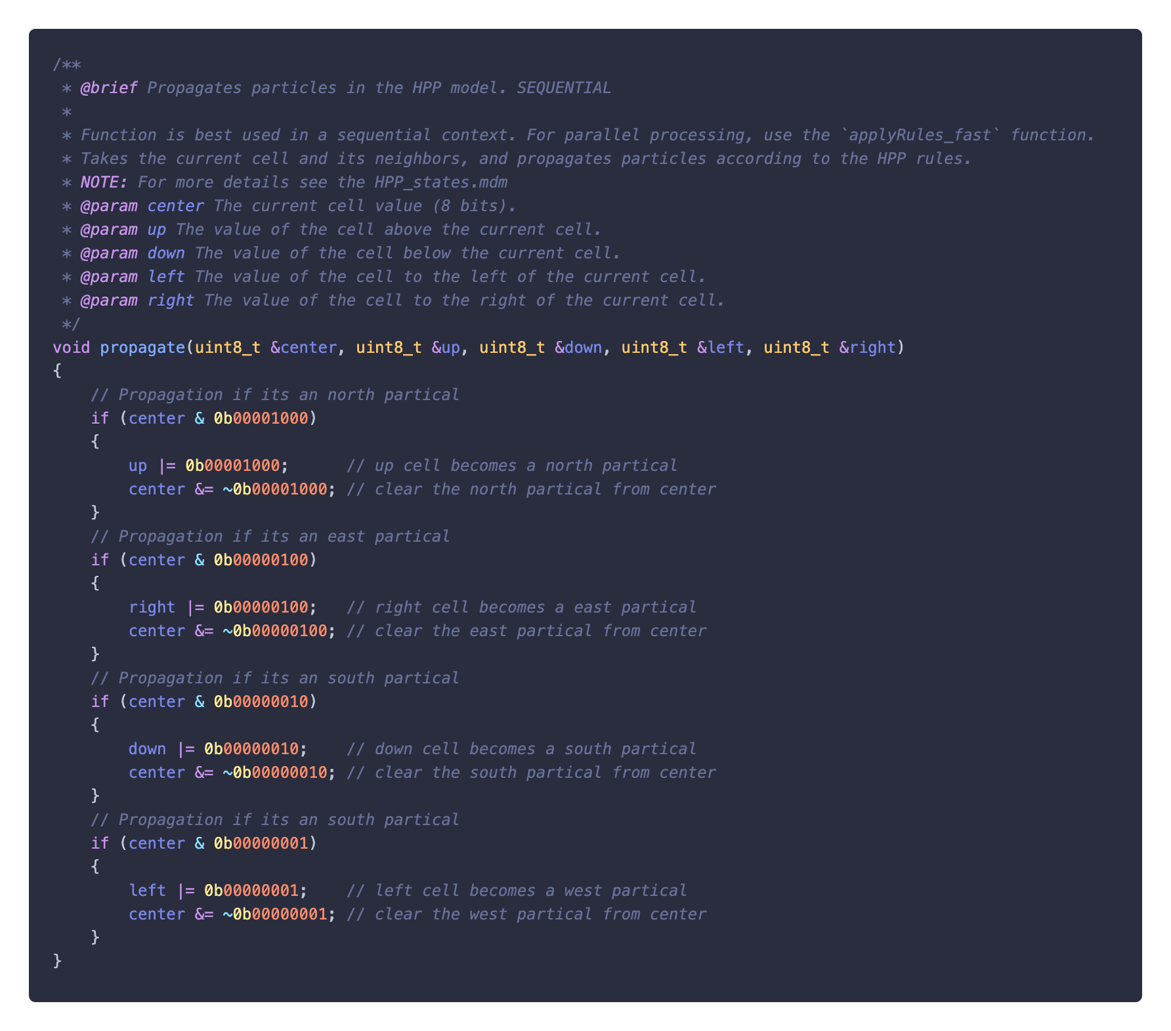
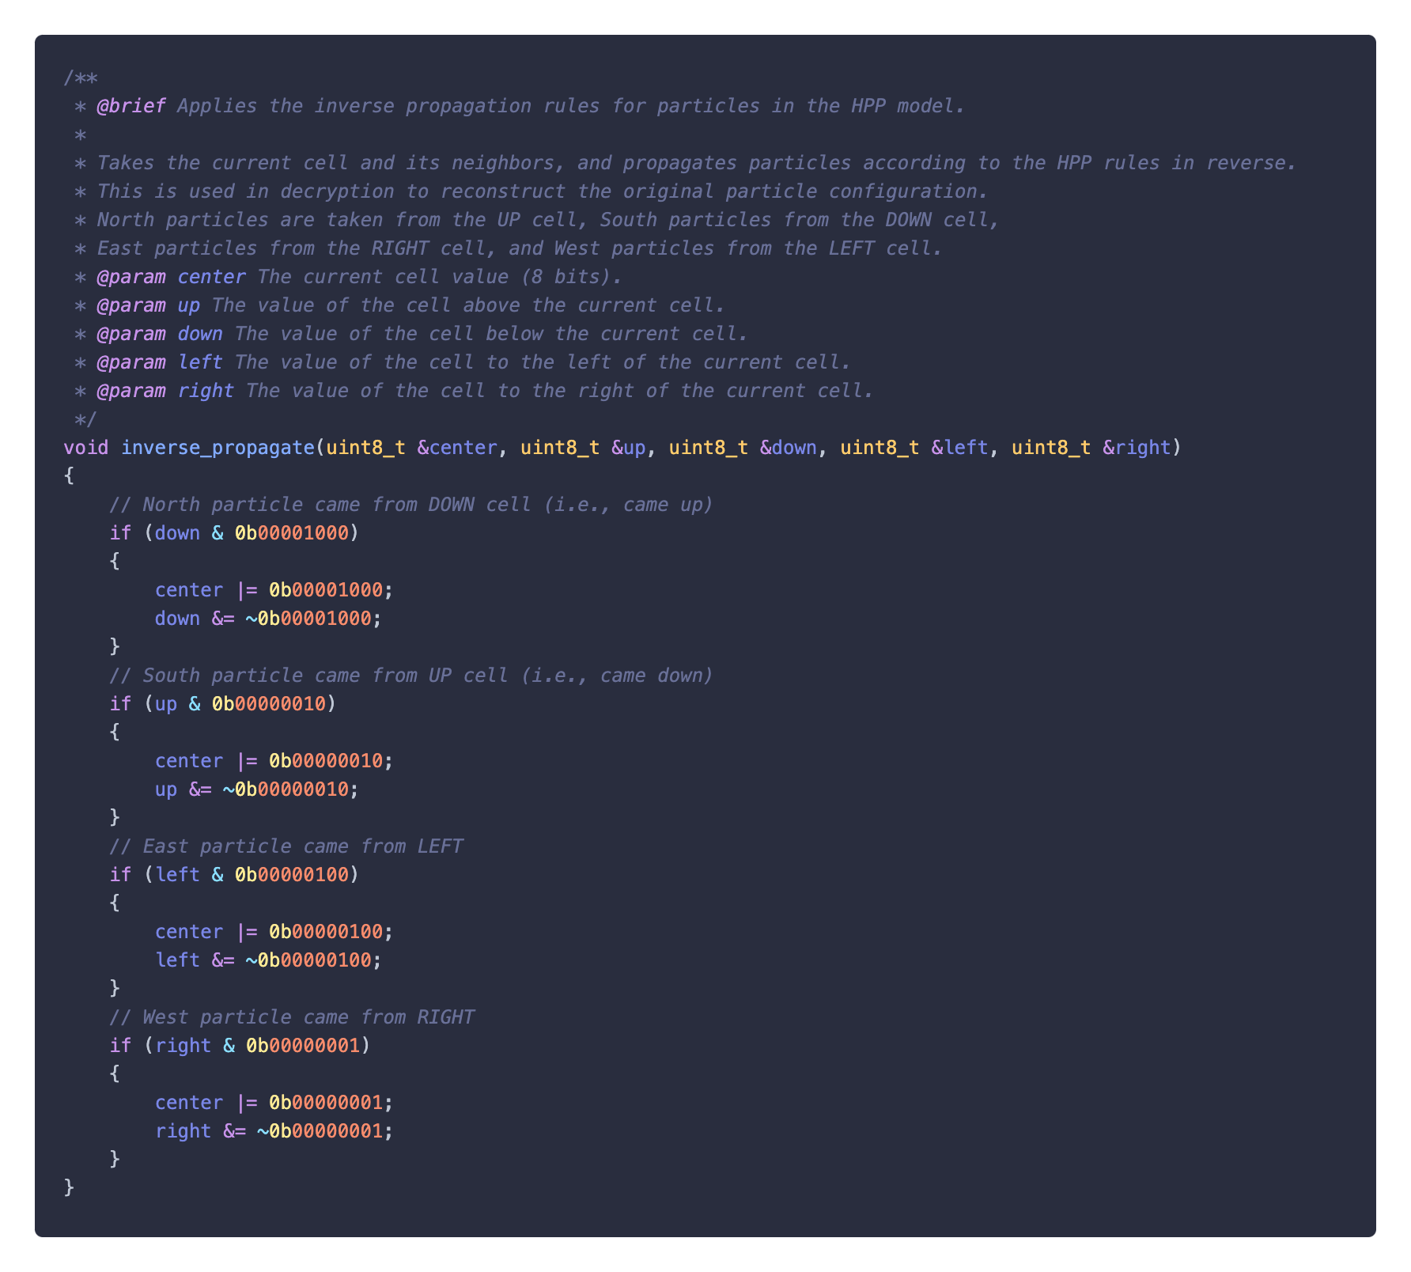
HPP-Rules Implementation
Propagation
Inverse propagation

Slide 26
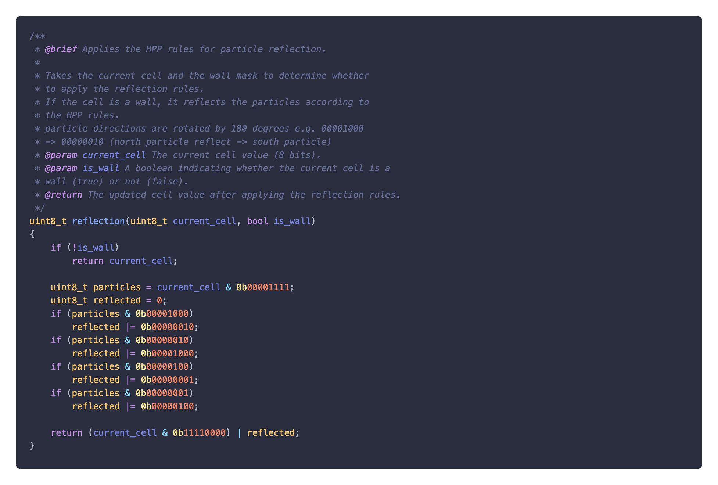
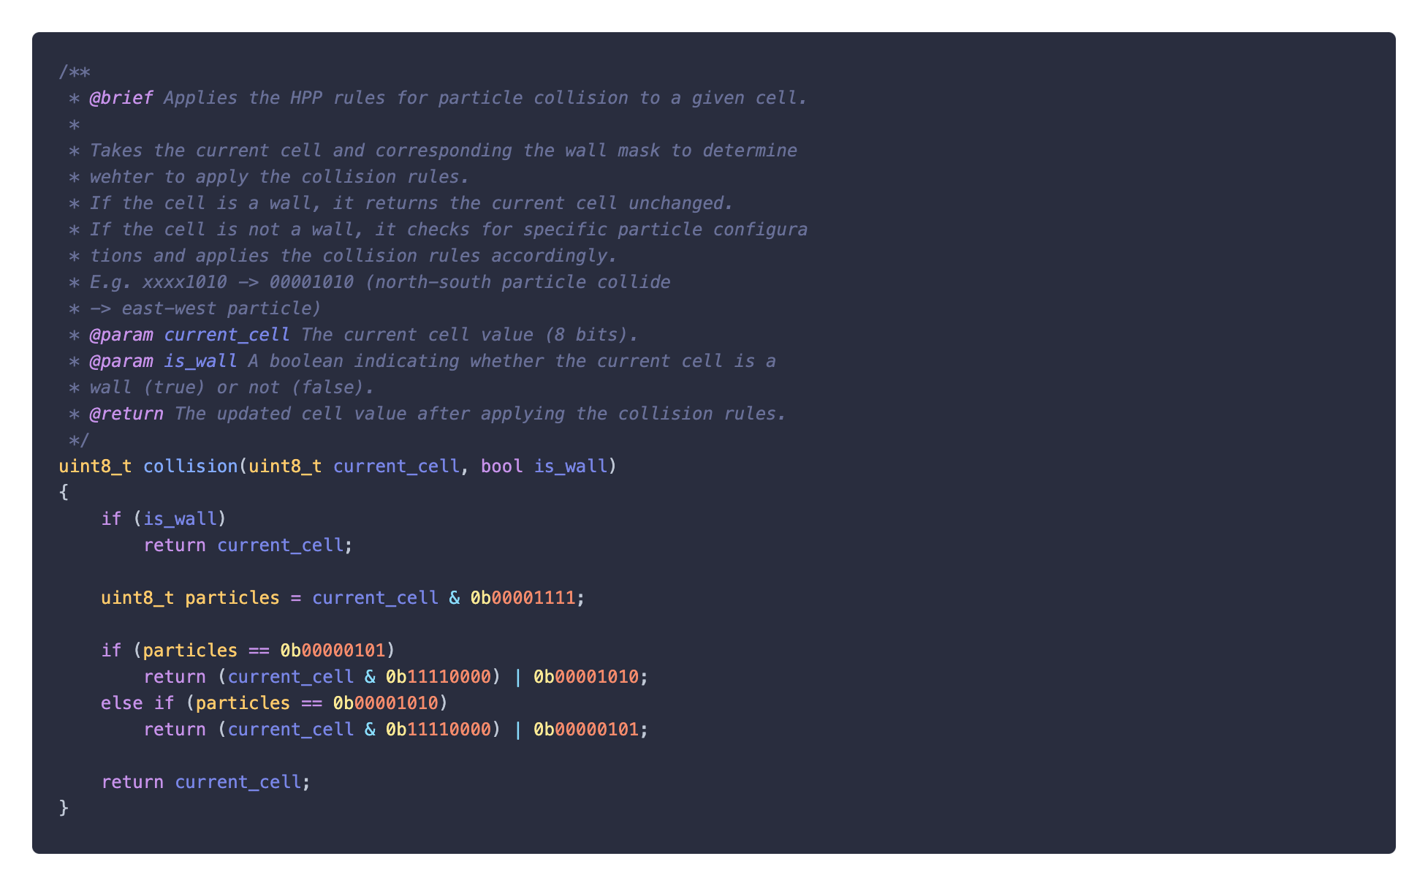
HPP-Rules Implementation
Reflection
Collision

Slide 27
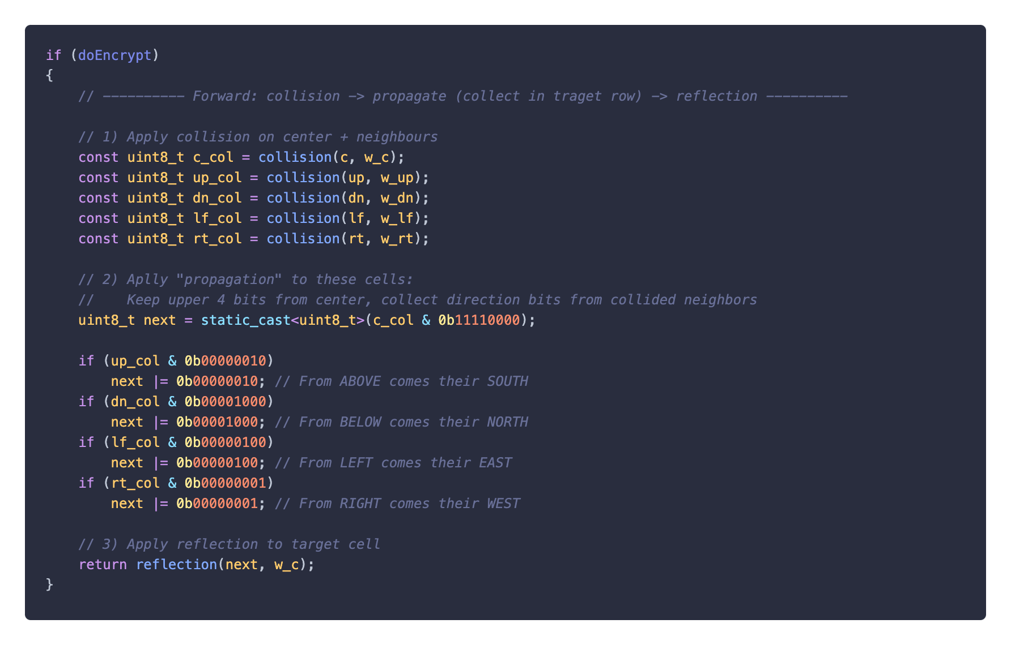
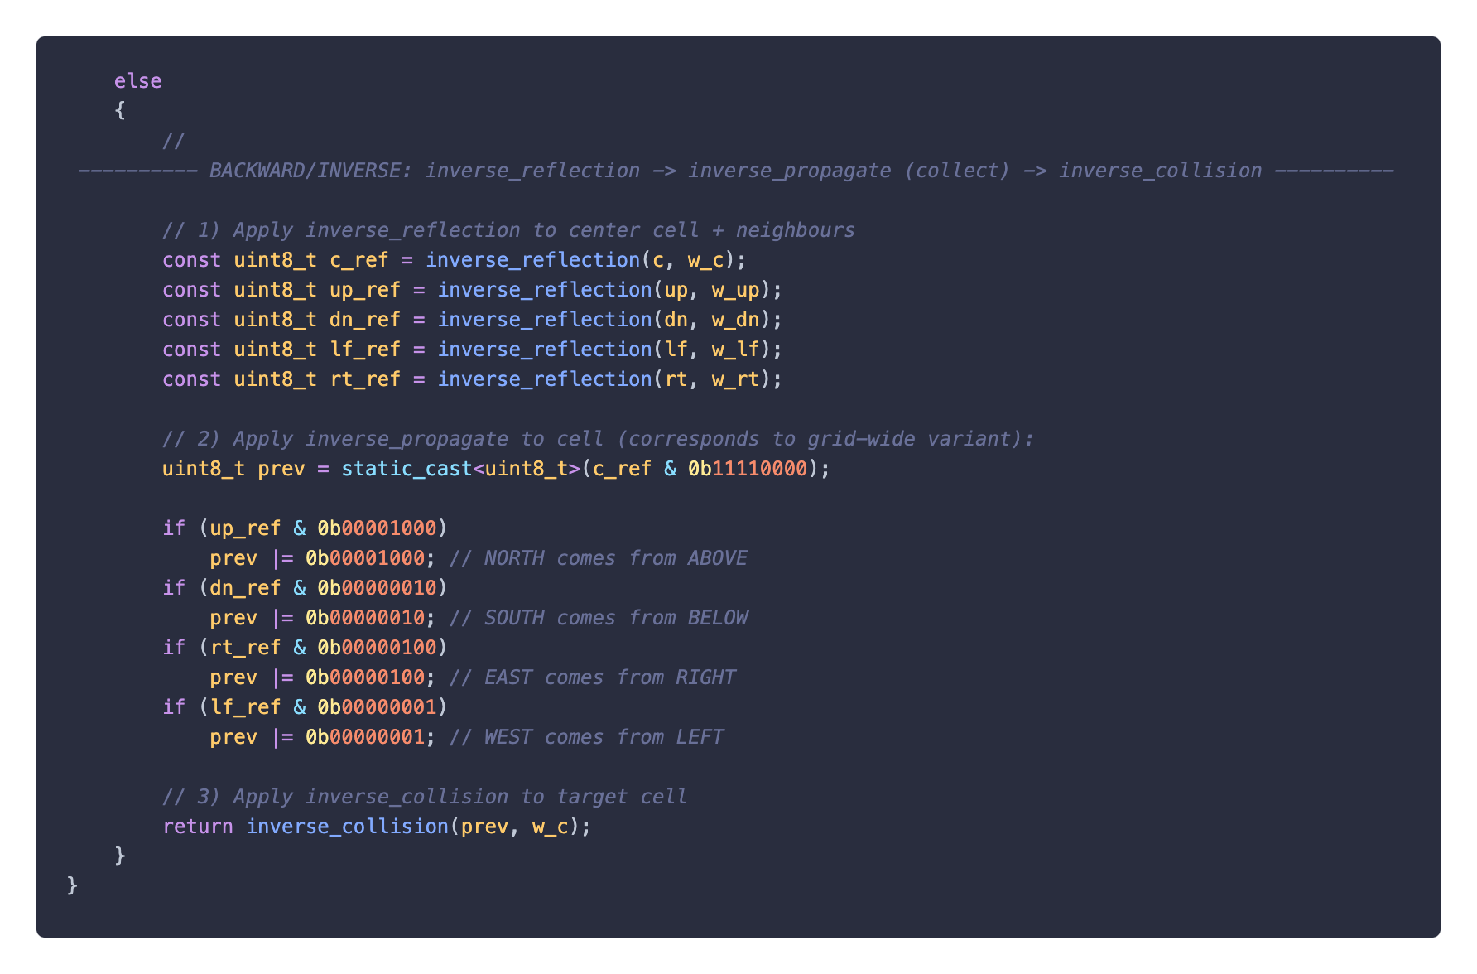
HPP-Encryption/Decryption Implementation
Encryption
Decryption

Slide 28
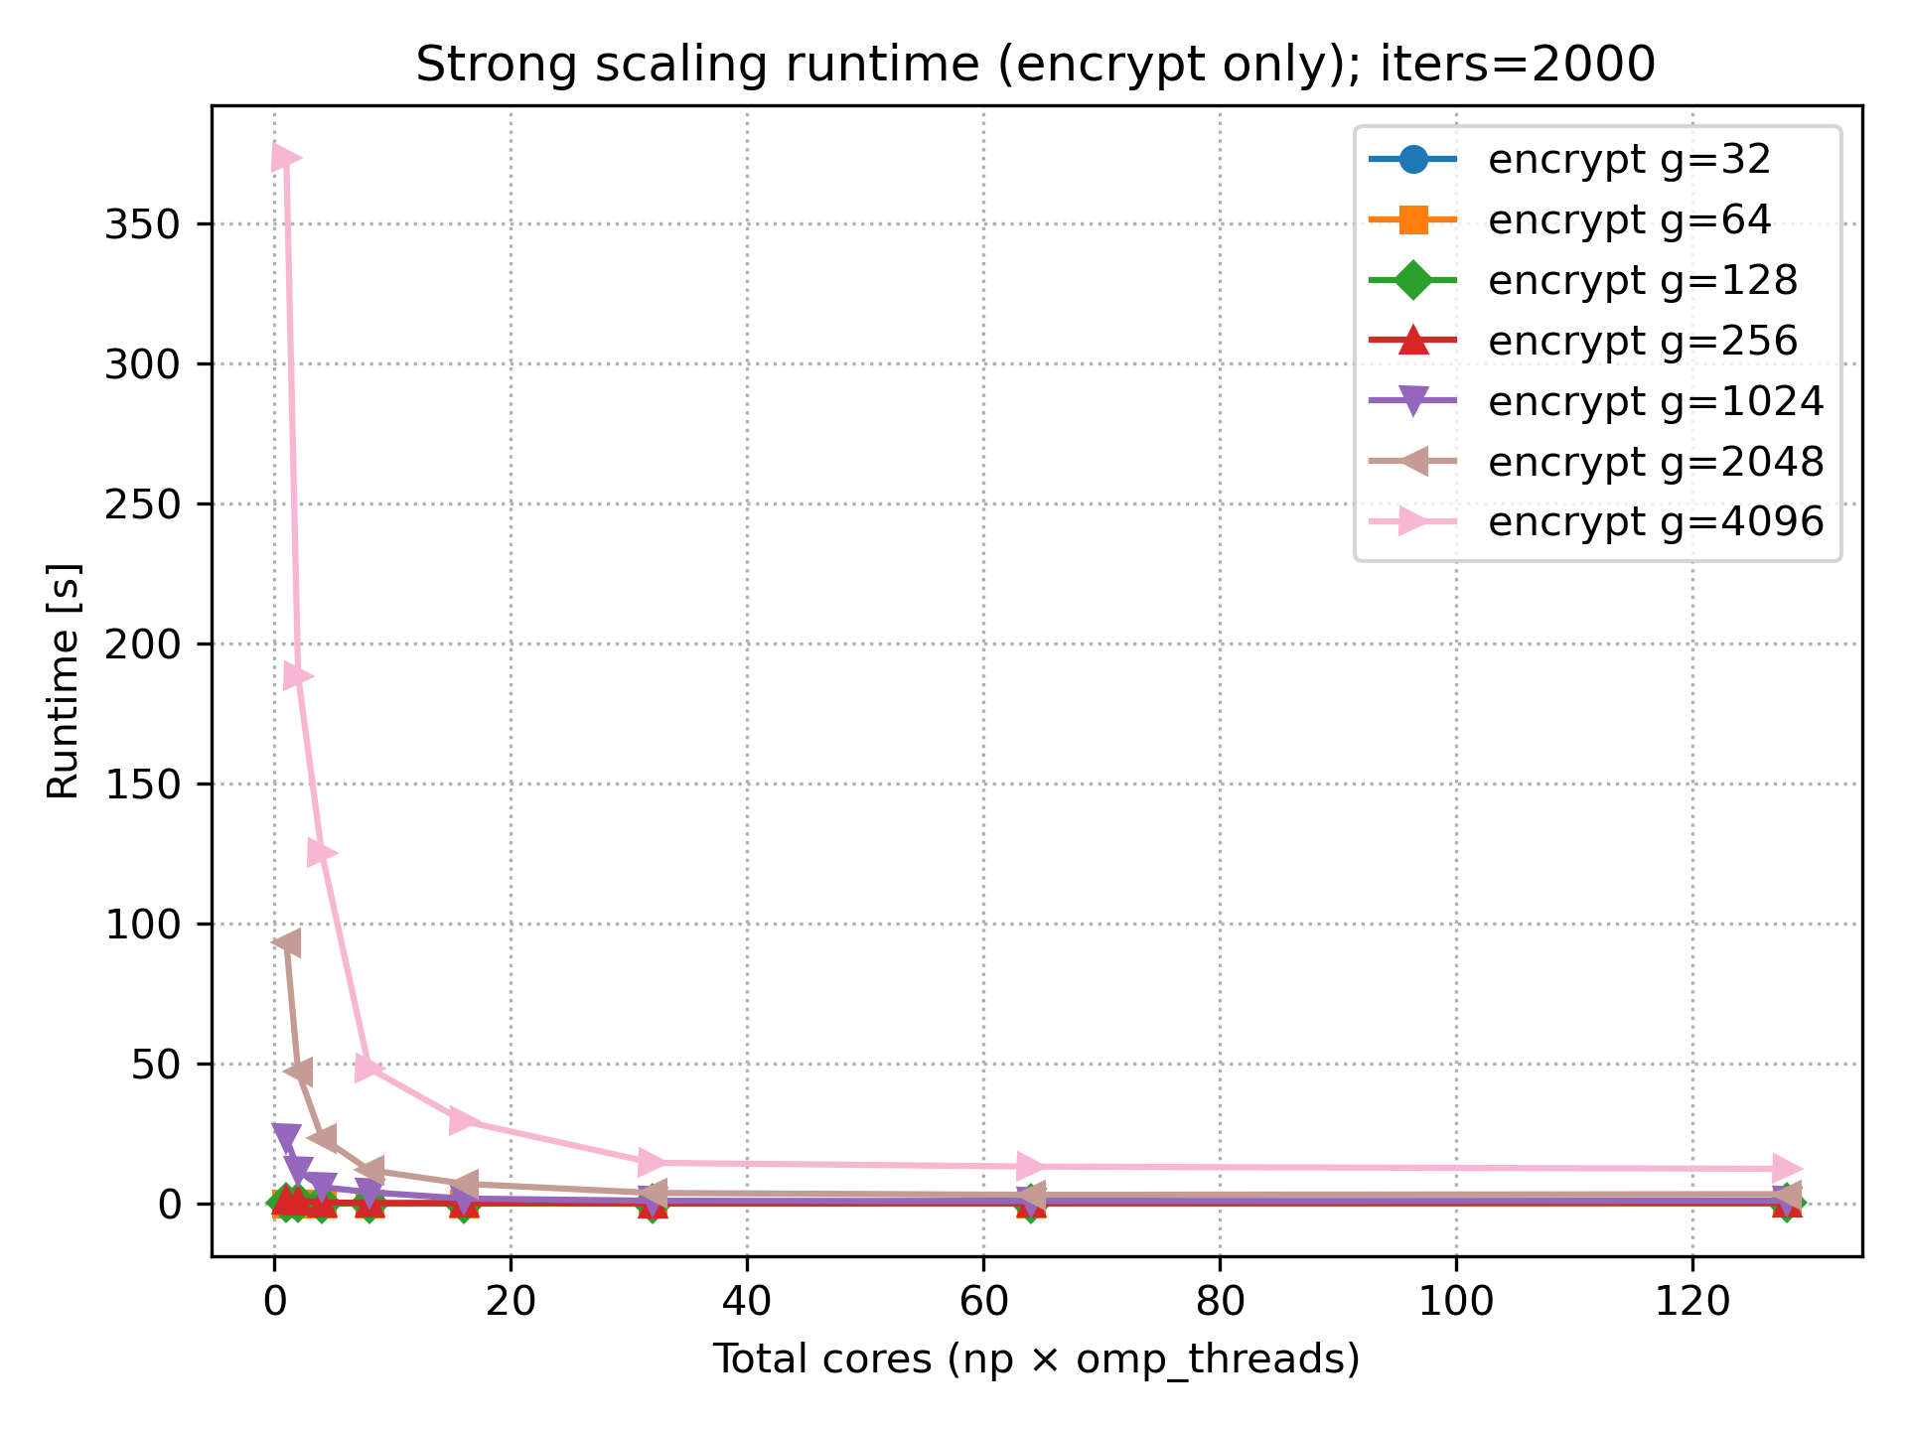
Results – Scaling runtime

