Slide 1
Handwritten Digit Recognition

Slide 2
Problem
How can you make a computer recognize single handwritten digits?
(Pictures from MNIST-database; [1])

Slide 3
Problem
‚Basic‘ Approach: Using Image processing for detection of special features: edges, corners, angles, etc.
For example: This features might be detected and their relative positioning and alignment to each other might me used for classification
(possible outcome of SIFT-features; [2])

Slide 4
Problem
But what if a 5 looks like that:
It‘s very difficult (you might even say impossible) to create a set of rules, which define the concept of a 5

Slide 5
Introduction
Is there a possibility to make a program understand the concept of given data itself?
→ Yes, there is!
Machine Learning Algorithms
Used Here: Artificial Neural Network (NN)
[3]

Slide 6
Excursion: NN
Inspired by the brain: A huge amount of simple computing units (brain-cells/neurons) heavily interconnected (synapses)
Impressively good at classification, learning and memory; rather bad at precise computation
[4]

Slide 7
Excursion: NN
Concept of a single (artificial) neuron:
A number of inputs, each multiplicated with a special weight, are added up in the neuron
If the sum reaches a special value, the neuron is being activated and ‚fires‘ a signal

Slide 8










Excursion: NN
Concept of a single (artificial) neuron: Example
$$0$$
$$0.5$$
∑
1
$$0$$
$$0$$
$$0.5$$
$$0$$
$$0.5$$
∑
1
$$0$$
$$1$$
$$0.5$$

Slide 9










Excursion: NN
$$1$$
$$0.5$$
∑
1
$$0$$
$$0$$
$$0.5$$
$$1$$
$$0.5$$
∑
1
$$1$$
$$1$$
$$0.5$$

Slide 10
Excursion: NN
Input 1 | Input 2 | Output
0 | 0 | 0
0 | 1 | 0
1 | 0 | 0
1 | 1 | 1
Input 2
1
0
1
0
0
Input 1
1
The weights define this line
(boolean AND)

Slide 11
Excursion: NN
A single neuron can‘t handle XOR
Multiple neurons in several layers can handle much more complex problems
1
1
0
0
1
1

Slide 12
Excursion: NN
How are the weights chosen, to solve a problem?
→ put in data example
→ measure error at output(s)
→ adapt weights to reduce error
Error
weights
(n-dimensional)

Slide 13
Methods
MNIST-database-files contain 1000 pictures of a single digit
Each picture is 28x28 pixels; greyscale
For input pixels are put in row
Creating a vector of 1x784
Pixel-values are normalized to be between 0 and 1

Slide 14
Methods
784 inputs (+bias input) are fully connected to 10 output neurons, representing the 10 different digits (0, …, 9)
0
0
0
.
.
.
0
1
→ input image is a 4
0
0
0
0
0

Slide 15
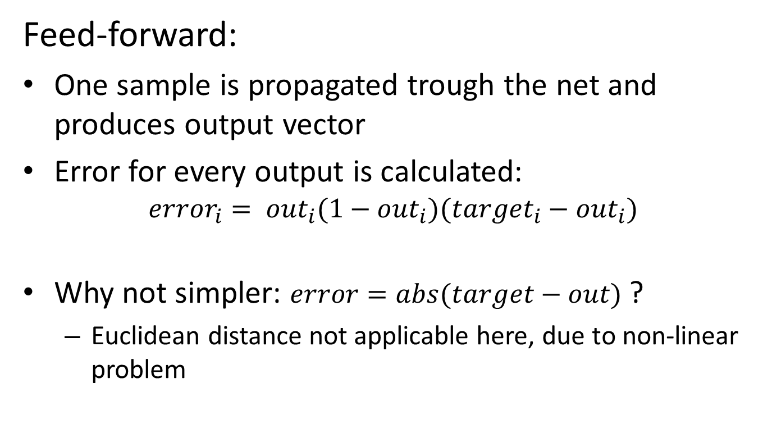
Methods
Feed-forward:
One sample is propagated trough the net and produces output vector
Error for every output is calculated: ${error}_{i}= {out}_{i}(1−{out}_{i})({target}_{i}−{out}_{i})$
Why not simpler: $error=abs(target−out)$ ?
Euclidean distance not applicable here, due to non-linear problem

Slide 16
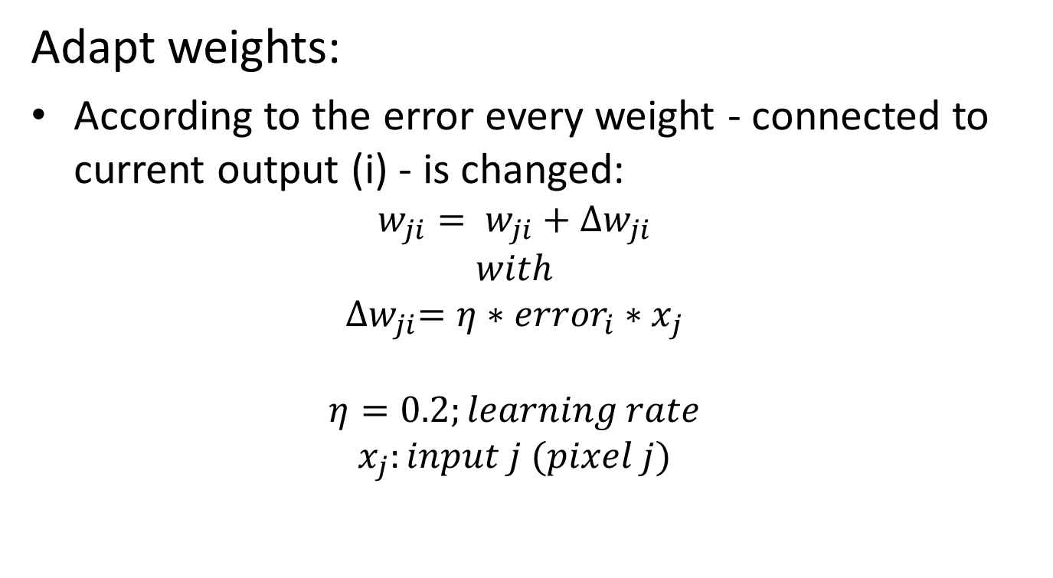
Methods
Adapt weights:
According to the error every weight - connected to current output (i) - is changed: $w_{ji}= w_{ji}+{∆w}_{ji}$ $with$ ${∆w}_{ji}=η∗{error}_{i}∗x_{j}$ $η=0.2;learning rate$ $x_{j}:input j (pixel j)$

Slide 17
Methods
After a few thousand examples the network learned the ‚concept‘ of handwritten digits
Now the outcomes should be tested:
Loading picture of digit, written by student
Scaling picture to 28x28
Apply threshold → binary image
Invert colors: now white on black
Put through network; see results

Slide 18
Methods

Slide 19
Methods

Slide 20
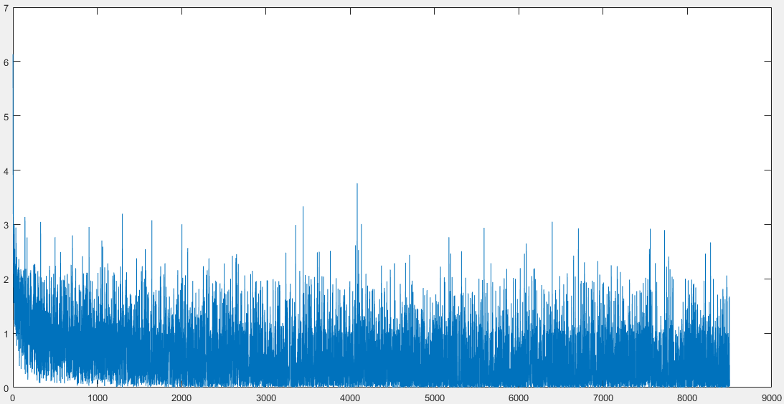
Results so far
Small demo

Slide 21
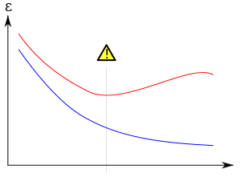
To be implemented
Using testing data
Show overfitting
Cancel learning process
Taking picture of a student writing a digit, scale and process it to be put into learning algorithm

Slide 22
Sources
[1] http://yann.lecun.com/exdb/mnist/
[2] https://en.wikipedia.org/wiki/Scale-invariant_feature_transform
[3] https://en.wikipedia.org/wiki/Machine_learning
[4] https://en.wikipedia.org/wiki/Brain#Cellular_structure

