Slide 1
Handwritten Digit Recognition

Slide 2
Problem
We want to make a computer learn to distinguish handwritten digits like the following:
(Pictures from MNIST-database; [1])

Slide 3
Problem
Basic Approach: Using Image processing for detection of special features: edges, corners, angles, etc.
For example: This features might be detected and their relative positioning and alignment to each other might me used for classification
(possible outcome of SIFT-features; [2])

Slide 4
Problem
There are more unusual types of handwriting:
It‘s very difficult (you might say impossible) to create a set of rules, which define the concept of a digit, e.g. a ‘5’

Slide 5
Introduction
As the definition of concepts for digits is rather complicated, we decided to use a learning algorithm: A Multilayer-feedforward Neural Network
[3]

Slide 6
Neural Network
Concept of a single (artificial) neuron:
A number of inputs, each multiplied with a special weight, are added up in the neuron
If the sum reaches a special value, the neuron is being activated and ‚fires‘ a signal
For more complex problems multiple Neurons are used in several layers
→ Network of Neurons

Slide 7
Methods
784 inputs (+bias input) are fully connected to 10 output neurons, representing the 10 different digits (0, …, 9)
0
0
0
.
.
.
0
1
→ input image is a 4
0
0
0
0
0

Slide 8
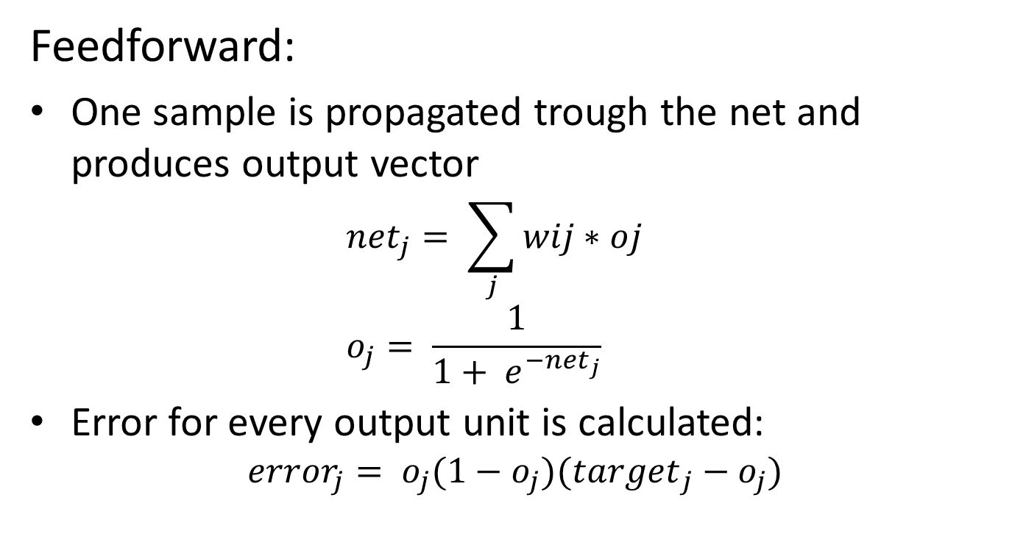
Methods
Feedforward:
One sample is propagated trough the net and produces output vector ${net}_{j}= \sum_{j}{wij∗oj}$ $o_{j}= \frac{1}{1+ e^{{−net}_{j}}}$
Error for every output unit is calculated: ${error}_{j}= o_{j}(1−o_{j})({target}_{j}−o_{j})$

Slide 9
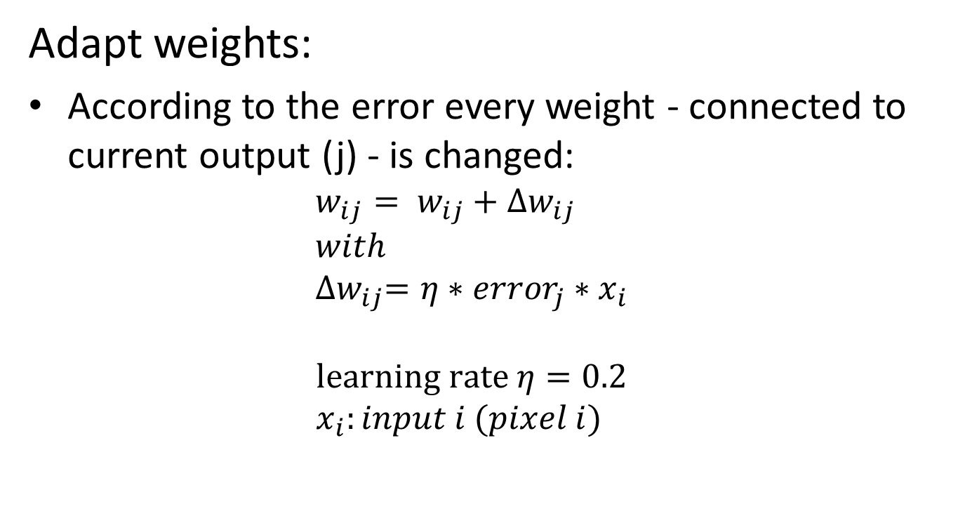
Methods
Adapt weights:
According to the error every weight - connected to current output (j) - is changed: $w_{ij}= w_{ij}+{∆w}_{ij}$ $with$ ${∆w}_{ij}=η∗{error}_{j}∗x_{i}$ $learning rate η=0.2$ $x_{i}:input i (pixel i)$
[7]

Slide 10
Methods
After a few thousand examples the network learned the ‚concept‘ of handwritten digits
For verifying results a set of data was left untouched

Slide 11
Materials
MNIST-database-files contain 1000 pictures of a single digit
Each picture is 28x28 pixels; greyscale
For input pixels are put in row
Creating a vector of 1x784
Pixel-values are normalized to be between 0 and 1

Slide 12










Verification
Picture | Classification | Certainty
 | 0 | 0.9990
 | 1 | 0.9309
 | 2 | 0.9997
 | 3 | 0.1275
 | 4 | 0.6142
 | 5 | 0.2406
 | 6 | 0.9956
 | 7 | 0.8898
 | 8 | 0.7294
 | 9 | 0.9750

Slide 13
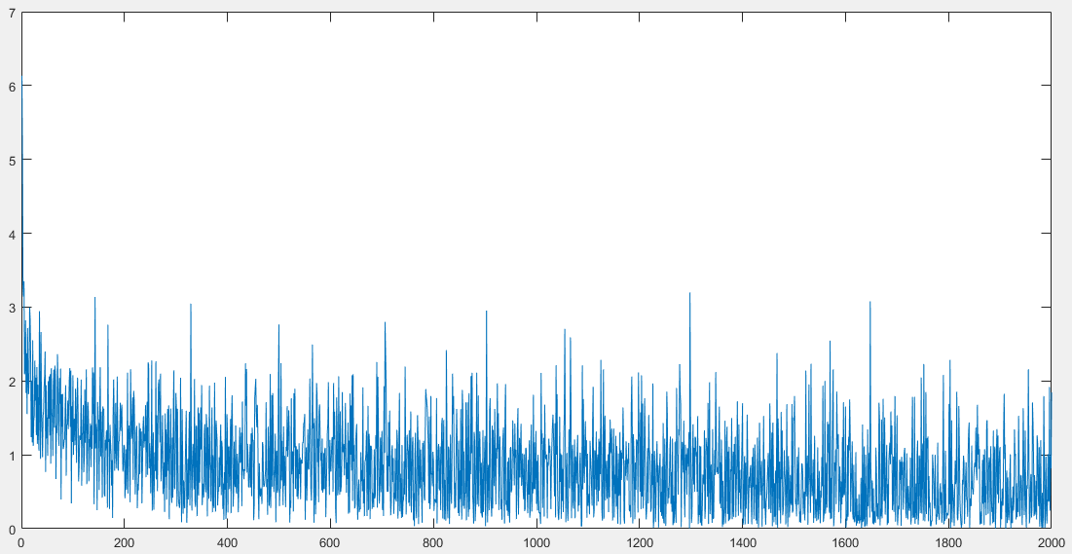
Results
Error-Plot

Slide 14
Discussion
Accuracy of classification: 85.60 %
Rather bad, compared to other works with MNIST database
Reference | Classifier | Accuracy
[9] | Support Vector Machine | 99.44%
[10] | Combination of convolutional Neural Networks | 99.73%
[11] | Combination of convolutional Neural Networks | 99.77%
[12] | Perceptron | 99.37%
[8]

Slide 15
Sources
[1] http://yann.lecun.com/exdb/mnist/
[2] https://en.wikipedia.org/wiki/Scale-invariant_feature_transform
[3] https://en.wikipedia.org/wiki/Machine_learning
[4] https://en.wikipedia.org/wiki/Brain#Cellular_structure
[5] http://www.mind.ilstu.edu/curriculum/mcp_neurons/mcp_neuron_1.php
[6] http://www.webpages.ttu.edu/dleverin/neural_network/neural_networks.html
[7] Tom M. Mitchell, Machine Learning, McGraw Hill, ISBN 0-07-115467-1
[8] Mendes, Filho, Costa: Handwritten Digit Recognition Using SVM Binary Classifiers and Unbalanced Decision Trees, Springer International Publishing Switzerland 2014; Brazil
[9] Decoste, D., Schölkopf, B.: Training Invariant Support Vector Machines. Kluwer Academic Publishers, The Netherlands (2002) [10] Ciresan, D.C., Meier, U., Gambardella, L.M., Schmidhuber, J.: Convolutional Neural Network Committees for Handwritten Character Classification. In: International Conference on Document Analysis and Recognition (ICDAR), pp. 1135 –1139 (2011)
[11] Ciresan, D., Meier, U., Schmidhuber, J.: Multi-column Deep Neural Networks for Image Classification. Dalle Molle Institute for Artificial Intelligence. IDSIA/USI-SUPSI, Manno, Switzerland (2012) [12] Kussul, E., Baidyk, T.: Improved method of handwritten digit recognition tested on MNIST database. In: 15th International Conference on Vision Interface, vol. 22, pp. 971–981 (2004)

