Slide 1
Handwritten Digit Recognition

Slide 2
Problem
How can you make a computer recognize single handwritten digits?
(Pictures from MNIST-database; [1])

Slide 3
Problem
‚Basic‘ Approach: Using Image processing for detection of special features: edges, corners, angles, etc.
For example: This features might be detected and their relative positioning and alignment to each other might me used for classification
(possible outcome of SIFT-features; [2])

Slide 4
Problem
But what if a 5 looks like that:
It‘s very difficult (you might even say impossible) to create a set of rules, which define the concept of a 5

Slide 5
Introduction
Is there a possibility to make a program understand the concept of given data itself?
→ Yes, there is!
Machine Learning Algorithms
Used Here: Artificial Neural Network (NN)
[3]

Slide 6
Excursion: NN
Inspired by the brain: A huge amount of simple computing units (brain-cells/neurons) heavily interconnected (synapses)
Impressively good at classification, learning and memory; rather bad at precise computation
[4]

Slide 7
Excursion: NN
Concept of a single (artificial) neuron:
A number of inputs, each multiplicated with a special weight, are added up in the neuron
If the sum reaches a special value, the neuron is being activated and ‚fires‘ a signal

Slide 8










Excursion: NN
Concept of a single (artificial) neuron: Example
$$0$$
$$0.5$$
∑
1
$$0$$
$$0$$
$$0.5$$
1
$$0$$
$$0.5$$
∑
1
$$0$$
$$1$$
1
$$0.5$$

Slide 9










Excursion: NN
$$1$$
$$0.5$$
∑
1
$$0$$
$$0$$
$$0.5$$
1
$$1$$
$$0.5$$
∑
1
$$1$$
$$1$$
1
$$0.5$$
[5]

Slide 10
Excursion: NN
Input 1 | Input 2 | Output
0 | 0 | 0
0 | 1 | 0
1 | 0 | 0
1 | 1 | 1
Input 2
1
0
1
0
0
Input 1
1
The weights define this line
(boolean AND)

Slide 11
Excursion: NN
A single neuron can‘t handle XOR
Multiple neurons in several layers can handle much more complex problems
1
1
0
0
1
1

Slide 12
Excursion: NN
How are the weights chosen, to solve a problem?
→ put in data example
→ measure error at output(s)
→ adapt weights to reduce error
Error
weights
(n-dimensional)

Slide 13
Methods
MNIST-database-files contain 1000 pictures of a single digit
Each picture is 28x28 pixels; greyscale
For input pixels are put in row
Creating a vector of 1x784
Pixel-values are normalized to be between 0 and 1

Slide 14
Methods
784 inputs (+bias input) are fully connected to 10 output neurons, representing the 10 different digits (0, …, 9)
0
0
0
.
.
.
0
1
→ input image is a 4
0
0
0
0
0

Slide 15
Methods
Bias Unit:
„The use of biases in a neural network increases the capacity of the network to solve problems by allowing the hyperplanes that separate individual classes to be offset for superior positioning. “
[6]

Slide 16
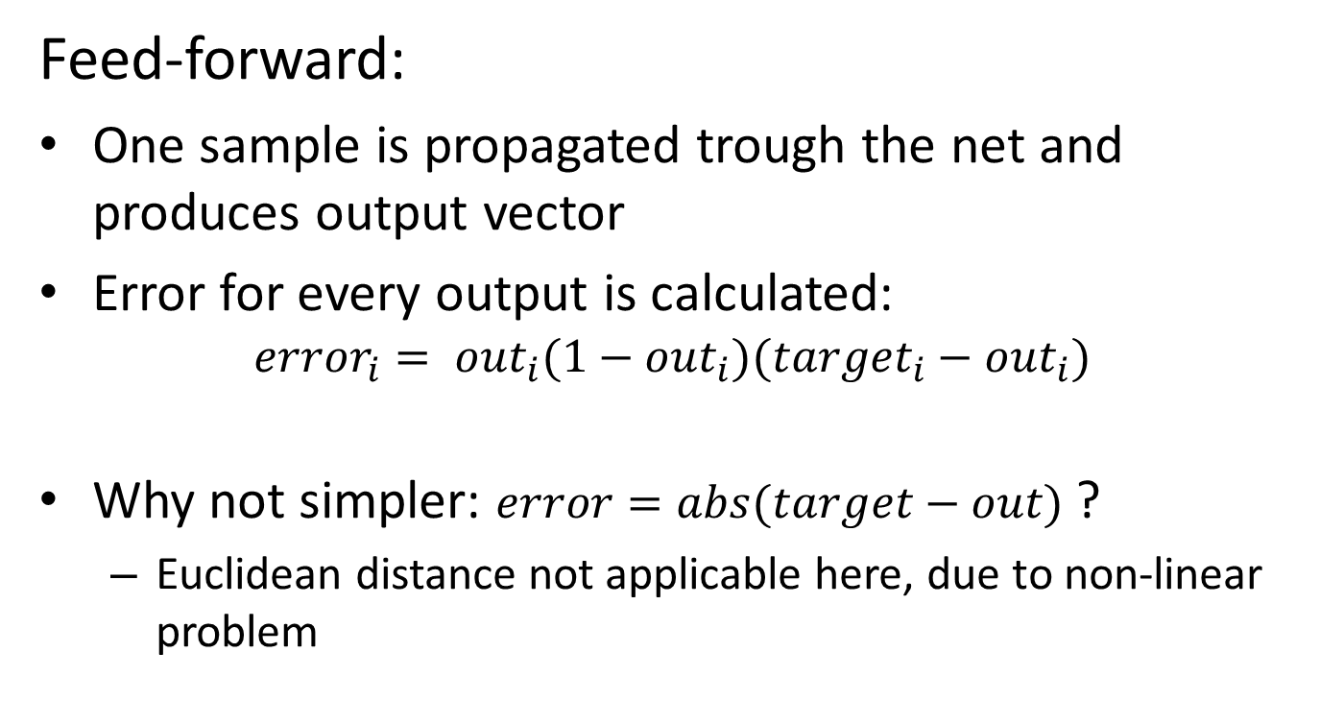
Methods
Feed-forward:
One sample is propagated trough the net and produces output vector
Error for every output is calculated: ${error}_{i}= {out}_{i}(1−{out}_{i})({target}_{i}−{out}_{i})$
Why not simpler: $error=abs(target−out)$ ?
Euclidean distance not applicable here, due to non-linear problem

Slide 17
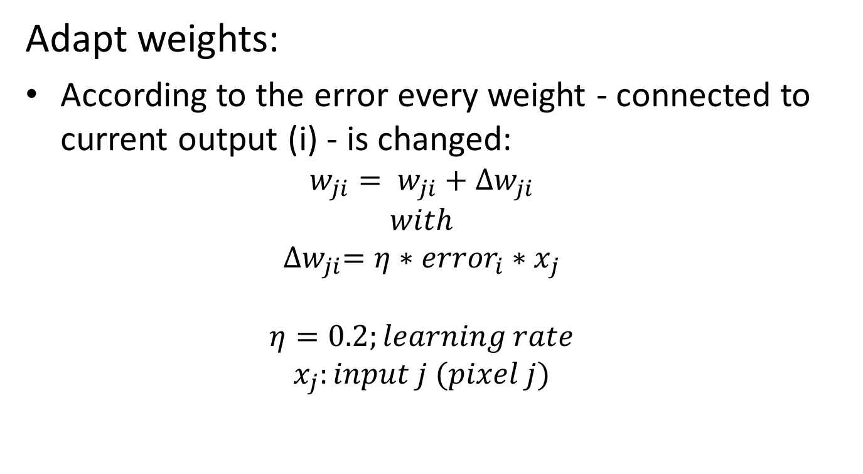
Methods
Adapt weights:
According to the error every weight - connected to current output (i) - is changed: $w_{ji}= w_{ji}+{∆w}_{ji}$ $with$ ${∆w}_{ji}=η∗{error}_{i}∗x_{j}$ $η=0.2;learning rate$ $x_{j}:input j (pixel j)$
[7]

Slide 18

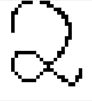

Methods
After a few thousand examples the network learned the ‚concept‘ of handwritten digits
Now the outcomes should be tested:
Loading picture of digit, written by student
Scaling picture to 28x28
Apply threshold → binary image
Invert colors: now white on black
Put through network; see results

Slide 19
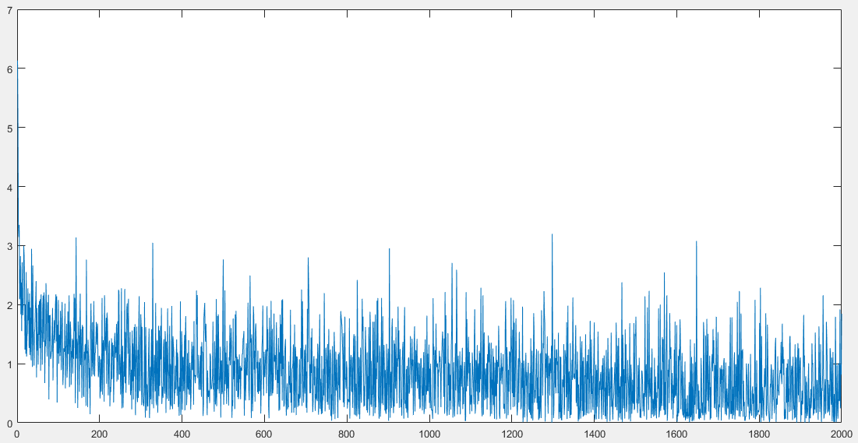
Results
Error-Plot

Slide 20










Results
Picture | Classification | Certainty
 | 0 | 0.9990
 | 1 | 0.9309
 | 2 | 0.9997
 | 3 | 0.1275
 | 4 | 0.6142
 | 5 | 0.2406
 | 6 | 0.9956
 | 7 | 0.8898
 | 8 | 0.7294
 | 9 | 0.9750

Slide 21
Not implemented
Using Test-Data
Adding complexity to code
Unsatisfying results
Concept is hard to understand (learning theory)
Add source here

Slide 22
Summary
Training with only 2000 samples shows good learning behavior (8500 planned)
Test-data doesn‘t show significant results
Verification satisfying
Working with actual photographs also shows good results

Slide 23
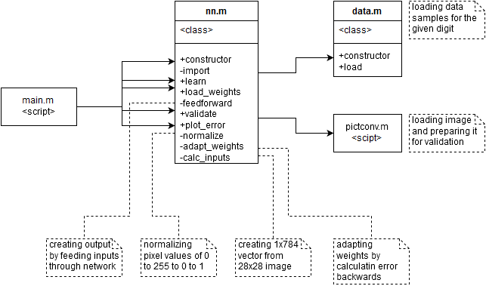
Code structure

Slide 24
matlab functions
randn -creating (array) of small random values; ca. between -4 and 4
squeeze - removing unnecessary array dimensions: 1x1x28x28 to 28x28
csvread - loading .csv file (comma-separated values)
ceil - rounding decimals up to next integer value: 0.3 -> 1
imread - loading image file and returning array
imresize - resizing image to given tuple
imcomplement - returns complement image (“negative”)
imshow - displays image
gray2ind - converts the binary image to grayscale
imwrite - writing image (array) to file

Slide 25
Sources
[1] http://yann.lecun.com/exdb/mnist/
[2] https://en.wikipedia.org/wiki/Scale-invariant_feature_transform
[3] https://en.wikipedia.org/wiki/Machine_learning
[4] https://en.wikipedia.org/wiki/Brain#Cellular_structure
[5] http://www.mind.ilstu.edu/curriculum/mcp_neurons/mcp_neuron_1.php
[6] http://www.webpages.ttu.edu/dleverin/neural_network/neural_networks.html
[7] Tom M. Mitchell, Machine Learning, McGraw Hill, ISBN 0-07-115467-1

