Slide 1


Slide 2

Outline
Problem Description and Data
Analysis
Conclusion

Slide 3
Problem Description
What characterizes a tweet that gets retweeted by many people?

Slide 4
Problem Description
What characterizes a tweet that gets retweeted by many people?

Slide 5

Successful Example
Souce: https://2012.twitter.com/en/golden-tweets.html

Slide 6
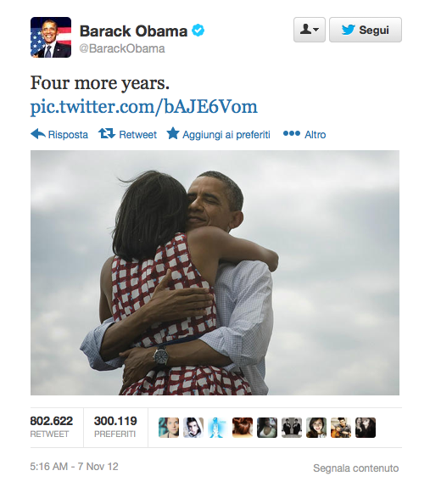
Successful Example

Slide 7

Problem Description
Too many…
…too few!

Slide 8
Data
Google Analytics
Queries: 10-9 Cerrone, Abortion, Acne, Alex Morgan, AllyFollowSpree, Amanda Todd, Apple, Audi, Aurora Shooting, Back Pain, Bank, Barack Obama, Barcelona, Bared to you, Baseball, Basket, Big Bang Theory, Bloody Mary, BMW, Cancer, Cat, Chuck, CNN, Converse, Dad, Dance, Defendig Jacob, Depression, Derrick Rose, Diabetes, Dodge, Dog, Economic, Election, Enviroment, ESPN, Fast & Furious 6, Fifty Shades Darker, Fifty Shades Freed, Flowers, Food, Football, Ford, Fox News, Froch, Galaxy, Game of Thrones, Gangnam Style, Gas, Gay Marriage, Glee, Golf, Good Morning, Heart, Hello, Herpes, Honda, Hotel, Huffington Post, Hunger Games, Hurricane, Hurricane Isaac, Immigration, Instagram, iPhone, Jeremy Lin, Joe Paterno, Justin Bieber, Kate Middleton, Kevin Durant, KJ Noons, Kobe, KONY 2012, Lebron, Lolo Jones, Love, Magic Mike, Marc Gasol, Margarita, McDonald, MentionSomeoneYouLove, Michael Clarcke Duncan, Michael Phelps, Mitt Romney, Mojito, Mom, Money, Morgan Freeman, MSN, Music, NBC, Neil Armstrong, News, Nexus, Nicki Minaj, Nike, Nokia, NY, Obama, Obamacare, ObamacareKidsBooks, Olympics, One Direction, Parking, Paul Ryan, Peyton Manning, Photo, Pizza, Pizza Hut, President, Presidential Election, Prometheus, PSY, Restaurant, Ron Paul, Selena Gomez, Serena Williams, Snooki, Son, Song, SOPA, Sport, Starbucks, Super Bowl, Swimming , Ted, Tennis, ThatOneExWho, The Avengers, The Dark Knight Rises, The Serpent's Shadow, Toyota, Twilight, UEFA Euro 2012 , UFC160, Walmart, WeAllKnowThatOnePersonWho, Whitney Houston, WI, X Factor

Slide 9
Information retrieval
Topsy.com
Twitter Streamer API
Twitter API
GET search
GET users/lookup
GET statuses/user_timeline

Slide 10
Information retrieval
Topsy.com
Twitter Streamer API
Twitter API
GET search
GET users/lookup
GET statuses/user_timeline

Slide 11
Information retrieval
92 010 Unique tweets
9 606 Retweeted
82 404 Non-Retweeted
Hardware Limits…
9 000 Retweeted
9 000 Non-Retweeted

Slide 12
Features
Text Mining:
Normalization (lowercase)
Removing Stop Words
Features A:
Top 600 Most common words
Top 300 Most common Screen Names (@)
Top 400 Most common Hash Tag (#)
Average word length
Lexical diversity

Slide 13
Naive Bayes classifier
Tweets
92 010 unique tweets
Features
(9000+9000) tweets
NBC
Trained on 14400 tweets
Test
Tested on 3600 tweets
Results

Slide 14
Results
F-measure: 0.61 - Accuracy: 0.58 - Precision: 0.56 - Recall: 0.66
has(enviroment) = True False : True = 16.3 : 1.0
has(prometheus) = True False : True = 11.1 : 1.0
has(f1) = True False : True = 9.1 : 1.0
has(retweet) = True True : False = 8.7 : 1.0
has(sale) = True False : True = 7.5 : 1.0
has(mojito) = True False : True = 7.3 : 1.0
avg<3 = True False : True = 7.1 : 1.0
has(syria) = True False : True = 6.8 : 1.0
has(sopa) = True False : True = 6.5 : 1.0
has(mi) = True False : True = 6.4 : 1.0
has(honda) = True False : True = 5.1 : 1.0
has(toyota) = True False : True = 4.9 : 1.0
has(nexus) = True False : True = 3.9 : 1.0
has(manchester) = True True : False = 3.7 : 1.0
has(alcohol) = True False : True = 3.7 : 1.0
has(ufc160) = True False : True = 3.7 : 1.0
has(architecture) = True False : True = 3.7 : 1.0
has(barcelona) = True True : False = 3.7 : 1.0
has(iran) = True True : False = 3.6 : 1.0
has(snooki) = True False : True = 3.3 : 1.0
| F |
| a T |
| l r |
| s u |
| e e |
------ +-----------+
False | <917> 912 |
True | 598<1173>|
------ +-----------+

Slide 15
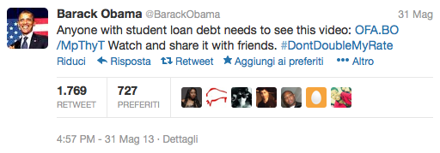
Features
Features related to a particular tweet
Features B: A + Tweet Properties
N. of Links
N. of Hash Tags

Slide 16
Results
F-measure: 0.61 - Accuracy: 0.62 - Precision: 0.62 - Recall: 0.60
has(enviroment) = True False : True = 16.3 : 1.0
has(prometheus) = True False : True = 11.1 : 1.0
has(f1) = True False : True = 9.1 : 1.0
has(retweet) = True True : False = 8.7 : 1.0
has(sale) = True False : True = 7.5 : 1.0
has(mojito) = True False : True = 7.3 : 1.0
avg<3 = True False : True = 7.1 : 1.0
has(syria) = True False : True = 6.8 : 1.0
has(sopa) = True False : True = 6.5 : 1.0
has(mi) = True False : True = 6.4 : 1.0
has(honda) = True False : True = 5.1 : 1.0
has(toyota) = True False : True = 4.9 : 1.0
has(nexus) = True False : True = 3.9 : 1.0
has(manchester) = True True : False = 3.7 : 1.0
has(architecture) = True False : True = 3.7 : 1.0
has(alcohol) = True False : True = 3.7 : 1.0
has(ufc160) = True False : True = 3.7 : 1.0
has(barcelona) = True True : False = 3.7 : 1.0
has(iran) = True True : False = 3.6 : 1.0
has(snooki) = True False : True = 3.3 : 1.0
| F |
| a T |
| l r |
| s u |
| e e |
------ +-----------+
False |<1180> 650 |
True | 706<1064>|
------ +-----------+

Slide 17
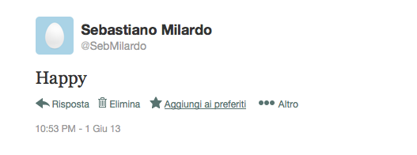

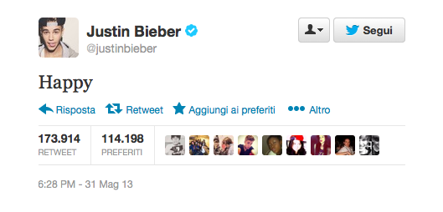
Followers

Slide 18
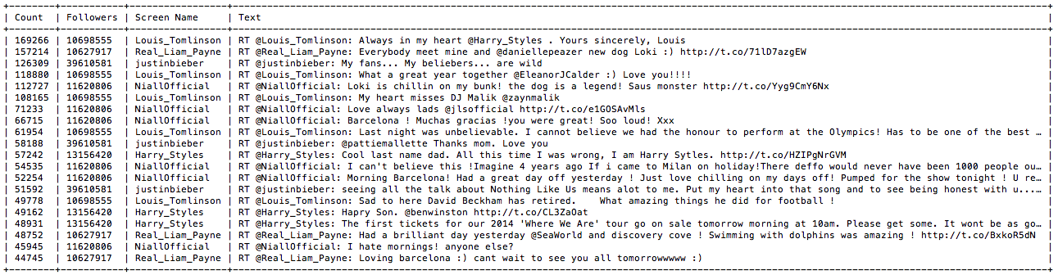
Top Retweeted

Slide 19
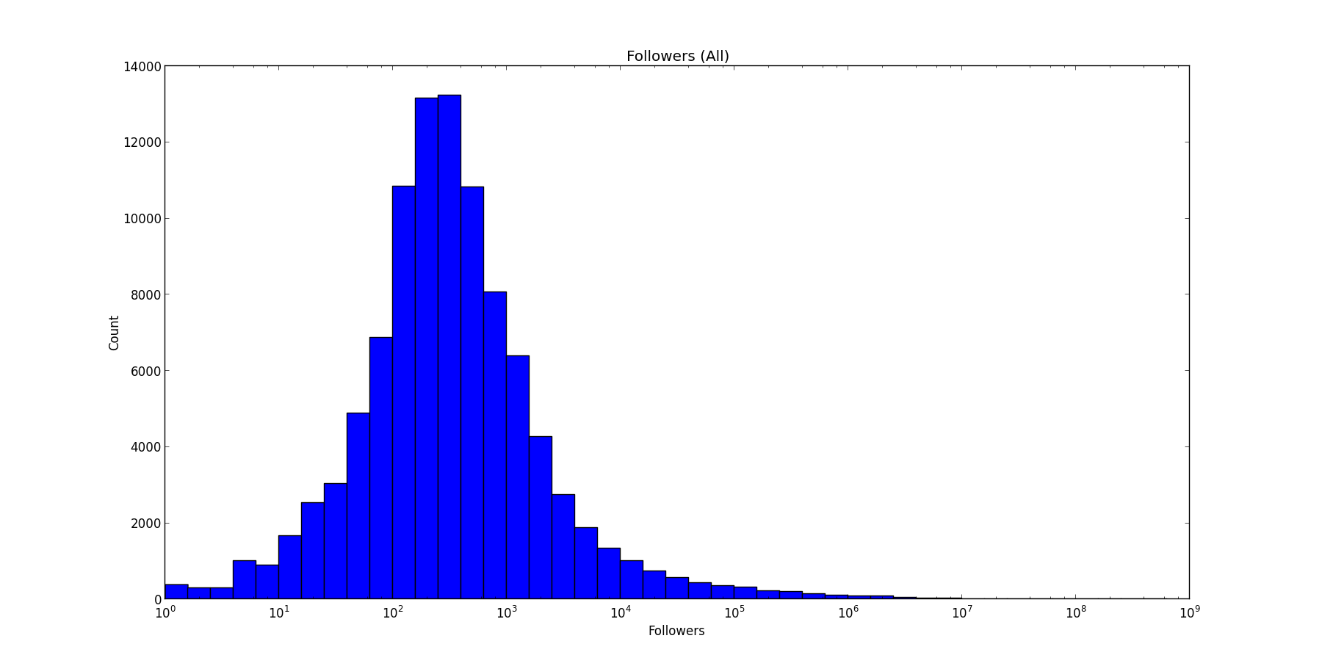
Followers (all tweets)

Slide 20

Followers (non retw.)

Slide 21
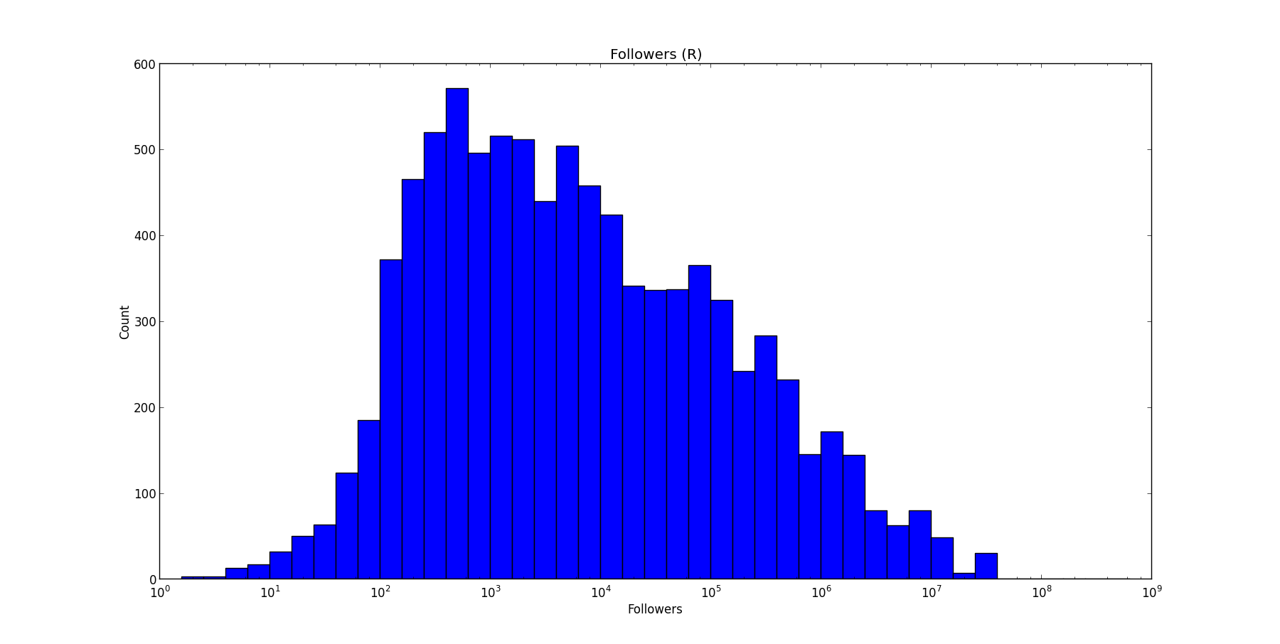
Followers (retw.)

Slide 22
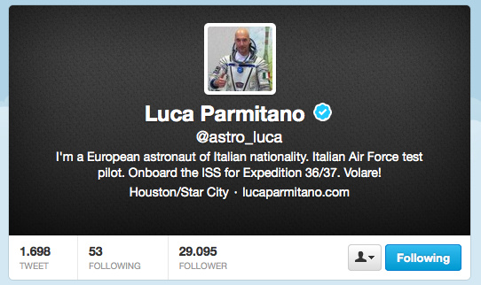
Features
Features related to a particular user.
Features C: B + User Properties
N. Followers
N. Friends
N. Statuses
Account age
Verified
Default Profile

Slide 23
Results
F-measure: 0.71 - Accuracy: 0.73 - Precision: 0.75 - Recall: 0.68
5.0<=log_flw<7 = True True : False = 40.1 : 1.0
5.0<=log_frnds<7 = True True : False = 18.3 : 1.0
verified = True True : False = 18.2 : 1.0
has(enviroment) = True False : True = 16.3 : 1.0
log_flw<1.0 = True False : True = 15.8 : 1.0
has(prometheus) = True False : True = 11.1 : 1.0
has(f1) = True False : True = 9.1 : 1.0
has(retweet) = True True : False = 8.7 : 1.0
has(sale) = True False : True = 7.5 : 1.0
has(mojito) = True False : True = 7.3 : 1.0
avg<3 = True False : True = 7.1 : 1.0
has(syria) = True False : True = 6.8 : 1.0
has(sopa) = True False : True = 6.5 : 1.0
has(mi) = True False : True = 6.4 : 1.0
has(honda) = True False : True = 5.1 : 1.0
has(toyota) = True False : True = 4.9 : 1.0
has(nexus) = True False : True = 3.9 : 1.0
has(manchester) = True True : False = 3.7 : 1.0
has(architecture) = True False : True = 3.7 : 1.0
has(alcohol) = True False : True = 3.7 : 1.0
| F |
| a T |
| l r |
| s u |
| e e |
------ +-----------+
False |<1421> 408 |
True | 567<1204>|
------ +-----------+

Slide 24

Features
There is something missing…

Slide 25
Time
# of tweets
# of tweets
n. of tweets
1 5 10
1 5 10
0
time
Position
Position

Slide 26
Features
Time (Unix Time)
1369425527.0 0 0
1369479072.0 0 0
1369485446.0 1.0 5
1369485553.0 3.25 5
1369485829.0 5.5 5
1369486150.0 7.75 5
1369486388.0 10.0 5
1369512154.0 0 0
1369532095.0 0 0
1369539965.0 1.0 3
1369540138.0 5.5 3
1369540254.0 10.0 3
1369540866.0 0 0
1369544351.0 0 0
1369553350.0 0 0
Start
Length
Stop

Slide 27
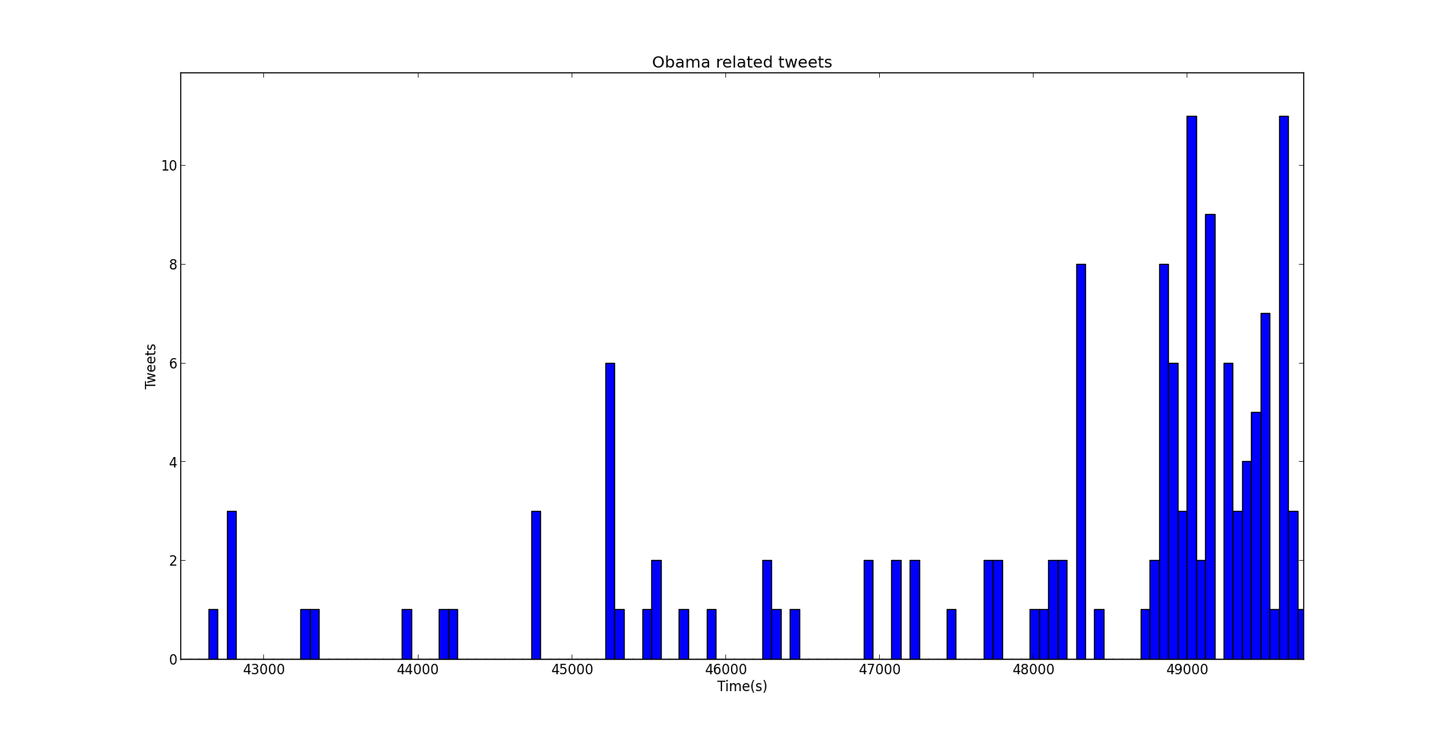
Time

Slide 28
Features
Features related to time
Features D: C + Time Properties
Is the first tweet in a series
Is the last tweet in a series
Is not in a series
Position in the series
Total number of Tweets in a series

Slide 29
Results
F-measure: 0.86 - Accuracy: 0.87 - Precision: 0.90 - Recall: 0.83
s.pos.==0 = True True : False = 40.6 : 1.0
5.0<=log_flw<7 = True True : False = 40.1 : 1.0
5.0<=log_frnds<7 = True True : False = 18.3 : 1.0
verified = True True : False = 18.2 : 1.0
has(enviroment) = True False : True = 16.3 : 1.0
log_flw<1.0 = True False : True = 15.8 : 1.0
has(prometheus) = True False : True = 11.1 : 1.0
s.pos.==1 = True True : False = 10.9 : 1.0
has(f1) = True False : True = 9.1 : 1.0
has(retweet) = True True : False = 8.7 : 1.0
has(sale) = True False : True = 7.5 : 1.0
has(mojito) = True False : True = 7.3 : 1.0
7.5<s.pos.< 10 = True False : True = 7.2 : 1.0
avg<3 = True False : True = 7.1 : 1.0
s.pos.== 10 = True True : False = 6.8 : 1.0
has(syria) = True False : True = 6.8 : 1.0
has(sopa) = True False : True = 6.5 : 1.0
has(mi) = True False : True = 6.4 : 1.0
s.length<300.0 = True True : False = 5.3 : 1.0
has(honda) = True False : True = 5.1 : 1.0
| F |
| a T |
| l r |
| s u |
| e e |
------ +-----------+
False |<1657> 172 |
True | 294<1477>|
------ +-----------+

Slide 30
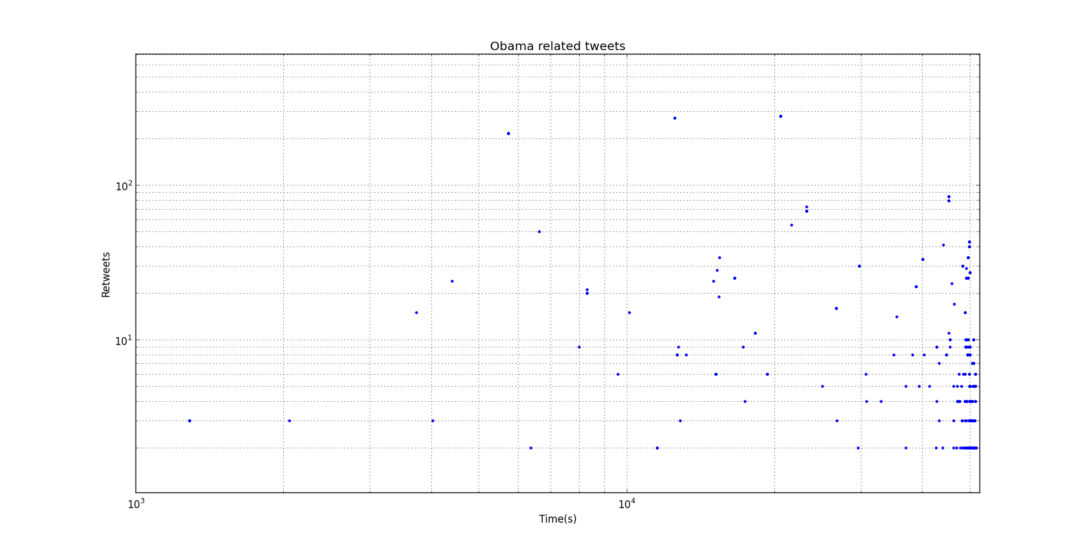
…too good to be true

Slide 31
Results
F-measure: 0.85 - Accuracy: 0.86 - Precision: 0.87 - Recall: 0.83
5.0<=log_flw<7 = True True : False = 40.1 : 1.0
5.0<=log_frnd<7 = True True : False = 18.3 : 1.0
verified = True True : False = 18.2 : 1.0
has(enviroment) = True False : True = 16.3 : 1.0
log_follow<1.0 = True False : True = 15.8 : 1.0
has(prometheus) = True False : True = 11.1 : 1.0
s.pos.==1 = True True : False = 10.9 : 1.0
has(f1) = True False : True = 9.1 : 1.0
has(retweet) = True True : False = 8.7 : 1.0
has(sale) = True False : True = 7.5 : 1.0
has(mojito) = True False : True = 7.3 : 1.0
7.5<s.pos.< 10 = True False : True = 7.2 : 1.0
avg<3 = True False : True = 7.1 : 1.0
s.pos.== 10 = True True : False = 6.8 : 1.0
has(syria) = True False : True = 6.8 : 1.0
has(sopa) = True False : True = 6.5 : 1.0
has(mi) = True False : True = 6.4 : 1.0
s.length<300.0 = True True : False = 5.3 : 1.0
has(honda) = True False : True = 5.1 : 1.0
has(toyota) = True False : True = 4.9 : 1.0
| F |
| a T |
| l r |
| s u |
| e e |
------ +-----------+
False |<1607> 222 |
True | 296<1475>|
------ +-----------+

Slide 32
Comparison
Features Set | F-Measure | Accuracy | Precision | Recall
A | 0,61 | 0,58 | 0,56 | 0,66
B | 0,61 | 0,62 | 0,62 | 0,60
C | 0,71 | 0,73 | 0,75 | 0,68
D | 0,86 | 0,87 | 0,90 | 0,83
*D | 0,85 | 0,86 | 0,87 | 0,83

Slide 33
Problem Description
What characterizes a tweet that gets retweeted by many people?

Slide 34
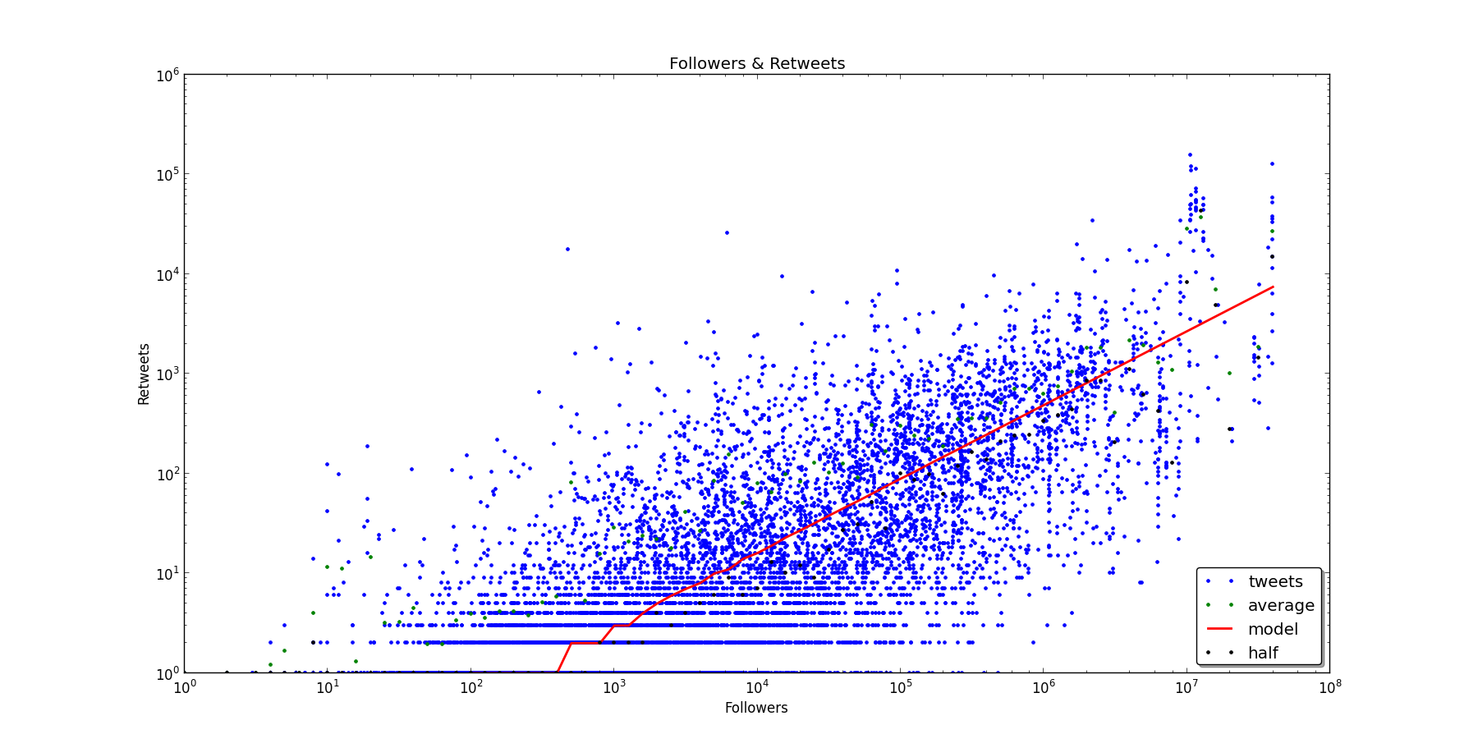
Results

Slide 35
Retweet vs Followers
Expected retweet count = a^(log(f)-b)
f = n. of followers
a in [5;6]
b in [2;2.5]
r_score = Retweet count/Expected retweet count
Examples:
5.5^(log(f)-2.37)=1 f=10
5.5^(log(f)-2.37)=100 f=160k
5.5^(log(f)-2.37)=800 000 f=31M

Slide 36
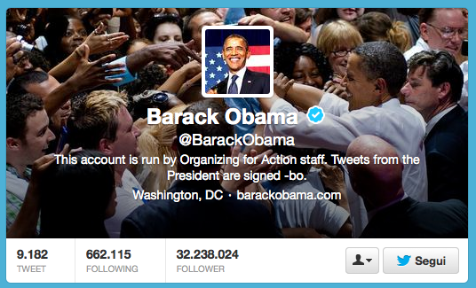
Retweet vs Followers
Was it a golden tweet? (r_score =1 ? Maybe not…)

Slide 37
Retweet vs Followers
4319 Good Retweets (r_score>1)
4681 Bad Retweets (r_score<=1)
+
Bayesian Magic…

Slide 38
Comparison
Features Set | F-Measure | Accuracy | Precision | Recall
A | 0,49 | 0,57 | 0,56 | 0,44
B | 0,63 | 0,57 | 0,53 | 0,77
C | 0,62 | 0,67 | 0,68 | 0,58
D | 0,65 | 0,69 | 0,69 | 0,61
*D | 0,64 | 0,68 | 0,69 | 0,59

Slide 39
Results
F-measure: 0.64 - Accuracy: 0.68 - Precision: 0.69 - Recall: 0.59
user<30Days = True True : False = 12.2 : 1.0
has(goodmorning) = True True : False = 7.1 : 1.0
has(missing) = True False : True = 6.0 : 1.0
5.0<=log_statuses<7 = True False : True = 5.9 : 1.0
1.0<=log_statuses<3.0 = True True : False = 4.8 : 1.0
has(senate) = True False : True = 4.7 : 1.0
has(retweet) = True True : False = 4.2 : 1.0
has(oil) = True False : True = 4.0 : 1.0
1Month<=user<6Months = True True : False = 3.7 : 1.0
has(monaco) = True False : True = 3.5 : 1.0
has(snooki) = True False : True = 3.5 : 1.0
has(bcci) = True False : True = 3.4 : 1.0
has(fail) = True True : False = 3.2 : 1.0
has(uk) = True False : True = 3.1 : 1.0
has(ufc) = True False : True = 3.1 : 1.0
has(war) = True False : True = 3.1 : 1.0
3.0<=log_statuses<5.0 = False True : False = 3.0 : 1.0
has(lumia) = True False : True = 2.8 : 1.0
has(union) = True False : True = 2.8 : 1.0
has(boxing) = True False : True = 2.8 : 1.0
| F |
| a T |
| l r |
| s u |
| e e |
------ +---------+
False |<726>226 |
True | 348<500>|
------ +---------+

Slide 40
Conclusions
Recipe for a golden tweet:
Popularity is the key!
Try to be the first one… or the last one
At the beginning everything is easier
Don’t write too many statuses
Ask for a retweet

Slide 41

Questions

Slide 42
Thank You!

