Slide 1
CS 4311 Software Engineering II
Spring 2025
Lecture 11
Integration Testing
Dr. Bhanukiran Gurijala

Slide 2
Outline
Integration Testing
Definition
Strategies
Big bang
Top-down
Bottom-up
Sandwich
Integrating OO Applications

Slide 3
Integration testing
Done between unit testing and system testing
Objective: ensure assembled modules, that work fine in isolation, work well together
Attempt to find interface faults
Need a module call graph.
main
A
B
C
D
E
F

Slide 4
Integration Strategy
How low-level modules are assembled to form higher-level program entities
Strategy impacts
the type of test tools to use
the order of coding/testing units
the cost of generating test cases
the cost of locating and correcting detected defects

Slide 5
Integration testing strategies
Several different strategies can be used for integration testing
Examples of strategies
Big-bang
Top-down
Bottom-up
Sandwich
Comparison criteria:
fault localization
effort needed (for stubs and drivers)
Stub – called program(s) or module(s)
Drivers – Calling program(s) or module(s)
degree of testing of modules achieved
possibility for parallel development

Slide 6
Big Bang Integration - 1
Non-incremental strategy
Unit test each module in isolation
Integrate as a whole
test
main
main
test
A
A
B
C
test
B
test
main, A, B, C
D, E, F
test
C
D
E
F
test
D
test
E
test
F

Slide 7
Big Bang Integration - 2
Advantages
Convenient for small systems
Disadvantages
Integration testing can only begin when all modules are ready
Fault localization difficult
Easy to miss interface faults

Slide 8
Top-down Integration - 1
Incremental strategy
Start by including highest level modules in test set.
All other modules replaced by stubs or mock objects.
Integrate (i.e. replace stub by real module) modules called by modules in test set.
Repeat until all modules in test set are integrated. This includes regression testing
test
main
main
test
main, A, B,C
A
B
C
D
E
F
test
main, A, B, C
D, E, F

Slide 9
Top-down Integration - 2
The integration order can be modified to:
include critical modules first
leave modules not ready to later
test
main
main
test
main, A, C
A
B
C
D
E
F
test
main, A, C, D, E, F
test
main, A, B, C
D, E, F

Slide 10
Top-down Integration - 3
Advantages
Fault localization easier
Few or no drivers needed
Possibility to obtain an early prototype
Different order of testing/implementation possible
Major design flaws found first
in logic modules on top of the hierarchy
Disadvantages
Need lot of stubs / mock objects
Potentially reusable modules (in bottom of the hierarchy) can be inadequately tested (Why?)

Slide 11
Bottom-up Integration - 1
Incremental strategy
Test low-level modules, then
Modules calling them until highest level module
main
test
D
test
D,E,A
A
B
C
test
E
test
main, A, B, C
D, E, F
test
B
D
E
F
test
F
test
C,F

Slide 12
Bottom-up Integration - 2
Advantages
Fault localization easier (than big-bang)
No need for stubs / fewer mock objects
Operational modules tested thoroughly
Testing can be in parallel with implementation
Disadvantages
Need drivers
High-level modules (that relate to the solution logic) tested in the last (and least)

Slide 13
Sandwich Integration
Combines top-down and bottom-up approaches
Distinguish 3 layers
logic (top) - tested top-down
middle
operational (bottom) – tested bottom-up
test
D
main
test
D,E,A
A
B
C
test
E
test
main, A, B, C
D, E, F
D
E
F
test
F
test
C,F
test
main
test
main, A, B, C
Top-Down

Slide 14
Risk Driven integration
Integrate based on criticality
most critical or complex modules integrated first with modules called

Slide 15
Integration of Object-Oriented Systems
Different scopes
Intra Class (methods within a class)
Big-bang
Bottom-up: constructors - accessors - predicates– iterators – destructors
State based integration
Inter Class / Cluster Integration
Big Bang
Bottom-up
Top-down
Scenario based
Subsystem/System Integration
Big Bang
Bottom-up
Top-down
Scenario based

Slide 16
Intra-Class Integration
Operations in classes (methods)
black box, white box approaches
each exception raised at least once
each interrupt forced to occur at least once
each attribute set interrogated at least once
state-based testing (Following Slides)
Integration of methods
Big-bang used for situations where methods are tightly coupled
Complex methods can be tested with stubs/mocks

Slide 17
State-Based Testing
Natural representation with finite state machines
States correspond to certain values of the attributes
Transitions correspond to method calls
FSM can be used as a basis for testing
e.g., “drive” the class through all transitions, and
Verify the response and the resulting state

Slide 18
FSM Example: Stack
States
Initial: before creation
Empty: number of elements = 0
Holding: number of elements >0, but less than the max capacity
Full: number elements = max capacity
Final: after destruction
Transitions: starting state, ending state, event that triggers the transition, and possibly some response to the event

Slide 19
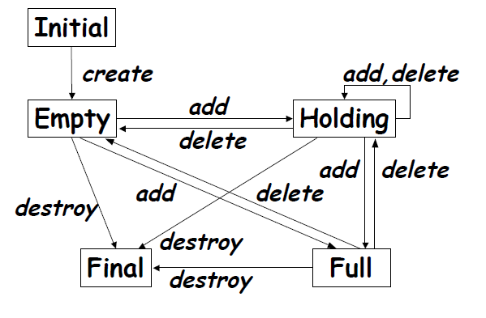
Possible Transitions
Initial → Empty: event= “create”
e.g. “s = new Stack()” in Java
Empty → Holding: event = “add”
Empty → Full: event = “add”
if max_capacity = 1
Empty → Final: event = “destroy”
e.g. destructor call in C++, garbage collection in Java
Holding → Empty: event = “delete”

Slide 20
FSM-based Testing
Each valid transition should be tested
Verify the resulting state using a state inspector that has access to the internals of the class
Each invalid transition should be tested to ensure that it is rejected, and the state does not change
e.g., Full → Full is not allowed (Example?):
Need to test calling add on a full stack

Slide 21
Exercise
Gumball machine example
States:
NoQuarter, HasQuarter, Sold, SoldOut, Error
Transitions:
turnCrank(), addQuarter(), takeGumball()
(you may add states/transitions if necessary)

Slide 22
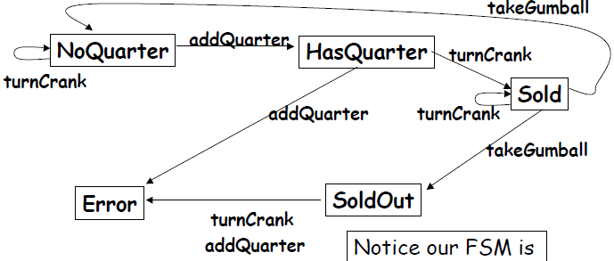
Solution
Possible Tests?

