Slide 1
Tank (Name TBC)
Leandro santos, Joshua Ruane, Sebastian rabau

Slide 2
The concept
Player controlled tank vs enemy tanks which move through a maze towards the player’s base, located in the centre. The Player must shoot the enemy tanks and defend their base; if they don’t, its game over!

Slide 3
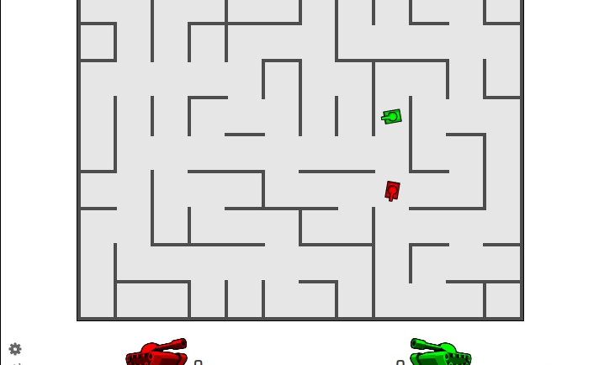
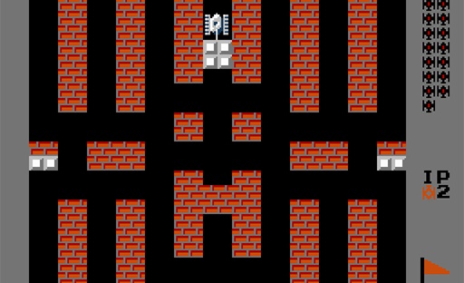
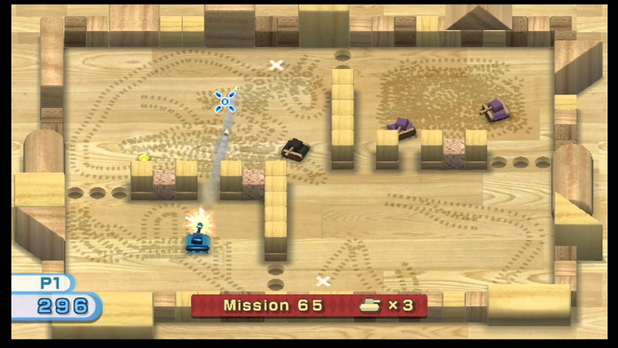
Reference Material
Tank Trouble
Battle City
Tanks – Wii Play

Slide 4
rules
Player wins if they destroy all tanks .
Player loses if they die or if their base is destroyed.

Slide 5
Enemies
Enemy tanks are Artificially Controlled.
Their priority is to move through the maze towards the base and destroy it.
They can shoot bullets at the player in order to destroy them.
If the player collides with an enemy, the player die.

Slide 6
Physics
Player can move.
Collision between {Player/Enemy | Enemy}; {Player/Enemy | Walls}; {Bullets | Player/Enemy}; {Player/Enemy | Floor Tiles}

Slide 7
Extensions
Scoreboard
Menu System
Lives
Power-Ups
Timer
Waves of Enemies/Rounds
Stronger Enemies (Smarter AI, Use shortcuts, tougher, faster)
Different Types of floor tiles (speed up, slow down, Decreased Friction)
Bullet Reflection
Two-Player Mode

