Slide 1



MeetOUT
Sebastiano piantanida
Professore:
Luciano Baresi

Slide 2



Key features
Login and registration
Search events nearby and by location
Create new events
Join events from all around the world
Chat with other event’s partecipants
Add new friends and keep an eye on their events
An event-based
Social network
Find and organize events around you, stay in touch with your friends, and meet up with all of them using MeetOUT!
Helps you connect with new people who share your passions in the real world.

Slide 3





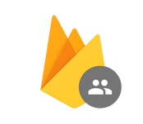


App Structure
Flutter at its core
MVC like
External services
Only cross platform services
Firebase back-end
Tencent messaging
Google maps
GeoCoding
Local services
Firebase
GeoCoding
Storage
Database
Authentication
GoogleMaps
Tencent Cloud IM

Slide 4
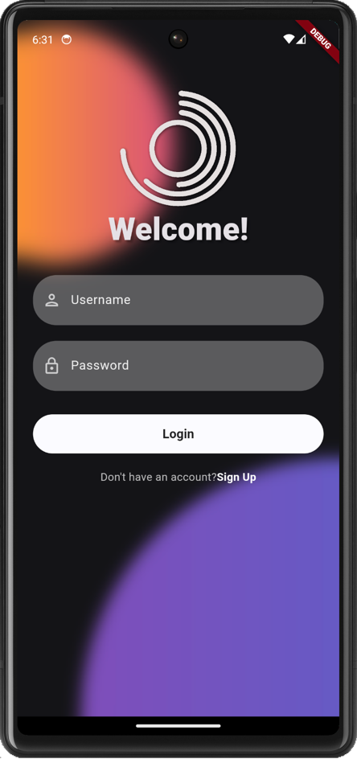
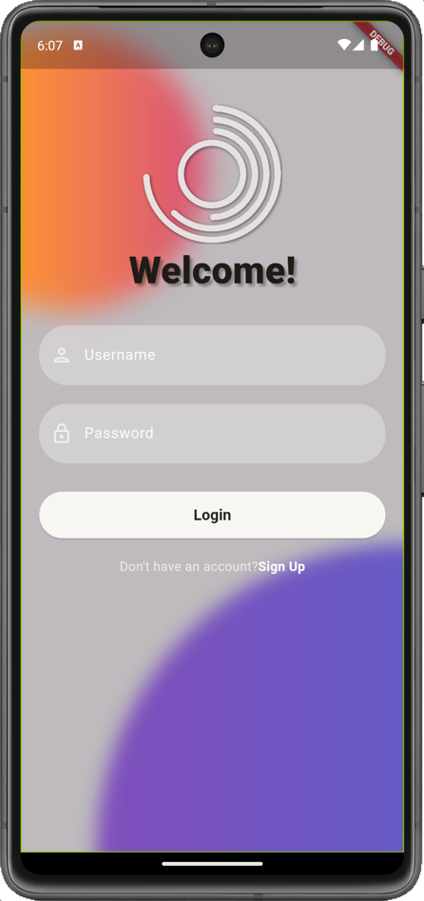
UI Design
Navigation bar
Responsive layout
The Dark side or the light?

Slide 5
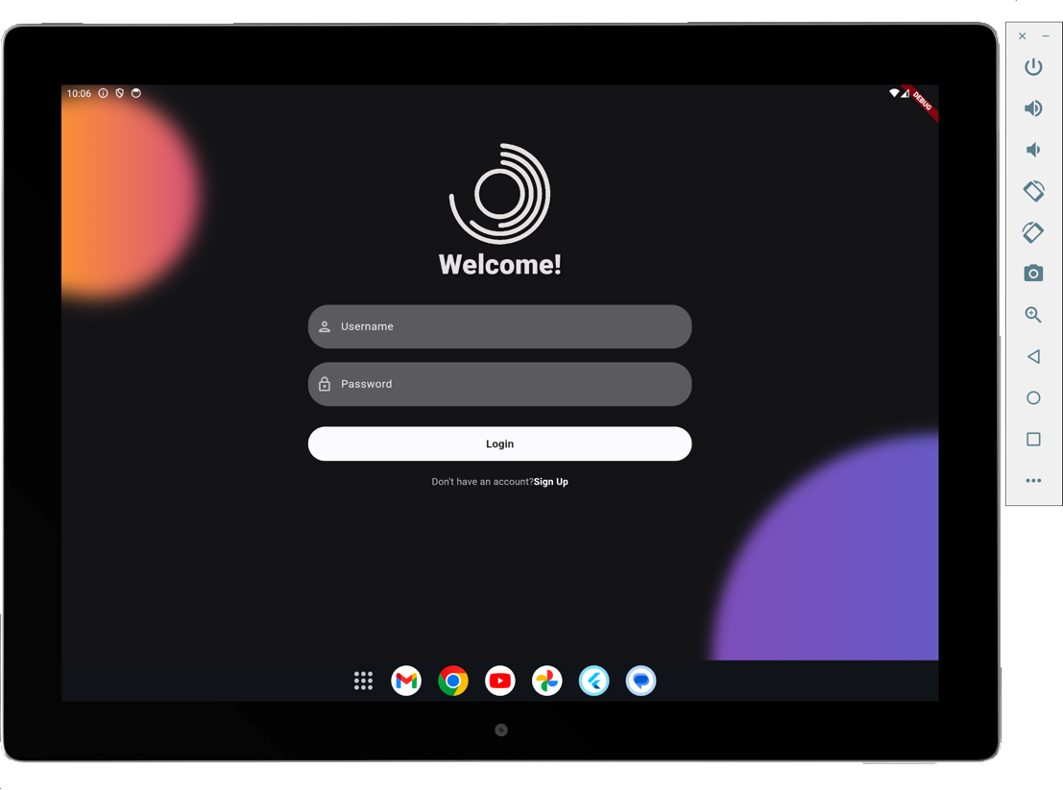
UI Design

Slide 6
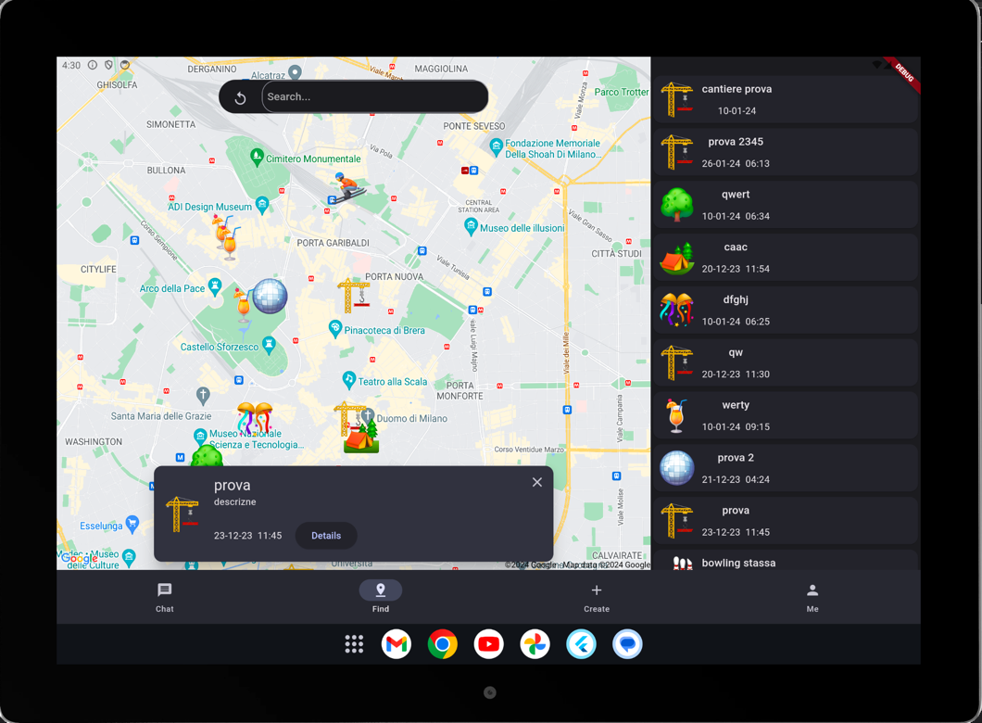
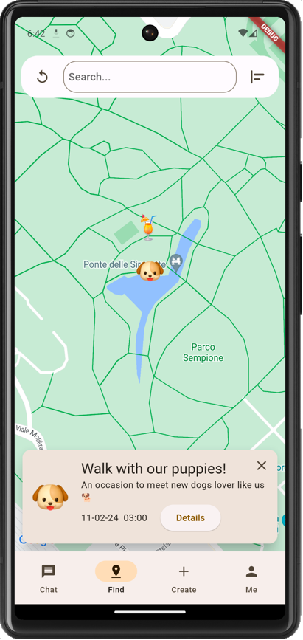
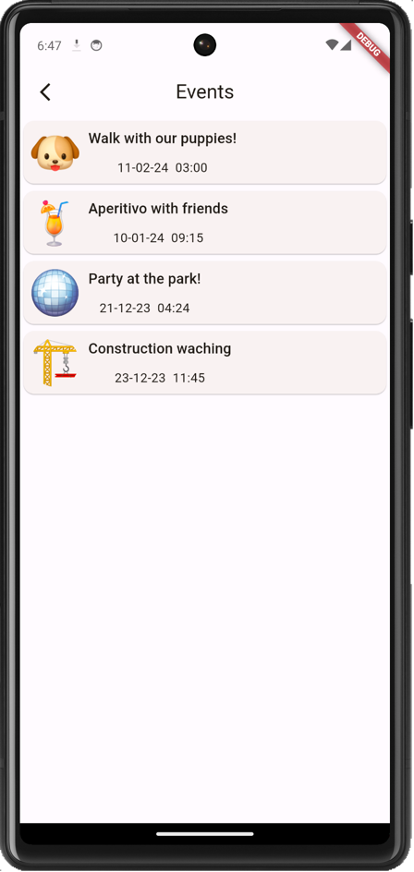
UI Design

Slide 7
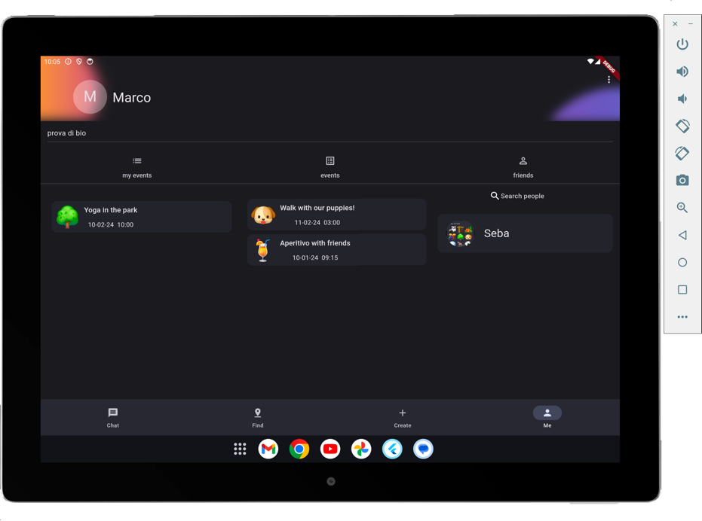
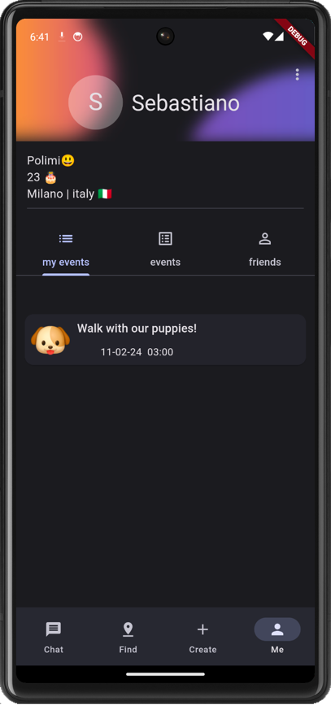
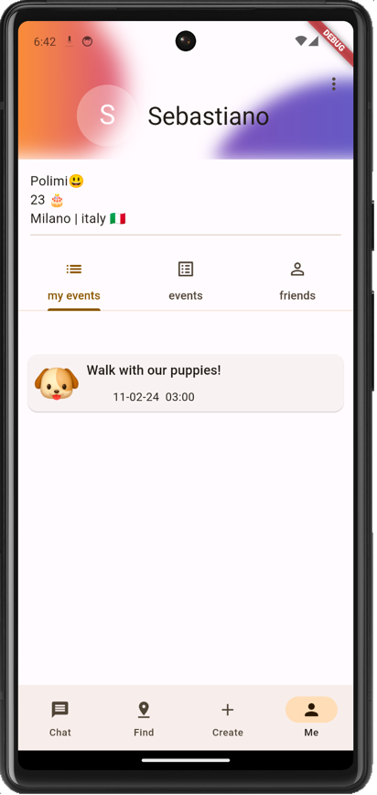
UI Design

Slide 8
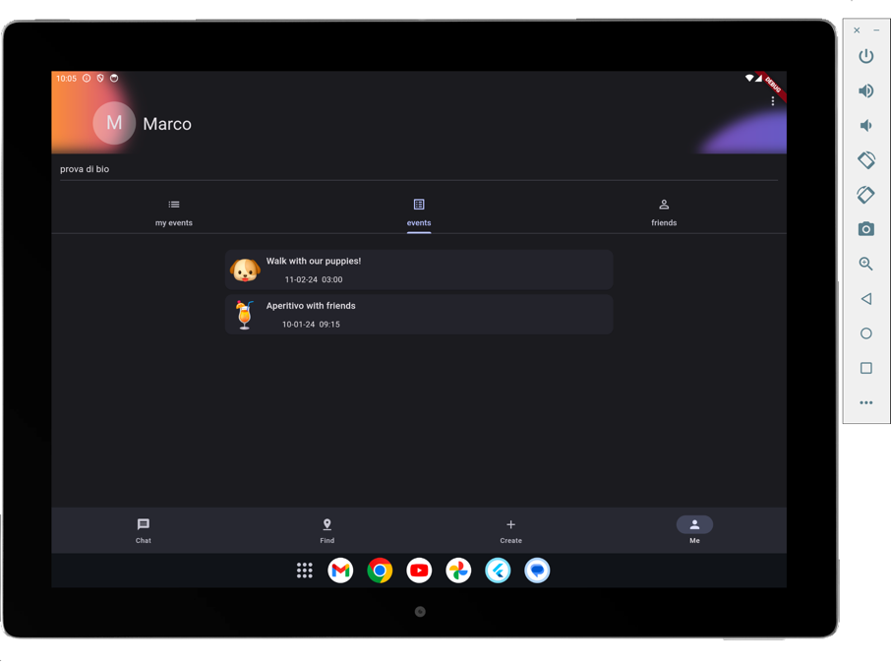

Testing
User testing
Widget testing

Slide 9


Future development
Improve event search
Recomender system
Buisnes collaboration

Slide 10
Demo time!

