Slide 1
SEBA – Web Application Engineering
Exercise 4
TUM Nostradamus – A Pattern Analyzer

Slide 2

Business Idea Description
TUM Nostradamus is a web application which empowers various stakeholders in a business organization to efficiently design solutions to given tasks using design patterns as a foundation.
The primary objective for the project is to design and develop a web application which takes in the result from the Requirements Engineering Phase as input and suggest the best possible design pattern that can be used to meet the current goals.
The application can also be used as a reference tool to identify existing anti-patterns in existing solutions and take appropriate measures to reduce or eradicate their negative influence.
Considering the importance of the Design Phase in every Software Lifecycle, the application can be used as a support tool to significantly reduce the time invested in choosing the right design to be implemented.
Notes:
http://www.gliffy.com/go/publish/9760315

Slide 3
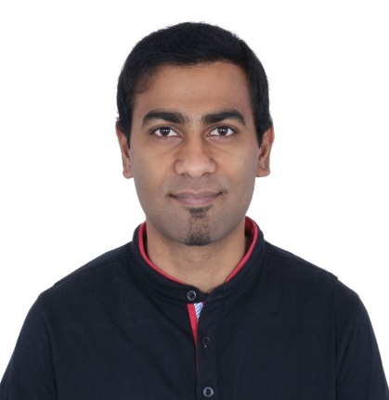
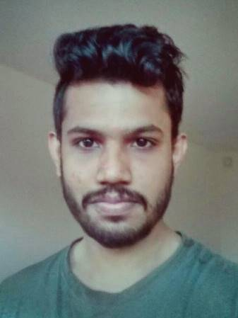
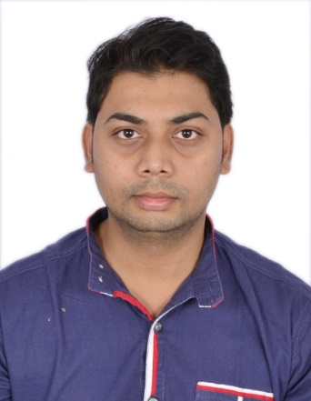
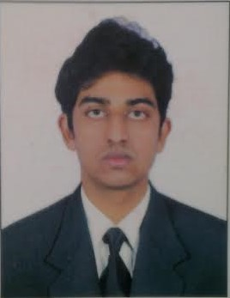
Team Composition
Akash Manjunath (03670142) | Gopala Krishna Char (03669041) | Prateek Bagrecha (03671298) | Shankar Mohan Satya (03667448)
Role: Full Stack Development and Scrum Master Responsibilities: Conception of Business Idea Development of Anti Pattern User Story Development of Learning Center User Story. Development of Dashboard User Story. Development of Charts for Admin User Story Task Management on Trello Code Clean UP | Role: Full Stack Development and Deployment Lead Responsibilities: Development of Landing page Development of Admin User Story Development of User Management. Management of Repositories Development of Feedback framework and News Feed for dashboard user story | Role: Full Stack Development and Application Tester Responsibilities: Development of Pattern User Story Development of Result View for Pattern and Anti-Pattern User Stories Setting up of Communication channels and Repositories Application Testing and Bug Fixes Code Clean Up Management of Deliverables | Role: Full Stack Development and Application Tester Responsibilities: Development Login and Sign Up Management. Development Landing Page Development of Team Profile Dialog View Development of Support view
Time Spent: 24 days | Time Spent: 22 days | Time Spent: 24 days | Time Spent: 20 days
Notes:
http://www.gliffy.com/go/publish/9760315

Slide 4
Our Sources:
Advanced Topics of Software Engineering (ASE)
Prof. Dr. Florian Matthes, Prof. Dr. Alexander Pretschner
SourceMaking
https://sourcemaking.com/
Live Demo…….
Notes:
http://www.gliffy.com/go/publish/9760315

