Slide 1
COPERTINA

Slide 2
Big Data - Project Report
Project Goal:
The goal of this project is to analyze a dataset of hotel reviews and to extract information about the hotel’s quality based on the customers’ reviews and ratings.
We used the MapReduce programming model to process the data and to extract the information we needed, We then used a Deep Learning model to perform sentiment analysis on the reviews.
Finally, using PySpark ML, we trained a model to perform the same task for ablation studies.

Slide 3
Background
MapReduce
Sentiment Analysis with Deep Learning
PySpark, PySpark ML, and PySpark SQL

Slide 4
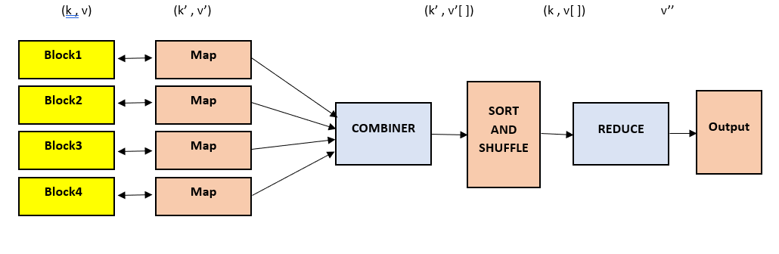

MapReduce
A programming model designed for processing large data sets with a distributed algorithm on a cluster. Consists of Map and Reduce functions.
Map Function: Processes input data to generate intermediate key-value pairs.
Reduce Function: Merges intermediate values to produce final results.
RDD: Re
Advantages: Scalability, fault tolerance, and simplified programming for distributed computing.

Slide 5
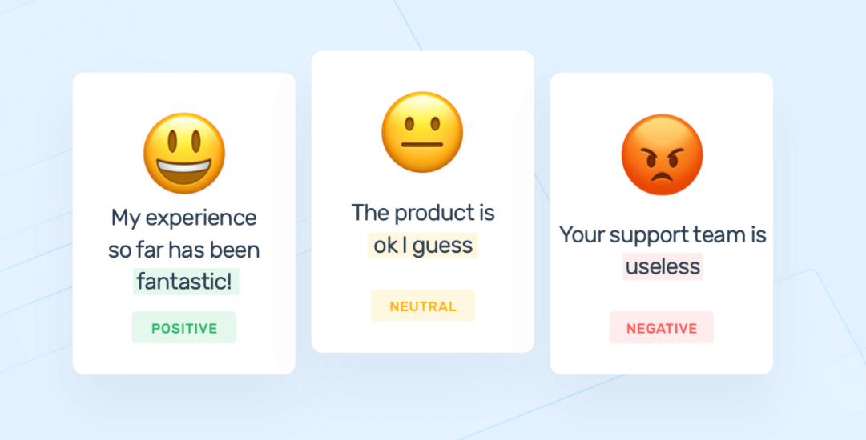
Sentiment Analysis with Deep Learning
Determines the emotional tone behind a series of words. Crucial for marketing, customer service, and social media monitoring.
LSTM Model: Long Short-Term Memory networks capture long-range dependencies in text.
Transformer Model: Uses self-attention mechanisms to capture global dependencies in text, improving performance over LSTMs.

Slide 6

PySpark, PySpark ML, and PySpark SQL
Apache Spark is an open-source, distributed computing system that provides an integrated framework for big data processing.
Apache Spark is an open-source distributed computing system that provides an integrated framework for big data processing.
PySpark: Python API for Apache Spark, providing an interface for programming entire clusters with data parallelism.
PySpark ML: Machine learning library with high-level APIs for creating and tuning ML pipelines.
PySpark SQL: Module for structured data processing, enabling SQL queries on data.

Slide 7

Dataset
Source: Reviews of hotels scraped from TripAdvisor containing 878.561 reviews from 4.333 hotels.
Structure: Each review includes ratings (1 to 5 on different categories), title, text, author, date stayed, and other metadata.

Slide 8
Pipeline
Data Preprocessing: Initial parsing of dataset and preparation for MapReduce jobs: each hotel id is linked with all its reviews
Sentiment Analysis: For each hotel with more than 1000 reviews, we select a significant number of reviews for sentiment analysis using a DL model
Sentiment Analysis with PySpark ML: As an ablative study we use PySpark ML to implement a model to perform sentiment analysis in order to test the library using the previous inferences to label the dataset

Slide 9
Data Preprocessing
Map Function: The function emits a key-value pair where the key is the hotel id and the value is a dictionary containing the average of the ratings and the text of the reviews
Reduce Function: Takes the key-value pairs and merges the reviews for each id, also computing the average rating
Output files: 35
Time: 13 seconds

Slide 10
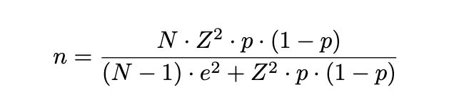
Sentiment analysis
1. Sampling
To make the inference time feasible we performed the inference on a reduced number of reviews, for each hotel the number of sampled reviews would be:
N: Number of reviews
Z: Z-value for 95% confidence = 1.96
p: Expected proportion = 0.5
e: Margin of error = 0.05
2. Inference
For each hotel and its sampled reviews, we used flair, a powerful SoA Deep Learning framework to perform sentiment analysis on them.
Each review is tagged with POSITIVE (2), NEGATIVE (0) or NEUTRAL (1).

Slide 11
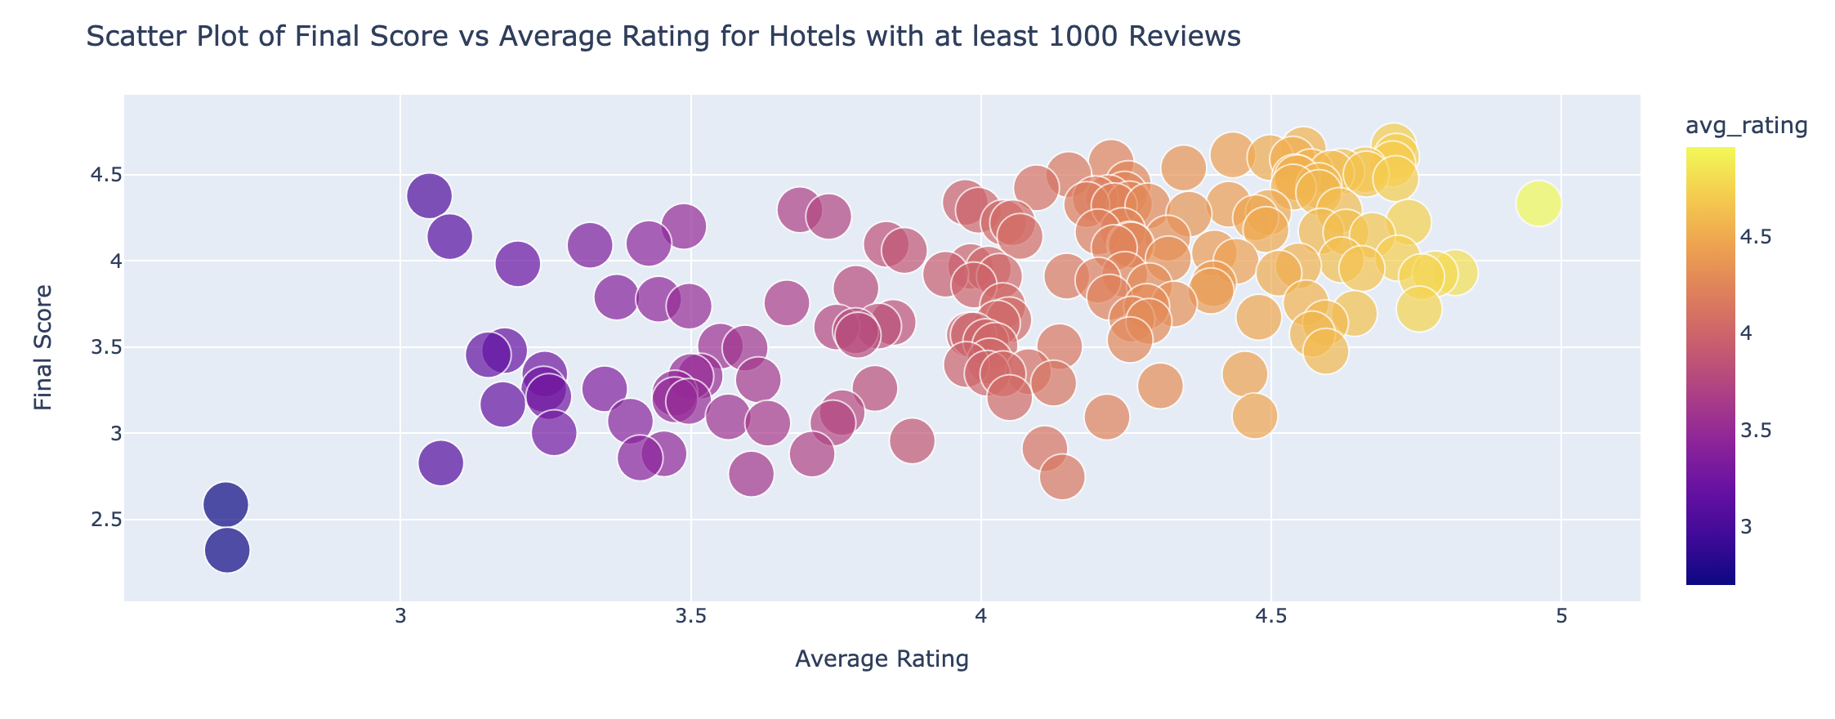
Results
Final Score: Average of all the reviews sentiments, scaled on 0-5
Average Rating: Average of the star ratings for each hotel

Slide 12
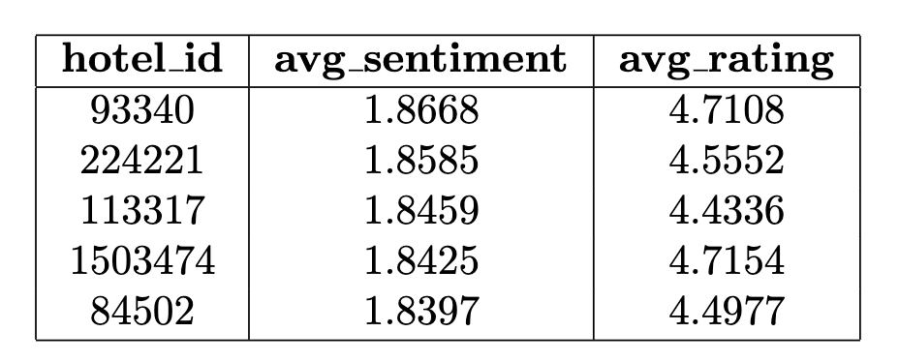
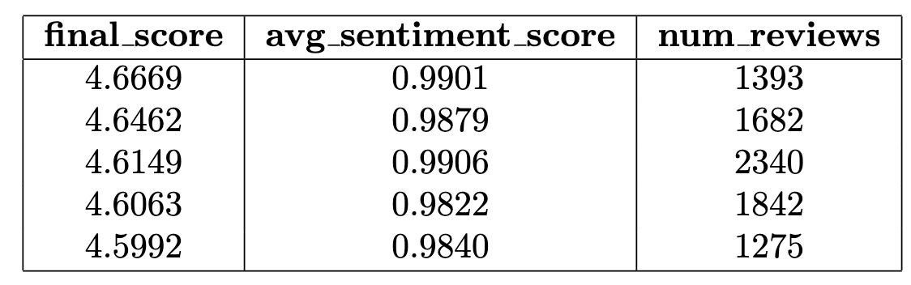
Sentiment Analysis with PySpark ML
Tokenization: Each review is divided into words using the Tokenizer
Stopwords removal: The most frequent words in the English language are removed since they do not provide useful information for the sentiment analysis
Hashing TF: The hashing is used to map a word to an index in a feature vector
Logistic Regression fit: We trained a Logistic Regressor on the data labeled with POSITIVE, NEGATIVE or NEUTRAL after dividing the dataset into test and train set (20% and 80%)
Evaluation: 88% Accuracy on test set

Slide 13

Conclusions
Summary: Implemented a pipeline for analyzing hotel reviews using MapReduce and Deep Learning. Achieved accurate sentiment analysis with PySpark ML.
Future Work: Optimize the sentiment analysis process, explore more advanced models, and apply the pipeline to other domains.

