Slide 1


NEW!
AtliQ Grands
The Hotel Data Comic
How Business & Data Intelligence can win back market share and revenue
Metrics • Dashboard • Insights
Notes:
Welcome. This comic walks through the problem, the data and metrics we built, the dashboard, and what the data tells AtliQ Grands to do next.

Slide 2




The Problem
We are losing market share and revenue in luxury & business hotels - and we have NO in-house analytics team!
20 years
Five-star
Losing ground
in the hospitality industry
hotels across India
rivals move fast, decisions lag
Plan: hire a 3rd-party analyst (us!) to turn history into decisions
Notes:
AtliQ Grands has 20 years in hospitality and several five-star hotels, but competitors and weak decisions are eroding luxury and business-hotel share. There is no in-house analytics team, so they hired us.

Slide 3



Our Mission: 3 Tasks
1
2
3
Create metrics
Build the dashboard
Find new insights
Turn the metric list into reusable DAX measures: revenue, occupancy, rating, cancellations.
Follow the stakeholder mock-up: KPI cards, city / platform / property views, filters.
Go beyond the brief: cancellation leakage, channel mix, weekend skew, hotel report card.
Deliverable: a Power BI report - Overview, Monthly, About
Notes:
Three tasks: create the metrics from the metric list, build the dashboard from the stakeholder mock-up, and find extra insights that nobody asked for.

Slide 4
What Data We Need
dim_hotels
dim_rooms
dim_date
property_id, property_name, category, city
room_id, room_class
date, mmm yy, week no, day_type
fact_bookings
fact_aggregated_bookings
One row per booking: booking_id, property_id, booking_date, check_in_date, checkout_date, no_guests, room_category, booking_platform, ratings_given, booking_status, revenue_generated, revenue_realized
Daily capacity: property_id, check_in_date, room_category, successful_bookings, capacity
Typical AtliQ dataset - rename to match your model
Notes:
This is the typical AtliQ hospitality data model: three dimension tables feeding two fact tables. Names may differ slightly in your file, so adjust the DAX that follows.

Slide 5
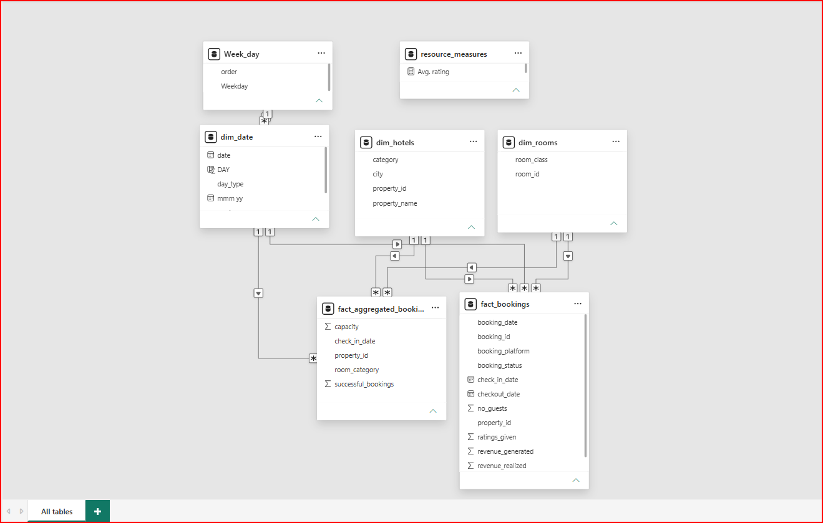
Data Model View

Slide 6

Metric Queries: The Basics
Metric | DAX query | Output
Revenue | Revenue = SUM(fact_bookings[revenue_realized]) | Rs 573.2M
Total Bookings | Total Bookings = COUNT(fact_bookings[booking_id]) | 45,129
Total Capacity | Total Capacity = SUM(fact_aggregated_bookings[capacity]) | about 78K
Occupancy % | Occupancy % = DIVIDE(SUM(fact_aggregated_bookings[successful_bookings]), [Total Capacity]) | 59%
Average Rating | Average Rating = AVERAGE(fact_bookings[ratings_given]) | 3.62
Tip: base measures first, then reuse them so every KPI stays consistent
Notes:
Build base measures first, then reuse them. Outputs are the May values shown on the dashboard. Total capacity is the sum of the four room-class bars, roughly 78K.

Slide 7
Metric Queries: Smart Ones
Metric | DAX query | Output
Cancelled Bookings | CALCULATE([Total Bookings], fact_bookings[booking_status] = "Cancelled") | 11,188
Cancellation % | DIVIDE([Cancelled Bookings], [Total Bookings]) | 24.8%
Revenue PM | CALCULATE([Revenue], DATEADD(dim_date[date], -1, MONTH)) | Jun: Rs 573.2M
Revenue MoM % | DIVIDE([Revenue] - [Revenue PM], [Revenue PM]) | Jun -1.5%, Jul -11.6%
NEW RevPAR | DIVIDE([Revenue], [Total Capacity]) | about Rs 7.3K
NEW Weekend share | DIVIDE(CALCULATE(SUM(fact_aggregated_bookings[successful_bookings]), dim_date[day_type] = "weekend"), SUM(fact_aggregated_bookings[successful_bookings])) | 59%
Yellow rows = extra measures we added. LDC/PDC (profit/loss due to cancellation) stays as defined in the report.
Notes:
Cancellation and month-on-month measures come from the metric list. Rows highlighted in yellow are extra measures we added for insights. LDC/PDC is the dashboard's own measure and was kept as built.

Slide 8
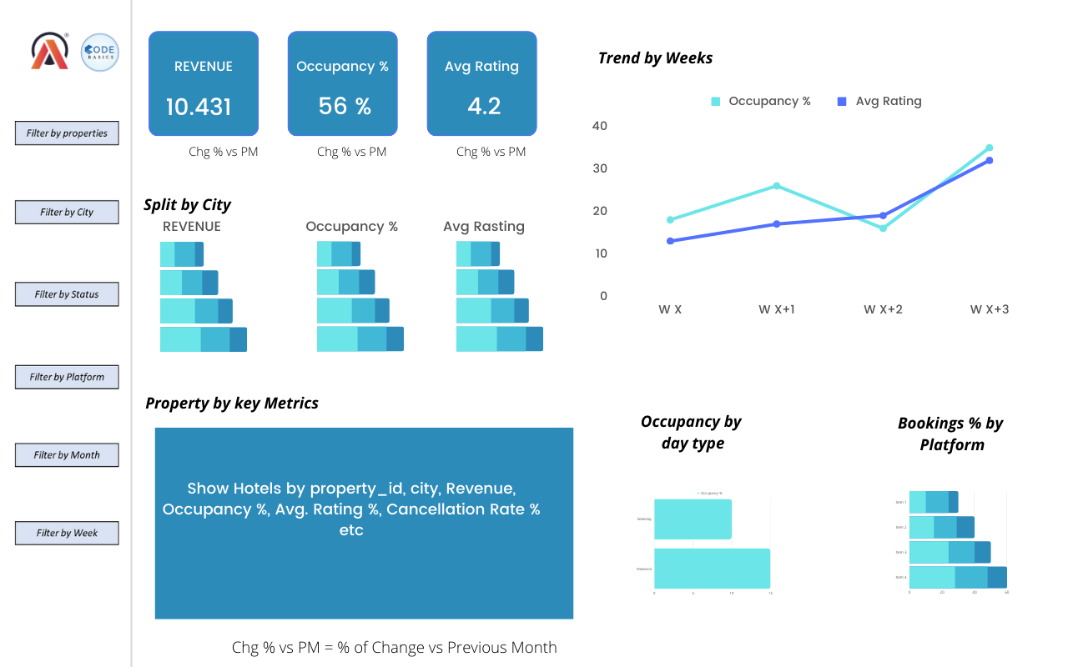
Mock Up Dashboard

Slide 9
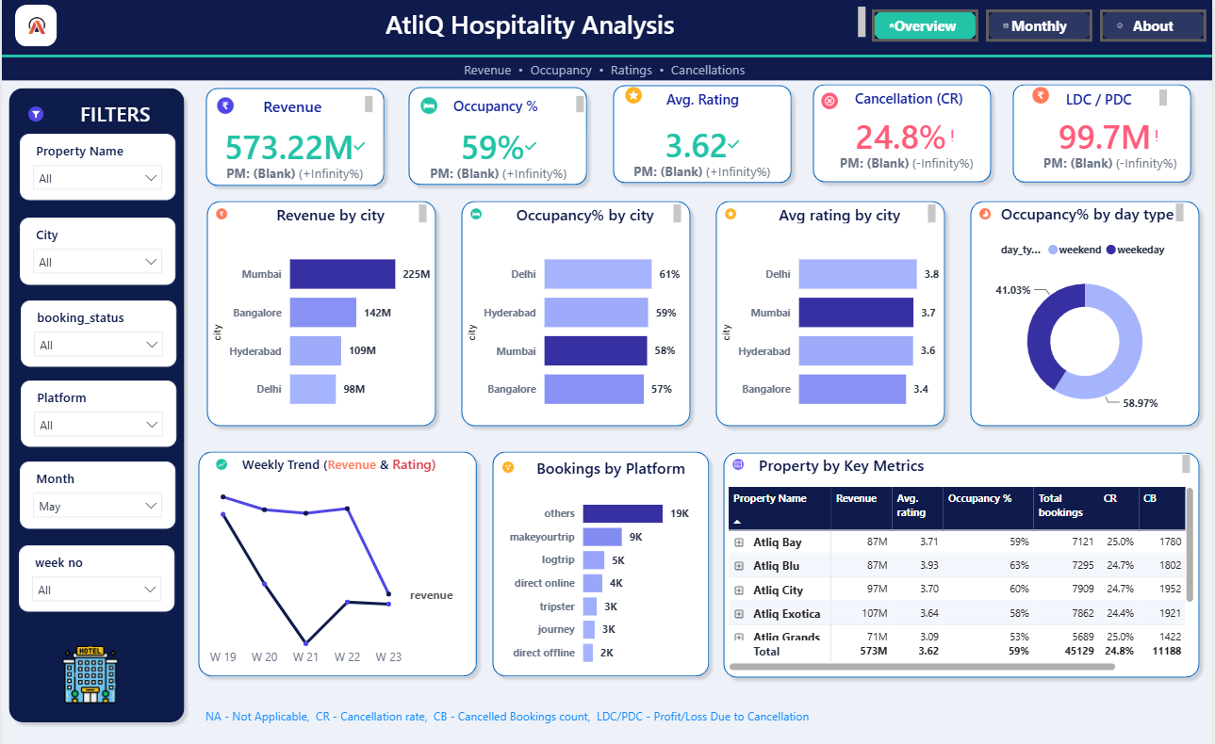
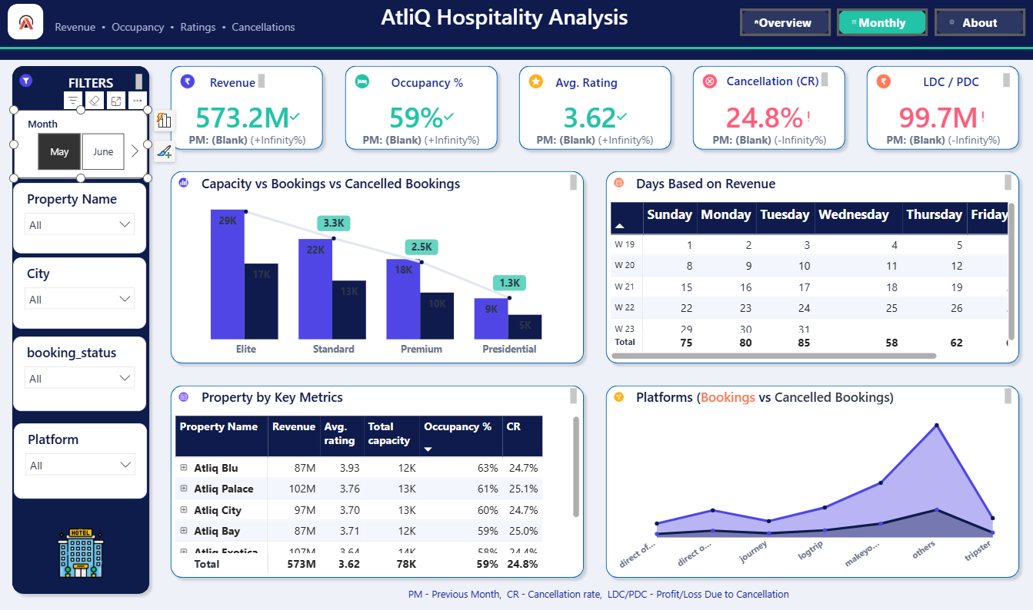
The Output: Our Dashboard
Page 1 Overview: KPIs, city, platform, property
Page 2 Monthly: month slicer, capacity, weekdays
All visuals react to the 6 filters on the left
Notes:
Page 1 is the Overview with five KPI cards, city, platform and property views. Page 2 is the Monthly page with a month slicer, capacity vs bookings and a weekday revenue table. Every visual reacts to the six filters.

Slide 10



May: The Baseline
Revenue
573.2M
first month
Occupancy
59%
first month
Avg rating
3.62
first month
Cancel (CR)
24.8%
first month
LDC / PDC
99.7M
first month
Baseline month: Rs 573M revenue, 59% occupancy, 24.8% cancellations
Notes:
May is the first month, so there is no previous-month comparison. Revenue 573.2M, occupancy 59 percent, cancellation rate 24.8 percent, loss from cancellation 99.7M.

Slide 11
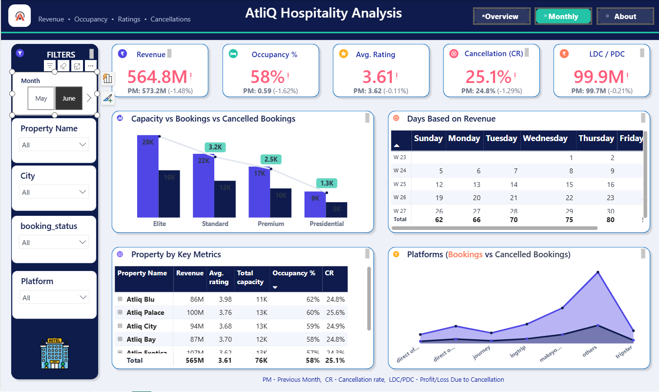
June: A Slight Slip
Revenue
564.8M
PM 573.2M (-1.48%)
Occupancy
58%
PM 59%
Avg rating
3.61
PM 3.62
Cancel (CR)
25.1%
PM 24.8%
LDC / PDC
99.9M
PM 99.7M
Slight slip: revenue -1.5%, occupancy -1 point, cancellations creep up to 25.1%
Notes:
June revenue is 564.8M, down 1.48 percent from May. Occupancy 58 percent. Cancellation rate crept up to 25.1 percent and the loss measure to 99.9M.

Slide 12
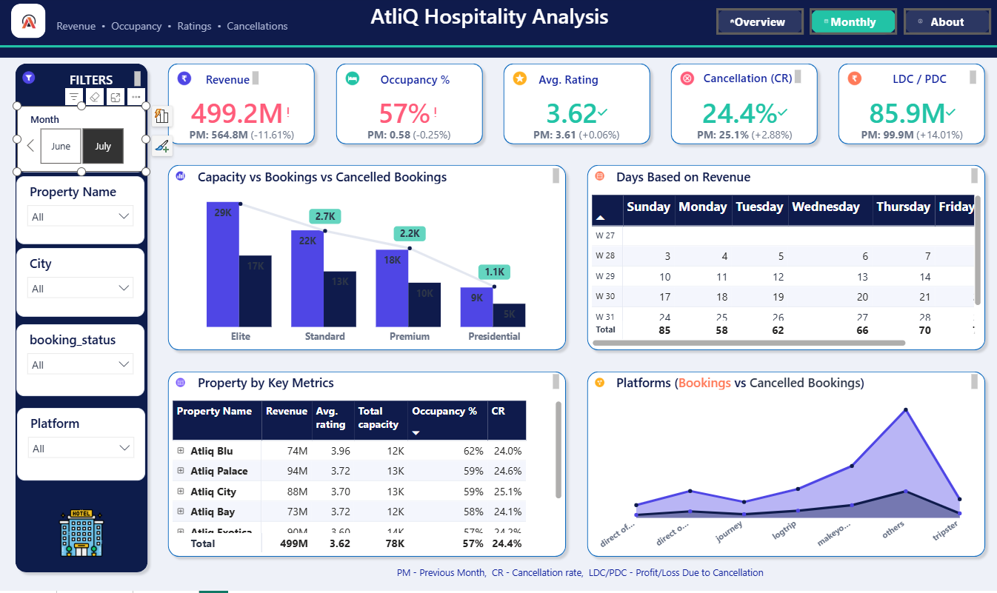
July: The Big Drop
Revenue
499.2M
PM 564.8M (-11.61%)
Occupancy
57%
PM 58%
Avg rating
3.62
PM 3.61
Cancel (CR)
24.4%
PM 25.1%
LDC / PDC
85.9M
PM 99.9M
Biggest drop: revenue -11.6%, but cancellations improve to 24.4% and LDC falls to Rs 85.9M
Notes:
July revenue fell 11.61 percent to 499.2M. Occupancy only slipped to 57 percent. Cancellation rate improved to 24.4 percent and the loss measure fell to 85.9M.

Slide 13
Month by Month: Revenue Slides
Occupancy
Cancellation
59 > 58 > 57%
24.8 > 25.1 > 24.4%
Avg rating
LDC / PDC
3.62 > 3.61 > 3.62
99.7 > 99.9 > 85.9M
Revenue fell 12.9% from May to July, but occupancy slipped only 2 points: the loss looks like price and mix, not empty rooms (to verify)
Notes:
Revenue fell from 573.2M in May to 499.2M in July, a 12.9 percent drop. Occupancy only slipped from 59 to 57 percent, so the gap suggests lower realised price or a weaker room mix. That is a hypothesis to verify with rate data.

Slide 14

Insight 1: Cities Tell Tales
Mumbai: the cash cow
39% of revenue (Rs 225M)
Delhi: the hidden gem
Lowest revenue, yet best occupancy (61%) and rating (3.8)
Bangalore: needs love
Lowest rating (3.4) and occupancy only 57%
Action: protect Mumbai, test higher rates in Delhi, fix guest experience in Bangalore
Notes:
Mumbai is the cash cow with 39 percent of May revenue. Delhi earns the least but has the best occupancy and rating, which hints at pricing headroom. Bangalore has the weakest rating at 3.4.

Slide 15
Insight: Room Class Fill
~56-59%
utilisation in every class (Elite 59%, Presidential 56%)
9K vs 5K
Presidential rooms: only 5K of 9K capacity booked
July: down
cancellations fell in every class (Standard 3.3K to 2.7K)
Empty rooms are spread across every class: use dynamic pricing and upgrade offers, not one-class fixes
Notes:
Every room class runs at roughly 56 to 59 percent utilisation, so empty rooms are spread across all classes. July cancellations fell in every class. Numbers are read from the capacity vs bookings chart and are rounded to the nearest thousand.

Slide 16

Insight: Hotels June vs July
Bay -16%, Blu -14%
biggest July drops (87 to 73M, 86 to 74M)
City, Palace -6%
smaller drops (94 to 88M, 100 to 94M)
Occupancy flat
Blu 62% and Bay 58% in both months
July revenue fell with no occupancy change in Bay and Blu: again points to price, not footfall
Notes:
From the Monthly page property tables. Atliq Bay and Atliq Blu lost the most revenue from June to July, while their occupancy did not move: 58 and 62 percent in both months.

Slide 17

Insight 2: Cancel Culture
1 in 4
bookings cancelled: 24.8% (11,188 of 45,129)
Rs 99.7M
LDC/PDC, about 17% of May revenue
3 months
rate stuck near 25%; July best at 24.4%, LDC down 14%
Fix: deposits or non-refundable rates, reminder nudges, tighter cancel windows; track by platform
Notes:
About one in four bookings is cancelled, and the loss measure is roughly 17 percent of revenue. The rate barely moved over three months; July improved slightly and LDC fell 14 percent.

Slide 18

Insight 3: Who Books and When
42%
"others" alone (19K of 45K bookings)
62%
top two channels: others + makeyourtrip
13%
direct online + offline: only 6K bookings
Grow direct bookings, and use weekday offers: weekends hold 59% of occupancy, weekdays only 41%
Notes:
Others and MakeYourTrip bring 62 percent of bookings; direct online and offline together only 13 percent. Weekends hold about 59 percent of occupancy versus 41 percent on weekdays.

Slide 19
Insight 4: Hotel Report Card
Hotel | Revenue | Avg rating | Occupancy | Bookings | Verdict
Atliq Exotica | 107M | 3.64 | 58% | 7,862 | Top earner
Atliq Palace | 102M | 3.76 | 61% | n/a | Strong
Atliq City | 97M | 3.70 | 60% | 7,909 | Solid
Atliq Bay | 87M | 3.71 | 59% | 7,121 | Mid-pack
Atliq Blu | 87M | 3.93 | 63% | 7,295 | Quality star
Atliq Grands | 71M | 3.09 | 53% | 5,689 | Needs rescue
May data, six of seven properties (Seasons not visible in the screenshots)
Atliq Grands: rating 3.09 (0.5 below the next hotel), 53% occupancy, fewest bookings. Copy Atliq Blu (3.93, 63%)
Notes:
May figures for six of the seven properties; Seasons was not visible. Atliq Grands has the lowest rating, occupancy and bookings of the six. Palace bookings were not visible.

Slide 20
All Insights at a Glance
# | Insight | Evidence | Action
1 | Revenue falls faster than occupancy | Rev -12.9%, occupancy -2 pts | Check rates and room mix
2 | 1 in 4 bookings cancelled | 24.8%, loss about Rs 99.7M | Deposits, reminders
3 | Mumbai carries the chain | 39% of revenue | Protect it, grow other cities
4 | Delhi may be underpriced | Best occupancy 61%, rating 3.8, lowest revenue | Test higher rates
5 | Bangalore service gap | Rating 3.4, occupancy 57% | Guest-experience audit
6 | Channel dependence | Top two 62%, direct only 13% | Push direct booking
7 | Weekend skew | 59% weekend vs 41% weekday | Weekday offers
8 | Atliq Grands lags | Rating 3.09, occupancy 53% | Rescue plan, copy Blu
9 | Empty rooms in every class | 56-59% utilisation | Dynamic pricing, upgrades
10 | July hit Bay and Blu | -16% and -14% revenue, flat occupancy | Review July pricing
Also worth a drill-down: the weekly trend shows a dip around week 21 in May.
Notes:
Ten findings in one place: what we saw, the evidence, and the action. Ranking by impact would need rate and cost data.

Slide 21
What This Data Cannot Tell
Market share
Why revenue dropped
The problem says share is falling, but there is no competitor or market data here. We only see internal performance.
Price and room mix are the likely cause, but this is a hypothesis.
Need: competitor / market benchmarks
Need: room rates (ADR) by class and date
Luxury vs Business
Missing hotels
The problem focuses on this category, but no category split appears on the dashboard views.
Seasons is not visible in any screenshot; Grands is missing from June and July tables.
Need: hotel category on a visual
Need: full property tables per month
Notes:
Being honest about limits builds trust. Market share needs competitor or market data. Price effects need room-rate data. Luxury versus business needs the hotel category field. Seasons and Grands are not visible in the June and July screenshots.

Slide 22
What We Do Next
Actions
Data we still need
1
Rescue Atliq Grands: service audit, learn from Blu
1
Room rates / ADR and competitor rates
2
Cut cancellations: deposits, non-refundable rates, reminders
2
Cancellation reasons, lead time and refund terms
3
Grow direct bookings beyond 13% share
3
Commission and marketing cost per channel
4
Fill weekdays with corporate and midweek offers
4
Guest review text (why 3.09 and 3.4?)
5
Test higher rates in Delhi (best occupancy and rating)
5
12+ months of history: seasonality and events
Notes:
Left: five actions from the insights. Right: the extra data that would let us confirm the hypotheses and size the prize.

Slide 23

Data In. Decisions Out!
1
Revenue -12.9% May to July
price and mix, not empty rooms
2
1 in 4 bookings cancelled
about Rs 99.7M at stake
3
Grands + direct channels
the biggest upside
Thank you!
Notes:
Three takeaways: revenue is falling faster than occupancy, one in four bookings is cancelled, and Atliq Grands plus direct channels are the biggest upside. Open for questions.

Slide 24


