Slide 1


Ad-Hoc Analytics
+36%
product range
Ad-hoc SQL analysis for AtliQ Hardwares
18 BUSINESS REQUESTS | FY2017 - FY2021
73%
retail share
110x
Croma growth
Notes:
Title slide: Finance Analytics - ad-hoc SQL analysis of 18 business requests for AtliQ Hardwares.

Slide 2






What we will cover
1
2
3
4
5
Company overview
Problem statement
Dataset and model
Analytics and insights
Recommendations
Who AtliQ is
Why a SQL challenge
Six linked tables
18 requests answered
What to do next

Slide 3

India's leading hardware maker, going global
AtliQ Hardwares (an imaginary company) is one of the leading computer hardware producers in India and has expanded into other countries too.
PC
Personal Computers
P&A
Peripherals and Accessories
N&S
Networking and Storage
129
84
27
Notebook products
Peripherals products
Storage products
Personal, business and gaming laptops
Internal HDD, graphics cards, processors, motherboards
External SSDs, USB flash drives
32
116
9
Desktop products
Accessories products
Networking products
397
Personal desktops
Mouse, keyboard, batteries
Wi-Fi extenders
unique products; P&A holds half

Slide 4





Why the SQL challenge?
1
2
3
4
Management saw a lack of insights for quick, data-informed decisions.
Decision: grow the data analytics team with several junior analysts.
Tony Sharma, the analytics director, looks for strong tech and soft skills.
To test them, Tony runs a SQL challenge of business requests.
The result: 18 real business requests, answered end-to-end in SQL, from sales to supply chain.

Slide 5

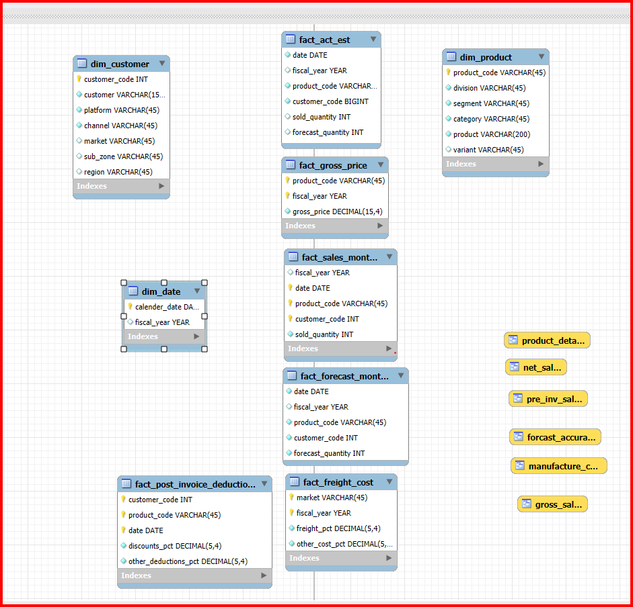
Dataset and data model
DIM
dim_customer
Customers, markets, channels
DIM
dim_product
Division, segment, category, variant
FACT
fact_sales_monthly
Monthly units sold
FACT
fact_gross_price
Gross price by fiscal year
FACT
fact_manufacturing_cost
Manufacturing cost per product
FACT
fact_pre_invoice_deductions
Pre-invoice discount percentages

Slide 6
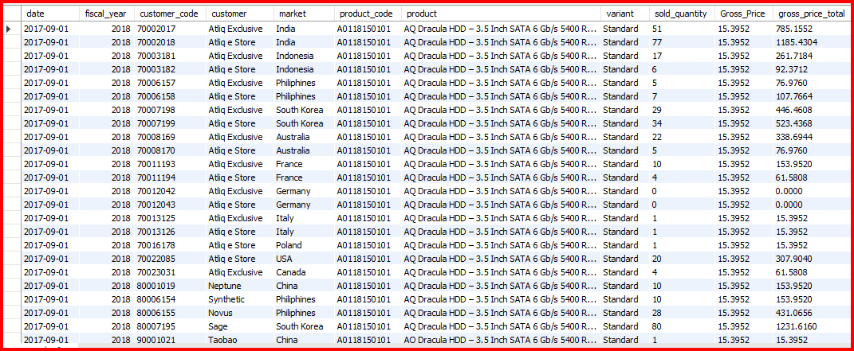
A peek at the data: gross_sales view
One row per customer, product and month
Gross total = quantity x gross price
Feeds net sales, top-N and market reports
Product: AQ Dracula HDD (3.5 inch, Standard variant), first sales month of FY2018.

Slide 7

18 business requests, one story
PART 1 | Sales and product analytics
PART 2 | Customers, markets and supply chain
1
APAC markets
2
Product growth
11
Top customers
12
APAC customer share
3
Segment mix
4
Segment growth
13
Top sellers by division
14
Croma yearly sales
5
Cost extremes
6
Top discounts
15
Market badges
16
Forecast accuracy
7
Monthly sales
8
Quarterly volume
17
Top products
18
Top markets
9
Channel mix
10
Top sellers

Slide 8
Headline insights at a glance
+36%
R2
82.87%
R3
73.22%
R9
Product range grew in a year
of variety sits in 3 segments
of gross sales via Retailers
245 to 334 unique products, about 7 launches a month.
Notebook, Accessories and Peripherals dominate the range.
Retail is about 4.7x Direct: a concentration risk.
110x
R14
1.6x
R18
0%
R16
Croma sales growth since 2017
India vs USA in net sales
Forecast accuracy in the Netherlands
0.53M to 58.37M, more than doubling every year.
210.67M vs 132.05M: India is 47% of the top four.
Down from 35-39% in FY2020: the steepest fall.

Slide 9

AtliQ Exclusive spans 8 APAC markets
REQUEST 01
Which markets does the customer AtliQ Exclusive operate in within the APAC region?
SQL p.31
India
Bangladesh
KEY INSIGHTS
8
AtliQ Exclusive operates in eight countries across APAC.
Coverage is balanced: two markets in each of four sub-regions.
So what: India anchors the region and leads FY2021 net sales (R18).
Japan
South Korea
Indonesia
Philippines
countries in the APAC region
Australia
New Zealand
4 x 2
South Asia
East Asia
Southeast Asia
Oceania
sub-regions covered, two markets each
Notes:
Request 1: Which markets does the customer AtliQ Exclusive operate in within the APAC region?

Slide 10

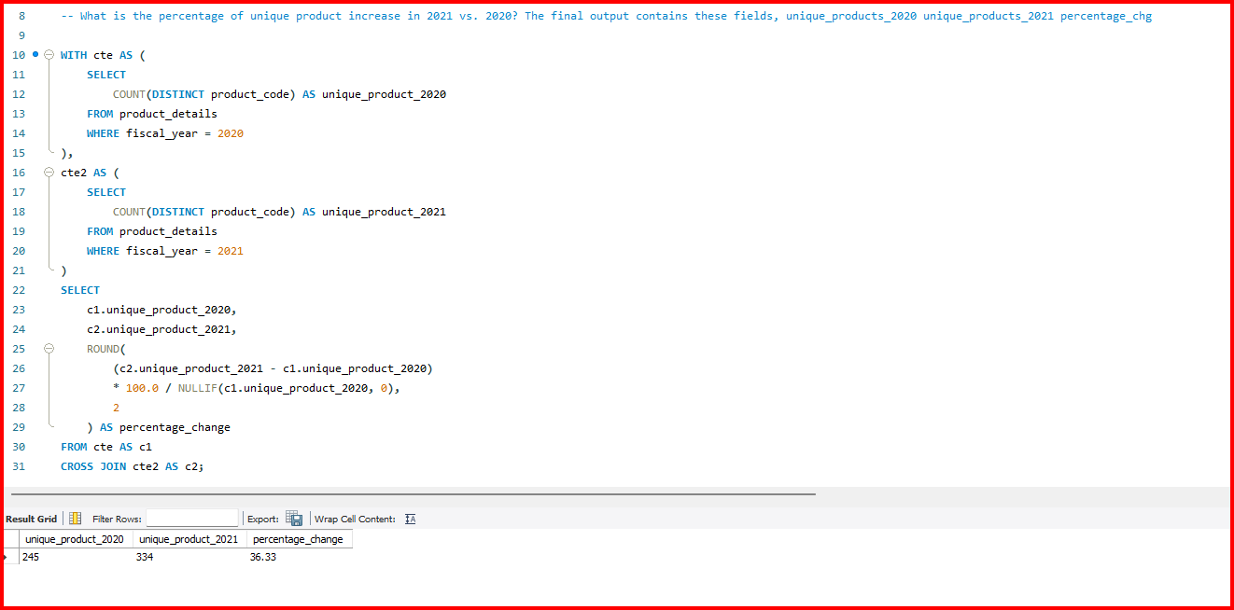
Product range up 36% in a year
REQUEST 02
What is the percentage increase in unique products in 2021 vs 2020?
SQL p.31
KEY INSIGHTS
MY SQL QUERY
Unique products grew from 245 in 2020 to 334 in 2021.
That is 89 new products, roughly 7 launches every month.
So what: A wider range signals innovation and diverse customer needs.
+89 new products
+36.33%
unique products, 2021 vs 2020
Notes:
Request 2: What is the percentage increase in unique products in 2021 vs 2020?
SQL:
with cte1 as (
select count(distinct product_code) as unique_product_2020
from fact_sales_monthly
where fiscal_year = 2020
),
cte2 as (
select count(distinct product_code) as unique_product_2021
from fact_sales_monthly
where fiscal_year = 2021
)
select
unique_product_2020,
unique_product_2021,
(unique_product_2021-unique_product_2020)*100/unique_product_2020 as pct_change
from cte1
cross join cte2
;
;

Slide 11
Three segments hold 83% of the range
REQUEST 03
Unique product count for each segment, sorted from highest to lowest.
SQL p.32
KEY INSIGHTS
Notebooks, Accessories and Peripherals make up 82.87% of variety.
Desktop, Storage and Networking hold just 17.13%.
So what: Match the thin segments to customer trends and demand.
82.87%
of the 397-product range in just three segments
Notes:
Request 3: Unique product count for each segment, sorted from highest to lowest.
SQL:
select
segment,
count(distinct product_code) as Product_count
from dim_product
group by segment
order by Product_count desc
;

Slide 12
Accessories added the most new products
REQUEST 04
Which segment gained the most unique products in 2021 vs 2020?
SQL p.32
KEY INSIGHTS
Accessories added the most: +34 new products, 38% of all 89 additions.
Desktop grew about 214% (7 to 22), the fastest growth rate.
So what: Storage (+5) and Networking (+3) added the fewest: room to grow.
+34
new Accessories products, the most of any segment
Notes:
Request 4: Which segment gained the most unique products in 2021 vs 2020?
SQL:
with unique_products as(
select
p.segment,
count(distinct(case when fiscal_year = 2020 then s.product_code end)) as product_count_2020,
count(distinct(case when fiscal_year = 2021 then s.Product_code end)) as product_count_2021
from fact_sales_monthly s
join dim_product p
on s.product_code = p.product_code
group by p.segment
)
select
*,
product_count_2021-product_count_2020 as difference
from unique_products
order by difference desc
;

Slide 13


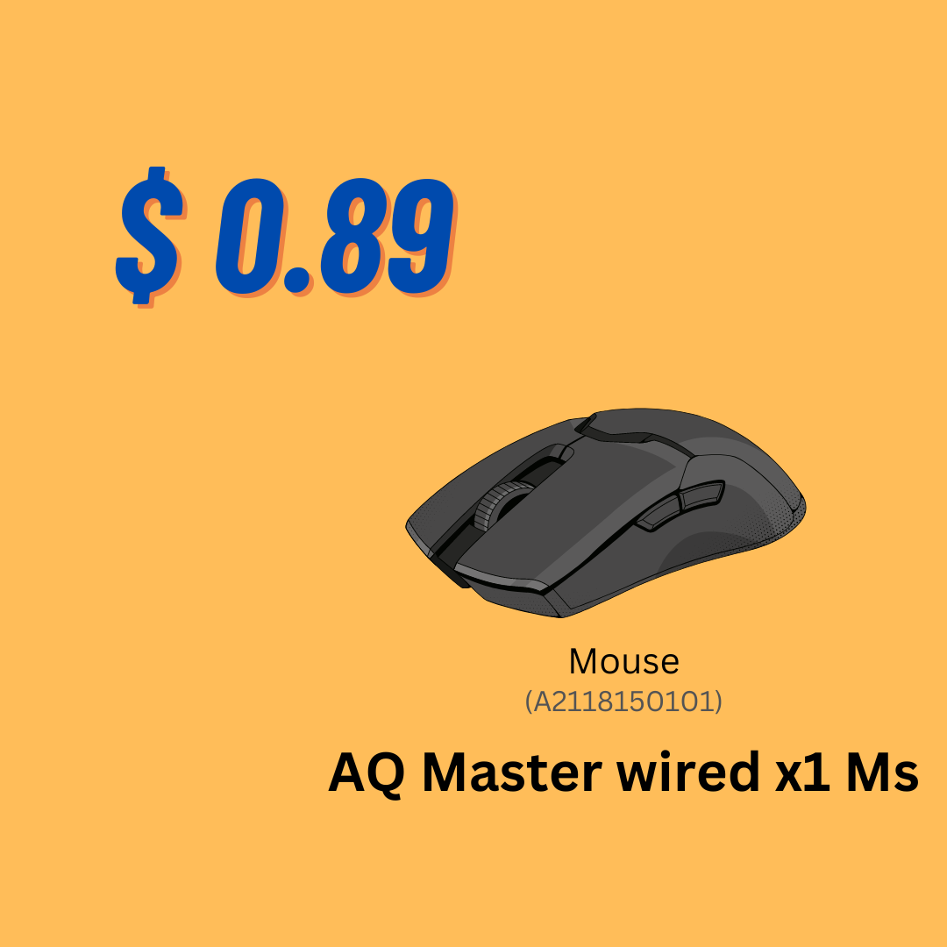
Costliest vs cheapest to make
REQUEST 05
Products with the highest and lowest manufacturing cost.
SQL p.33
KEY INSIGHTS
Highest: AQ HOME Allin1 Gen 2 (personal desktop) at $240.54.
Lowest: AQ Master wired x1 Ms (mouse) at $0.89.
So what: Costs span two orders of magnitude, so price product by product.
HIGHEST COST
LOWEST COST
270x
Product cost cards: manufacturing cost per unit
cost gap between the highest and lowest
Notes:
Request 5: Products with the highest and lowest manufacturing cost.
SQL:
(select
p.product_code,
p.product,
m.manufacturing_cost
from dim_product p
join fact_manufacturing_cost m
on p.product_code = m.product_code
order by m.manufacturing_cost desc
limit 1)
union
(select
p.product_code,
p.product,
m.manufacturing_cost
from dim_product p
join fact_manufacturing_cost m
on p.product_code = m.product_code
order by m.manufacturing_cost asc
limit 1)
;

Slide 14
Flipkart tops the discount list
REQUEST 06
Top 5 customers by average pre-invoice discount, FY2021, Indian market.
SQL p.33
KEY INSIGHTS
Flipkart leads with an average discount of 30.83%.
The top five sit in a tight 29.33% to 30.83% band.
So what: Discount depth is similar everywhere; compete on service and promotions.
1.5 pts
spread between the #1 and #5 customers
Notes:
Request 6: Top 5 customers by average pre-invoice discount, FY2021, Indian market.
SQL:
with cte1 as(
SELECT
*
from fact_pre_invoice_deductions
join dim_customer c
using (customer_code)
where fiscal_year = 2021
and c. market = ‘india’
)
select
customer_code,
customer,
concat(round(avg(pre_invoice_discount_pct)*100,2),"%") as avg_discount_pct
from cte1
group by customer_code, customer
order by avg(pre_invoice_discount_pct)*100 desc
limit 5
;

Slide 15

Sales rebounded after the COVID dip
REQUEST 07
Monthly gross sales of AtliQ Exclusive, to spot low and high months.
SQL p.34
KEY INSIGHTS
Mar-May were the weakest months, likely COVID-19; recovery began after June.
November peaks both years: 15.23M in FY2020, 32.25M in FY2021.
So what: Every FY2021 month beat FY2020; stock up for the November peak.
-90%
sales drop from Feb to Mar in FY2020
Notes:
Request 7: Monthly gross sales of AtliQ Exclusive, to spot low and high months.
SQL:
Select
monthname(s.date) as Month ,
s.fiscal_year as Year,
sum(sold_quantity*gross_price) as Gross_sales
from fact_sales_monthly s
join fact_gross_price g
on s.product_code = g.product_code
join dim_customer c
on s.customer_code = c.customer_code
where customer = "AtliQ Exclusive“
group by month,year
order by year asc
;

Slide 16
Q1 led volume; Q3 fell hardest
REQUEST 08
Which fiscal quarter of 2020 had the highest total quantity sold?
SQL p.34
KEY INSIGHTS
Q1 (Sep-Nov) led, at around 7 million units, a third of the year.
Q3 volume was 69% below Q2; Q4 then rebounded 142%.
So what: Plan stock and cash for sharp, shock-driven swings.
-69%
Q3 volume vs Q2, likely COVID-19
Notes:
Request 8: Which fiscal quarter of 2020 had the highest total quantity sold?
SQL:
select (
case
when month(date) in (9, 10, 11) then "Q1"
when month(date) in ( 12,1, 2) then "Q2"
when month(date) in ( 3, 4, 5) then "Q3"
when month (date) in (6,7,8) then "Q4"
end) as Quarter,
sum(sold_quantity) as total_sold_qty
from fact_sales_monthly
where fiscal_year = 2020
group by Quarter
order by total_sold_qty desc
;

Slide 17
Retailers drive 73% of gross sales
REQUEST 09
Which channel brought the most gross sales in FY2021, and its share?
SQL p.35
KEY INSIGHTS
Retailers contribute 73.22% of total gross sales.
Direct and Distributor together add only 26.79%.
So what: Retailer sales are 4.7x Direct: grow the other channels to cut risk.
73.22%
of FY2021 gross sales come via Retailers
Notes:
Request 9: Which channel brought the most gross sales in FY2021, and its share?
SQL:
with cte1 as (
select
c.channel,
round(sum((s.sold_quantity*g.gross_price)/1000000),2) as gross_sales_mln
from dim_customer c
join fact_sales_monthly s
on c.customer_code = s.customer_code
join fact_gross_price g
on s.product_code = g.product_code
where s.fiscal_year = 2021
group by c.channel
)
select
*,
concat(round(gross_sales_mln*100/ (select sum(gross_sales_mln) from cte1),2)," %") as pct_contribution
from cte1
order by pct_contribution desc
;

Slide 18
Each division has a clear bestseller type
REQUEST 10
Top 3 products in each division by units sold, FY2021.
SQL p.36
N&S
Networking and Storage
P&A
Peripherals and Accessories
PC
Personal Computers
1
AQ Pen Drive 2 IN 1 (Premium)
1
AQ Gamers Ms (Standard 2)
1
AQ Digit (Standard Blue)
701,373
428,498
17,434
2
AQ Pen Drive DRC (Plus)
2
AQ Maxima Ms (Standard 1)
2
AQ Velocity (Plus Red)
688,003
419,865
17,280
3
AQ Pen Drive DRC (Premium)
3
AQ Maxima Ms (Plus 2)
3
AQ Digit (Premium Misty Green)
676,245
419,471
17,275
Pen drives take all three spots; #3 trails #1 by just 3.6%.
All three are mice, and #3 trails #1 by only 2.1%.
All personal laptops, separated by just 0.9% at the top.
Notes:
Request 10 SQL:
with cte1 as(
select
p.division,
s.product_code,
concat(p.product," (", p.variant,")") as product,
sum(s.sold_quantity) as total_sold_qty,
rank() over(partition by p.division order by sum(s.sold_quantity) desc) as rank_order
from dim_product p
join fact_sales_monthly s
on p.product_code = s.product_code
where fiscal_year = 2021
group by p.division,s.product_code,p.product
)
select
*
from cte1
where rank_order in (1,2,3)
order by division, rank_order asc
;

Slide 19
Amazon leads FY2021 net sales
REQUEST 11
Top 3 customers by net sales in FY2021 (stored procedure top_customer).
SQL p.37
KEY INSIGHTS
Amazon leads with 109.03M in net sales.
The two AtliQ stores add up to 150.23M, 38% more than Amazon alone.
So what: AtliQ's own stores are a major revenue engine: grow both.
+38%
two AtliQ stores combined vs Amazon alone
Notes:
Request 11: Top 3 customers by net sales in FY2021 (stored procedure top_customer).

Slide 20
Amazon holds 13% of APAC net sales
REQUEST 12
Share of APAC net sales by customer, FY2021.
SQL p.37
KEY INSIGHTS
Amazon (12.99%), AtliQ Exclusive (11.67%) and AtliQ e Store (8.36%) hold 33.02%.
The next five customers each hold 3% to 6%.
So what: The top 8 hold 55.37%; a long tail of 1%-or-less customers holds the rest.
33.02%
of APAC net sales held by the top 3 customers
Notes:
Request 12: Share of APAC net sales by customer, FY2021.

Slide 21
Pen drives and mice sell in the millions
REQUEST 13
Top 3 product families in each division by units sold, FY2021.
SQL p.38
N&S
Networking and Storage
P&A
Peripherals and Accessories
PC
Personal Computers
Pen Drive DRC leads with 2.03M units, 1.6x the runners-up.
Three mice sit within 30K units of each other.
Digit, Gen Y and Elite are neck and neck, 0.5% apart.

Slide 22
Croma sales exploded 110x since 2017
REQUEST 14
Yearly gross sales of Croma India, FY2017 to FY2021.
SQL p.38
KEY INSIGHTS
Gross sales rose from 0.53M in 2017 to 58.37M in 2021.
2021 alone grew about 363% over 2020 (12.60M).
So what: Every year more than doubled: about 3.2x growth a year.
110x
Year-on-year multiple: 2018: 4.2x | 2019: 2.5x | 2020: 2.3x | 2021: 4.6x
Croma growth, FY2017 to FY2021
Notes:
Request 14: Yearly gross sales of Croma India, FY2017 to FY2021.

Slide 23
India and USA earn the Gold badge
REQUEST 15
Markets tagged Gold (over 5M units) or Silver, FY2021 units sold.
SQL p.39
KEY INSIGHTS
Only India (13.75M units) and the USA (7.95M) cross the 5M Gold line.
India outsells the USA and South Korea combined (13.75M vs 11.90M).
So what: South Korea (3.95M) and Canada (2.70M) lead the 25 Silver markets.
2 Gold
GOLD: over 5M units
SILVER: all other markets
markets above 5M units: India and USA
Notes:
Request 15: Markets tagged Gold (over 5M units) or Silver, FY2021 units sold.

Slide 24
Forecast accuracy fell across markets
REQUEST 16
Customers whose forecast accuracy dropped from FY2020 to FY2021 (%).
SQL p.40
KEY INSIGHTS
All nine Netherlands customers fell from about 35-39% accuracy to 0%.
Sweden, Philippines and South Korea lost roughly 10 to 19 points.
So what: Fix the Netherlands first: 0% likely signals a data or process break.
-38.5 pts
steepest fall: Radio Popular (NL), 38.53 to 0
Notes:
Request 16: Customers whose forecast accuracy dropped from FY2020 to FY2021 (%).
SQL:
-- The supply chain business manager wants to see which customers’ forecast accuracy has dropped from 2020 to 2021. -- Provide a complete report with these columns: customer_code, customer_name, market, forecast_accuracy_2020, forecast_accuracy_2021 -- forcast accuracy WITH cte AS ( SELECT customer_code, fiscal_year, SUM(forecast_quantity - sold_quantity) AS net_error, SUM(ABS(forecast_quantity - sold_quantity)) AS abs_net_error, SUM(forecast_quantity - sold_quantity) * 100 / SUM(forecast_quantity) AS net_err_pct, SUM(ABS(forecast_quantity - sold_quantity)) * 100 / SUM(forecast_quantity) AS abs_net_err_pct FROM fact_act_est WHERE fiscal_year IN (2020, 2021) GROUP BY customer_code, fiscal_year),cte2 AS ( SELECT c1.customer_code, d1.customer AS customer_name, d1.market, c1.fiscal_year, IF( c1.abs_net_err_pct > 100, 0, 100 - c1.abs_net_err_pct ) AS forecast_accuracy FROM cte AS c1 JOIN dim_customer AS d1 ON c1.customer_code = d1.customer_code),cte3 AS ( SELECT customer_code, customer_name, market, MAX(CASE WHEN fiscal_year = 2020 THEN forecast_accuracy END) AS forecast_accuracy_2020, MAX(CASE WHEN fiscal_year = 2021 THEN forecast_accuracy END) AS forecast_accuracy_2021 FROM cte2 GROUP BY customer_code, customer_name, market)SELECT customer_code, customer_name, market, ROUND(forecast_accuracy_2020, 2) AS forecast_accuracy_2020, ROUND(forecast_accuracy_2021, 2) AS forecast_accuracy_2021FROM cte3WHERE forecast_accuracy_2021 < forecast_accuracy_2020ORDER BY forecast_accuracy_2020 - forecast_accuracy_2021 DESC;

Slide 25
AQ BZ Allin1 tops product net sales
REQUEST 17
Top 5 products by net sales in FY2021 (stored procedure top_product).
SQL p.41
KEY INSIGHTS
AQ BZ Allin1 leads with 33.75M in net sales.
It sits 21% ahead of the runner-up, AQ Qwerty (27.84M).
So what: The top five bring in 134.44M: protect supply of the hero product.
33.75M
FY2021 net sales of AQ BZ Allin1
Notes:
Request 17: Top 5 products by net sales in FY2021 (stored procedure top_product).

Slide 26
India is the top net-sales market
REQUEST 18
Top 4 markets by net sales in FY2021 (stored procedure Top_Market).
SQL p.41
KEY INSIGHTS
India leads with 210.67M, about 1.6x the USA (132.05M).
South Korea (64.01M) and Canada (45.89M) complete the top four.
So what: Double down on India and the USA; nurture South Korea and Canada.
47%
India's share of the top-four net sales
Notes:
Request 18: Top 4 markets by net sales in FY2021 (stored procedure Top_Market).

Slide 27
Recommendations
1
2
3
4
Focus on the Desktop, Storage and Networking segments
Emphasize multi-channel marketing beyond retailers
Combine pricing strategies with attractive promotions
Grow key accounts such as Amazon, Flipkart and Croma
Only 17% of the range; Desktop grew 214% (R3, R4)
Retailers bring 73% of gross sales (R9)
Top discounts sit within 1.5 pts (R6)
Amazon leads net sales; Croma grew 110x (R11, R14)
5
6
7
8
Double down on India and USA; nurture South Korea and Canada
Fix forecast accuracy in the Netherlands, Sweden, Philippines and South Korea
Continuously improve based on customer feedback
Invest in sales-team training for improved performance
India is 47% of top-four net sales (R18)
Netherlands fell to 0% (R16)
Range grew by 89 products in a year (R2)
Q3 volume fell 69% vs Q2 (R8)

Slide 28
What the data told us
WHAT WE DID 18 business requests answered end-to-end in SQL across 6 linked tables, FY2017 to FY2021
PRODUCT AND RANGE
CHANNELS AND PRICING
CUSTOMERS AND MARKETS
SUPPLY CHAIN AND RISK
+36%
73%
47%
0%
Range grew 245 to 334 products in a year
83% of variety sits in 3 segments; Desktop grew 214%
Retailers drive 73.22% of gross sales, 4.7x Direct
Top-5 discounts sit in a tight 29-31% band
India is 47% of top-four net sales (210.67M)
Croma grew 110x; AtliQ stores beat Amazon by 38%
Netherlands forecast accuracy fell from 35-39% to 0%
Q3 FY2020 volume fell 69%, then rebounded 142%
So what: growth is real but concentrated in one channel, two markets and a handful of hero products.

Slide 29
How to improve the business
LEVER
WHAT TO DO
PROPOSED KPI
Cut channel risk
Grow Direct and Distributor beyond today’s 26.8%; lean on AtliQ’s own stores
1
Retailer share below 65%
Widen thin segments
Back Desktop, Storage and Networking with launches matched to demand
2
Segments at 17% of range to 25%
Fix forecasting
Audit the Netherlands data break first, then Sweden, Philippines, South Korea
3
Accuracy back above FY2020 levels
Grow key accounts
Joint plans with Amazon, Flipkart, Croma; promotions over deeper discounts
4
Net sales per top-5 account
Be shock-ready
Stock and cash buffers for demand dips and the November peak
5
Q-to-Q volume swing below 40%

Slide 30
Next steps: the 90-day plan
NEXT 30 DAYS
DAYS 31 TO 60
DAYS 61 TO 90
Fix and measure
Pilot and test
Scale and automate
Audit Netherlands forecast data and process
Build channel-mix and discount dashboards
Agree KPI targets with each business owner
Pilot promotions with Flipkart, Amazon, Croma
Test Direct and Distributor growth plays
Add demand-based forecast review for 4 markets
Roll out winning plays to India and USA
Automate monthly reports with stored procedures
Plan Desktop and Storage launches for FY2022
MY NEXT STEPS
as the analyst
Extend the analysis to profit and margin using manufacturing cost, then add forecast-bias and customer-level trend views to the SQL toolkit.

Slide 31

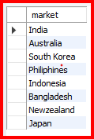
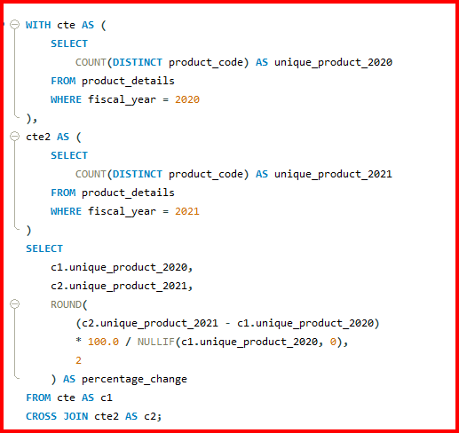
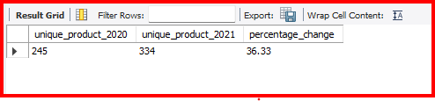
Appendix: SQL queries (1 of 11)
REQUEST 01
Which markets does the customer AtliQ Exclusive operate in within the APAC region?
QUERY
OUTPUT
REQUEST 02
What is the percentage of unique product increase in 2021 vs. 2020?
QUERY
OUTPUT

Slide 32
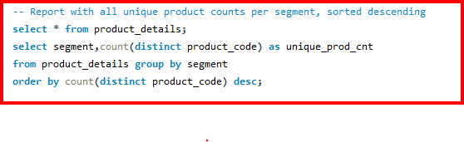
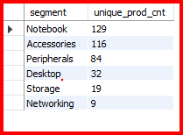
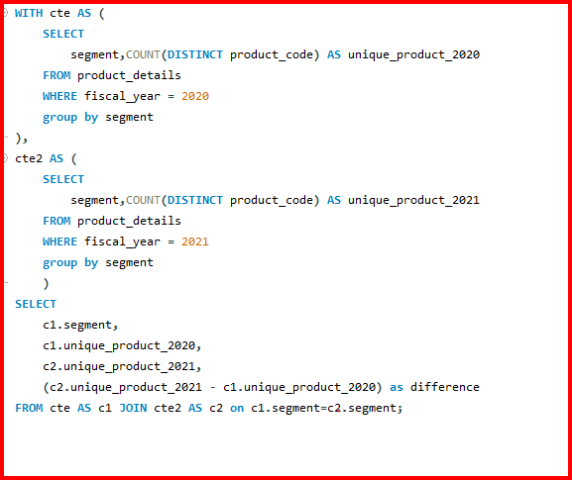
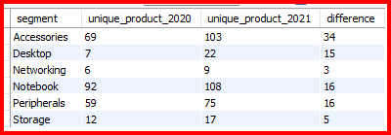
Appendix: SQL queries (2 of 11)
REQUEST 03
Report with all unique product counts per segment, sorted descending.
QUERY
OUTPUT
REQUEST 04
Which segment had the most increase in unique products in 2021 vs 2020?
QUERY
OUTPUT

Slide 33
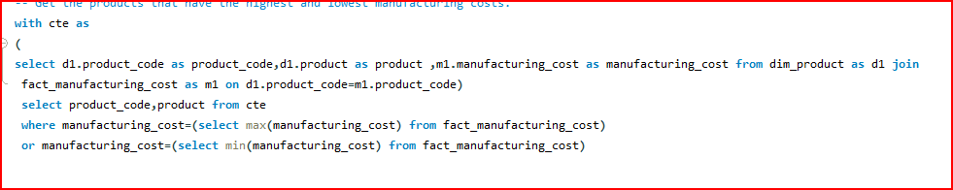

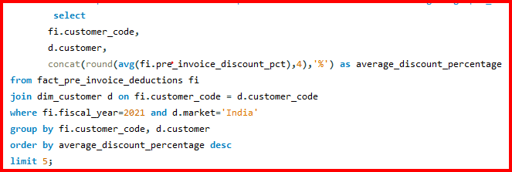
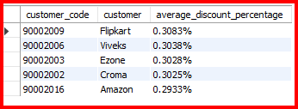
Appendix: SQL queries (3 of 11)
REQUEST 05
Get the products that have the highest and lowest manufacturing costs.
QUERY
OUTPUT
REQUEST 06
Top 5 customers with the highest average pre_invoice_discount_pct for FY2021 in the Indian market.
QUERY
OUTPUT

Slide 34
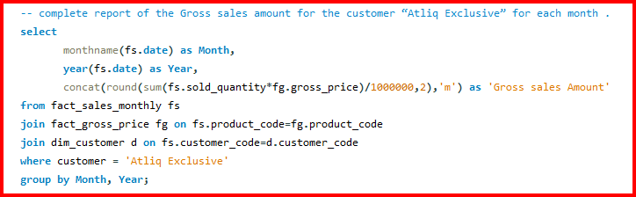
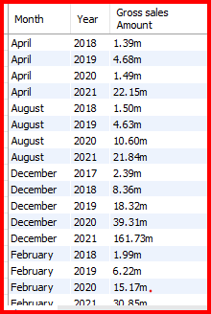
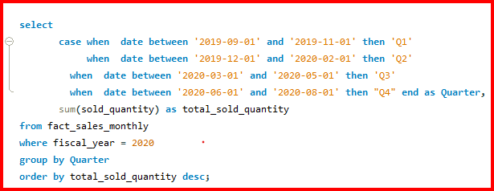
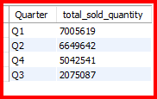
Appendix: SQL queries (4 of 11)
REQUEST 07
Complete report of the gross sales amount for the customer "Atliq Exclusive" for each month.
QUERY
OUTPUT
REQUEST 08
In which quarter of 2020 was the maximum total_sold_quantity, sorted by total_sold_quantity?
QUERY
OUTPUT

Slide 35
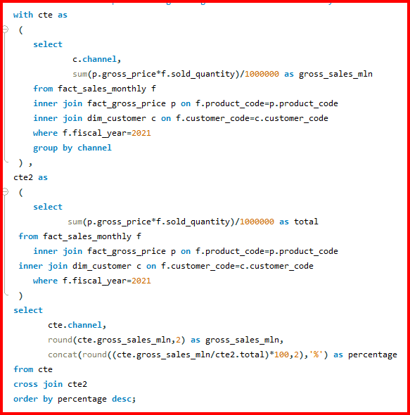

Appendix: SQL queries (5 of 11)
REQUEST 09
Which channel helped to bring more gross sales in the fiscal year 2021, and the percentage of contribution?
QUERY
OUTPUT

Slide 36
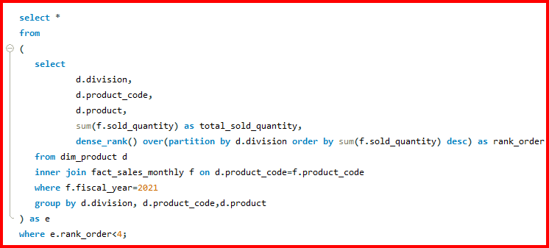
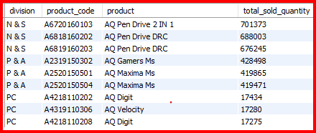
Appendix: SQL queries (6 of 11)
REQUEST 10
Get the top 3 products in each division with the highest total_sold_quantity in fiscal_year 2021.
QUERY
OUTPUT

Slide 37
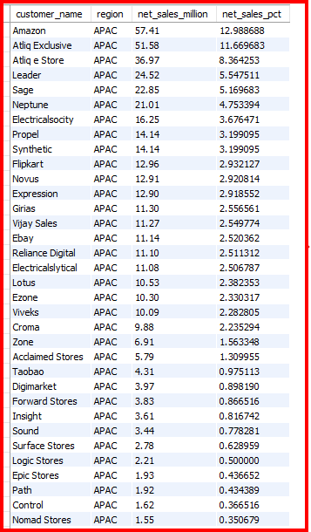
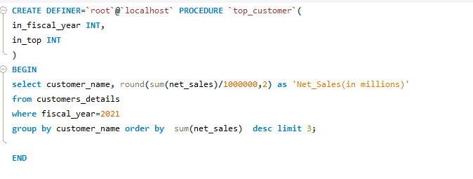
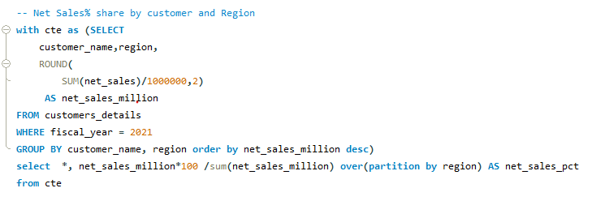
Appendix: SQL queries (7 of 11)
REQUEST 11
Stored procedure top_customer: net sales by customer for a fiscal year, top N.
REQUEST 12
OUTPUT
QUERY
OUTPUT
Output: see the chart on slide 19
REQUEST 12
Window function: each customer as a percent of its regional net sales, FY2021.
QUERY

Slide 38
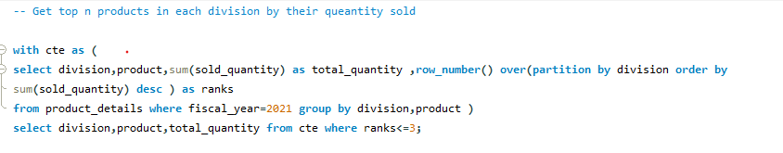
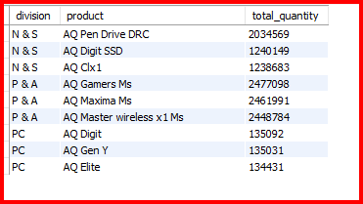
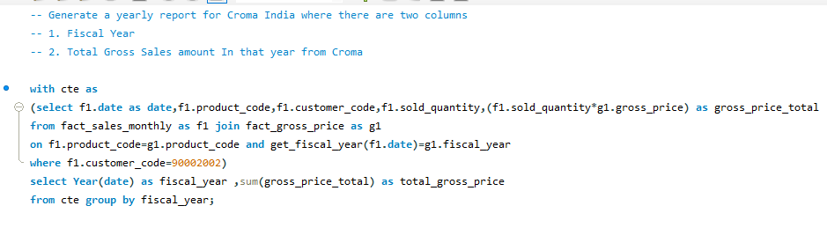
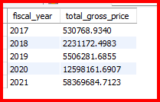
Appendix: SQL queries (8 of 11)
REQUEST 13
row_number() ranks products inside each division; ranks 1 to 3 are kept.
QUERY
OUTPUT
REQUEST 14
Joins monthly sales and gross price for Croma India, grouped by fiscal year.
QUERY
OUTPUT

Slide 39
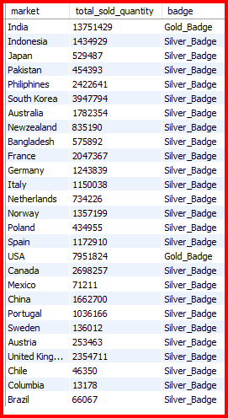
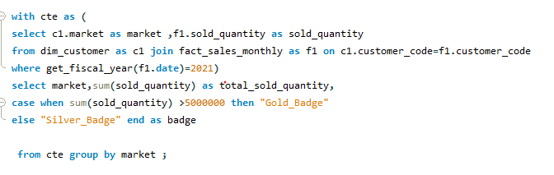
Appendix: SQL queries (9 of 11)
REQUEST 15
CASE tags markets above 5M units as Gold_Badge, all others as Silver_Badge.
QUERY
OUTPUT

Slide 40
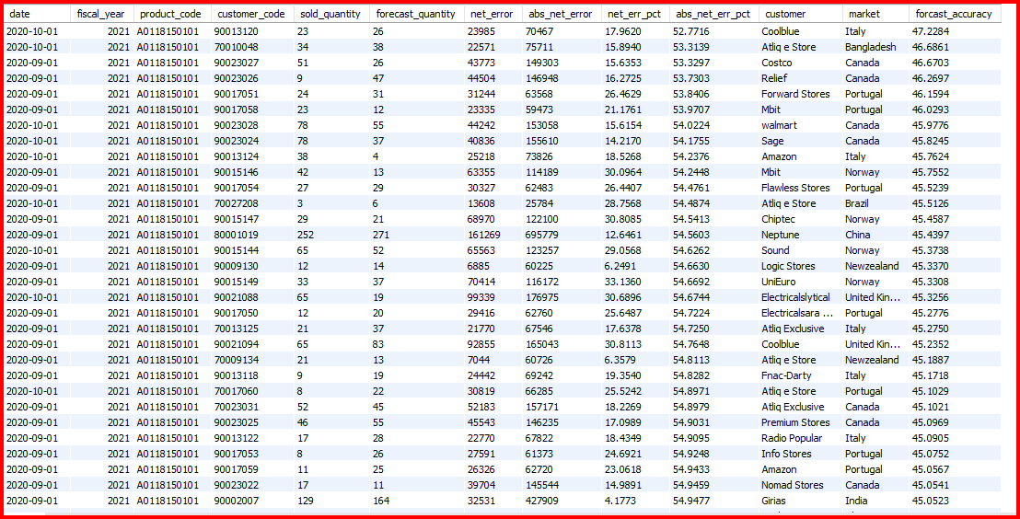
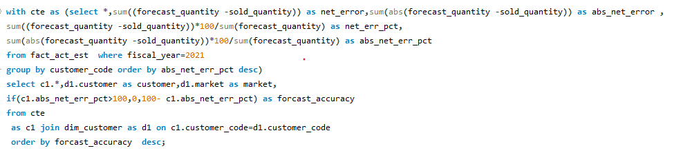
Appendix: SQL queries (10 of 11)
REQUEST 16
Forecast accuracy = 100 minus absolute net error percent, floored at 0.
QUERY
OUTPUT

Slide 41
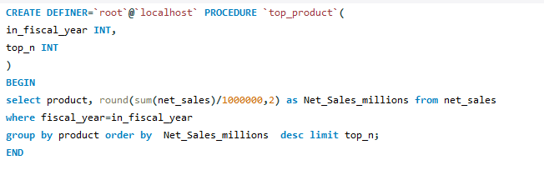
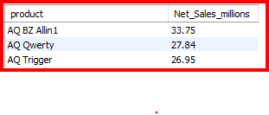
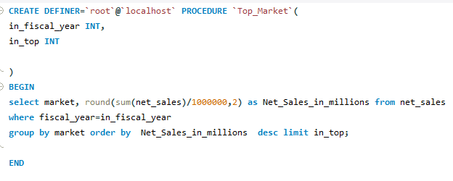
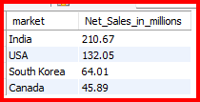
Appendix: SQL queries (11 of 11)
REQUEST 17
Stored procedure top_product: net sales by product for a fiscal year, top N.
QUERY
OUTPUT
REQUEST 18
Stored procedure Top_Market: net sales by market for a fiscal year, top N.
QUERY
OUTPUT

Slide 42
INSIGHTS
• AtliQ Exclusive operates its business in eight countries within the APAC region are as follows: India, Indonesia,
Japan, Philiphines, South Korea, Australia, New Zealand, Bangladesh.
• In the fiscal year 2020, we had a total of 245 products, which increased to 334 in the fiscal year 2021, marking
a 36% growth.
• Notebooks, Accessories, and Peripherals are the three top segments.
• The Accessories segment had the most unique products in 2021 compared to 2020.
• The AQ HOME Allin1 Gen 2 has the highest manufacturing cost, while the AQ Master wired x1 MS has the
lowest manufacturing cost.
• Flipkart, Viveks, Ezone, Croma, and Amazon offered the highest average discount percentages in the Indian
market for the fiscal year 2021.
• In 2019, September was the lowest performing month, while November saw the highest performance. For
2020, March was the lowest performing month, with November again being the highest.
• The first quarter of 2020 (September, October, November) saw the highest number of pro
ducts sold.
• The retailer channel significantly boosted gross sales in the fiscal year 2021, contributing 73.23%.
• The top-selling products in the fiscal year 2021 were as follows: N&S Division: AQ Pen Drive 2 in 1, AQ Pen
Drive DRC P&A Division: AQ Gamers MS, AQ Maxima MS PC Division: AQ Digit, AQ Velocity

Slide 43
Thank you
Questions and discussion

