Slide 1
Credit Card Customer & Transaction Analysis
Weekly Power BI dashboard | SQL → DAX → Interactive insights
Prepared for: [Manager name] | Presented by: [Your name] | October 2026
Notes:
Hi, I am [Your name]. In this video I will walk you through the Credit Card dashboard I built in Power BI: what data I used, how I built it, and the key insights for the business. It takes about five minutes. You can click the agenda on the next slide to jump to any section.

Slide 2
Agenda (click any item to jump)
1
Objective & data pipeline
2
Headline KPIs
3
Card category & quarterly trend
4
Customer segments
5
Live dashboard views
6
Spending behaviour
7
Insights & recommendations
2
◂ Agenda
Notes:
This is the agenda. Every item is clickable, so you can jump straight to the section you care about, and every slide has a link back here at the bottom right.

Slide 3
Objective & Data Pipeline
Objective
Give stakeholders a weekly, interactive view of credit card revenue, spend, interest and customer mix to monitor operations and spot trends.
1
2
3
4
5
Prepare CSV
Load to SQL
Connect Power BI
DAX measures
Dashboard
Clean customer & transaction files
Create tables, import CSVs
Live connection to SQL DB
AgeGroup, IncomeGroup
Filters by card, quarter, week, education
3
◂ Agenda
Notes:
The objective was a weekly credit card dashboard giving stakeholders near real-time visibility into performance. I prepared the CSV files, created tables in a SQL database, and imported the data. In Power BI I connected to SQL and used DAX to create two derived fields: age group and income group, so we can segment customers easily.

Slide 4
Headline KPIs
55M
45M
7.84M
Revenue
Transaction amount
Interest earned
57.5%
6.06%
Activation rate
Delinquent rate
Source: Power BI dashboard (rounded). Activation & delinquency rates from project summary.
4
◂ Agenda
Notes:
Overall the portfolio generated 55 million in revenue on 45 million in transaction amount, with 7.84 million in interest earned. Male customers contribute 30 million and female customers 25 million, so slightly more than half of revenue comes from men. Activation rate is 57.5 percent and the delinquency rate is 6.06 percent, which is the number to watch.

Slide 5
Card Category & Quarterly Trend
Takeaway: heavy dependence on Blue (83% of revenue); premium tiers are under-penetrated.
5
◂ Agenda
Notes:
Blue cards drive about 83 percent of revenue, 46 of 55 million, while Silver, Gold and Platinum together add under 10 million. Blue and Silver account for 93 percent of all transactions. Quarterly revenue is stable between 13.3 and 14.2 million, peaking in Q3 and dipping in Q4. Q4 is the weakest quarter and also shows the lowest transaction amount.

Slide 6
Customer Segments
TX · CA · NY
High income
≈68% of revenue
≈29M (53%)
Age values read from chart bars, so approximate.
6
◂ Agenda
Notes:
Looking at who our customers are: Businessmen are the top job segment at 17.4 million, then white-collar at 10.1 million. The 40 to 50 age band is by far the biggest, around 42 million, so roughly three quarters of revenue. High-income customers contribute about 29 million. Geographically Texas, California and New York lead, together roughly 68 percent of revenue.

Slide 7
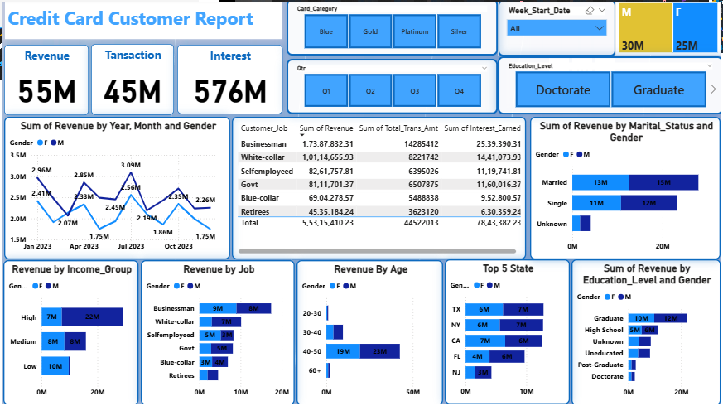
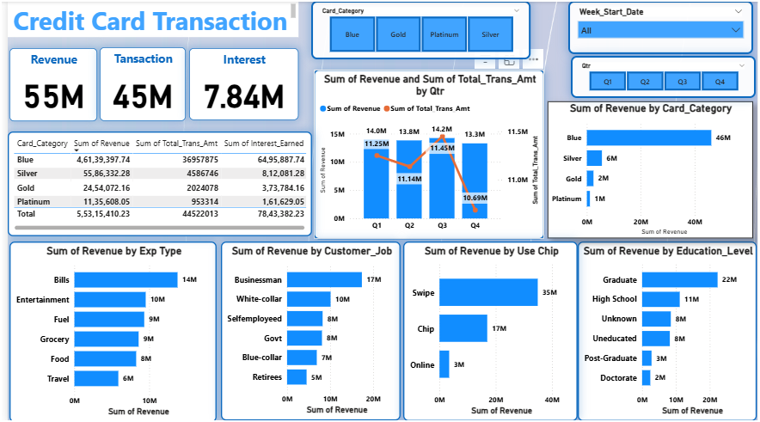
Live Dashboard Views
Customer Report
Transaction Report
Tip: open the .pbix file for the live, filterable version.
7
◂ Agenda
Notes:
Here are the two dashboard pages. The customer report on the left slices revenue by gender, job, age, income, state and education. The transaction page on the right breaks revenue and transaction amount down by card category and quarter. In Power BI, every visual cross-filters, and slicers for card, quarter, week and education let managers drill in.

Slide 8
Spending Behaviour
Takeaway: Swipe is ~64% of revenue while Online is only ~5% – the biggest channel growth opportunity.
8
◂ Agenda
Notes:
The bottom row of the transaction dashboard shows how customers spend. By expenditure type, Bills lead at 14 million, followed by Entertainment at 10 million, with Fuel and Grocery at 9 million each. By usage method, Swipe is dominant at 35 million, Chip is 17 million, and Online is only 3 million, so digital spend is a clear growth opportunity. By education, Graduates bring 22 million and High School 11 million, while Post-graduate and Doctorate are small.

Slide 9
Insights & Recommendations
What we found
Recommendations
Revenue 55M; interest 7.84M; spend 45M
Males 30M vs females 25M
Blue = 83% of revenue; Blue + Silver = 93% of transactions
TX, NY, CA ≈ 68% of revenue
Activation 57.5%; delinquency 6.06%
Upsell Blue holders to Gold/Platinum
Grow online spend (only ~5% of revenue)
Investigate the Q4 revenue dip
Tighten monitoring of delinquent accounts
Run activation campaigns (target > 57.5%)
Broaden beyond top-3 states and 40–50 band
9
◂ Agenda
Notes:
To wrap up. Revenue is concentrated in Blue cards, in the 40 to 50 age group, and in three states. That is a strength but also a risk. My recommendations are to grow Gold and Platinum with targeted offers, to look into why Q4 dips, to monitor the 6 percent delinquency rate, and to push activation from 57.5 percent upward. Happy to take questions and thank you for watching.

