Slide 1
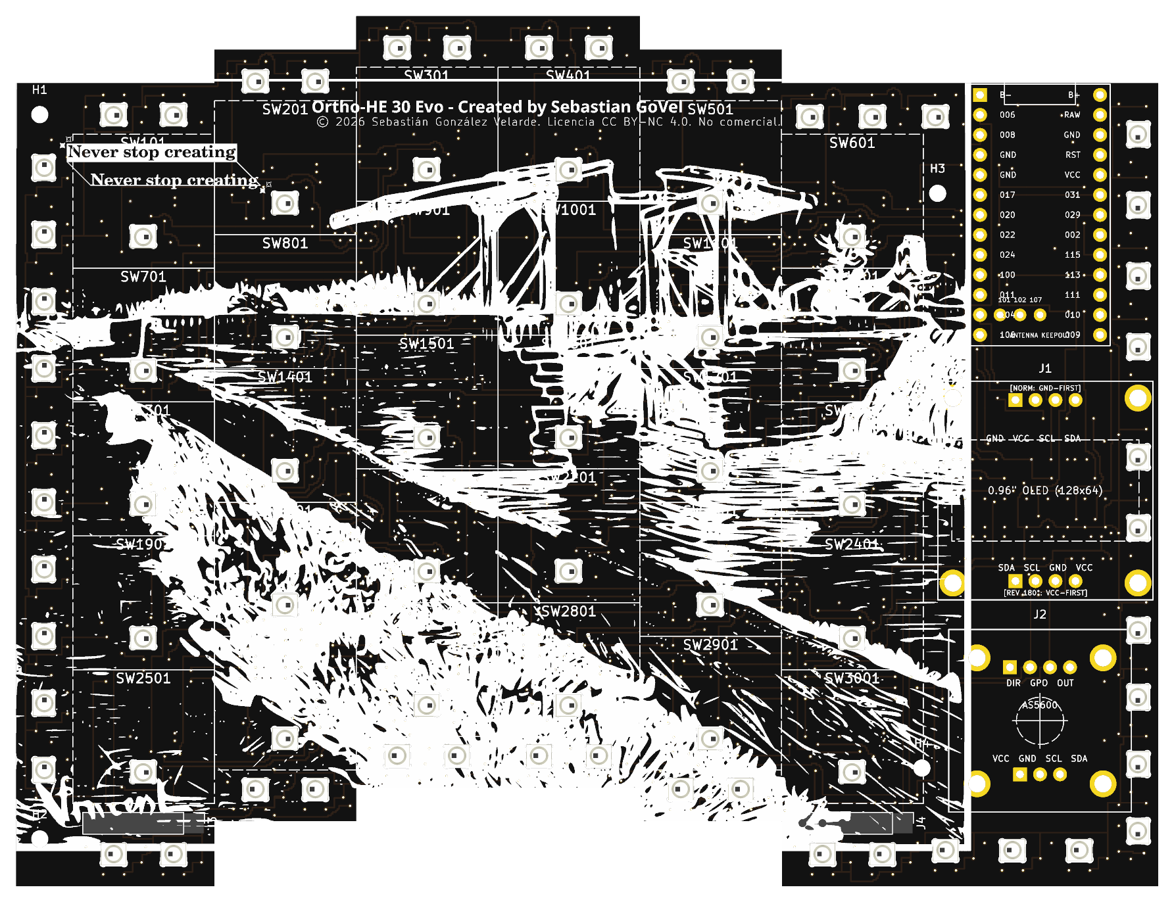
1517 FUND • MEDICI GRANT CANDIDATE
FloatForce
The Open-Source Continuous Analog Ergonomic Keyboard
Where every key floats on magnets instead of metal springs—turning physical press depth into expressive music, 360° analog game vectors, and zero-app precision mouse emulation.
Sebas GV • Jalisco, Mexico • Independent Hardware Maker
Open Hardware License: CERN-OHL-W v2 • Showcase: sebas-govel.github.io/HE_KB_Showcase

Slide 2
THE PROBLEM & OPPORTUNITY
Disrupting a Stagnant Multi-Billion Dollar Industry
1. Commercial Black Boxes
• Multi-hundred dollar price tags on closed consumer peripherals.
• Essential physical ergonomics (split layouts, tenting, low-profile, wireless) are artificially segmented into luxury tiers.
• Proprietary drivers locked behind bloated cloud software.
2. The Switch Dilemma
• Sourcing the 'perfect' commercial switch is difficult: many options exist, but almost all have rigid trade-offs or proprietary footprints that won't fit your board.
• Commercial boards force post-purchase mods instead of design-stage customization.
3. Universal Freedom
• Design & 3D print your own custom magnetic switches for pennies with radical freedom.
• Or drop in virtually ANY commercial magnetic switch: Hall sensors recalibrate in software, and the 3D-printed plate adapts in CAD to any footprint.
• 100% open-source under CERN-OHL-W v2.

Slide 3
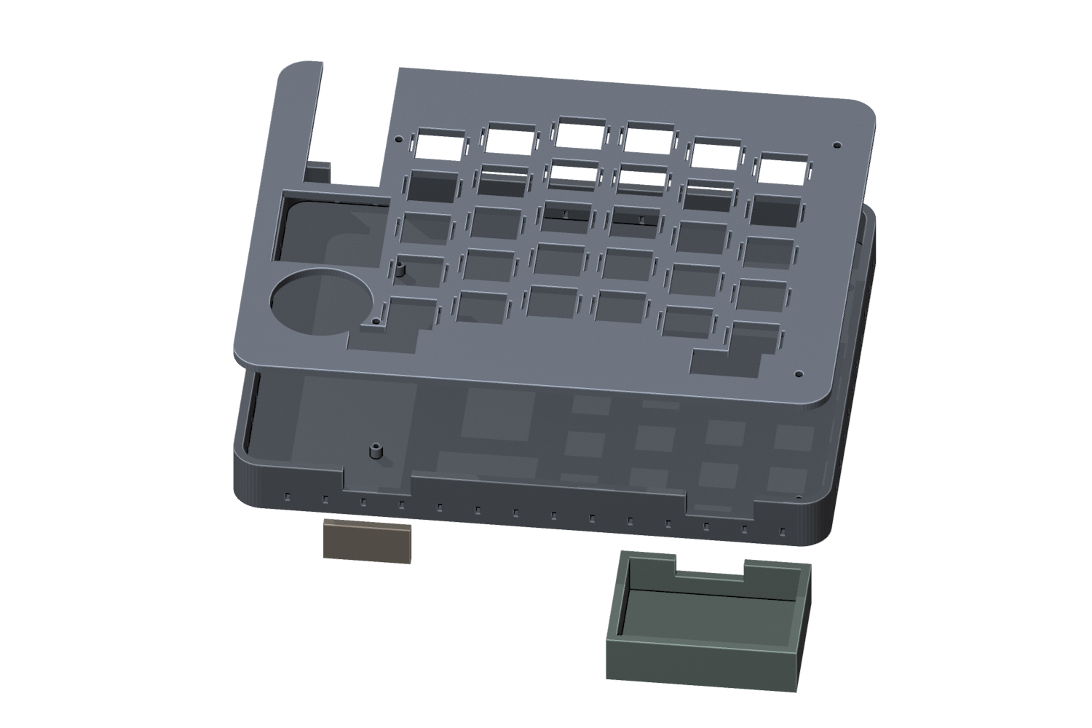
POSTURAL ERGONOMICS
Van Gogh's Drawbridge: Split & Tenting Architecture
Fixing 150 Years of Typewriter Flaws
• Drawbridge Elevation (0° → 25° Tenting): Outer pinky edges anchor on the desk while inner thumb edges rise, rotating forearms into a neutral handshake posture.
• Active Design Stage: Physical tenting stand mechanism is currently being designed—once PCB Rev A arrives, hands-on testing will guide fixed vs foldable angle mechanisms and chair armrest mounts.
• Ergonomic 18 × 17 mm Pitch: Reduces finger travel distance by 15%, reducing ulnar deviation and carpal tunnel risk.
• Bottom-Mount Monolithic Canvas: All 30 Hall sensors on bottom; top surface is a monolithic art canvas.

Slide 4
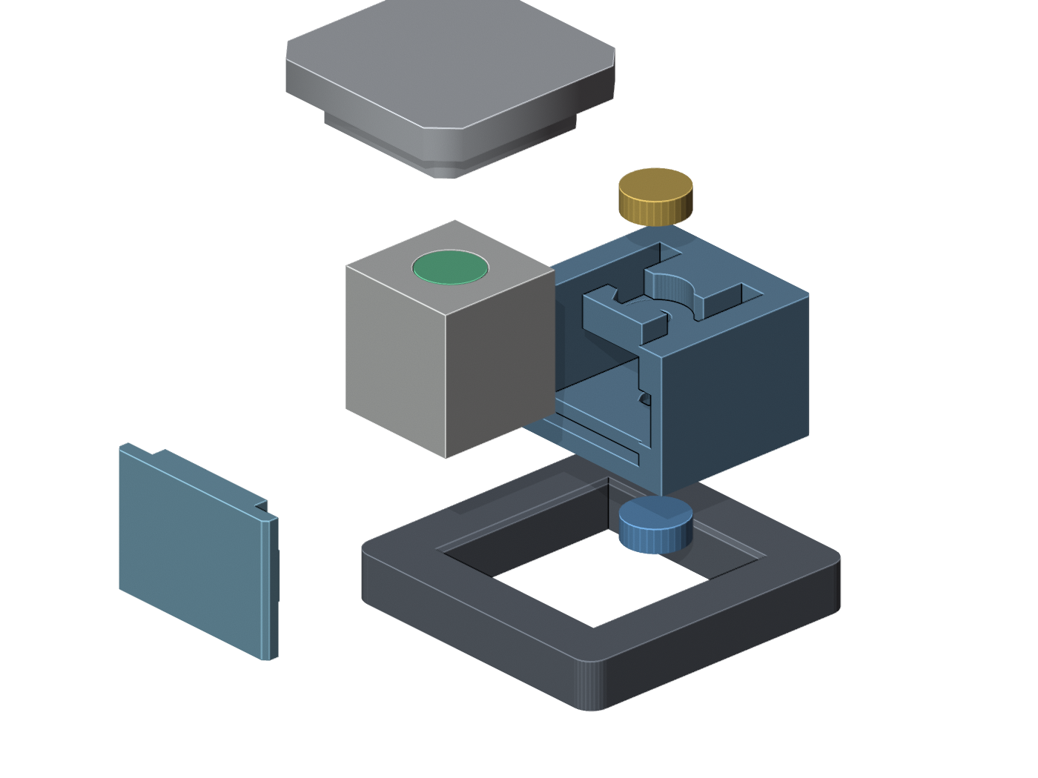
KINEMATIC HARDWARE
FloatForce Switch V5.0: Springless Magnetic Sensing
Springless 3-Magnet Levitation
• 2.36 mm Travel (+33% over V4.0): Sub-millimeter calibrated sockets (Ø4.06 mm / Ø4.16 mm) with knockout ejection pins.
• Monolithic U-Body + Keyed SideWall: Clamped by 3.0 mm plate; zero stem wobble and 0.000 mm³ collision margin.
• Pre-rotated -45° in Z: Layer lines print 100% parallel to stroke, eliminating friction without requiring lube.
4 Continuous Analog Interaction Modes
• 1. Expressive MIDI Synth: Continuous velocity and filter swell directly on the home row keys.
• 2. WASD 360° Joystick: True proportional vector movement & stealth pacing in games.
• 3. Rapid Trigger & Dual-Stage: Dynamic reset upon lift; light tap for letter 'a', deep press for screenshot.
• 4. Precision Analog Mouse Emulation: PLANNED FIRMWARE: Cursor velocity proportional to key depth. Multi-speed navigation and CAD micro-positioning across any OS without third-party apps.

Slide 5
DECENTRALIZED INNOVATION
AI as an Engineering Copilot & Global Accessibility
A Solo Maker in Jalisco, Mexico
+6 Months of ideation, R&D, and learning.
By leveraging modern AI as an engineering copilot:
• Magpylib for magnetic flux simulations
• KiCad 10 for multi-channel PCB routing
• Python for procedural CAD generation
• Zephyr RTOS for deterministic firmware
I designed, tested, and sent to fabrication this entire physical stack as an independent builder in Mexico.
Global Maker Accessibility
• 100% Support-Free FDM Printing: Switches and keycaps print with zero non-removable supports on everyday desktop 3D printers (Bambu A1, Ender 3, etc.).
• Accessible for All Alphabets: Standardized parametric CAD enables makers worldwide—from Latin America to Japan and Africa—to manufacture and customize localized keyboards at minimal cost.

Slide 6
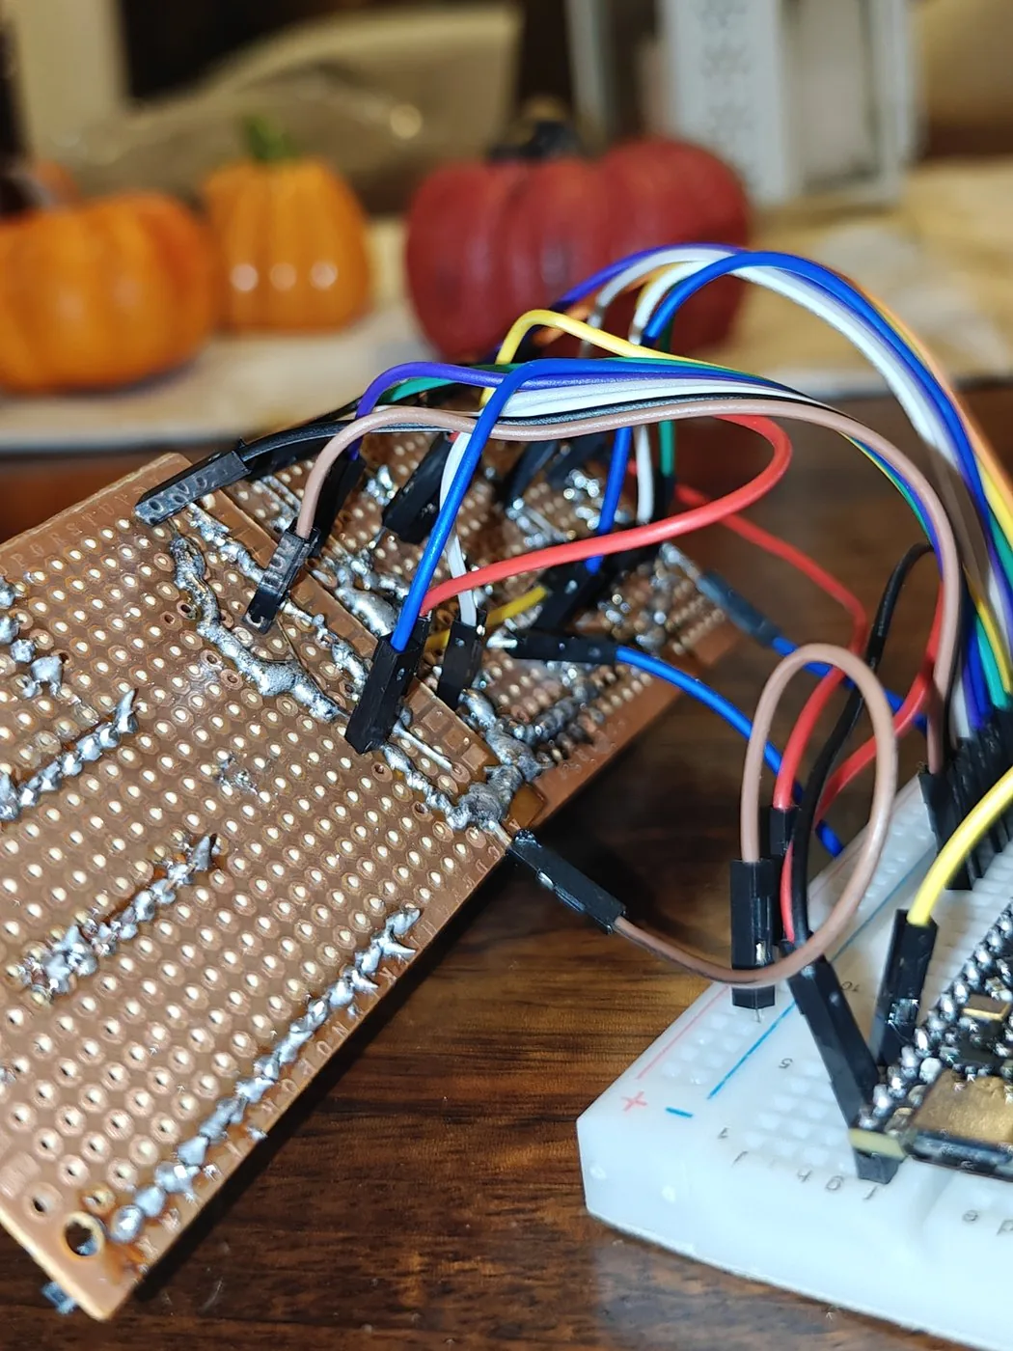
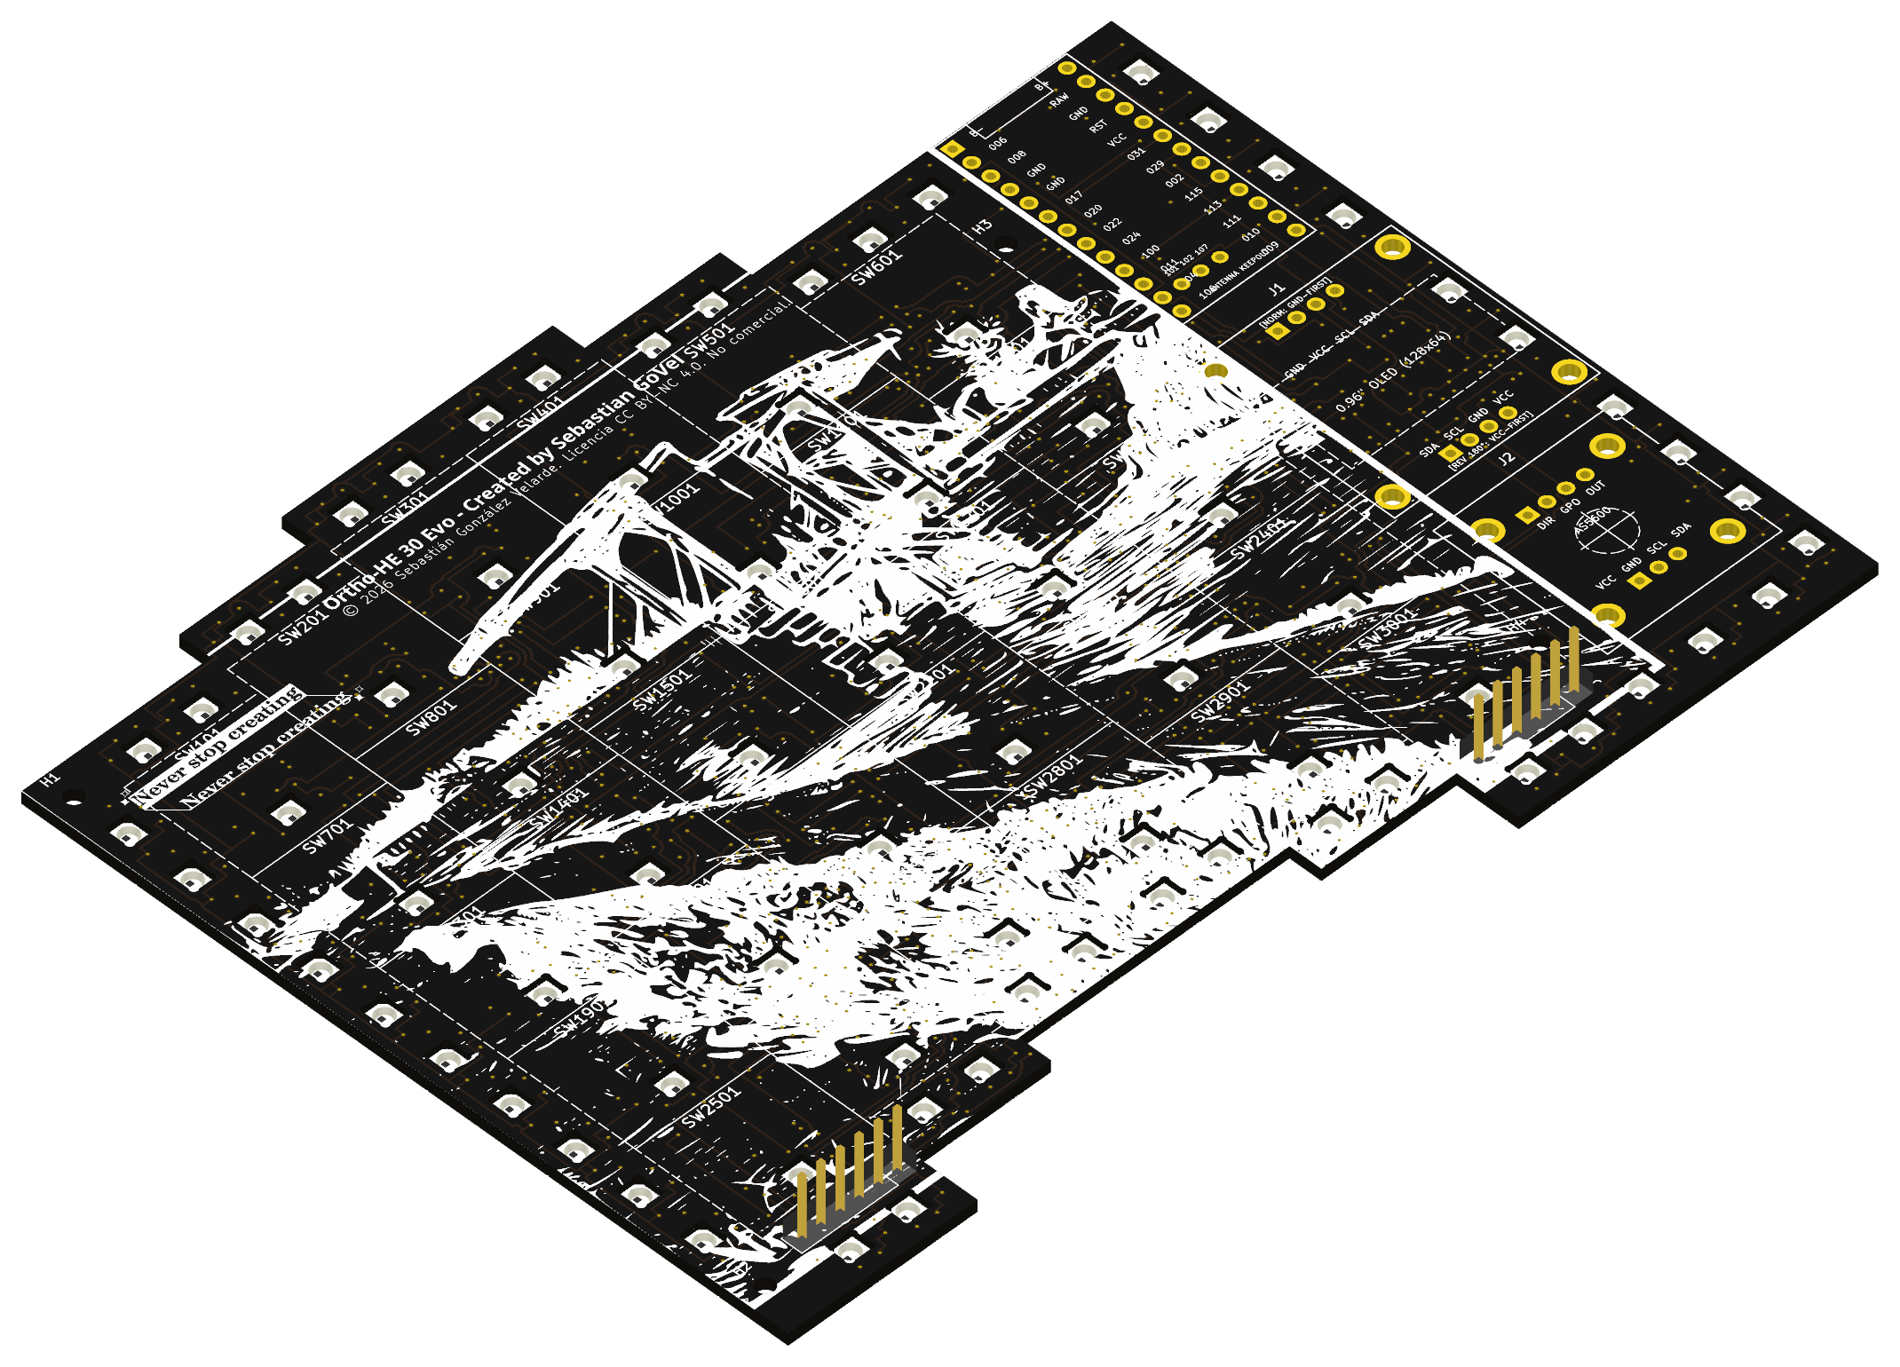
ENGINEERING RIGOR
Physical Laboratory Proof: What's Real Today
The 16-Key Functional Macropad
Bench-tested physical proof: 16 working FloatForce keys running Zephyr RTOS firmware. Validated magnetic repulsion, plate clamping, and progressive force curves under typing load.
PCB Rev A: In International Air Transit
SMT assembly complete at JLCPCB; currently in international air transit from Hong Kong to Mexico. Features 30x HAL403SO sensors, dual-bank TMUX1308 split (-34% capacitance), and 100 nF bypass caps.

Slide 7
THE MEDICI PITCH
$1,000 USD Grant Allocation & Sustainable Open Model
100% Forward-Looking Capital Runway
Past R&D (~$500 USD) was 100% self-funded from personal savings (not for reimbursement). The $1,000 USD grant funds forward development:
• $250.00 — Rev B Prototyping
PCB fabrication run informed by Rev A testing, plus sensors, OLEDs, encoders, LiPo batteries & N52 magnets for working test units.
• $300.00 — Brand, Legal & Tax Advisory
IMPI trademark registration in Mexico, prior-art search, and IP/tax advisory for certified 3rd-party builds.
• $450.00 — Materials R&D, Tooling & Creator
Specialized filaments, hardened nozzles, BMCU multicolor/resin testing, and creator gear for build guides.
Sustainable Open Hardware Model
100% of the CAD files, schematics, and Zephyr firmware remain permanently open under CERN-OHL-W v2.
Financial sustainability is built on three independent pillars:
1. Trademark Certification (IMPI): Third parties can freely build hardware; certified builds pay a license for the official quality mark.
2. Official Patreon Community: Devlogs, early CAD drops, and participatory advisory.
3. Frictionless Direct Donations: GitHub Sponsors & community support.

Slide 8
FUTURE HORIZON
Beyond the Keyboard: The Future of Human-Computer Interaction
Chapter One of a Broader Interface Vision
• Spatial Bezel-Tracking Eye Glasses: Lightweight open-hardware glasses combining pupil gaze tracking with monitor bezel detection in 3D space, mapping gaze directly to cursor positioning across multi-monitor setups without head turns.
• Capacitive Surface (Touchpad) Lightweight Mouse: Ultra-light mouse shell with capacitive multi-touch surface for fluid gesture navigation, panning, and continuous analog control without switch fatigue.
• Non-Invasive Continuous Forms of Input: Wearable micro-interfaces (gyroscopic spatial rings, gestural wristbands, finger tracking) for ambient, hands-free computing.
Thank you 1517 team for backing independent, unorthodox builders.
Sebas GV • Jalisco, Mexico • sebasgonzalezvelarde@outlook.com • sebas-govel.github.io/HE_KB_Showcase

