Slide 1


Fake News Classifier
R
Classic ML results, evaluation, and leakage analysis

Slide 2
Agenda
Task and dataset
Preprocessing and evaluation setup
Classic classifiers (simple, no SVM, no deep learning)
Results and interpretation
Subject leakage analysis

Slide 3
Task
Classify news as real or fake using the provided dataset
Use title and text fields
Evaluate with 5-fold cross-validation
Compare multiple classic ML classifiers
Analyze unusual performance and possible leakage

Slide 4
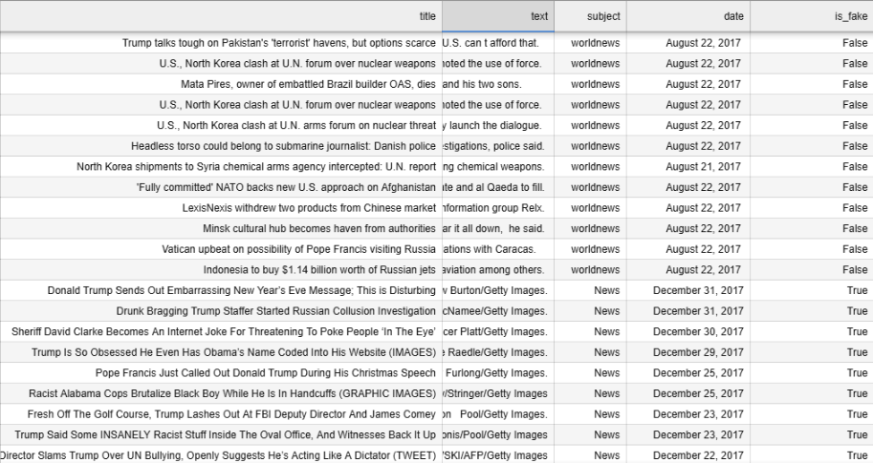
44,898 articles
Combine title + text into a single body field
Tokenization, stopword removal, stemming (for counting models)
TF-IDF for linear models
5-fold stratified cross-validation

Slide 5
Classic Models (Simple, No SVM, No Deep Learning)
Counting heuristics
is_fake1: compares most common fake vs real token
is_fake2: overlaps with fake vs real token counters
Linear Regression (thresholded)
Logistic Regression (TF-IDF)
Naive Bayes (Multinomial, Bernoulli)

Slide 6
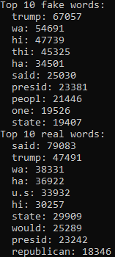
Very simple fake news filter
Model | Accuracy | F1 | MCC
is_fake1 | 0.618 | 0.567 | 0.260
is_fake2 | 0.928 | 0.931 | 0.857

Slide 7
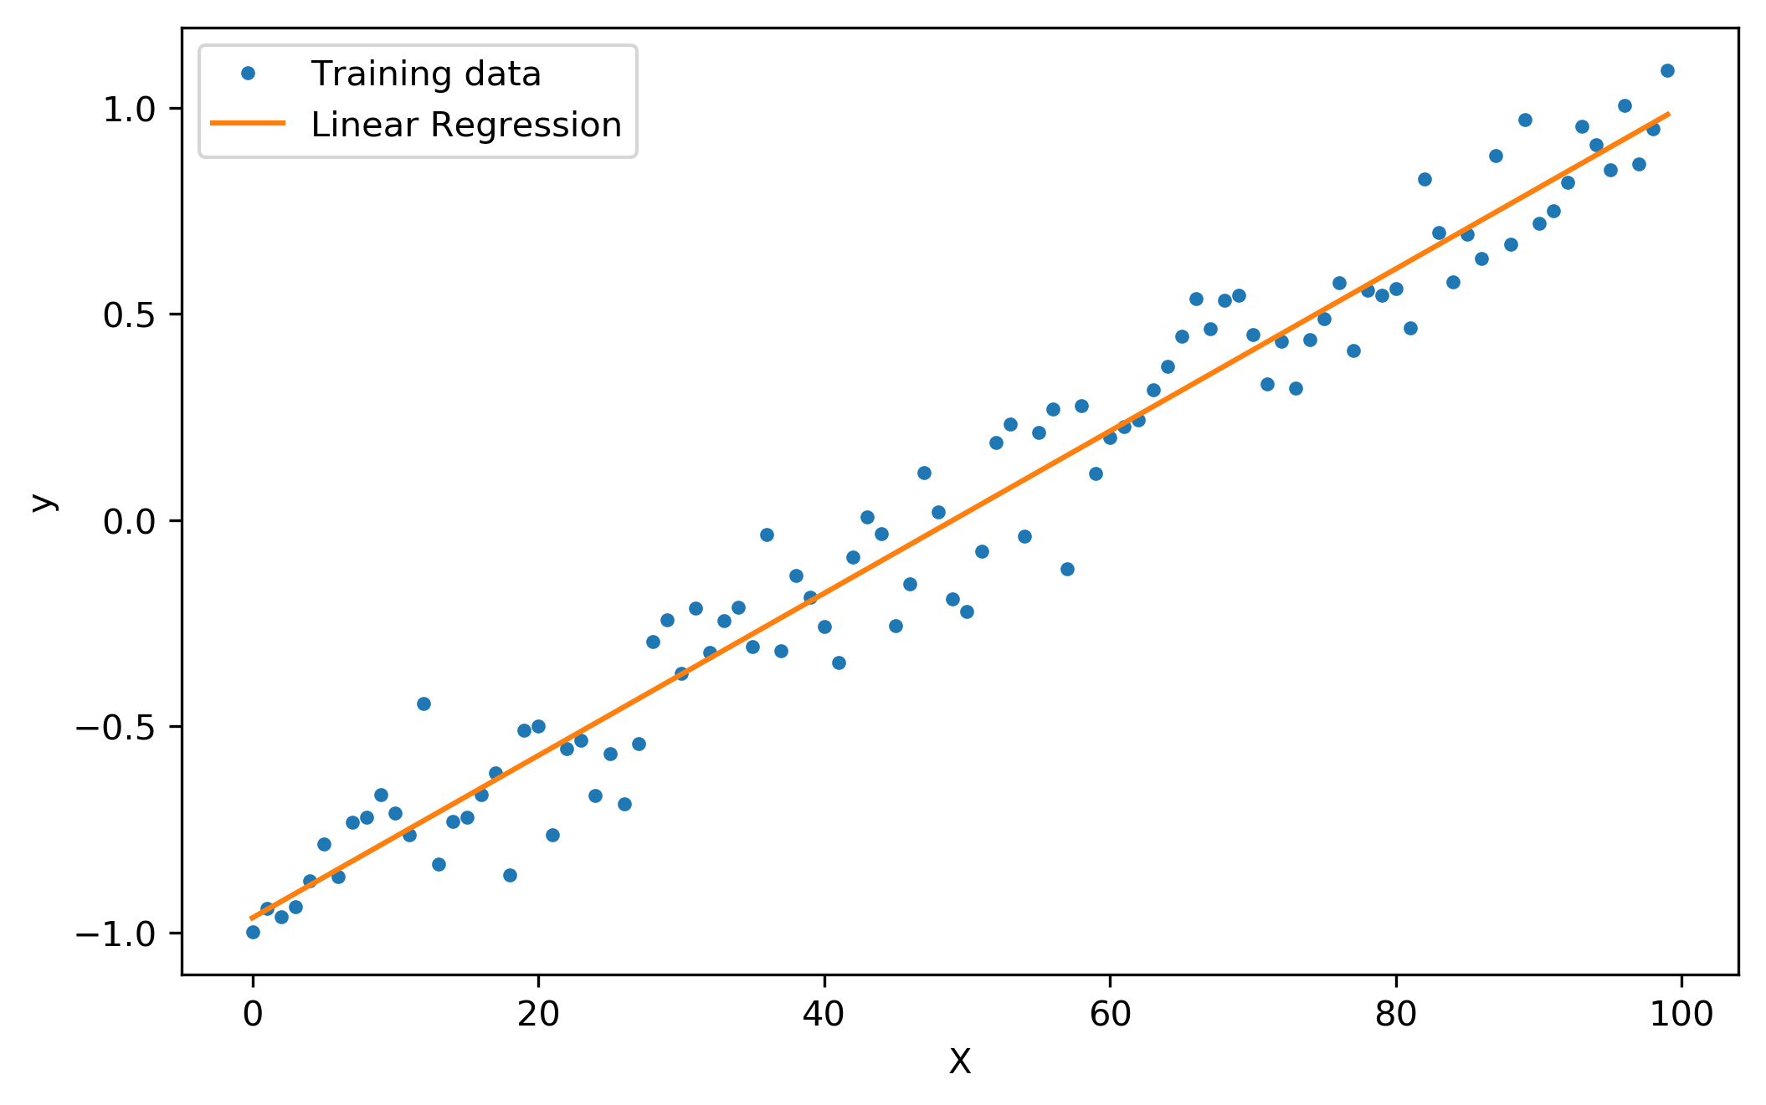

Linear regression
Model | Accuracy | F1 | MCC
is_fake1 | 0.618 | 0.567 | 0.260
is_fake2 | 0.928 | 0.931 | 0.857
Linear Regression | 0.956 | 0.958 | 0.911
Logistic Regression | 0.981 | 0.981 | 0.961

Slide 8
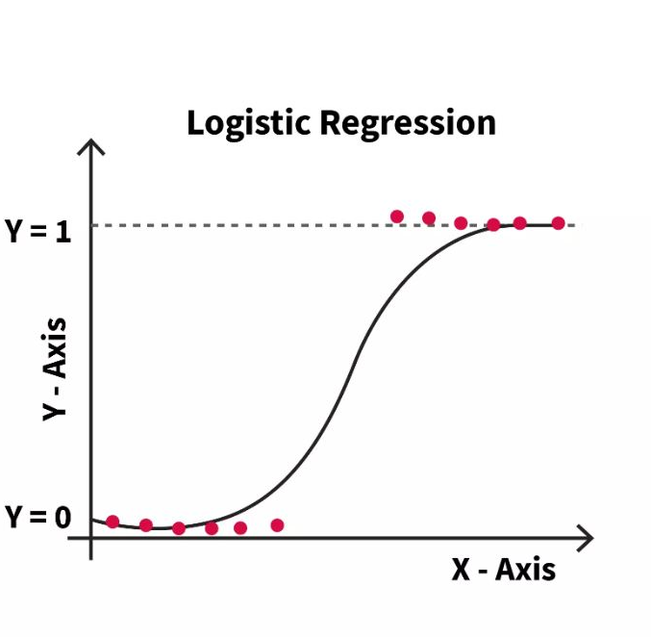


Slide 9
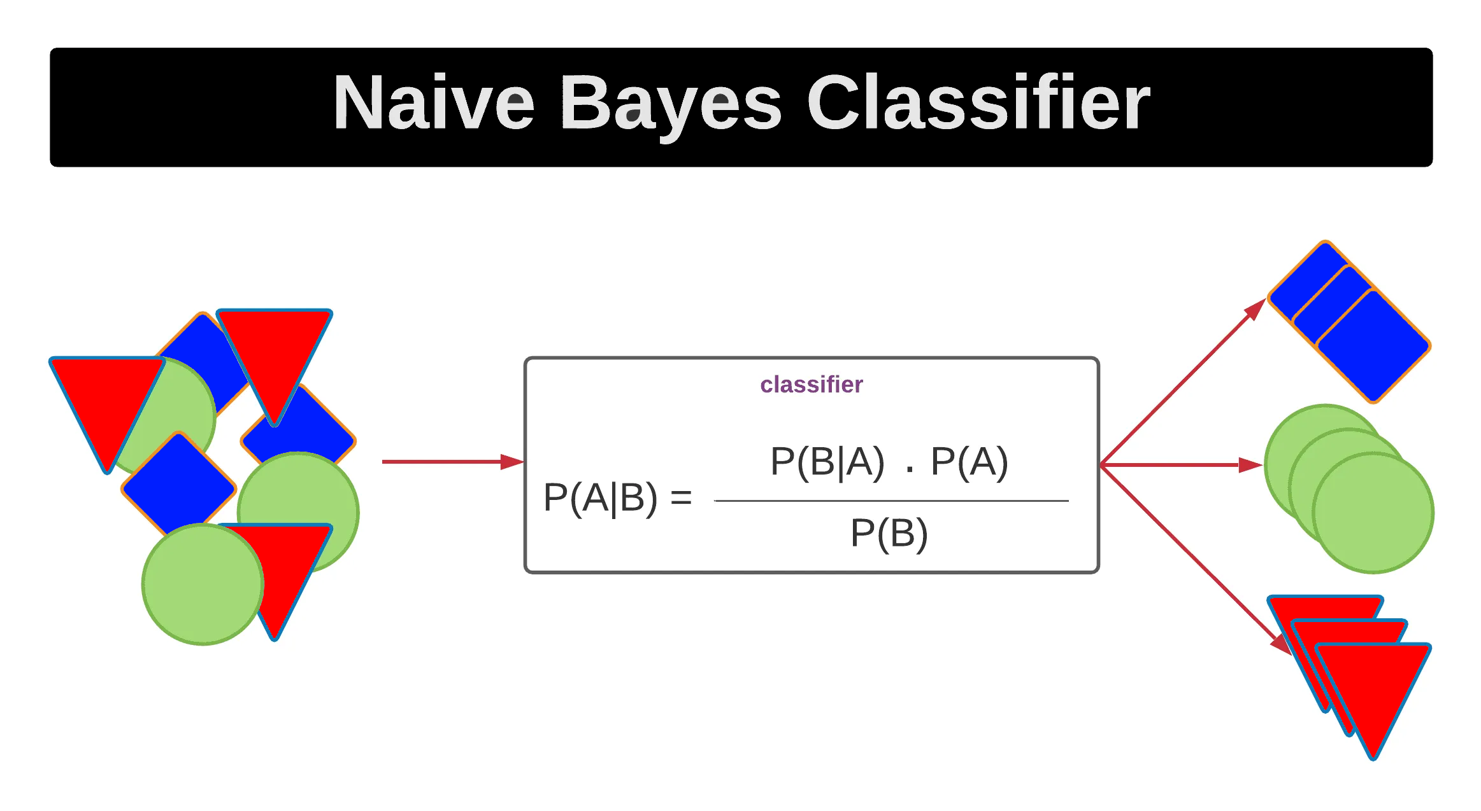

Slide 10
Interpretation
is_fake1 is weak: single-token heuristic
is_fake2 is surprisingly strong, likely due to dataset bias
Linear/LogReg perform very well on TF-IDF features
High scores suggest strong stylistic or source signals

Slide 11
Subject Leakage
Subject column is perfectly predictive in this dataset
Many subjects have fake_ratio = 1.0 or 0.0
Subject-only classifier reaches 1.000 metrics
Conclusion: subject must be excluded for fair evaluation

Slide 12
Why Are Scores So High?
Dataset-specific signals dominate
Publisher/subject bias in labels
Stylistic cues (wording, formatting) captured by TF-IDF
Potential source leakage (e.g., consistent tokens)

Slide 13
SVM
Preprocessing:
Title and text are considered
Tokenization with normalization and noise reduction (lowercase, removing stopwords and stemming)
Fusion of both features into one vector
Training:
Define reproducible parameters (seed, CV-folds)
Train basic SVM
Hyperparameter tuning with RandomizedSearchCV (based on accuracy)
Train final SVM with the best hyperparameters

Slide 14
SVM results
Basic SVM
Accuracy: 0.9945
MCC: 0.9891
Class | Precision | Recall | F1-score | Support
Real | 1.00 | 0.99 | 0.99 | 4284
Fake | 0.99 | 1.00 | 0.99 | 4696
Accuracy | - | - | 0.99 | 8980
Macro Avg | 0.99 | 0.99 | 0.99 | 8980
Weighted Avg | 0.99 | 0.99 | 0.99 | 8980

Slide 15
SVM results
SVM with tuning
Best Hyperparameters: {'kernel': 'linear', 'C': 0.1}
Accuracy: 0.9999
MCC: 0.9998
Class | Precision | Recall | F1-score | Support
Real | 1.00 | 1.00 | 1.00 | 4284
Fake | 1.00 | 1.00 | 1.00 | 4696
Accuracy | - | - | 1.00 | 8980
Macro Avg | 1.00 | 1.00 | 1.00 | 8980
Weighted Avg | 1.00 | 1.00 | 1.00 | 8980

Slide 16
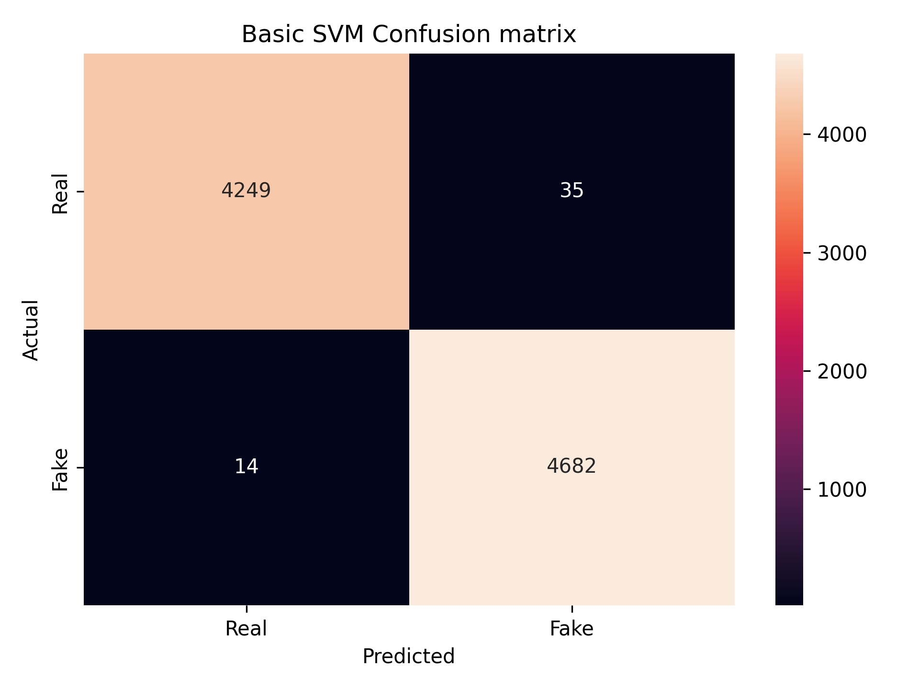
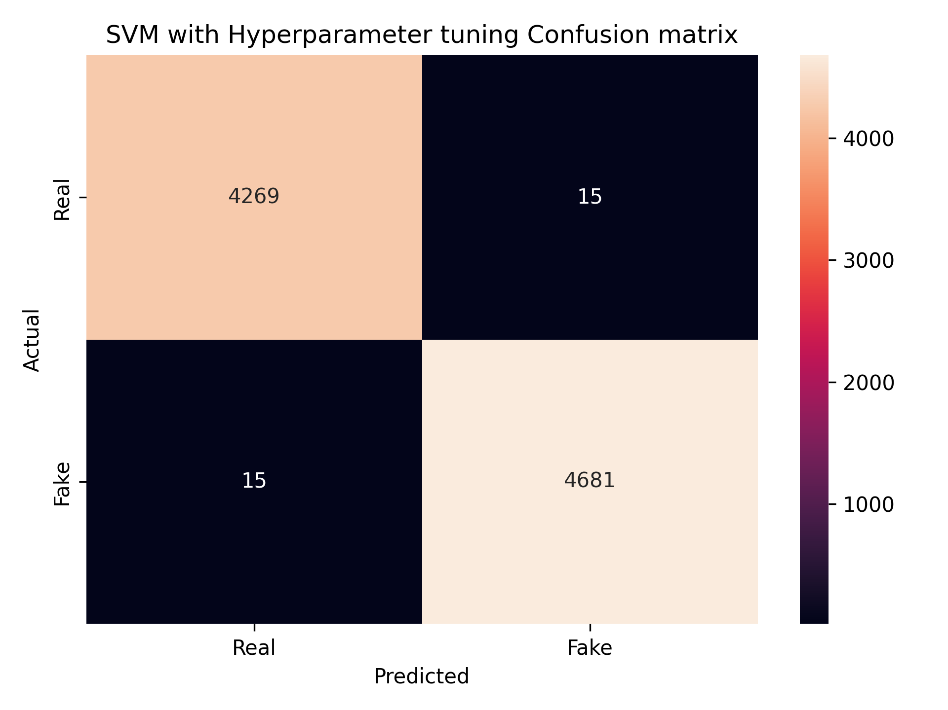
SVM results
Basic SVM
SVM with tuning

Slide 17
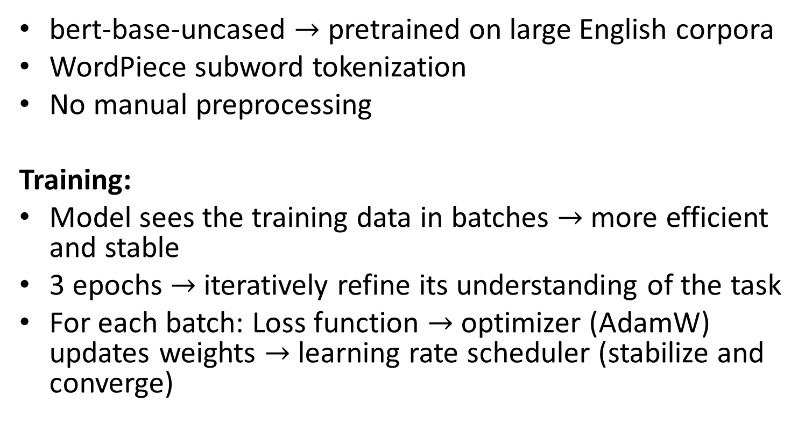
BERT
bert-base-uncased $→$ pretrained on large English corpora
WordPiece subword tokenization
No manual preprocessing
Training:
Model sees the training data in batches $→$ more efficient and stable
3 epochs $→$ iteratively refine its understanding of the task
For each batch: Loss function $→$ optimizer (AdamW) updates weights $→$ learning rate scheduler (stabilize and converge)

Slide 18

BERT results
Test Accuracy: 0.9993
Test MCC: 0.9987

Slide 19
Do you see anything strange?

Slide 20
Bias in dataset
Dataset on Kaggle (similar one): '(Reuters)' tag on text column
Our dataset didn’t have it, but Reuters was used
Reuters: major global news agency
Indicator of true news?
Train on a new dataset

Slide 21
New dataset results
Logistic Regression
Linear Regression
Accuracy: 0.9174
MCC: 0.8360
Accuracy: 0.9067
MCC: 0.8134

Slide 22
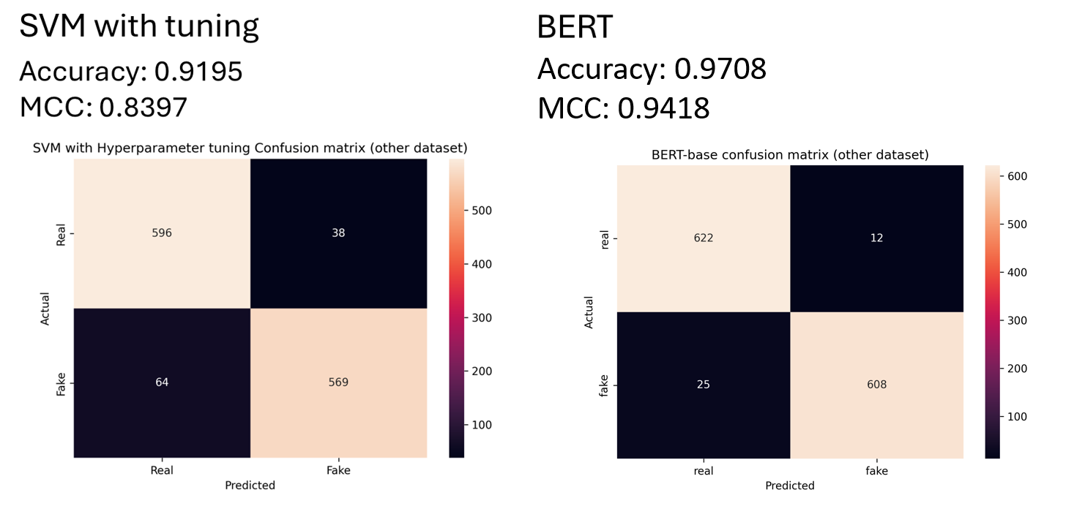
New dataset results

Slide 23
Takeaways
Classic models achieve strong performance
Performance is likely inflated by dataset bias
Subject leakage is extreme and must be handled
Future work: debiasing, cross-source validation

