Slide 1



Power BI
Guenda Sciancalepore
Technical Evangelist
@guenda_s
guscianc@microsoft.com

Slide 2
What is Power BI?
Power BI a cloud-based business analytics service that is used for visualizing, exploring and extracting insights from data.

Slide 3
Connect to all the data around you!
Connect to a broad range of data across on-premises and cloud
Shape, transform, and clean data for analysis
Join and model data from multiple data sources and different types
Extend your analysis with support for technologies such as R for advanced analytics

Slide 4
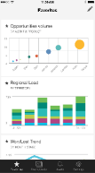
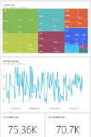
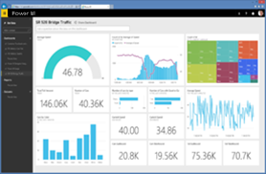
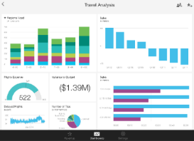
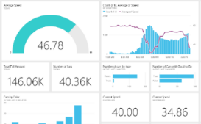



Power BI - Overview
Power BI service
Data sources
Content packs
Natural language query
Sharing & collaboration
SaaS solutions
E.g. Marketo, Salesforce, GitHub, Google analytics
Live dashboards
On-premises data
E.g. Analysis Services
Visualizations
Organizational content packs Corporate data sources, or external data services
Reports
Azure services
E.g. Azure SQL, Stream Analytics
01001
10101
Excel files
Workbook data or data models
Datasets
Power BI Desktop files
Related data from files, databases, Azure, and other sources
Data refresh

Slide 5
Power BI - Overview
Power BI Desktop
Data sources
SaaS solutions
E.g. Marketo, Salesforce, GitHub, Google analytics
Prepare
Explore
Report
Share
On-premises data
E.g. Analysis Services
Organizational content packs Corporate data sources, or external data services
Azure services
E.g. Azure SQL, Stream Analytics
Excel files
Workbook data or data models

Slide 6
Power BI - Overview
Power BI Embedded
Data sources
embed, extend, integrate inside your application
</>
Azure services
Azure SQL DB, Azure SQL Data Warehouse
This is an Azure Service!

Slide 7
Embedding

Slide 8
Choose the right Power BI embedding option
Is the app extending or integrating with PowerBI.com
Do users need to be authenticated?
No
No
Yes
Yes
Use PowerBI.com REST APIs
Use Power BI Embedded
Use PowerBI.com publish to web
Authentication
Via PowerBI.com Azure Active Directory
Via application, using Power BI app tokens
N/A
User licensing
End-User PowerBI.com subscription
Consumption based, via Azure
No end-user license required
No end-user license required
Report authoring
Power BI Desktop and Power BI.com subscription
Power BI Desktop
PowerBI.com subscription and/or Power BI Desktop
Learn more
Dev.powerbi.com
https://azure.microsoft.com/en-us/services/power-bi-embedded/
https://powerbi.microsoft.com/en-us/publishtoweb/

Slide 9

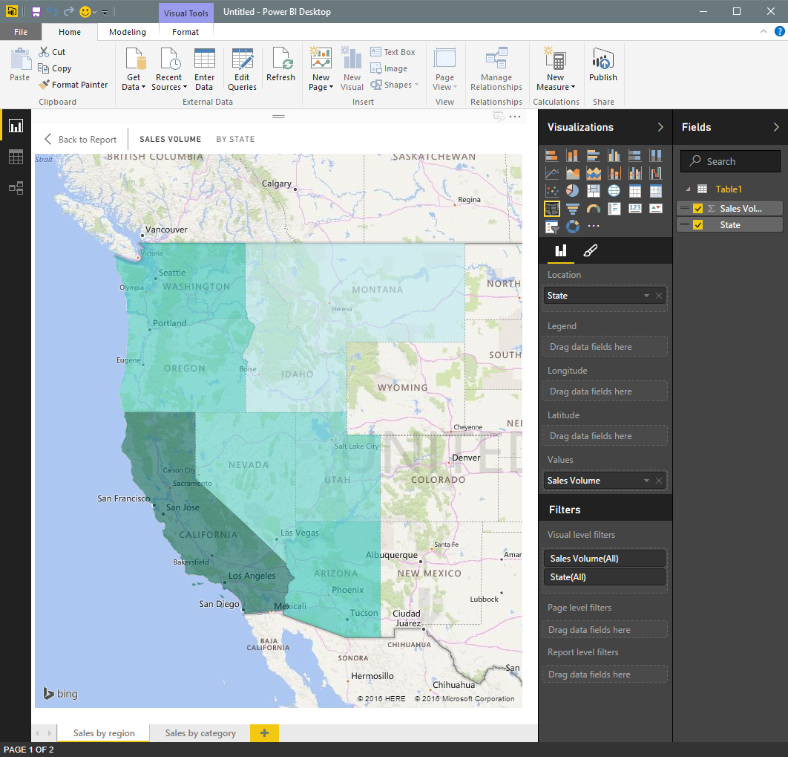
Power BI Embedded Conceptual Model
1,N
ARM – Azure Resource Management
Microsoft Azure subscription
Developer
1,N
Workspace collection
Name
Admin Users
Endpoints
Keys
Gateways
Credentials
Geo Location
Tags
Azure SQL Database
Azure SQL Data Warehouse
1,N
on Azure HDInsight
Workspace
Name
Reports
Datasets
Tags
Embed
ARM
Your app
End users
Power BI Desktop

Slide 10
Provide seamless authentication experiences
Application
Power BI
Users
Workspace
Auth. providers
Token
+ Claim: Can view Report 1
+ Expiration: 5 minutes
Report 1
Permissions
Report 2
Sign token
App generates token using secret in server-side code
API keys
API keys
Copy API keys to your application
Create
Embed
Deploy

Slide 11
Provide seamless authentication experiences
Application
Power BI
User requests to view Report 1
Users
Workspace
Auth. providers
Token
+ Claim: Can view Report 1
+ Expiration: 5 minutes
Report 1
Permissions
Report 2
Validate token
API keys
API keys
Create
Embed
Deploy

Slide 12
Provide seamless authentication experiences
Application
Power BI
Users
Workspace
Auth. providers
Report 1
Report 1
Permissions
Report 2
API keys
API keys
Create
Embed
Deploy

Slide 13
Thank you!
Notes:
http://powerbiangular.azurewebsites.net/dist/#/scenario1

