Slide 1
FS
FoodShock
RECALL RESPONSE COMMAND CENTER
1
2
3
4
From recall notice to
human-approved recovery plan.
NOTICE
TRACE
REPLAN
APPROVE
live authority
lots + POs
LP + FEFO
human gate
Trace implicated lots and inbound orders, quantify seven-day supply risk, then optimize a feasible response before anything executes.
1.20s
+1,800
0
planning time
lb served
violations
latest seeded run
vs baseline
hard constraints
LIVE DEMO
foodshock.sebastianalexis.com
Live FDA/USDA incidents. Synthetic food-bank operations. No client PII.
1
Notes:
FoodShock is a decision-support command center for food-bank recall response. Current openFDA and USDA FSIS incidents enter through official APIs, while inventory, purchase orders, demand, and recovery offers remain synthetic. The system ends at a human approval gate and exposes no action when an authority incident has no linked lot or purchase order.

Slide 2
WHY NOW
Recall volume is high; consequences are operational.
Public 2024 records show the scale. A single contaminated ingredient can intersect a perishable, high-throughput food-bank network.
482
34 + 19
104
A reference food-bank network
distinct FDA event IDs
FSIS recalls + PHAs
onion-outbreak cases
67M lb
distributed in FY2024
1,387 product records initiated in 2024
numbered recalls and public-health alerts
34 hospitalized, 1 death, 14 states
Fresh product share
~70%
The constraint is not only finding recalled product. It is restoring service without reintroducing risk.
53k
215
households / week
pantries
SAFETY
Quarantine, cancellation, and lot-state exclusions must survive every scenario and plan.
Counts retrieved for calendar year 2024; event/product distinction preserved. openFDA enforcement API | FSIS recalls API | CDC/FDA onion outbreak | SF-Marin Food Bank FY2024
Notes:
The public-record counts are evidence of volume, not a claim about food-bank-specific incident frequency. The network scale comes from the SF-Marin Food Bank annual report and illustrates why perishable inventory and distributed pantry demand complicate recovery.

Slide 3
PROBLEM
The operational blind spot is the join.
Recall notices describe risk in prose. Response teams must connect that prose to exact inventory, inbound purchase orders, pantry commitments, and feasible replacements.
NARRATIVE NOTICE
“Fresh yellow onions … lot codes GVP-8842 and GVP-8843 … packed between June 20 and July 2 … distributed in California and Nevada.”
01
02
03
04
05
JOIN
Product
Lot / PO
Warehouse
Pantry
Recovery
fresh yellow onions
GVP-8842, PO-1002
Oakland DC
28 lines infeasible
substitute + buy
Supplier, lot, date, region, and action are embedded—not normalized.
Missing joins create three failure modes
DELAYED QUARANTINE
INFEASIBLE ALLOCATIONS
SILENT SHORTAGES
Workflow sources show notice intake, inventory isolation, agency notification, and disposition tasks. Rhode Island Community Food Bank recall process | MANNA FoodBank recall workflow
Notes:
The job is not summarization. It is a relational join across notice fields and operational records, followed by constrained recovery planning. FoodShock makes each join inspectable.

Slide 4
SYSTEM
Agentic analysis. Deterministic execution boundary.
Current openFDA and FSIS incidents cross a provenance-verified source boundary before the agent joins them to synthetic operations. Zero linked lots or POs means zero exposure and no approval action.
AGENT LOOP
Boring stack, on purpose
Observe
Extract
Trace
Project
Optimize
Explain
official feed + state
typed fields
graph joins
7-day service
LP recovery
draft + comms
✓
openFDA + FSIS
live authority incidents
✓
SQLite + NetworkX
auditable state + lineage
DETERMINISTIC GUARDRAIL LANE
✓
Linear program
Provenance
Recall state
Projection
Optimization
Approval
feasible recovery plan
unsupported fields dropped
confirmed inventory never returns
warehouse FEFO + PO ETA
capacity, demand, expiry, cost
latest, intact, feasible, idempotent
✓
Streamlit
review and approval UI
Authority incidents are real; operational records and computed impacts remain synthetic. Technical architecture | Official source adapters | Approval implementation
Notes:
The architectural boundary is deliberate. Each authority feed fails independently. Structured API fields are verified against the retained normalized source snapshot, and malformed fields cannot become operational facts. Language-model output cannot mutate inventory or approve a plan; approval revalidates identity, payload integrity, and hard constraints inside the state layer.

Slide 5
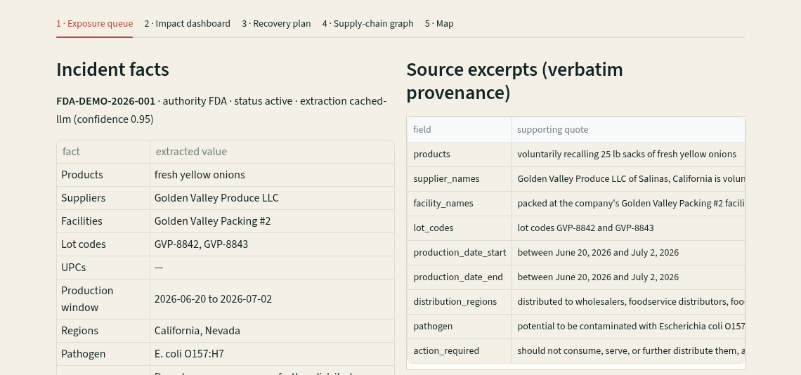
PRODUCT PROOF
Every claim can be traced back to evidence.
The curated positive-exposure view pairs typed incident facts with verbatim source excerpts and exact operational lineage. Live API incidents use the same evidence contract and can stop honestly at zero exposure.
Evidence contract
✓
Source snapshot retained
input remains inspectable
✓
Field-level quote
each value has supporting text
✓
Unsupported value dropped
verifier removes weak provenance
✓
Exact operational join
lot or inbound PO drives impact
Screenshot: curated positive-exposure fallback. Live authority incidents use the same provenance contract. Live exposure queue | Extraction verifier
Notes:
The screenshot is not a mockup; it is the public Streamlit application running the deterministic positive-exposure fallback. Current openFDA and USDA FSIS records retain the same field-level provenance, authority warning, retrieval time, and source link. If no synthetic lot or purchase order joins to that real incident, FoodShock presents an explicit no-exposure result instead of manufacturing a recovery action.

Slide 6
MEASURED DEMO RUN
The recovery plan restores service without breaking safety.
Baseline and recommended scenarios use the same seven-day synthetic demand. Confirmed recall states are excluded from both.
Seven-day service outcome (lb)
86.1%
68
worst pantry fill
boxes disrupted
from 64.3%
from 248
$990
7+
procurement cost
produce days
recommended plan
from 4.8
0
1.20s
hard violations
planning time
approval gate
latest seeded run
Measured locally on the synthetic scenario. No comparison to the hypothetical 2.0 staff-hour task model is claimed. Deterministic demo runner | Scenario database
Notes:
The recommended plan adds 1,800 pounds served, cuts unmet demand by the same amount, raises the worst pantry fill rate by 21.8 percentage points, and cuts disrupted boxes from 248 to 68 for 990 dollars. The runtime is a measured software run; the manual-time comparator remains hypothetical and is intentionally excluded from the chart.

Slide 7
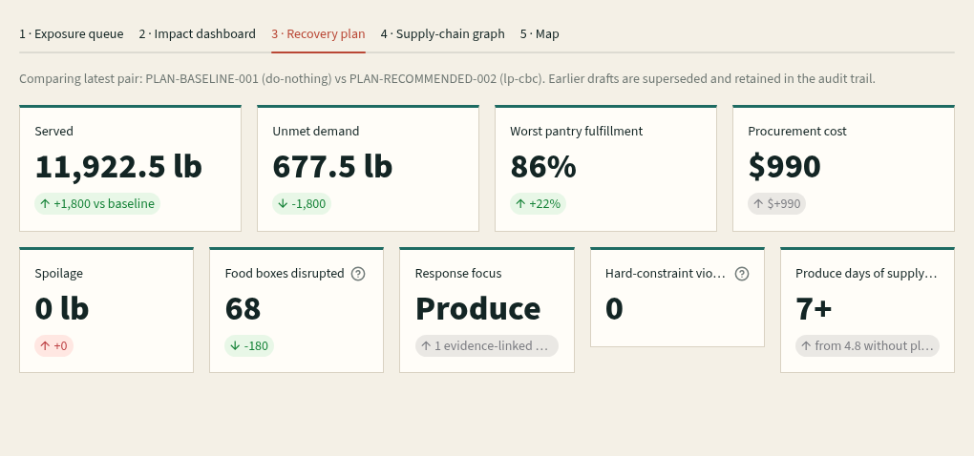
CONTROL
Human approval is a transaction, not a button.
The UI presents a draft plan and its tradeoffs. Approval revalidates plan currency and feasibility, then writes one auditable state transition.
Approval gates
✓
Latest recommendation
stale drafts rejected
✓
Plan lines re-evaluated
offers, timing, constraints checked
✓
Zero hard violations
state checked again
After approval
Lot-specific pantry notices
Purchase instructions
Auditable approval event
Screenshot captured from the public synthetic-data demo. Live recovery plan | Approval regression tests
Notes:
Approval is idempotent, rejects unknown or stale plans, revalidates plan lines, and re-checks hard constraints. Communications are scoped to implicated lot IDs instead of broadcasting generic recall language to unaffected recipients.

Slide 8
VALIDATION STATUS
Evidence is separated from ambition.
Measured behavior, evaluation readiness, and future validation are reported as different categories. No unavailable result is converted into a claim.
MEASURED
READY / NOT RUN
NOT YET VALIDATED
Implemented + measured
Extraction evaluation
In live operations
2 feeds
on-demand openFDA + FSIS
5 notices
frozen official gold set
0 interviews
food-bank operator discovery
78 tests
deterministic regression suite
Exact match
field-level scorer
No timing study
manual response comparator
0
hard-constraint violations
Provenance
raw + verified outputs
No client data
production performance
+1,800 lb
curated recovery vs baseline
No rate
Anthropic credential unavailable
Pilot needed
workflow and impact validation
MODEL ACCURACY / NOT CLAIMED
Published evidence is a fallback for discovery, not a substitute for operator interviews. Frozen gold set | Evaluation runner | Safety tests
Notes:
The live source adapters retrieve current openFDA and USDA FSIS records, but an authority record is not evidence that the synthetic network is exposed. The deck does not report extraction accuracy because a valid Anthropic credential was unavailable. The gold set and scorer are committed for a reproducible future run. Operational outcomes remain synthetic and are not operator-validated.

Slide 9

FS
FoodShock
Pilot one recall.
Prove the decision loop.
Open the live command center
Start with one notice type, one warehouse, and one pantry network. Measure trace completeness, planning time, reviewer corrections, and service recovery.
01
Connect
inventory, purchase orders, allocations
foodshock.sebastianalexis.com
02
Shadow
run beside the current recall process
github.com/Sebastian-Alexis/
ai_supplychain_foodbank
Source code
03
Measure
safety, speed, reviewer confidence
LIVE FEEDS · SYNTHETIC OPS
Human gate required.
Sources: openFDA | FSIS | CDC/FDA | SF-Marin | RI Food Bank
9
Notes:
The proposed next step is a bounded shadow pilot. The public command center already accepts current openFDA and USDA FSIS incidents while keeping food-bank operations synthetic. The goal of a pilot is to connect real operational records and validate the evidence loop with operators before making impact claims.

