Slide 1
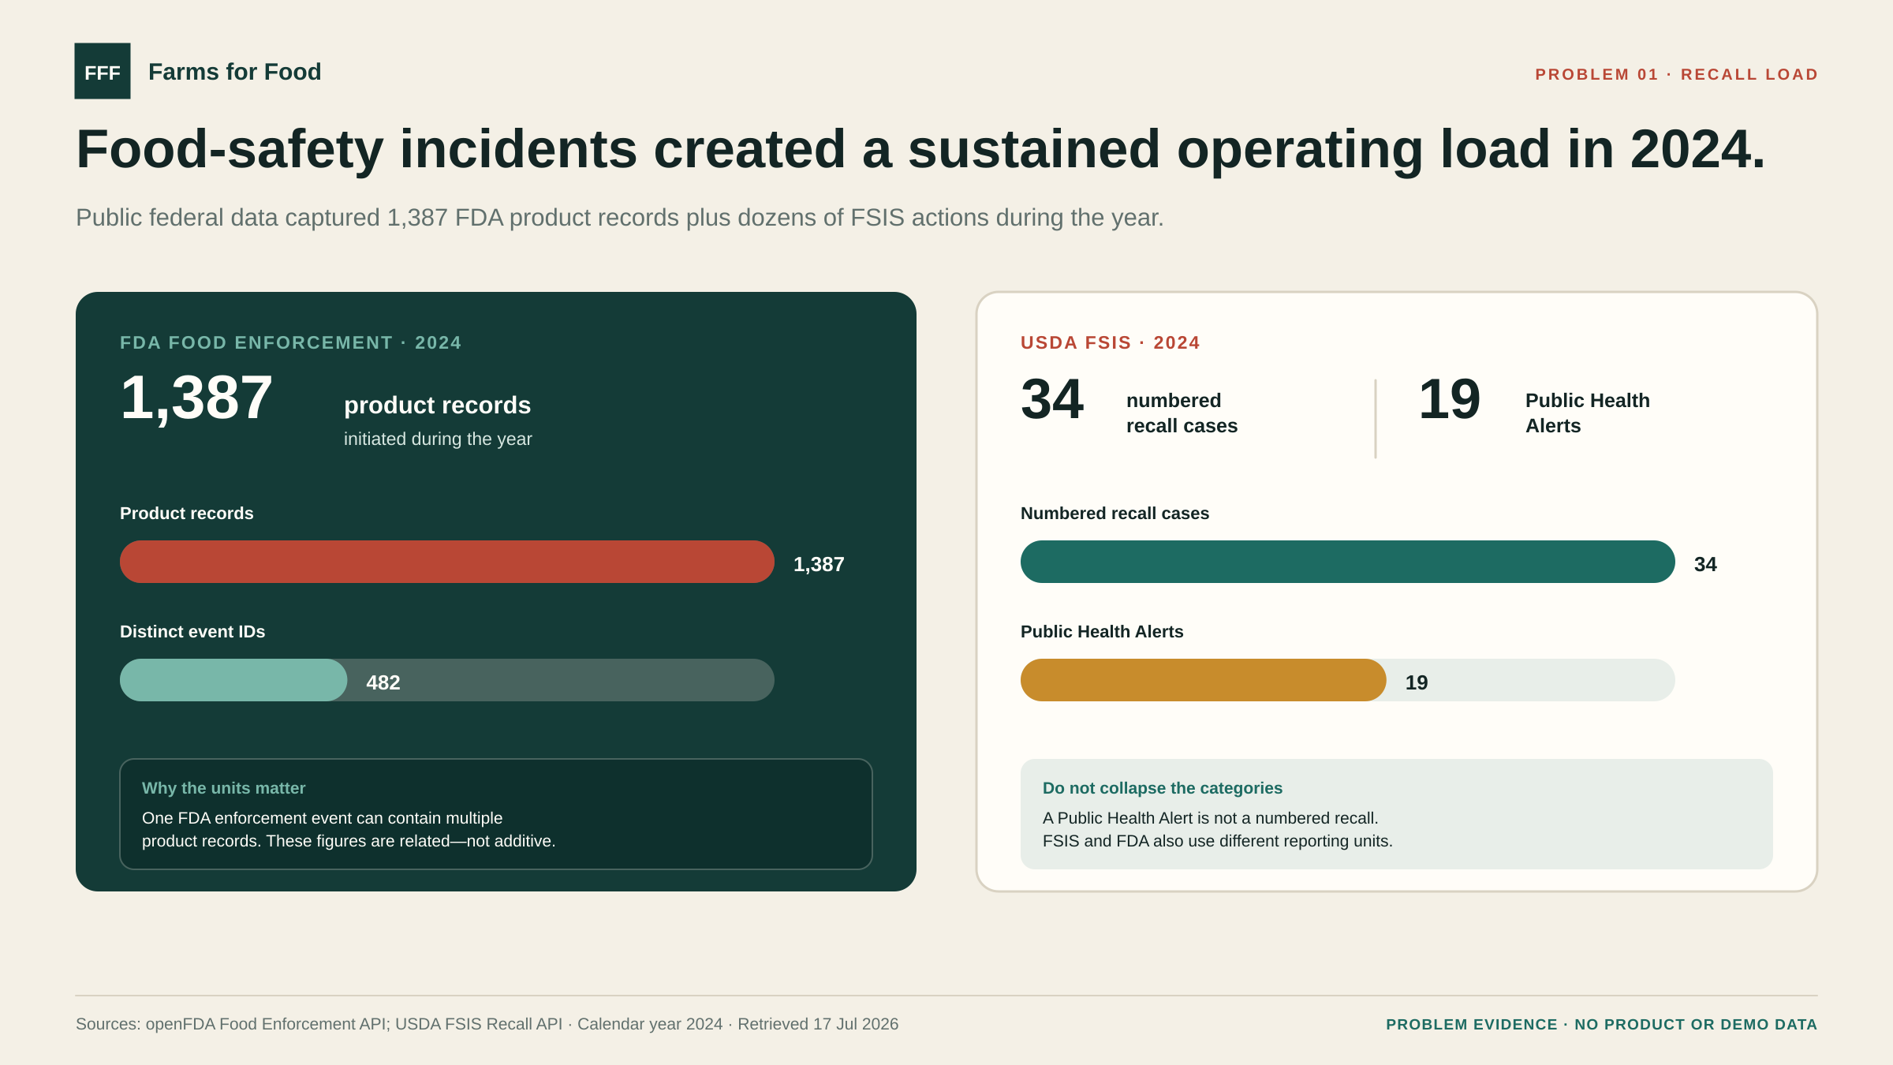
Notes:
Sources and definitions: - FDA product records: https://api.fda.gov/food/enforcement.json?search=recall_initiation_date:%5B20240101%20TO%2020241231%5D&limit=1 - FDA distinct event IDs: https://api.fda.gov/food/enforcement.json?search=recall_initiation_date:%5B20240101%20TO%2020241231%5D&count=event_id&limit=1000 - USDA FSIS recalls and Public Health Alerts: https://www.fsis.usda.gov/fsis/api/recall/v/1 Calendar-year 2024. FDA product records and distinct event IDs are related, not additive. FSIS numbered recalls and Public Health Alerts are different action types. For the FSIS totals, translated duplicate rows and -EXP expansion records were normalized to the base recall number before counting 34 distinct numbered recall cases and 19 distinct Public Health Alerts. Counts retrieved July 17, 2026.

Slide 2
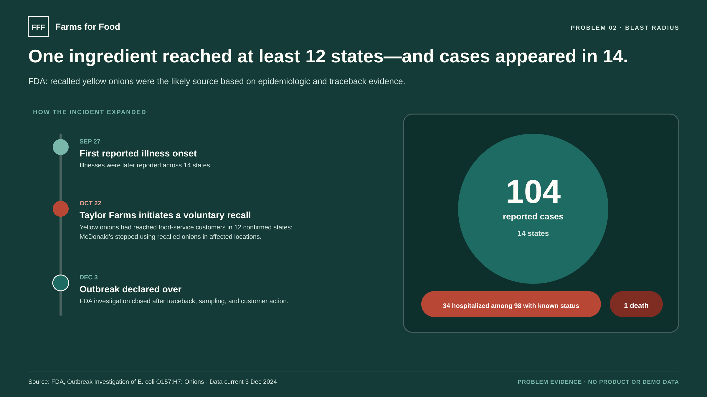
Notes:
Primary source: https://www.fda.gov/food/outbreaks-foodborne-illness/outbreak-investigation-e-coli-o157h7-onions-october-2024 FDA reported 104 cases, 34 known hospitalizations, one death, and cases in 14 states; hospitalization status was available for 98 cases. Recalled onions had confirmed distribution in 12 states. Taylor Farms initiated the voluntary recall on October 22, 2024; FDA closed the investigation and CDC declared the outbreak over on December 3, 2024. FDA described recalled yellow onions as the likely source based on epidemiologic and traceback evidence.

Slide 3
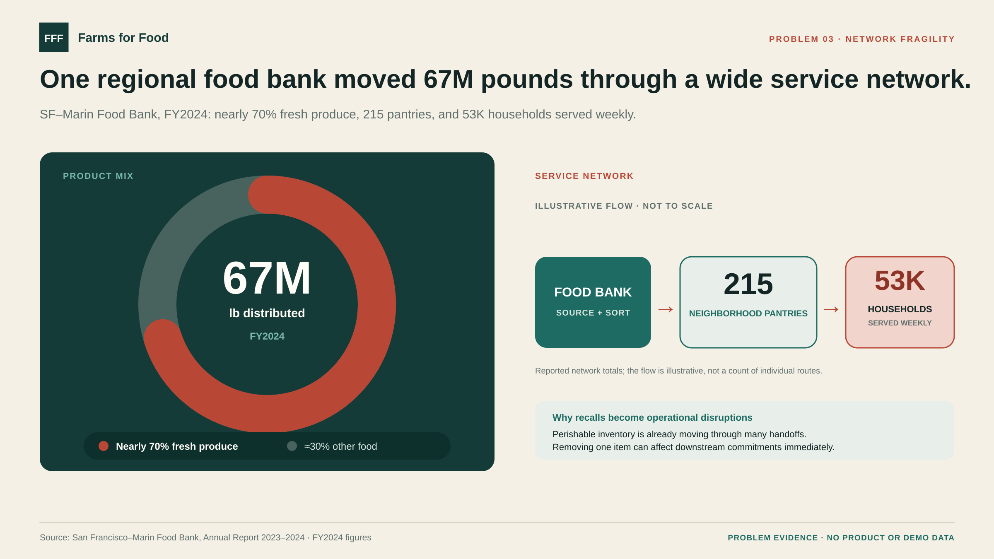
Notes:
Primary source: https://www.sfmfoodbank.org/annual-report-2023-2024/ San Francisco–Marin Food Bank FY2024 figures: 67 million pounds distributed; nearly 70 percent fresh produce; 53,000 households served weekly; 215 weekly neighborhood food pantries. The approximately 30 percent “other food” segment is the visual complement of the reported “nearly 70 percent” fresh-produce share, not a separately reported figure. This slide uses one regional food bank as a scale and perishability example, not as a national estimate.

Slide 4
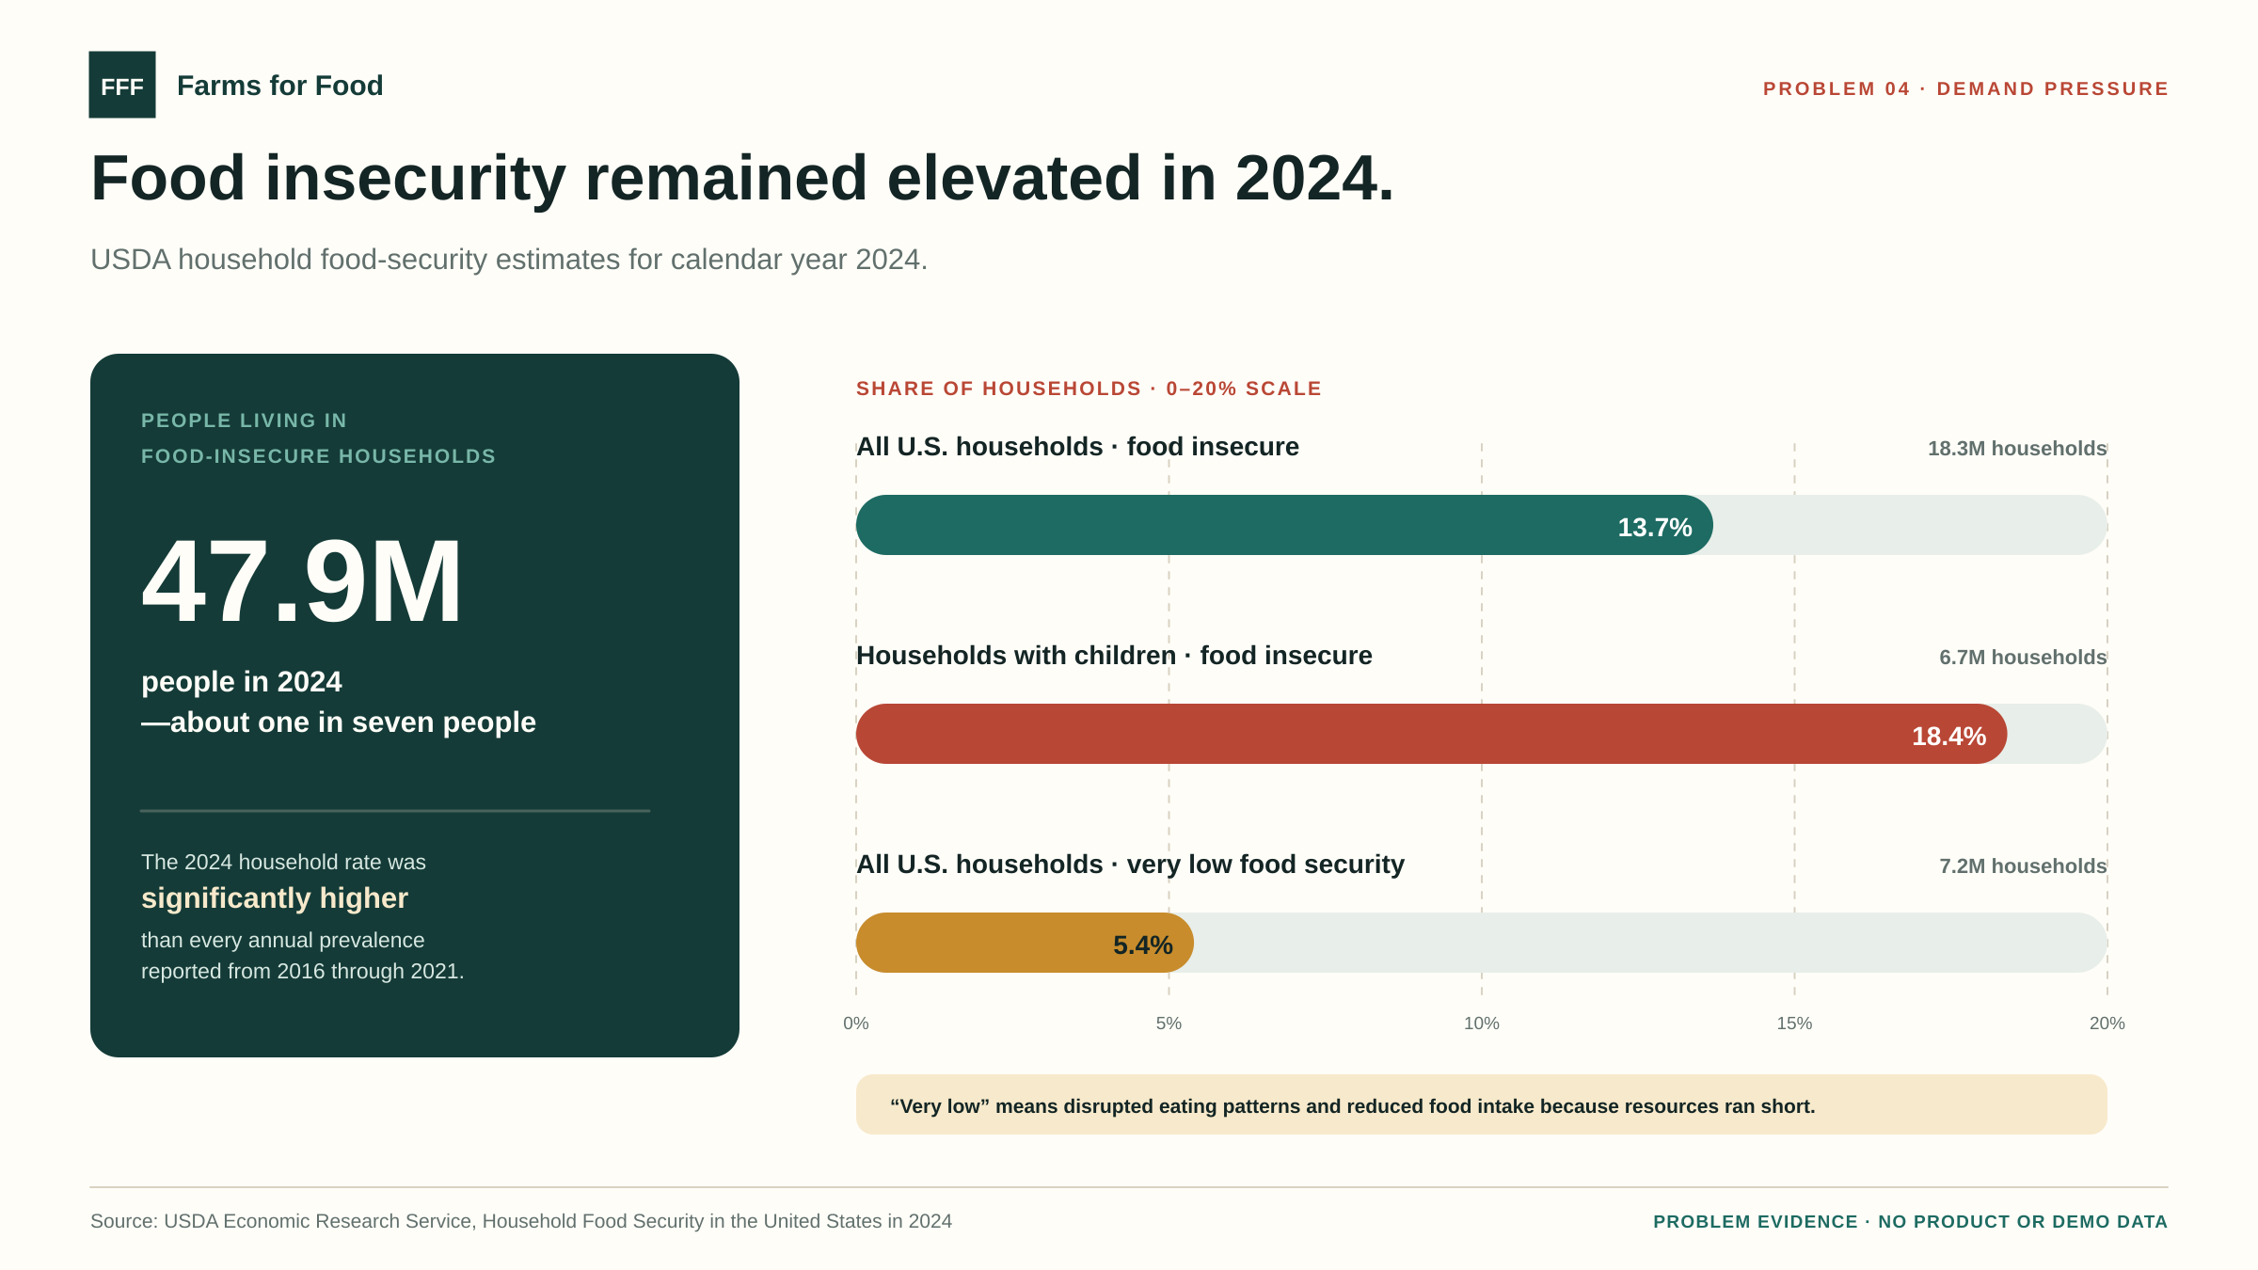
Notes:
Primary source: https://www.ers.usda.gov/topics/food-nutrition-assistance/food-security-in-the-us/key-statistics-graphics USDA ERS 2024 estimates: 47.9 million people lived in food-insecure households; 13.7 percent (18.3 million) of all U.S. households were food insecure; 18.4 percent (6.7 million) of households with children were food insecure; 5.4 percent (7.2 million) of all households had very low food security. USDA reports the 2024 prevalence was significantly higher than annual prevalence from 2016 through 2021.

