Slide 1
The National Bioinformatics Platform Sweden
Sebastian Di Lorenzo
Sebastian.DiLorenzo@NBIS.se
https://github.com/Sebastian-D/Presentations

Slide 2
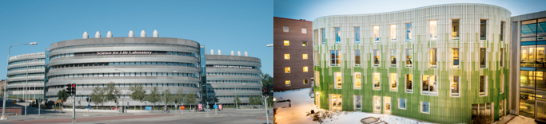
SciLifeLab Vision
“To be an internationally leading center that develops, uses and provides access to advanced technologies for molecular biosciences with focus on health and environment.”
Solna
Uppsala
Notes:
NBIS will enable world-class life science by providing expert knowledge, creative data integration, advanced training, efficient data publication and access to high-performance data and analysis methods. NBIS will continue coordinating bioinformatics support within Sweden and make bioinformatics easily accessible for life science researchers.

Slide 3
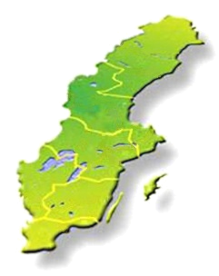
Facilities
Short-term support and infrastructure
Wide competence in bioinformatics, Assembly/Annotation, SysDev
Long-term support
Large collaborative projects selected by scientific ranking
Systems biology
Network analyses and Integrative bioinformatics
Compute and storage
Computational and storage resources for bioinformatics, especially next-generation sequencing

Slide 4



Focus areas
Support
Infrastructure
Training
Notes:
Support: 400 consultations
200 research projects per year and growing
3 tracks, short, long partner
Training: 35 Training events
500 phd/post-doc students
Infrastructure: 800 compute projects
200 software and databases
Publishing data repositories

Slide 5
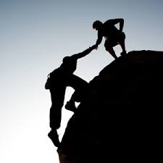
Grant season
Free consultations
Project planning
Grant writing
Bioinformatics tools
Reproducability
Data management
Storage
Data Management Plans (DMPs)

Slide 6
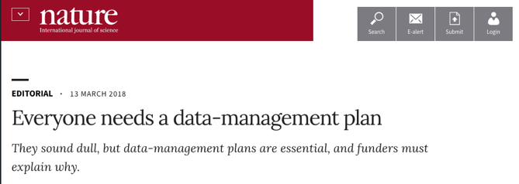
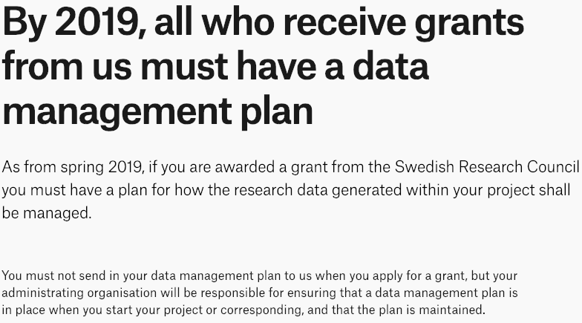
Data management
Will become a standard part of the research funding process
Notes:
Project Planning
-Metadata
-File formats
-Licensing
-Data Management Plans
Data publication and submission
-Support submissions to public repositories
- DOIs to dataset (if needed)

Slide 7
DMPs - National guidelines
VR & SUHF (Association of Swedish Higher Education Institutions)
Central parts of a data management plan*
Description of data – reuse of existing data and/or production of new data
Documentation and data quality
Storage and backup
Legal and ethical aspects
Accessibility and long-term storage
Responsibility and resources
Notes:
https://www.vr.se/english/calls-and-decisions/grant-terms-and-conditions/data-management-plan.html

Slide 8
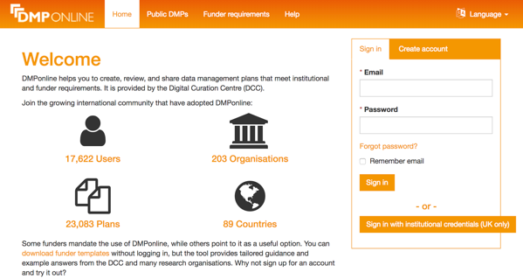
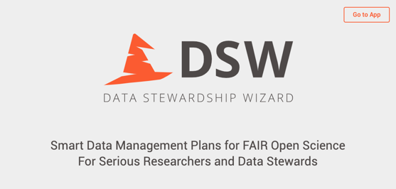
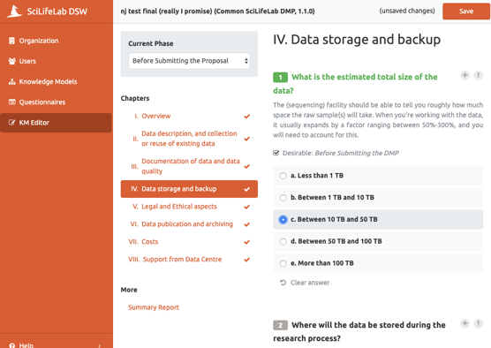
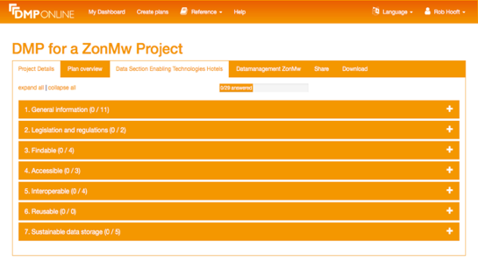
DMP tools
DMPonline
ELIXIR Data Stewardship Wizard
https://dmponline.dcc.ac.uk/
https://dsw.scilifelab.se
https://ds-wizard.org/

Slide 9
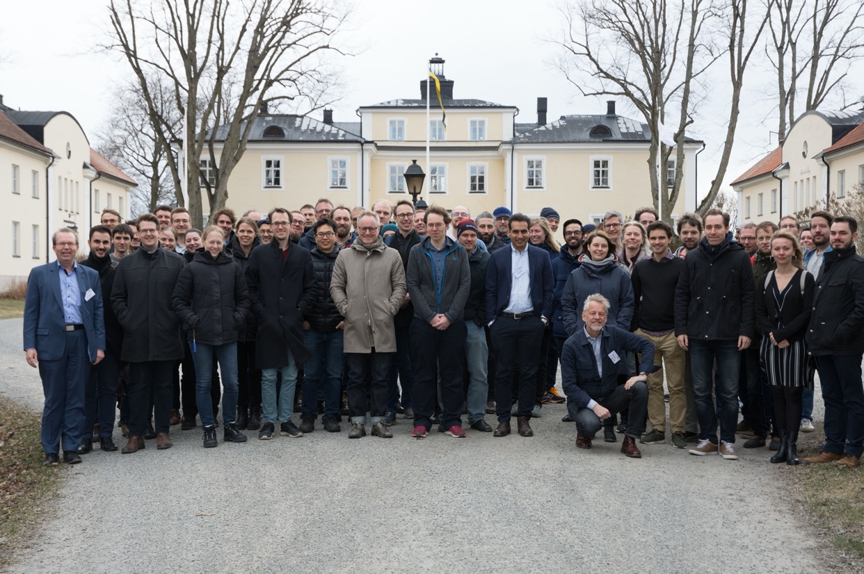
Thanks for listening!
https://github.com/Sebastian-D/Presentations

Slide 10
VRs recommendations
Description of data – reuse of existing data and/or production of new data
How will data be collected, created or reused?
What types of data will be created and/or collected, in terms of data format and amount/volume of data?
Documentation and data quality
How will the material be documented and described, with associated metadata relating to structure, standards and format for descriptions of the content, collection method, etc.?
How will data quality be safeguarded and documented (for example repeated measurements, validation of data input, etc.)?
Storage and backup
How is storage and backup of data and metadata safeguarded during the research process?
How is data security and controlled access to data safeguarded, in relation to the handling of sensitive data and personal data, for example?
Legal and ethical aspects
How is data handling according to legal requirements safeguarded, e.g. in terms of handling of personal data, confidentiality and intellectual property rights?
How is correct data handling according to ethical aspects safeguarded?
Accessibility and long-term storage
How, when and where will research data or information about data (metadata) be made accessible? Are there any conditions, embargoes and limitations on the access to and reuse of data to be considered?
In what way is long-term storage safeguarded, and by whom? How will the selection of data for long-term storage be made?
Will specific systems, software, source code or other types of services be necessary in order to understand, partake of or use/analyse data in the long term?
How will the use of unique and persistent identifiers, such as a Digital Object Identifier (DOI), be safeguarded?
Responsibility and resources
Who is responsible for data management and (possibly) supports the work with this while the research project is in progress? Who is responsible for data management, ongoing management and long-term storage after the research project has ended?
What resources (costs, labour input or other) will be required for data management (including storage, back-up, provision of access and processing for long-term storage)? What resources will be needed to ensure that data fulfil the FAIR principles?

Slide 11
Cheat sheet, don’t show audience!
Short Term Support – an hourly fee
Always open for applications
Quick turn-over
Work usually starts within 2 weeks from signed agreement
Most projects 30-60 hours, stretching over 1-3 months
800 kr/h, time logged per hour used
Long Term Support – free
Application rounds, 3 times/year
Scientific committee
Projects chosen for support based on scientific excellence
500 h of support, usually stretching over 1-2 years
Hands-on involvement from research group mandatory
Partner project – 50% of an expert’s salary
For longer projects with a large bioinformatics component
Always open for applications
At least 2 years, at least 50%
Hands-on involvement from research group recommended
Decisions on case-by-case basis
Expert might work at another site, will in general retain workplace located at NBIS hubs (regular visits with group can of course be arranged)

Slide 12
Training
Introduction to omics data analysis
4 x Introduction to Bioinformatics using NGS data, 5 days (Manfred Grabherr)
1 x Omics data analysis, 10 days (Erik Fredlund, Lukas Orre)
Advanced topical courses
2 x RNAseq, 3 days (Johan Reimegård)
1 scRNA, 2 days (Åsa Björklund)
1 x Genome assembly, 3 days (Henrik Lantz)
1 x Genome annotation, 3 days (Henrik Lantz)
1 x ChIP-seq 3 days (Agata Smialowska, Olga Dethlefsen)
1 x Proteomics, 4 days (Fredrik Levander)
Programming and reproducible research
1 x Reproducible research, 2 days (Rasmus Ågren, Leif Wigge)
2 x Python, 2 days (Nina Norgren, Sergiu Netotea)
1 x R Summer School, 10 days: RaukR (Marcin Kierczak,Sebastian DiLorenzo) 1 x R programming Foundations for Life Scientists, 5 days (Marcin Kierczak)
1 x Unix/Linux Tutorial for beginners, 3 days (Mihaela Martis)

