Slide 1

SebMedia
A Sebastian Webster product.
Notes:
Good morning everyone! Today I’m going to be talking about SebMedia, my new social media platform made for this capstone project. I chose to make a social media platform because I am currently working with some of my friends to make a social media platform for iOS and Android and I like building complex/large projects so I thought it would be cool to make a social media website using React.

Slide 2

Purpose
To make a privacy-focused alternative to current social media platforms
Almost all social media platforms today are constantly gathering as much data as they can on their users
Privacy is a fundamental human right. People should be able to use the products they love without getting tracked across the internet.
User’s privacy is slipping away and it needs to stop.
Notes:
The purpose of SebMedia is to provide a privacy-foused alternative to the current social media platforms out in the market. As of now there is a major problem with current social media platforms. Almost all of them constantly gather as much data as they can on their users. This problem is valuable to address as privacy is a fundamental human right. Giant tech companies shouldn’t get to exploit their users’ data just to earn extra money. It’s wrong. User’s privacy is slipping away and it needs to stop.

Slide 3
Similar Projects to SebMedia
Ello – https://ello.co
Eyeem – https://eyeem.com
BitChute – https://bitchute.com
Notes:
There have been similar projects that have the same vision as SebMedia; to make a social media platform that is private and secure. But most of them are not very well known, and/or they operate in a niche market. Like for example, Ello. Ello is a social media platform focused on user privacy that is targeted towards people interested in art, fashion, and photography. Although there are a lot of people who enjoy those things, it doesn’t cater to as large an audience as Instagram does because Instagram is designed for people to share videos and photos of themselves with friends and family. Eyeem is another one of these user-privacy advocating social media platforms. Eyeem is designed for professional photographers to share their photos with the world. Professional photographers is a very niche market. BitChute on the other hand caters to many people. It’s a video sharing platform – basically like YouTube, but privacy focused and allows free speech. The downside to BitChute is that it is not well known, and doesn’t really have an attractive design. This is where SebMedia stands out in the social media market. SebMedia has an attractive design, and caters to a large audience. SebMedia is basically Twitter and Instagram combined.

Slide 4

Current State of the Social Media Industry
All of the major players track their users
All of the social media platforms that value users’ privacy are either targeting a niche audience, not well heard of, or both
Notes:
The current state of the social media industry isn’t so good. All of the major players track their users. As mentioned in the previous slide, there are some startups focusing on privacy and security, but they aren’t very well known. For example, Minds has 2.5 million registered users as of May 2020. Compared to Facebook’s 2.934 billion as of July 2022, that is 0.08%.

Slide 5
Desired State for the Industry
All social media platforms should not track their users
Any platforms that do track their users should go out of business
Notes:
People are starting to wake up to the fact that social media tracks them. With Instagram and Facebook injecting JavaScript code in the websites you visit in their app to track you, and with TikTok user data being accessed by the Chinese government, the news is spreading around fast. Eventually to be able to survive in the social media industry, you must not track your users.

Slide 6
Social Media Industry Value-Chain
Get users to register to their platform
1
Show other users’ posts that align with their point of view and liking
2
Entice the users to stay on as long as possible
3
After every few posts, show an ad
4
Notes:
The social media industry makes money by first getting users to register for a social media platform. The users’ then view other users’ posts and in between those posts the user would sometimes see ads. The ads are what make the industry their money.

Slide 7
Key Concepts of the Industry
Register as many users as possible
The more users on your platform, the more ads you can display
The more ads you can display, the more money you make
Stay ahead of trends or create new trends to avoid losing market share
Notes:
The key concepts of the social media industry are to register as many people as possible on your platform. The more users you have on your platform, the more ads you can display. The more ads you display, the more money the company makes. Another important key concept is to stay ahead of trends or create new trends to avoid losing market share. For example, when TikTok got released, it introduced short form content to the masses, and lots of people loved it. TikTok created a new trend, and got a lot of market share because of it. Q4 of 2021 is the first time that Facebook ever reported a loss in user base. That happened in part because they weren’t as trendy anymore.

Slide 8
SebMedia industry participation
Social Media
Communications
Notes:
Other than the social media industry, SebMedia also participates in the communications industry as well because creating posts and sharing them with your friends and family is communication.

Slide 9

Stakeholders
Anyone who uses social media
Notes:
The stakeholders of SebMedia are anyone who uses social media today. That is roughly 4.7 billion people as of 2022.

Slide 10

Why do they care?
SebMedia is like social media is today, however with the added benefit of protecting users’ privacy
Notes:
As said before, people are starting to wake up and realize that social media platforms are collecting their data and tracking them. People are starting to realize that this is really bad. Stakeholders would care about SebMedia because it combines the best of both worlds. Social media, and user privacy.

Slide 11
Stakeholder expectations
SebMedia should be easy to use
SebMedia should let me control my data and not track me
SebMedia should look attractive and be accessible to many people
Notes:
Stakeholders expect SebMedia to be easy to use. They also expect SebMedia to not collect their data and to not track them. As well as that, SebMedia should look attractive and be accessible to anyone. SebMedia meets all 3 of those expectations.

Slide 12
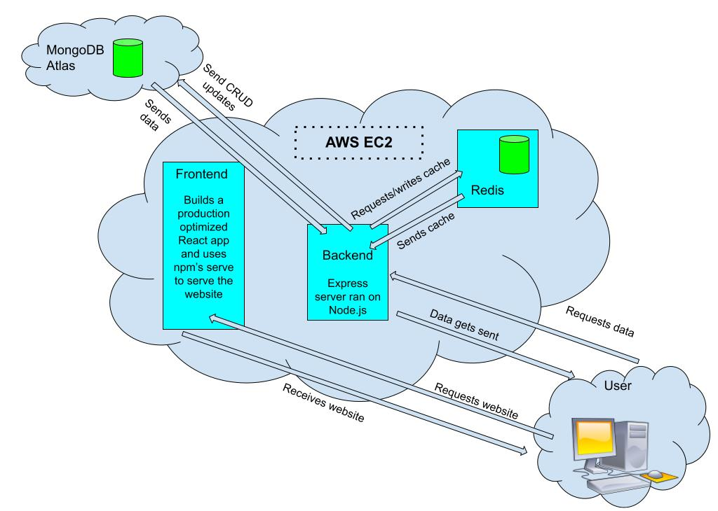
Architecture Design
Notes:
This is SebMedia’s architecture design. We have an AWS EC2 instance running 3 docker containers: Frontend, Backend, and a Redis cache. The backend uses MongoDB Atlas as a database. When the user wants to open SebMedia, they do a REST call to the Frontend container, which sends back a production optimized React app. When the user does anything that interacts with the backend (such as logging in, signing up, or creating a post), it does a REST call to the Backend container. Depending on which task the user is trying to carry out, the Backend may carry out CRUD updates to the MongoDB Atlas database or the Redis cache.

Slide 13
User Stories
# | User Story Title | User Story Description | Priority | Additional Notes
1 | Privacy | As a user, I want to not have my data be collected or for me to get tracked so that I can enjoy my favourite services and still have some privacy. | High
2 | Finding Friends’ Posts | As a user, I want to be able to find my friends’ profiles and view and like the posts they share so that I can see what my friends are up too | High
3 | Signing Up | As a user, I want to be able to sign up so that I can use SebMedia | High
4 | Logging in | As a user, I want to be able to login so that I can use my SebMedia account on separate devices | High
5 | Following a user / friend | As a user, I want to be able to follow my friends and users that I like so that I can show my appreciation for them and have their posts show up in my home feed | High
6 | Creating a post | As a user, I want to be able to create a post so that I can share my life and opinions with other people | High
7 | Editing a post | As a user, I want to be able to edit my posts so that if I have a typo or false/outdated information in my post, I can easily update it without having to delete and make a new post. | Medium
Notes:
SebMedia has user stories for all major functionality, such as finding friends’ posts. So for example, as a user, I want to be able to find my friends’ profiles and view and like the posts they share so that I can see what my friends are up too.

Slide 14
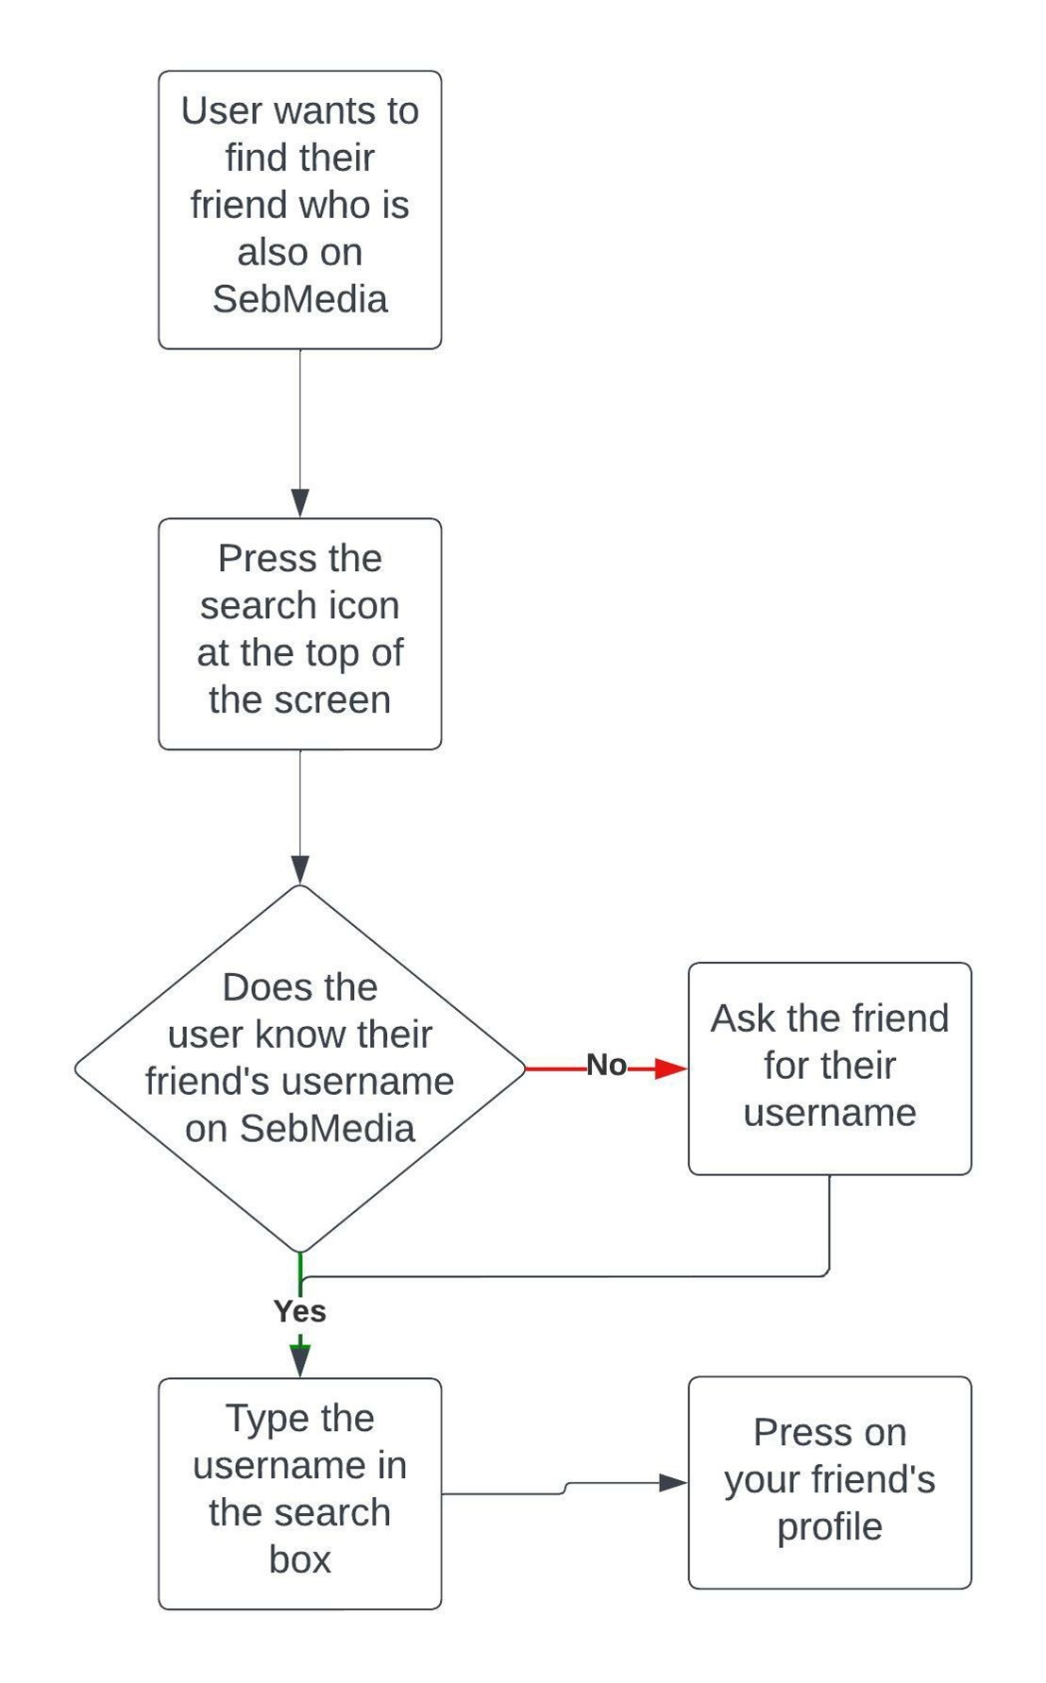
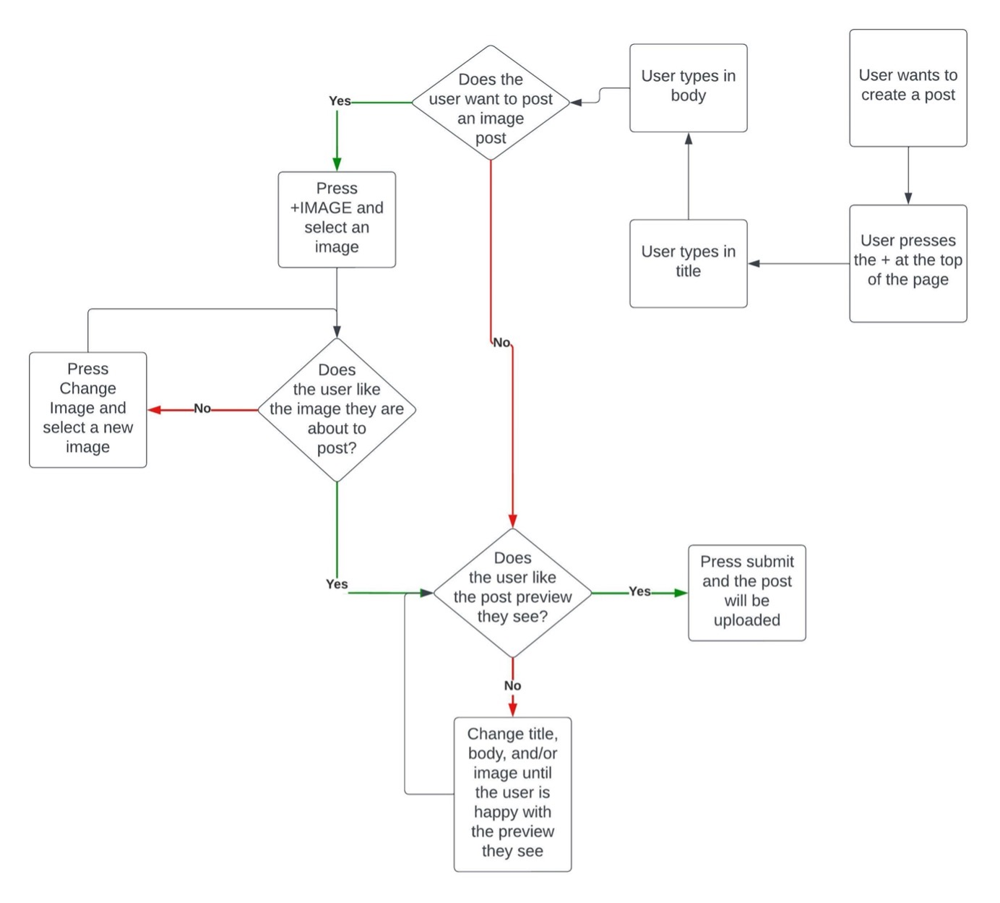
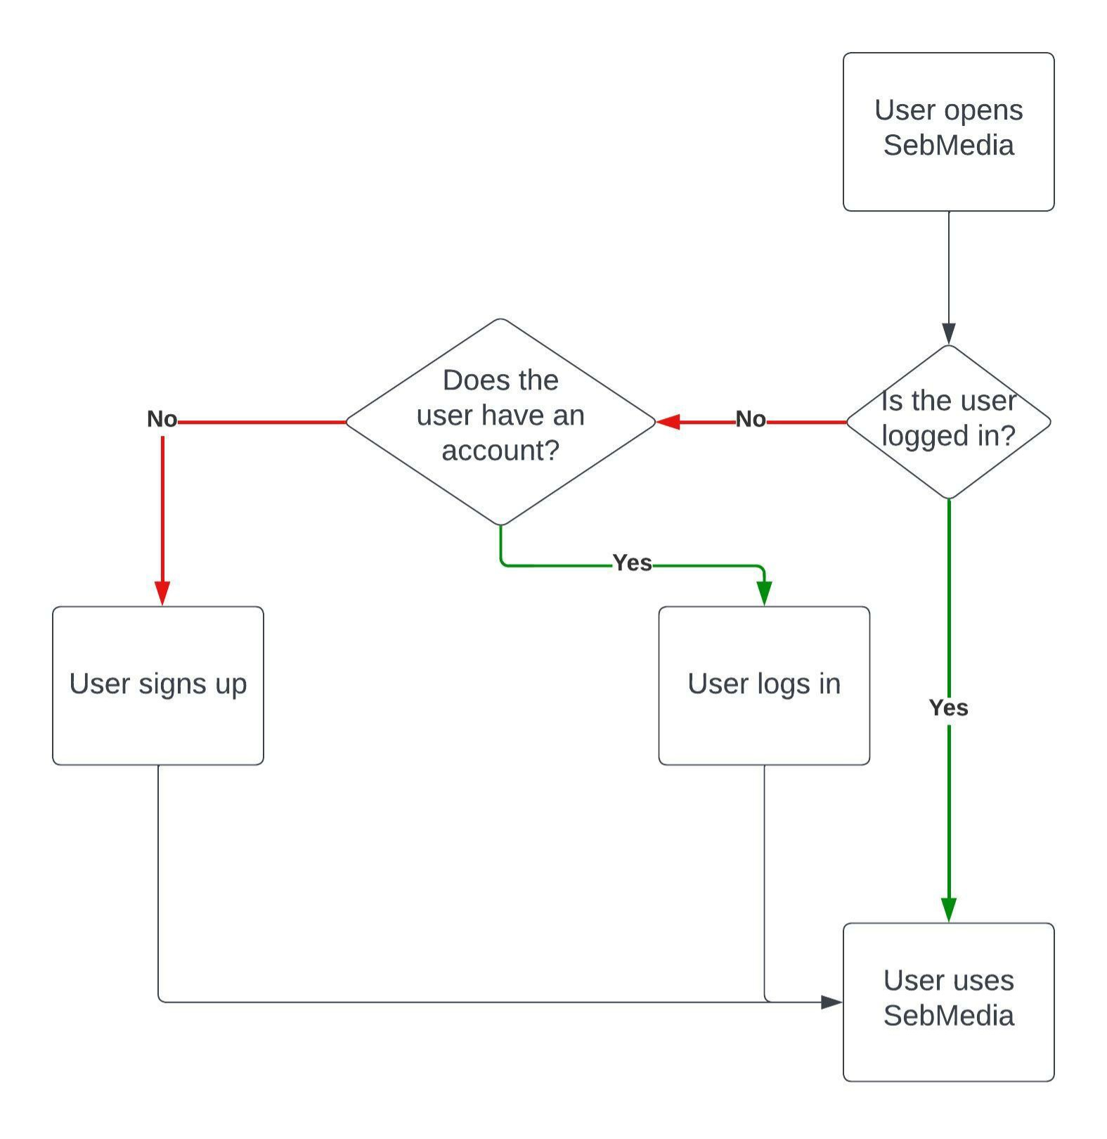
User Flow
Finding your friends on SebMedia Process
Creating A Post Process
Onboarding Process
Notes:
User flow diagrams have been made for the major features of SebMedia. For example, the onboarding process. ---EXPLAIN THE ONBOARDING PROCESS---

Slide 15
Figma Designs
Notes:
Show everyone the figma designs

Slide 16
Out of Scope
Encryption / HTTPS
Image Compression
Optimization for mobile
Redux implementation
Notes:
This is the list of Out of Scope functionalites for SebMedia. Encryption and HTTPS is out of scope because those are not required when SebMedia is in development. SebMedia would have to have encryption and HTTPS before it went into production however. Image compression is also out of scope as there aren’t many users during development and as such data usage is not too much of a worry. Mobile optimization is out of scope because it would’ve taken up too much time. SebMedia would greatly benefit from implementing Redux, but as it would’ve taken too much time to implement, it is out of scope.

Slide 17
Non-functional requirements
Storage of personal details
Password Hashing
Notes:
One of the non-functional requirements is storage of personal details. Users will signup with their username and email. This must be handled carefully to make sure this data doesn’t end up with a malicious actor. Another one is password hashing. We cannot let passwords be stored in the database in plaintext. If that happened, if a malicious actor got unathorized access to the database, all users’ accounts will be compromised. Since passwords are hashed 2^16 times (or 65536) times before getting saved in the database, if anyone got unathorized access to the database, user accounts will not be as compromised.

Slide 18
How many transactions should be enabled at peak time?
At least 500 per minute per instance
Notes:
At least 500 transactions per minute per instance should be enabled at peak time. Right now SebMedia only runs on 1 instance. If SebMedia were to go in production, it would have to run on a lot more to enable the high traffic.

Slide 19

How easy to use does SebMedia have to be?
Extremely easy
Notes:
SebMedia has to be extremely easy for users of all ages and skill levels to be able to use it. Making SebMedia simple and easy to use allows it to cater to a large audience.

Slide 20
How quickly should SebMedia respond to user requests?
As fast as possible (except in cases that would harm user security)
Notes:
SebMedia should respond to user requests as fast as possible. Except in cases where it would harm user security, such as password hashing.

Slide 21
How reliable must SebMedia be?
As close to 100% uptime as possible.
Notes:
SebMedia has to have as close to a 100% uptime as possible. People all around the world in all sorts of different time zones trust SebMedia to be available at all times of the day.

Slide 22
Software conformation to technical standards
Backend
MVC Structure
Frontend
Custom hooks implement shared functionality
Common elements like Profile Items are in separate files and are used by many different parts of the application
Notes:
SebMedia’s code conforms to technical standards. The backend uses the Model View Controller structure, and the frontend has custom hooks that implement shared functionality between components, and also common elements like Profile Items are separated into their own files to be used across different parts of the application

Slide 23
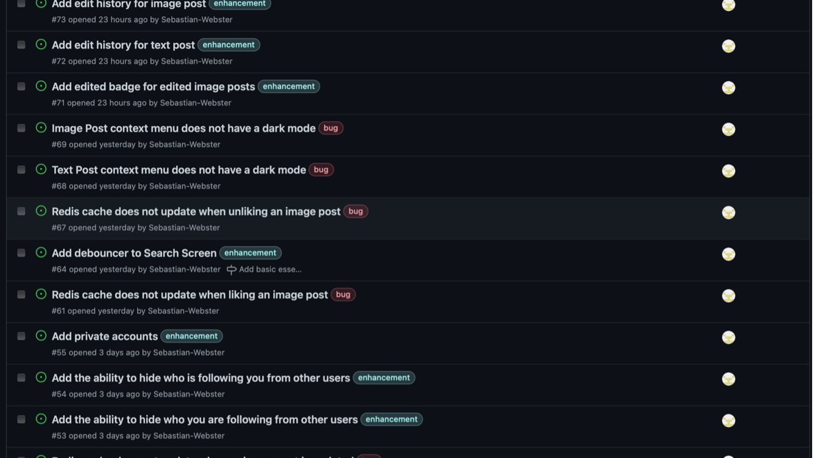
Project Planning – GitHub Issues
Notes:
For SebMedia project planning, I used GitHub issues. GitHub Issues allows you to label issues, essentially putting them into categories. It integrates directly into my GitHub repository and also I can link branches to an issue so stakeholders can view what is being done to fix the issue or add a new feature.

Slide 24
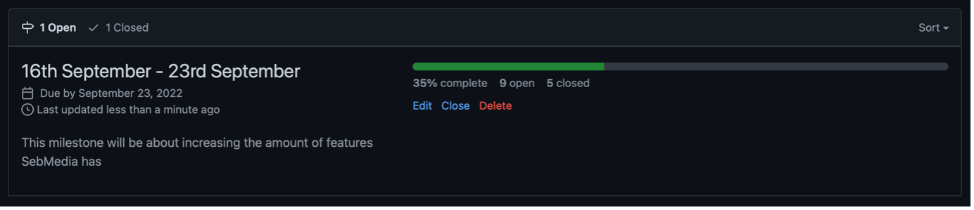
Project Planning – GitHub Milestones
Notes:
I chose to use GitHub milestones to track what to get done by a certain time because it integrates directly with my GitHub repository and also it’s easy to see what has been done and what still needs to get done within a certain timeframe. It also allows stakeholders to easily view what code changes were made to implement a feature or fix.

Slide 25
Steps taken to achieve product quality
Checked to make sure application looked like Figma design
Ran multiple automated and manual tests
Code is cleanly written
Application and code is well documented
Notes:
4 key steps were taken to ensure SebMedia is a quality product. Firstly, I checked to make sure SebMedia looked like the Figma design. I had SebMedia and Figma side by side on my screen to look for any discrepancies, and if there were any, I would fix them. Secondly, I ran multiple automated and manual tests. Thirdly, the code is cleanly written, and split up into easy to understand parts. This makes it easy to identify issues within the code and to make any changes to it. Lastly, SebMedia and code is well documented. This makes each piece of the app and code easy to understand.

Slide 26
How was each feature tested?
Automated tests ran on GitHub Actions instances
Ubuntu running Node 16
Windows running Node 16
macOS running Node 16
Ubuntu running Node 17
Windows running Node 17
macOS running Node 17
Ubuntu running Node 18
Windows running Node 18
macOS running Node 18
Other features were tested manually
Manual tests followed strict instructions
Notes:
For the tests that could be automated, they ran on 9 different GitHub actions instances on any push to the repository, and on any pull request merged. The tests that weren’t so easily automated were tested manually while following strict instructions.

Slide 27
How were edge cases handled
JavaScript
Console.logs were added to each part of the broken feature to see the data at different steps of the process, and to see if there were any abnormalities in the data
Frontend
Browser Developer tools were used to see each computed CSS value, and to change the CSS on the fly
Notes:
JavaScript edge cases were handled by adding console logs to each part of the broken feature to see the data at different steps of the process, and to see if there were any abnormalites in the data. Frontend edge cases were handled with the browser developer tools to see each computed CSS value, and to change the CSS on the fly to see instantly what was causing the frontend to not look exactly right

Slide 28
What were the considerations for deploying SebMedia
Using an AWS EC2 instance with docker-compose running 3 docker containers (frontend, backend, and Redis cache)
Notes:
From the start, the considerations for deploying SebMedia was to run an AWS EC2 instance with docker-compose running 3 docker containers (frontend, backend, and Redis cache) and that is the implementation I have stuck with

Slide 29
How well did SebMedia meet it’s objectives?
Amazingly.
Notes:
How well did SebMedia meet it’s objectives? To put it simply (SHOW AMAZINGLY TEXT) amazingly. SebMedia is a functioning social media platform that protects user’s privacy. That means it has met it's goal.

Slide 30
SebMedia Code
https://github.com/Sebastian-Webster/Capstone-Project
Notes:
SebMedia’s code is hosted on GitHub at github.com/Sebastian-Webster/Capstone-Project

Slide 31
Resources used
MongoDB Atlas - https://www.mongodb.com/atlas/database
Redis - https://redis.io
Docker - https://www.docker.com
AWS EC2 - https://aws.amazon.com/ec2
NodeJS – https://nodejs.org
React – https://reactjs.org
Notes:
The resources used for SebMedia are MongoDB Atlas, Redis, Docker, AWS EC2, NodeJS, and React

Slide 32
Demo

Slide 33

Questions?
Notes:
Any questions?

