Slide 1


Caching and typed interfaces in Flyte
Sebastian Morsch
302.1-Data infrastructures Topic 9

Slide 2
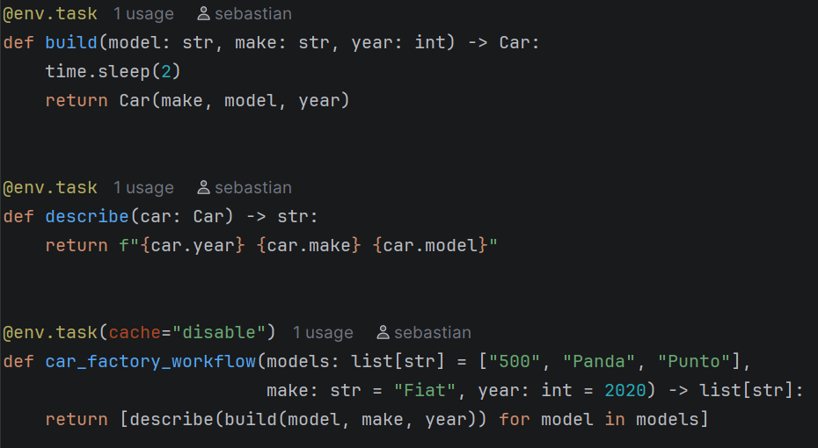
What is Flyte and what problems does it solve ?
Problem | How Flyte solves it
Reproducibility | Every task and run is versioned, with inputs and outputs recorded
Heterogeneous resources | Each step gets its own CPU, GPU and memory on Kubernetes
Fragility | Caching, unchanged steps are reused, reruns only redo what failed
Collaboration | Strongly typed, inputs and outputs checked before anything runs
Operational glue | Built-in scheduling, logging and lineage
Open-source, Kubernetes-native
orchestrator for data
and ML pipelines
302.1-Data infrastructures Topic 9

Slide 3
The problem: re-running work you have already done
Build time
Run 1
First build
500
Panda
Punto
6 s
built
built
built
Run 2: swap Punto for Uno
No cache
naive rerun
500
Panda
Uno
6 s
rebuilt for nothing
rebuilt for nothing
built
Flyte cache
cache="auto"
500
Panda
Uno
2 s
reused from cache
reused from cache
built
302.1-Data infrastructures Topic 9

Slide 4
Demo
Car_factory
302.1-Data infrastructures Topic 9

Slide 5
What the cache keys on
Task name
car_factory.build
Key found
Reuse the stored output
Uno
Interface
(model: str, make: str, year: int) -> Car
Cache key
One hash of all four
Cache version
cache="auto": hash of the function body
New key
Run the task, store the result
Uno
Inputs
model="Uno", make="Fiat", year=2020
Punto --> Uno
Change any of the four and you get a new key, so the task runs again.
302.1-Data infrastructures Topic 9

Slide 6
Who shares the cache ?
Same pipeline
car_factory_workflow
Other pipeline
fleet_worflow
Hit
reused from cache
rerunning it unchanged
Hit
reused from cache
Fleet reuses the 500 and Panda
Same cache store
Same laptop, or same project + domain on a cluster
Miss
built again
User B's laptop with --local
Miss
built again
new store, nothing to reuse
Different cache store
Another laptop, or project or domain
The pipeline doesn't matter. The cache store does.
Same task means same name, types and code: a copied and edited build() gets a new key.
302.1-Data infrastructures Topic 9

Slide 7
When the cache lies
The cache lies
Behavior changed, the function body didn't
The cache is too eager
The function body changed, behavior didn't
You edited a helper function def paint(): return "blue" | You added a log line print("building", model)
You upgraded a library pandas 2.2 -> 3.0 | You renamed a variable m -> model
The task reads external data Open("prices.csv") | You reformatted the file black_car_factory.py
Fix: pin the version yourself
cache=flyte.Cache(behavior="override", version_override="v2")
We bump it when the ouput should change. It makes it readable, reviewable for the team.
302.1-Data infrastructures Topic 9

Slide 8
Typed interfaces : what a type hint becomes
@env.task
def build(model: str, make: str, year: int) -> Car:
The signature becomes the task's interface: {model: STRING, make: STRING, year: INTEGER} → Car
Every value passed becomes a literal.
302.1-Data infrastructures Topic 9

Slide 9
Typed interfaces : Three checkpoints
@env.task
def build(model: str, make: str, year: int) -> Car:
flyte run
CLI
worflow
car_factor_workflow
build
Spends the compute
describe
(car: Car)
1
2
3
At submission
fails here :
--year "deux-mille"
nothing is submitted
Info a task
fails here :
build(m,make,"2020")​
Build never starts
Out of a task
fails here :
return ​{"model":m}
Build's time is lost, describe is protected
302.1-Data infrastructures Topic 9

