Slide 1


SMART INDIA HACKATHON 2025
Problem Statement ID – 25131
Problem Statement Title - AI-Based Scoliosis Detection and Screening System (Student Innovation)
Theme- MedTech / HealthTech
PS Category- Software
Team ID-
Team Name – HealthTech Innovators

Slide 2
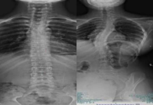
AI-Powered Scoliosis Detection and Screening
Health Tech Innovators
The Problem
Scoliosis = abnormal spine curvature
Impacts 2–3% of adolescents Manual X-ray + expert opinion → slow, subjective, error-prone Rural areas → no radiologists → late/missed detection
Our Solution
Innovation & Uniqueness
Non-invasive & low-cost (uses existing X-rays) Deployable in rural centers, schools, telehealth Seconds vs. hours/days for manual diagnosis Scalable → severity grading & other spinal deformities
CNN model trained on X-rays Binary output: Normal / Scoliosis Streamlit app for real-time screening Instant & user-friendly predictions
Comparative X-ray showing a normal spine vs. a scoliosis-affected spine.

Slide 3
TECHNICAL APPROACH
Health
Tech Innovators
Technologies Used: Python, TensorFlow/Keras, OpenCV, Streamlit, Google Colab
Methodology :-
labeled X-rays (scoliosis, normal)
2.
Preprocessing
Convert to grayscale Resize (224×224) Normalize pixels (0–1) Encode labels (0 = Normal, 1 = Scoliosis)
Convolution + pooling layers → feature extraction Dense + dropout layers → classification Output layer → binary prediction
4. Training
1. Dataset
3. CNN Architecture
Binary Cross-Entropy + Adam optimizer, 10 epochs
5.Deployment
Streamlit app for real-time screening
Prototype Flow:-
X – ray Image
Preprocessing
(Grayscale, Resize, Normalize)
CNN Model
(Convolution + Pooling + Dense + Dropout)
Output
Normal/Scoliosis

Slide 4
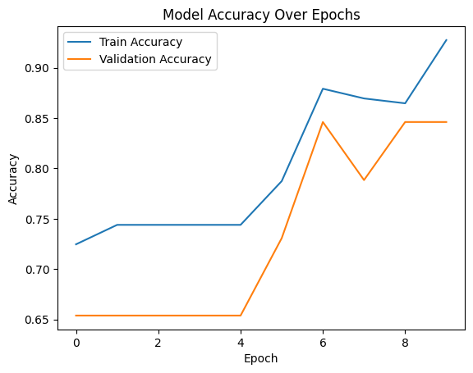
FEASIBILITY AND VIABILITY
Health Tech Innovators
Feasibility
Runs efficiently on mid-range CPUs/GPUs. Web app deployable in hospitals, schools, rural units. User-friendly interface → no technical expertise required.
Challenges
Small dataset (259 images) → limited generalization. Accuracy: Training 88.65% | Validation 78.85%. No clinical validation yet. Dependent on image quality from users.
Mitigation Strategies
Apply data augmentation & transfer learning. Collaborate with hospitals for larger datasets. Expand model to detect severity levels. Future integration with “Electronic Health Records (EHRs)”.
Shift from X-ray to direct image-based scoliosis screening for wider, low-cost deployment.

Slide 5
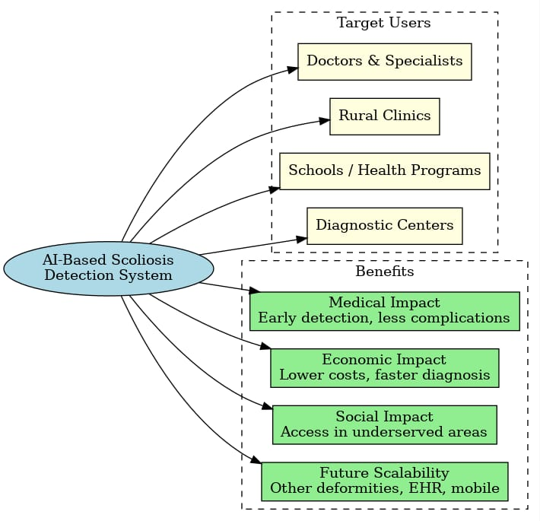
IMPACT AND BENEFITS
Health Tech Innovators
Impact on Target Users-
Doctors & Orthopaedic Specialists → support in diagnosis.
Rural & Community Clinics → low-cost, fast screening.
Schools / Health Programs → early adolescent detection.
Diagnostic Centers → reduce workload of radiologists.
Benefits -
Medical Impact 🩺
Early scoliosis detection prevents long-term complications (chronic pain, respiratory issues).
Reduces dependency on expert radiologists.
Economic Impact 💰
Cuts down diagnosis time & cost.
Reduces unnecessary follow-up scans.
Social Impact 🌍
Improves healthcare accessibility in rural/underserved regions.
Enables telemedicine & mobile health camps.
Future Scalability 🚀
Extendable to other spinal deformities.
Can integrate with EHR systems for hospital workflows.
Mobile deployment → useful for remote screenings.

Slide 6

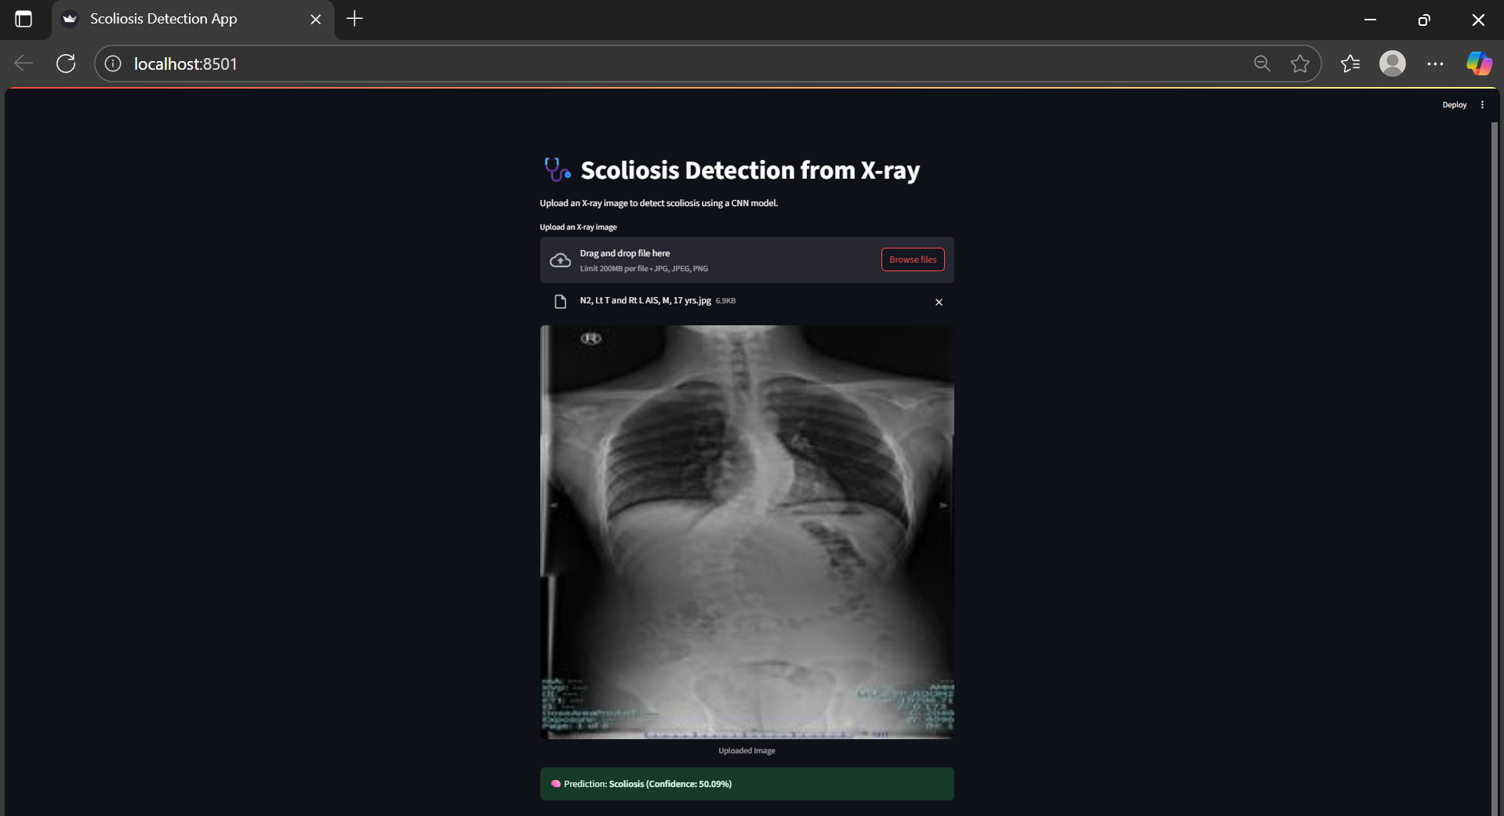
RESEARCH AND REFERENCES
Health Tech Innovators
Research Base & Credibility
Dataset: M. Fraiwan et al., Mendeley Data, 2021. DOI: 10.17632/9v3x7xwxg5.1
Achieved: *Validation accuracy 78.85%*
Backed by 10+ peer-reviewed papers
Review paper accepted in conference → academic credibility
Prototype Demonstration
Streamlit App Screenshot:
Upload spinal X-ray
Real-time prediction: Normal / Scoliosis
Shows feasibility & real-world usability
Prototype Demonstration & Video Link
Click Here https://drive.google.com/file/d/1gVI7Ag3UTu4f4lnA8FBD2KwFLDaDVgMZ/view?usp=sharing
Selected References
[1] M. Fraiwan, Z. Audat, L. Fraiwan, and T.Manasreh, “Using deep transfer learning todetect scoliosis and spondylolisthesis from X‐ray images,” *PLoS ONE*, vol. 17, no. 5,art. no. e0267851,2022,doi:10.1371/journal.pone.0267851
[2] G. B. Lee, D. T. Priefer, and R. Priefer,“Scoliosis: Causes and Treatments,”*Adolescents*, vol. 2, no. 2, pp. 220–234,2022.
[3] H. Wang, T. Zhang, K. M.‐C. Cheung and G. K.‐H. Shea, “Application of deep learning upon spinal radiographs to predict progression in adolescent idiopathic scoliosis at first clinic visit,”*EClinicalMedicine*,vol. 42,art. no. 101
220,Dec. 2021., doi:10.1016/j.eclinm.2021.101220
[4] S. Sung, H.-W. Chae, H. S. Lee et al.,“Incidence and surgery rate of idiopathic scoliosis: A nationwide database study,” *Int. J. Environ. Res. Public Health*, vol. 18, no. 15,
art. no. 8152,Aug. 2021, doi:10.3390/ijerph18158152.
[5] T. Kokabu et al., “An algorithm for using deep learning convolutional neural networks with three-dimensional depth sensor imaging in scoliosis detection,” *Spine J.*, vol. 21, no. 6, pp. 980–987, Jun. 2021.

