Slide 1

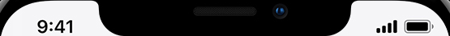

Welcome back,
Sebastian54

