Slide 1
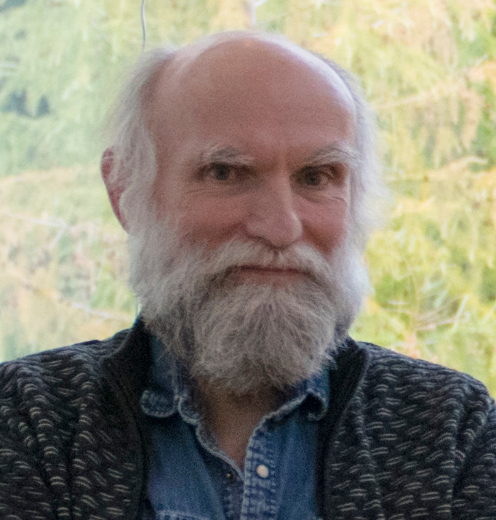
Software architecture for autonomous Robobot
J. Christian Andersen

Slide 2
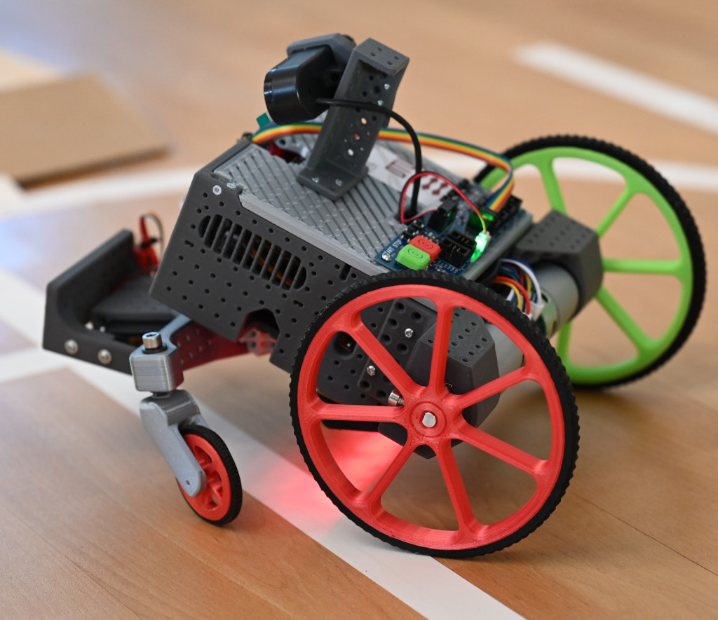
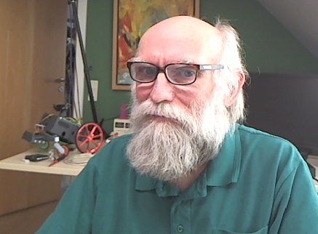
Robobot
Software architecture and introduction to software
J. Christian Andersen

Slide 3
Robobot
Introduction to software
Level 1
J. Christian Andersen

Slide 4
Robobot
Introduction to software
Level 3 – Situation / vision
J. Christian Andersen

Slide 5
Robobot
Introduction to software
Level 2 – Drive alternatives
J. Christian Andersen

Slide 6
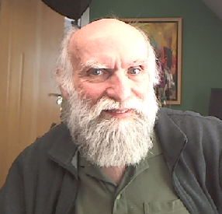
Robobot introduction to C++ software
J. Christian Andersen

Slide 7
Robobot introduction to C++ Plan100
J. Christian Andersen

Slide 8
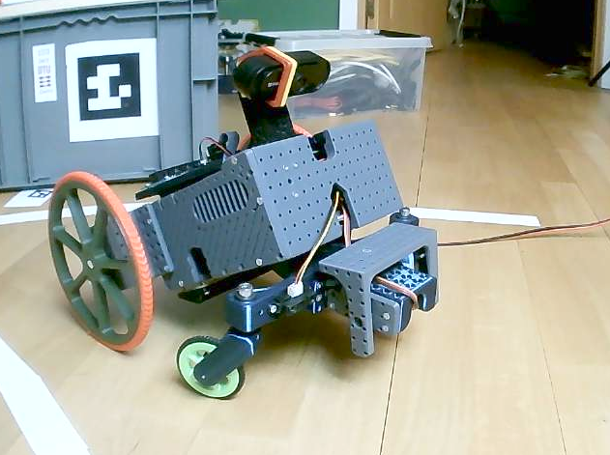
Robobot
Line sensor code and calibrate
J. Christian Andersen

Slide 9
Robobot
Edge and distance code
J. Christian Andersen

Slide 10
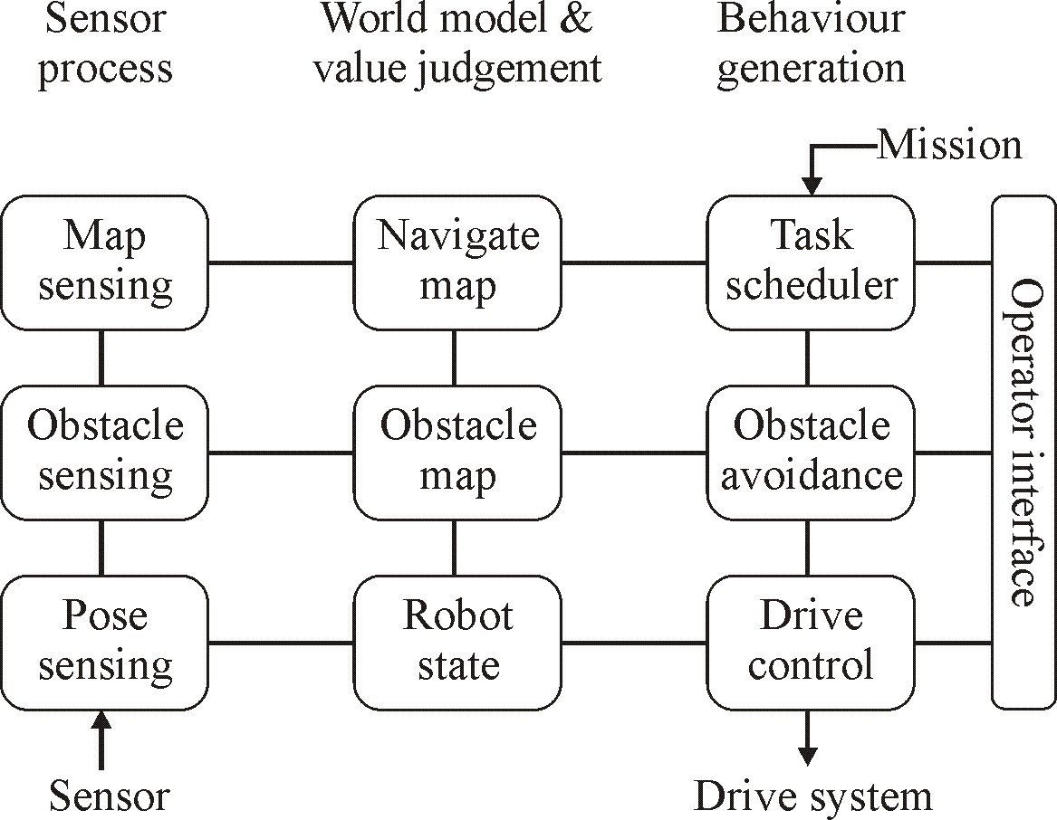
Robobot in blocks
Motor
Distance
Distance
Battery
12V
Servo
PWM
5V
Wifi
on
Raspberry PI
Mission control
Teensy board
(Regbot)
encoder
Camera
USB
USB
PWM
5V
display
encoder
digital
pulse
analogue
Motor
Digital IO
IMU
Line sensor
start

Slide 11
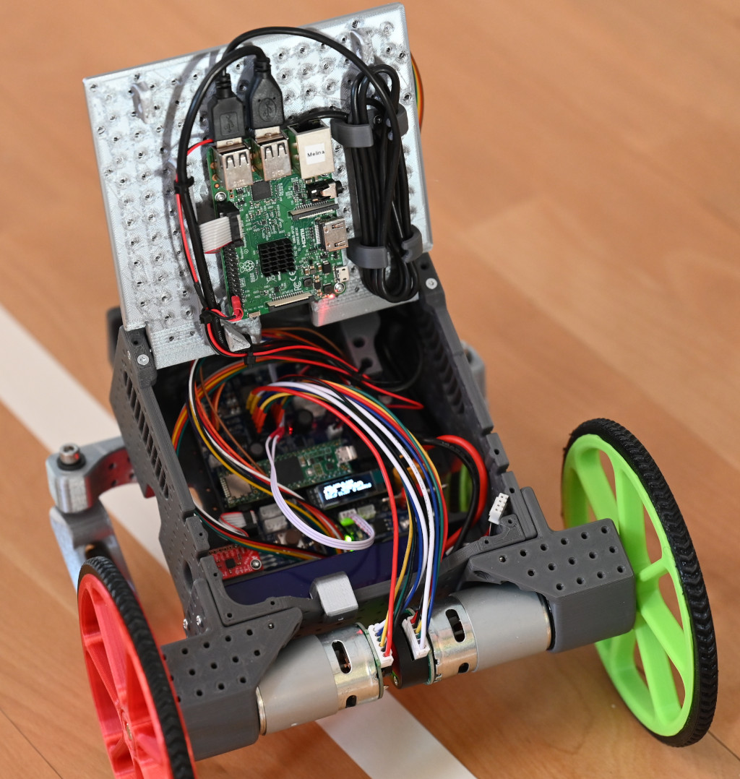
Robobot software blocks
Camera
Raspberry PI (3 or 4)
USB
Teensy PCB (Regbot)
Wifi
display
Sensor
Interface
Publish/
Subscribe:
Encoder,
IMU,
IR-distance,
line-sensor
battery,
current
...
Python3
(socket-base-py)
Base control
(raubase C++)
/dev/ttyACM0
USB
IP-display
(ip_disp)
Servo interface
Motor interface
Start button only
Digital IO
start

Slide 12
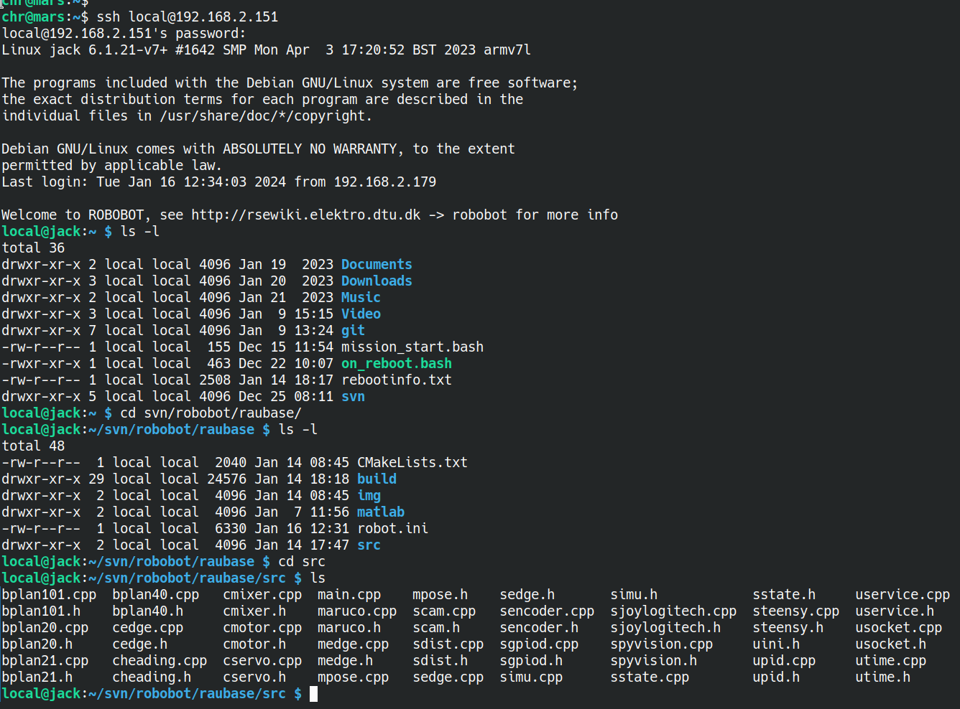
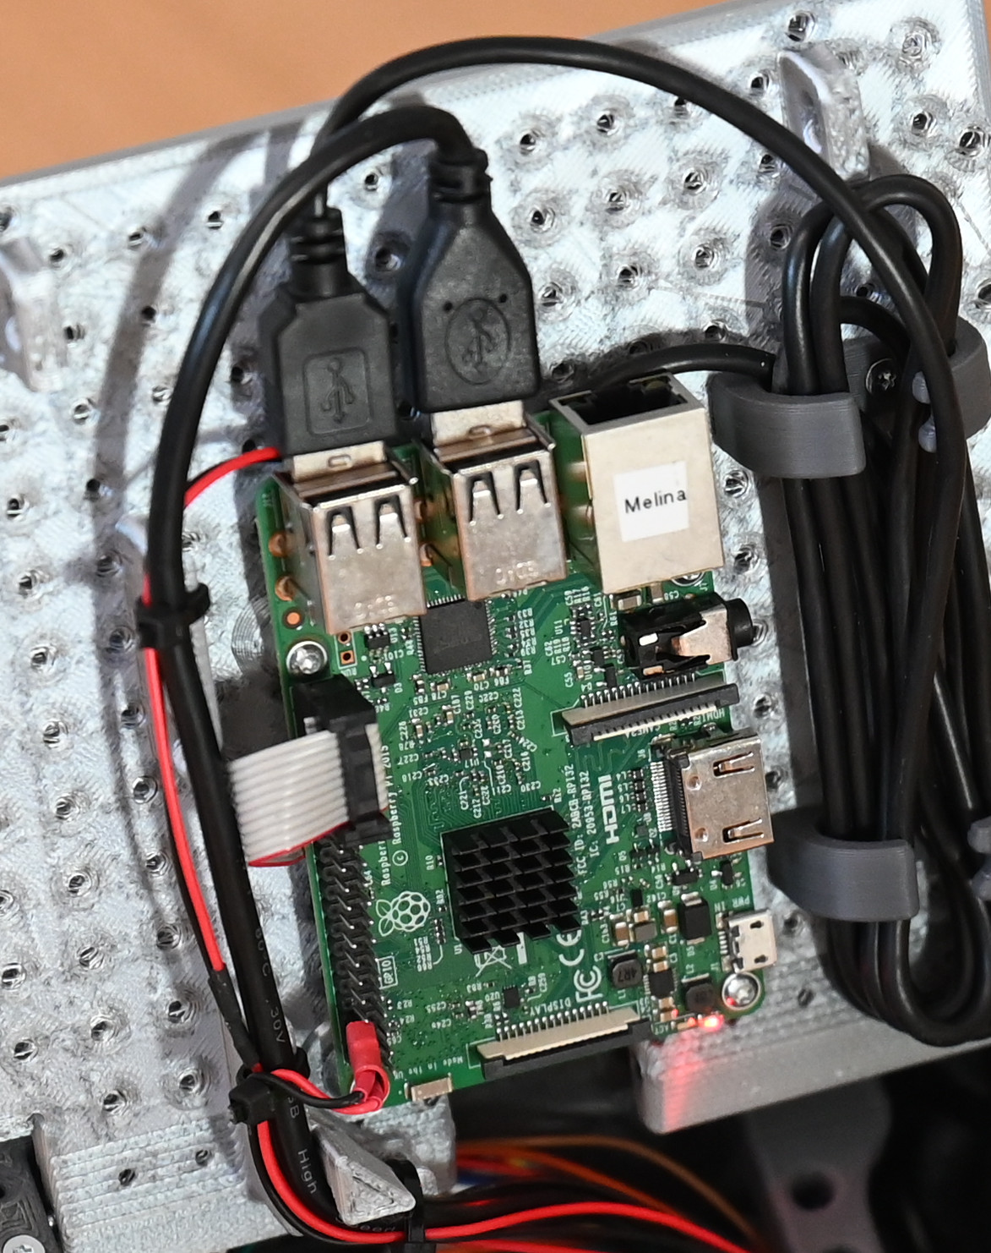
Software on Raspberry Pi
Camera
Raspberry PI (3 or 4)
USB
Wifi
Python3
(socket-base-py)
Base control
(raubase C++)
/dev/ttyACM0
IP-display
(ip_disp)
Start button only
Digital IO
start

Slide 13
Architecture description – NASREM
(text in boxes are just to exemplify)
hours
minutes
Sensory
processing
Modelling and
assessment
Behaviour
generation
Abstraction
Objectives
Update frequency
Situation
sensor
Situation
detect
Situation
behaviour
Drive
sensing
Drive
methods
Move type
control
Real time requirement
Planning horizon
Configuration
Operator interface (debug)
Pose
sensing
Robot
pose
Drive
control
seconds
milliseconds
sense
Drive system
ref: NASREM
The National Aeronautics and Space Administration (NASA) and the US National Institute of Standards and Technology (NIST) have developed a Standard Reference Model Telerobot Control System Architecture (NASREM). Albus, J. S. (1992), A reference model architecture for intelligent systems design.

Slide 14
Robobot level 1 (velocity and heading)
(version for the rsewiki)
Sensory
processing
Modelling
Plan and execute
Sensory
processing
Modelling and
assessment
Plan and
execute
Heading mode
Plan
Situation
sensor
Situation
detect
Situation
behaviour
Forward velocity
Rotation velocity
Forward velocity
Rotation velocity
Drive
sensing
Drive
methods
Drive type
control
Mixer
(cmixer)
Heading
(cheading)
Pose
sensing
Robot
pose
Drive
control
sense
Drive system
Encoder
(sencoder)
Pose
(mpose)
Velocity
(cmotor)
PID
(upid)
Logfiles
(for Matlab)
Parameters
(uservice)
Config.
(robot.ini)
Teensy i/f
(steensy)
USB
Hardware
(Teensy)
Most block text in brackets
corresponding to filenames
(eg. upid = upid.cpp and upid.h)
Sensor data
(text lines)
Motor voltage
(text lines)

Slide 15
Robobot level 2 (drive alternatives)
Behaviour plans
(version for the rsewiki)
Sensory
processing
Modelling
Behaviour generation
Selected
Drive type and
parameters
Sensory
processing
Modelling and
assessment
Plan and
execute
Situation
sensor
Situation
detect
Situation
behaviour
Distance
(sdist)
Distance
(mdist)
Wall drive
(cdist)
PID
(upid)
Drive
sensing
Drive
methods
Drive type
control
Pose
sensing
Robot
pose
Drive
control
Line sensor
(sedge)
Edge detect
(medge)
Edge drive
(cedge)
PID
(upid)
sense
Drive system
Parameters
(uservice)
Logfiles
(for Matlab)
Gyro/acc
(simu)
Tilt
(mimu)
Config.
(robot.ini)
Forward velocity
Rotation velocity
Heading mode
Teensy i/f
(steensy)
Pose
(mpose)
drive
control
Most block text in brackets
corresponding to filenames
(eg. upid = upid.cpp upid.h)
---- Dashed frame means
not provided.
Level 1

Slide 16
Robobot level 2 (drive alternatives)
Behaviour plans
(version for the rsewiki)
Sensory
processing
Modelling
Behaviour generation
Selected
Drive type and
parameters
Sensory
processing
Modelling and
assessment
Plan and
execute
Situation
sensor
Situation
detect
Situation
behaviour
Distance
(sdist)
Distance
(mdist)
Wall drive
(cdist)
PID
(upid)
Drive
sensing
Drive
methods
Drive type
control
Pose
sensing
Robot
pose
Drive
control
Line sensor
(sedge)
Edge detect
(medge)
Edge drive
(cedge)
PID
(upid)
sense
Drive system
Parameters
(uservice)
Logfiles
(for Matlab)
Gyro/acc
(simu)
Tilt
(mimu)
Config.
(robot.ini)
Forward velocity
Rotation velocity
Heading mode
Teensy i/f
(steensy)
Pose
(mpose)
drive
control
Most block text in brackets
corresponding to filenames
(eg. upid = upid.cpp upid.h)
---- Dashed frame means
not provided.
Level 1

Slide 17
Robobot level 3 (Vision)
Behaviour plans
(version for the rsewiki)
Sensory
processing
Modelling
Behaviour generation
Sensory
processing
Modelling and
assessment
Plan and
execute
Behaviour
sequence
(main)
Situation
sensor
Situation
detect
Situation
behaviour
Python
(socket-base-py)
Situation
detect
Drive
sensing
Drive
methods
Drive type
control
Behaviour
(bplanXX)
Pose
sensing
Robot
pose
Drive
control
Camera
(via USB)
Python i/f
(spyvision)
Golf ball
(m???)
sense
Drive system
Logfiles
(for Matlab)
Camera
(scam)
Aruco
(maruco)
Selected
Drive type and
parameters
Parameters
(uservice)
Config.
(robot.ini)
Most block text in brackets
corresponding to filenames
(eg. scam = scam.cpp scam.h)
---- Dashed frame means
not provided.
Drive
sensor
Drive
model
Drive
control
Level 1+2

Slide 18
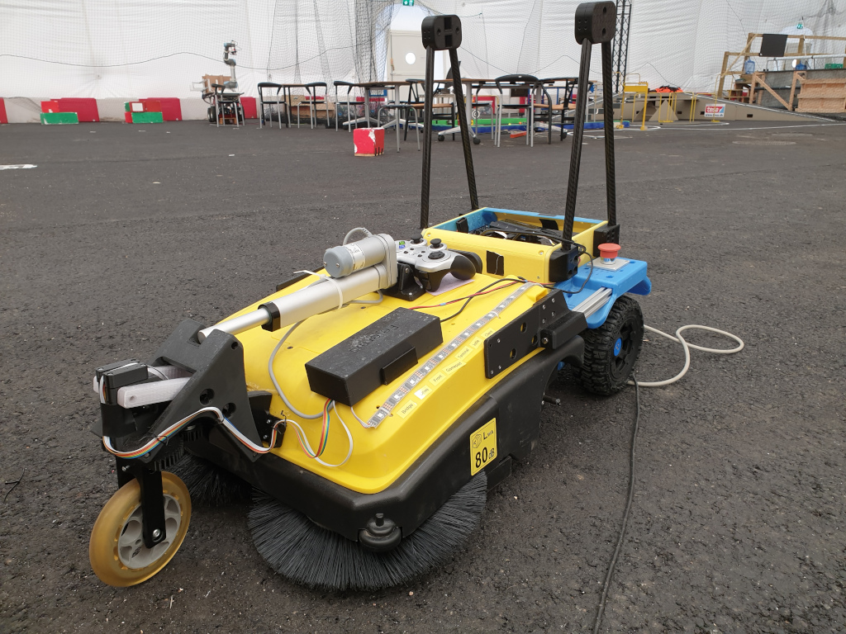
Architecture – higher levels?
Example
Situation detect
Snow, rain
Traffic situation
(Battery) power low
Road surface (soft, wet)
Localization lost
Someone in distress
Behavior rules (e.g. traffic)
Load status
Weed detect
opportunity
Task generate
deliver opportunity
pick up opportunity
cut weed
clean
assist/help
map
recharge option
Detect
Situation
Plan
Robot
Objective
Calendar
access
Calendar
assess
Objective
plan
go
Map
validity
Explore
plan
priority
e.g.
battery
Asset
sense
Asset
projection
Recharge
plan
Action
decision
Cable or net
Danger
detect
Area
limitations
Brush
use risc
Situation
items
Area
situation
Test setup
People
detect
People
movement
Friendly
behaviour
Mapping
localization
Map
route
Obstacle
sense
Local
map
Obstacle
avoid
NASREM
Pose
sense
Robot
state
Drive
control
sense
Action

Slide 19
NASREM software model
- for autonomous robot
Sensor processing
(prepare data)
World model
(in context)
Behavoiur
generation
Mission
objective
Abstraction
Situation
sensor
Situation
state
Behaviour
decision
Update frequency
Obstacle
sensor
Obstacle
map
Obstacle
avoidance
Configuration and monitoring
Pose
sensor
Robot
state
Drive
control
Sensor
Actuator
Function

