Slide 1
Task 1 – Method and results
Managed to implement: Brute force in C.
Wanted to implement: Ukkonen's algorithm.
Brute force: For every line, iterate over suffixes, if suffix matches adapter, then output suffix.
Sequences with a suffix matching some prefix of adapter = 646 364
N = nucleotides per sequence
L = number of sequences
Asymptotic worst case runtime = O(L * N^2)
Practical runtime = 0.47 seconds with an Intel i5 processor

Slide 2
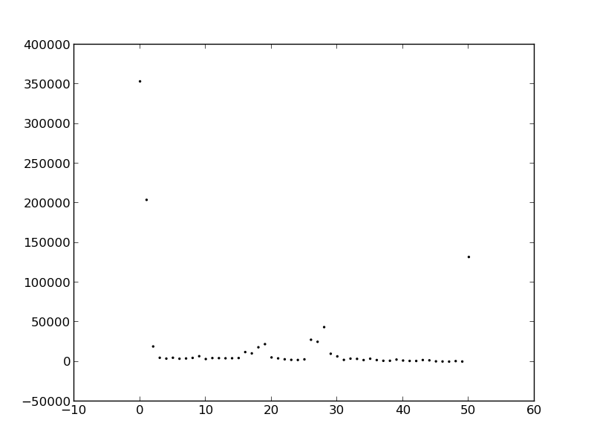
Task 1 – Remaining length distribution

Slide 3
Task 2 – Method and results
Managed to implement: Brute force in python
Wanted to implement: l-mer filtration
Sequences with a suffix matching some prefix of adapter
10% error rate = 385 273. 25% error rate = 389 527
Asymptotic worst case runtime = O(L * N^2)
Practical runtime = 140 seconds

Slide 4
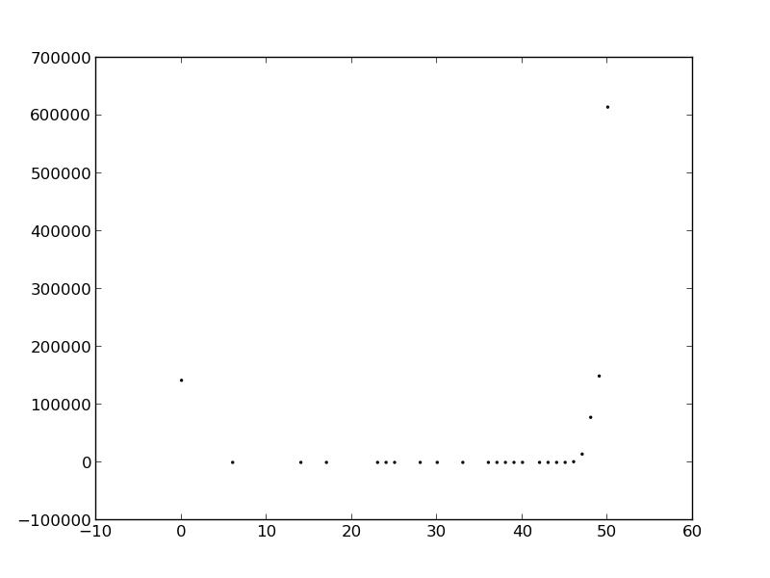
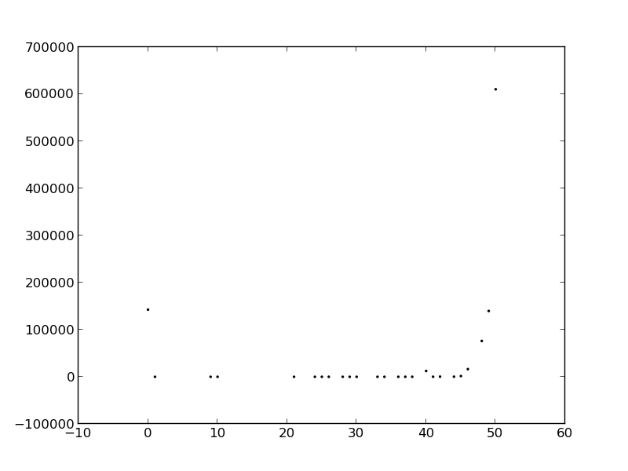
Task 2 – length distribution
Remaining sequence length. Error rate 10%
Remaining sequence length. Error rate 25%

Slide 5
Task 3 – method
Finally not brute force! (that would have been difficult)
Managed to implement: Branch and bound motif finding.
Wanted to implement: Branch and bound motif finding.
Search space – all possible alignments vs. all possible sequences
Preprocessing stage – building a hash table of the number of times a suffix is in the DNA Blob. O(lines * line_length). sort of.
Branch and bound stage – worst case exponential. Average ???
Optimizations:
  Keep track of “used up” potential at each index (keeps the upper_bound down)
  Only generate children that are in the hash table. ( legal? Removes some optimal solution?)

Slide 6
Task 3 – results
Går tom for minne på s_1_sequence_1M
Men på s_3_sequence_1M
Practical runtime: 107 seconds, (2.2 GB memory)
Infered sequence on s_3_sequence_1M
“GCCTCTGGATGCGGTAATTGTCCCTGAGTGGGAACAGGCACCACCCGCTG”

Slide 7
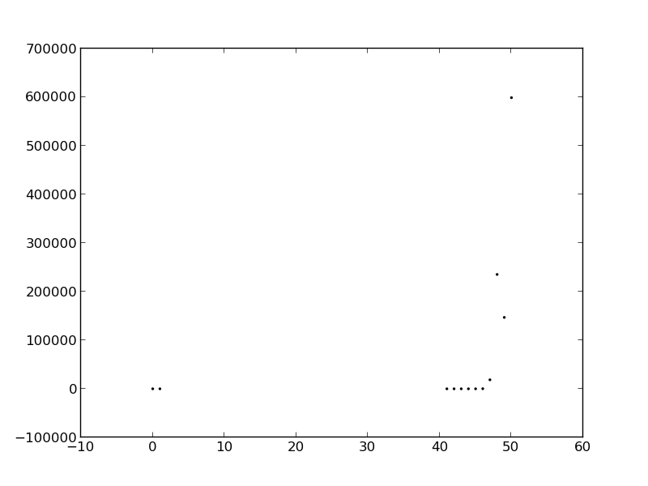
Task 3 – length distrubution

