Slide 1
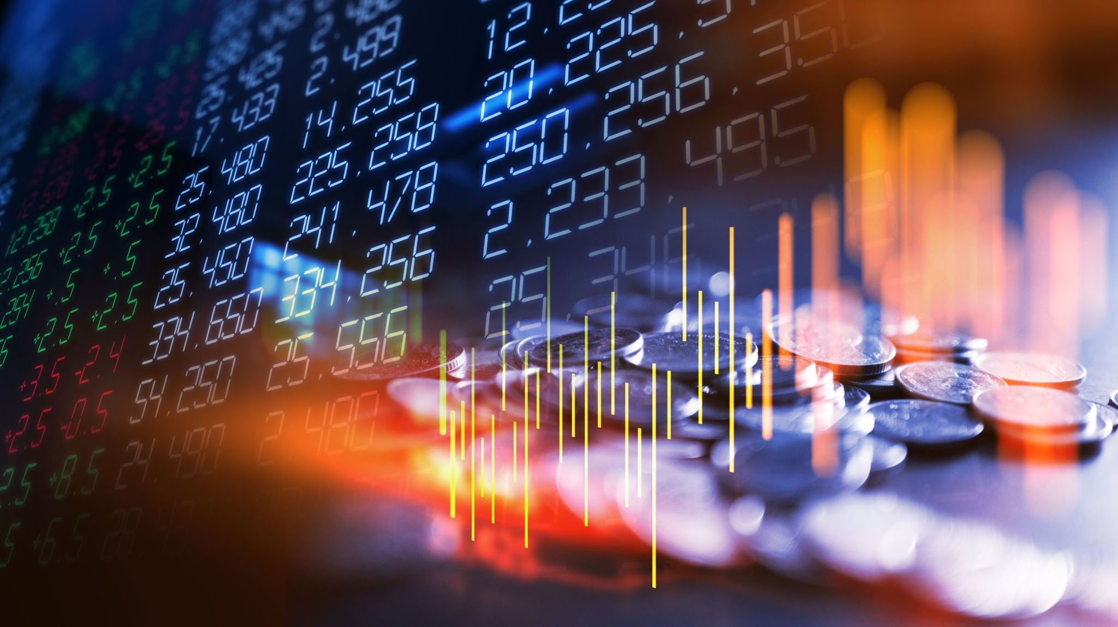
Poli Hedge Fund
Busani Ettore
Castellano Sebastian
De Bettin Andrea
Marcosignori Lucrezia

Slide 2
CONTENTS
01
02
03
04
05
PORTFOLIO COMPOSITION
MARKET INTEGRATION
MODELS AND CONSTRAINTS
PERFORMACE ATTRIBUTION
COMMENTS AND RESULTS

Slide 3
Portfolio Composition

Slide 4

Fund Composition
Period: from 22/09/21 to 3/11/21
Initial value: 5.000.000 €
Information Ratio = $\frac{{(R}_{p}−R_{b})}{σ_{(R_{p}−R_{b})}}$
$$R_{p} −Portfolio Return$$
$$R_{b} −Benchmark Return$$
$$σ_{(R_{p}−R_{b})} −Tracking Error$$

Slide 5
Benchmark
MIGAX: standard bond benchmark
MSCI: standard equity benchmark

Slide 6
Bond funds
Amount invested : 2.500.000 €
€
1
iShares Core U.S. Aggregate Bond ETF
iShares Core U.S. Aggregate Bond ETF
iShares Core U.S. Aggregate Bond ETF
2
PIMCO Active Bond Exchange - Traded Fund
2
3
iShares Core U.S. Aggregate Bond ETF
iShares iBoxx $ High Yield Corporate Bond ETF
iShares Core U.S. Aggregate Bond ETF
4
Nationwide Amundi Global High Yield Fund Class A
4

Slide 7
Equity Funds
DWS Smart Industrial Technologies LD
Fidelity Select Chemicals Portfolio
Fidelity Select Health Care Portfolio
02
04
06
01
03
05
Fidelity Select Financial Services Portfolio
Goldman Sachs Emerging Markets Equity Insights Fund Class R6
Fidelity Select Semiconductors Portfolio

Slide 8

Commodities “Safe Haven Assets”
01
Invesco Optimum Yield Diversified Commodity Strategy No K-1 ETF
02
Eurizon Azioni Energia E Materie Prime
03
PIMCO CommodityRealReturn Strategy Fund Class A
Amount invested: 500.000 €
€

Slide 9

Crypto
Ethereum
Amount invested: 150.000 €
Why?
Cryptos are high uncorrelated to the market

Slide 10
Market Integration

Slide 11
Main Market Events
Evergrande Crisis
670M $ bond interest due by the end of the year
Missed multiple coupon payments
Inflation Growth
Rise of Interest Rates
Inflation growth exceeding expectations
Reaching 6.2% in October
Central Banks rising interest rates to counter inflation
FED tapering starting in early November
Rise of Energy Prices
Higher costs for production
Energetic crisis in Europe and China
Gas FFT reaching all time highs
Due to high energy costs, many industries cut down production
Production chain also affected by Covid restrictions.

Slide 12
Implementation In Our Investment Plan
First Delivery – Building the Portfolio
Evergrande Crisis
Avoid direct exposure to asian Market when building the portfolio
Limit the weight of the Equity Asset Class
September worst month of 2021 for S&P (-4.8%)
50% Bond
27% Equity

Slide 13


Implementation In Our Investment Plan
Second delivery – Rebalancing weights of Asset Classes
Rise of Interest Rates
- 10% in the Bond Asset class
+ 8% in the equity asset class
+ 2% in the Commodities asset class
Third Delivery – Target value for Shrinkage Estimators
$$μ_{tgt}= \left\{\begin{aligned}μ_{bond}=−0.1\% \\ μ_{eth}= +3\% \\ μ_{eq}= μ_{com}=0\end{aligned}\right.$$
First Future Bitcoin ETF started trading in the New York stock exchange
$$\overline{μ}=\left(1−γ\right)\hat{μ}+γμ_{tgt}$$

Slide 14
Models and Constraints

Slide 15
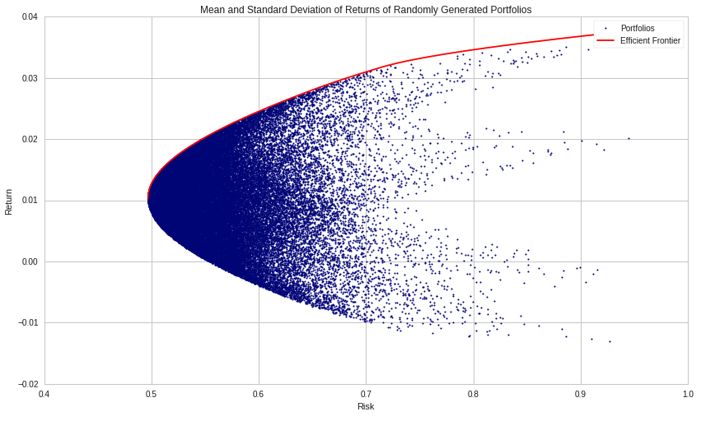
Markowitz Model
Find the efficient portfolios frontier basing on mean and variance.
Consider the covariance between assets to reduce risk.
Our own implementation.

Slide 16
Assumptions
1
Focus only on maximising the expected return and minimising variance.
Variance is the indicator for risk.
2
3
Implicitly assuming a normal distribution for the returns.

Slide 17
Why?
Flexible, both for alternative choices and for enlarging
Simple and easy to implement
02
04
01
03
Few assumptions
Fast (in general)

Slide 18
Implementation
1
Double optimisation problem
Classes and single assets requirements via linear constraints.
2
3
One year time horizon: short term prospective and reliable results.

Slide 19
Estimates Improvement I
Shrinkage estimators with views:
Bond: -0.1% (increasing rates)
Crypto: +3% (good performance and First Future Bitcoin ETF in New York Stock Exchange)
Equity and commodities: 0% (no clear view)

Slide 20
Estimates Improvement II
Resampling:
Balancing the number of frontier points and number of resamples to manage computational effort.
Security check on constraints compliance.

Slide 21
Value-at-Risk
Why? A further step towards safety.
Mild upper bound: to have a known bound rather than a harsh restriction.
Historical simulation approach:
No parametric assumptions.
Catching rare events previously occurred.
Possibility to add weights.
Two years time horizon so it includes covid crisis.

Slide 22
Performance Analysis

Slide 23
Fund vs Benchmark
5,269,497 Eur
5,066,316 Eur
1st Period
2nd Period
3rd Period

Slide 24
Performance of each class per period
1st Period 22/09-07/10
2nd Period 08/10-21/10
3rd Period 22/10-03/11

Slide 25
Performance of Fund per period
Total return:
+5.58%
Total IR:
0.264
1st Period
2nd Period
3rd Period
Return: +3.20%
IR: 0.6527
Return: +1.42%
IR: 0.0273
Return: +1.76%
IR: 0.0479

Slide 26
Total performance of fund classes vs benchmark classes
 | Fund | Benchmark
Equity | 9.05% | 1.01%
Bond | 0.37% | -0.86%
Commodities | 8.55% | N.A.
Crypto | 47.55% | N.A.
Total return | 5.58% | 0.69%

Slide 27
Performance Attribution
 | Asset Allocation | Stock Picking | Interaction Effect
Equity | -0.49% | 3.86% | -0.43%
Bond | 0.18% | 0.87% | -0.25%
Commodities | 0.00% | 0.00% | 0.91%
Crypto | 0.00% | 0.00% | 1.43%

Slide 28
Rebalancing Impact
Total Returns
1) No rebalancing = 4.7%
2) First rebalancing only = 5%
3) Both rebalancing= 5.6%

Slide 29
Forex Indirect Impact
Our investments were mainly focused on the United States therefore we were exposed to the volatility of the exchange market (with some minor exceptions such as Ethereum, quoted in EUR).
Analyzing separately the impact of the USD/EUR rate of exchange when calculating our position’s return in EUR, it ended up earning us about 40,000 euros (almost 1% of our 5.6%!)

Slide 30
Thank you for your attention!

