Slide 1
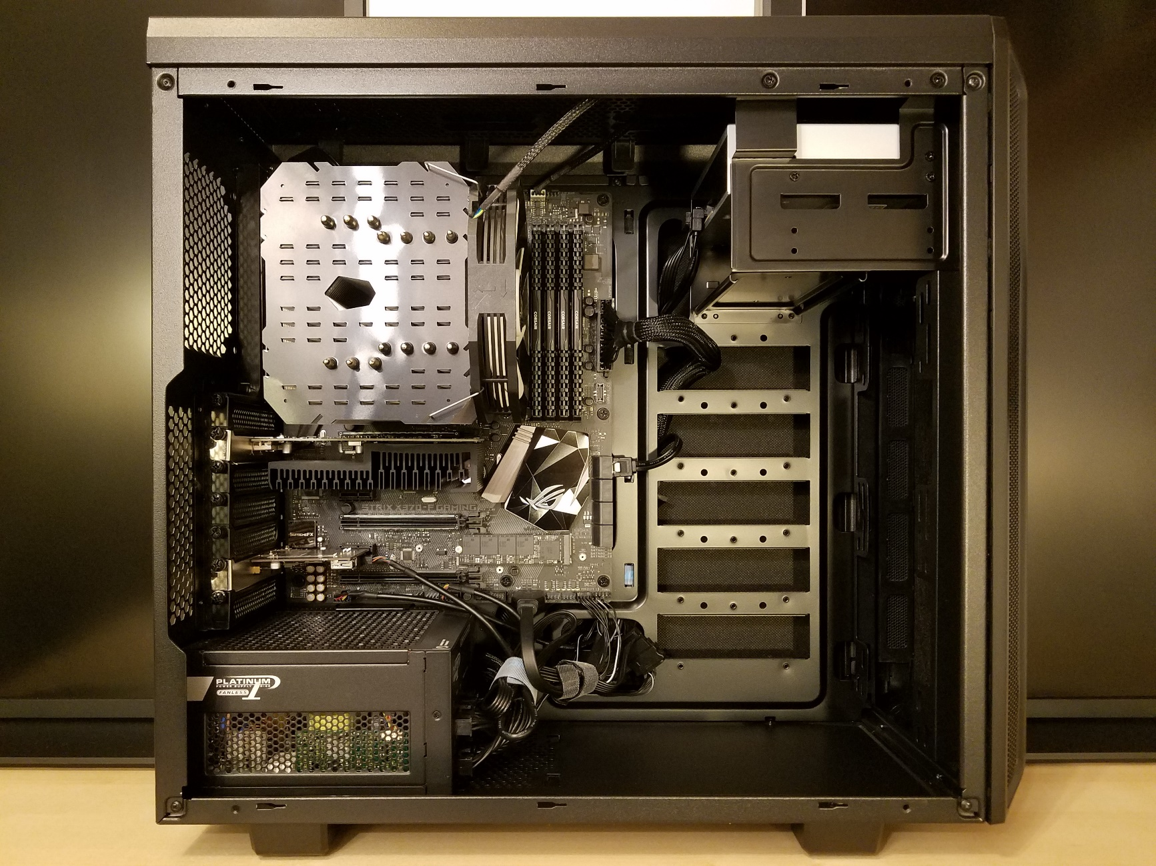
Optical drive slots: Larger transformers might be housed in 5¼“ cases, thus good mount & EMV shielding w/ HV outlets in slot covers.
May also house voltage regulators (like RD DVS5020) in 5¼“ cases with control panel in slot cover.
Shielded housing
provides for EMV
requirements
Microcontroller or single-board computer
Many applications ask for external or remote control, logging of sensor or diagnostics data, etc.
Peripheral components
These may include:
- Entire HV units (low power)
- HV drivers w/ ext. transformers
- Sensor cards
- Oscilloscope modules
- Spectrometer modules
…and more
PCIe bus seems suited for this.
Card slots / outlets
Suited for outlets of either limited HV voltages or connectors for ext. Transformers
Also take up connectors for sensors and diagnostics
ATX PSU
cheap and reliable, available up to 1000W
HDD rack:
Space may be used for further components, like pumps, flow controllers, etc.

