Slide 1


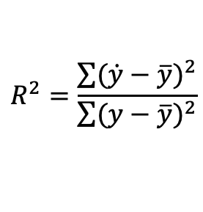
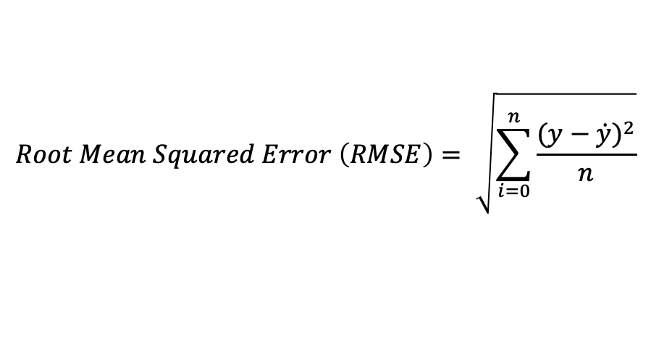
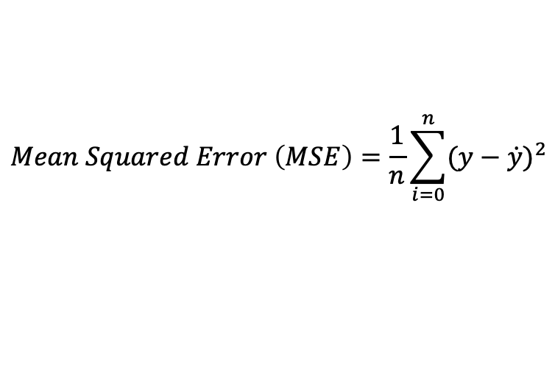

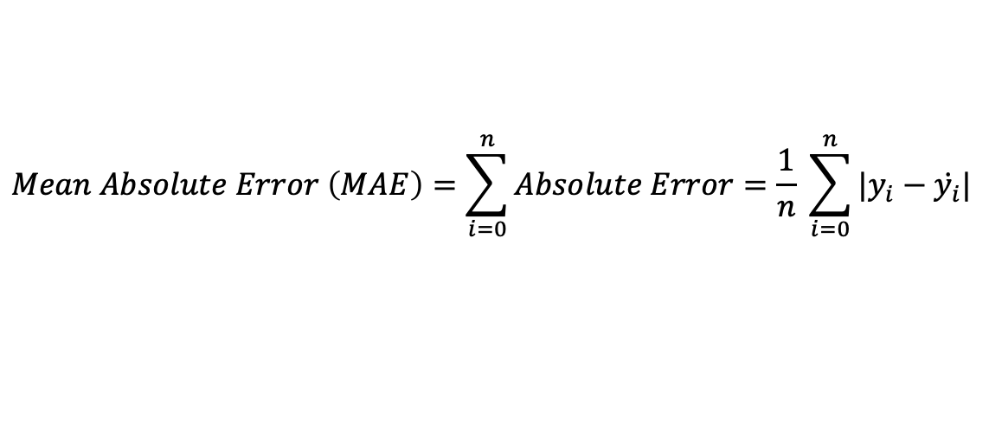

$$y=true value$$
$$\dot{y}=predicted value$$
$$\overline{y}=average value$$
$Error=True Value −Predicted Value=y − \dot{y}$
$$Absolute Error=\left|Error\right|=|y − \dot{y}|$$
$$Mean Absolute Error \left(MAE\right)=\sum_{i=0}^{n}{Absolute Error}=\frac{1}{n} \sum_{i=0}^{n}{|y_{i}−\dot{y_{i}}|}$$
$$Mean Squared Error \left(MSE\right)=\frac{1}{n}\sum_{i=0}^{n}{{(y−\dot{y})}^{2}}$$
$$Root Mean Squared Error \left(RMSE\right)= \sqrt{\sum_{i=0}^{n}{\frac{{(y−\dot{y})}^{2}}{n}}}$$
$$R^{2}=\frac{\sum{{(\dot{y}−\overline{y})}^{2}}}{\sum{{(y−\overline{y})}^{2}}}$$

Slide 2
 | Linear Regression | Support Vector Regression
MSE | 24.2911 | 29.4359
RMSE | 4.9286 | 5.4254
R2 | 0.6687 | 0.5986

