Slide 1
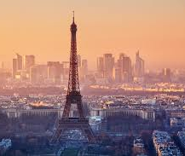
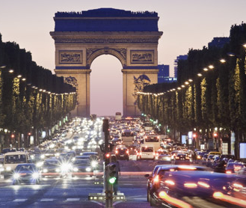
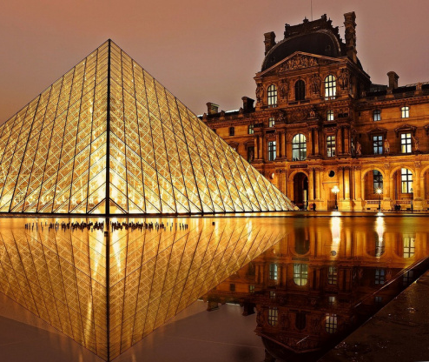
Capstone Project - The Battle of Neighborhoods
How to choose the best hotel in Paris?

Slide 2

I. Business Problem Section
Being one of the world capitals of arts, culture, gastronomy and fashion, millions of travelers visit Paris each year to explore the city's cultural attractions. There are a lot of travel agencies that offer various deals on flights, hotel stays and rental cars. Also, there are people who prefer not to work with a travel agency and who want to plan the holiday on their own.
In this scenario, the business problem is: How could I provide support to different stakeholders (people or tourism agencies) in choosing the best accommodation near the hotels? Where would I recommend that is the best place to stay based on the top accommodation around the hotel? There will also the average price per night in order for everyone to choose the right place with the budget that they have.
To solve this business problem, we will use Foursquare location data and we will create machine learning models to cluster Paris areas in order to recommend profitable hotels based on different surrounding facilities such as hotels, restaurants, stores, attractions and so on.
Through these models the stakeholders will have a wide range of recommendations for accommodation, they will know all the facilities to enjoy on vacation, will receive a wide range of options and, in this way, they will know exactly what hotel is the most suitable for them based on their budget and top venues around the hotel.

Slide 3
II. Data Section
To perform this idea, it was used data from 2 different sources. Data about hotels from Paris was taken from booking. It was collected information related to postal code, name of the hotel, address, average price per night and it was integrated into a database which contain 71 observations about 71 hotels from Paris. For a better analysis it was selected data about hotels from different areas and with different facilities but with the idea that the relevant stakeholders want to book an hotel in Paris not near Paris in order to be near all accommodation.
The second source used is Foursquare location data in order to explore and target recommended locations across different venues.
The final database which combine Foursquare location data and hotels data which will be used to develop our machine learning models and to cluster Paris neighborhoods in order to provide the best recommendations in choosing a hotel based on a wide range of surrounding facilities.

Slide 4
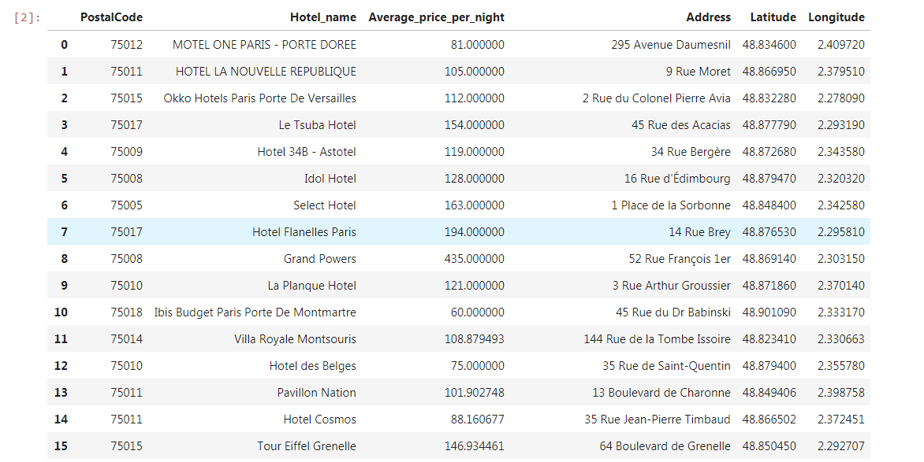
2.1 Data sourcing
Data about hotels from Paris was taken from booking
Out data is composed of Postal Code, Hotel name, Average price per night, Address of the hotel, Latitude and Longitude
These Hotels are the most appreciate by people. Budget and number of stars may differs from each other but the people who actually went there, they really appreciate their trip.

Slide 5
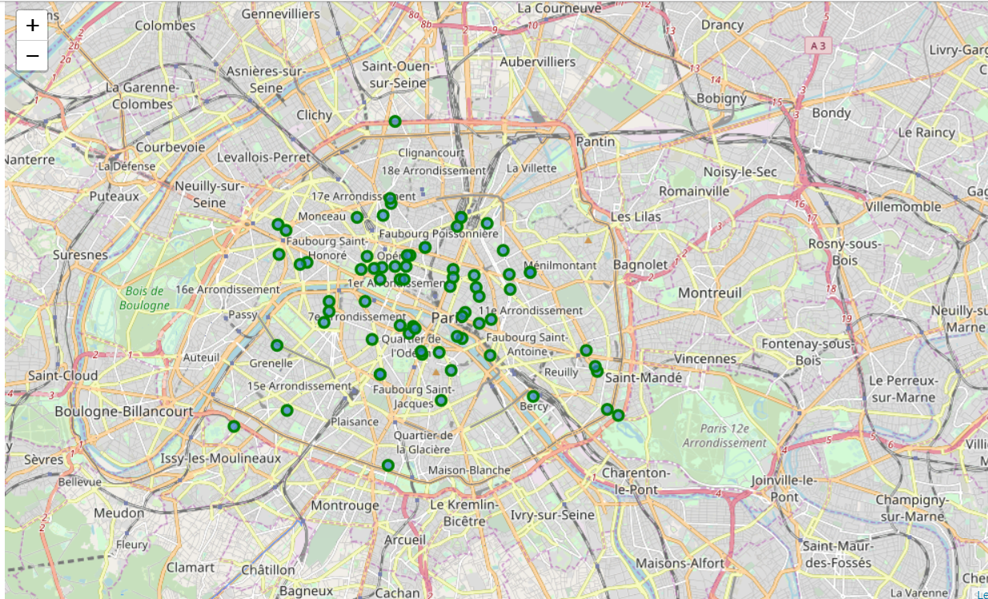
2.2 Map of Paris with hotels on top.
The hotels are in Paris and more especially near all the main tourism attractions that people may ask from an hotel.

Slide 6
III. Methodology section
The main components of the report are:
1. Data Collection: to bring all the required information in one single data frame. The main components of the data are: Postal Code, Hotel name, Average price per night, Address, Latitude and Longitude.
2. Data Exploration and Understanding: to inspect the data, extract and analyze all the hidden insights
3. Data Modeling: K-means Clustering: to cluster Paris and nearby hotels to see how they group together and based on what kind of information with the final purpose to provide useful information related to accommodation strategies

Slide 7
IV. Result Section
It was observed what venues are available near each hotel. Hotels that are in the center of Paris have the most facilities. Compared to the hotels located further from the center. There is a huge variety of facilities from local and foreign restaurants, airport services, art gallery, art museum, bus and train station, shops, church, comedy club, grocery stores, market, medical center, museum, nightclub, park, theater, and so on. Hotels from the central area have in particular facilities, such as local and foreign restaurants, bistro, cafe, bar, bakery, stores, plaza, lounge, along with the biggest tourist attractions: The Eiffel Tower, Louvre Museum, Notre Dame de Paris, Pantheon, Arc de Triomphe.
The clusters were grouped by similarities. It can be noticed that hotels with common venues and many tourist attractions are grouped together, compared with hotels located in less crowded areas and with fewer facilities and venues. The first cluster (Cluster 0), contains the most number of hotels. They have a lot of facilities and the benefit of many tourist attractions. But the largest facilities is in the third cluster (Cluster 2) and a plenty tourist attractions. The latest cluster is composed of few hotels which are isolated and the second cluster is composed of hotels which are far from the center.

Slide 8
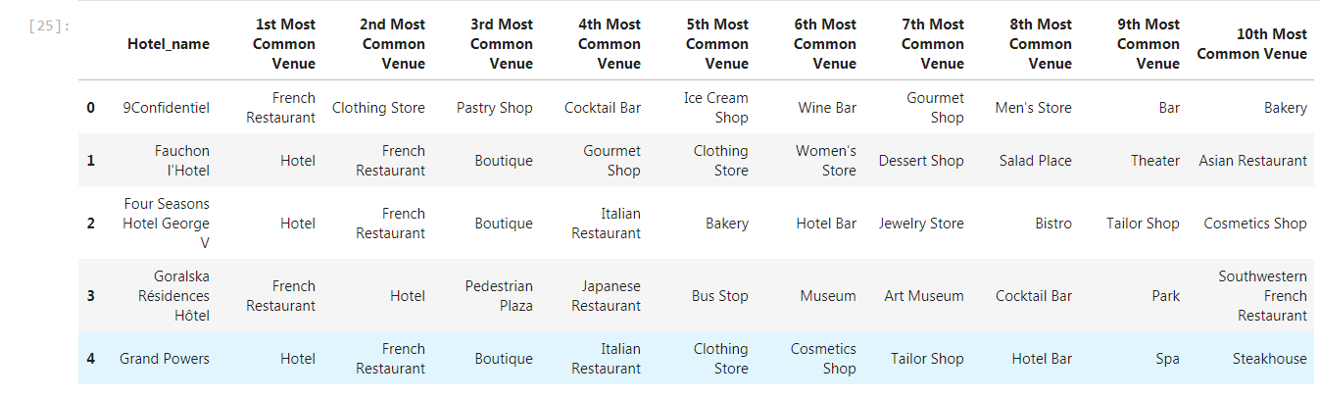
4.1 Top 10 venues.
- In summary of this graph 263 unique categories were returned by Foursquare, then I created a table which shows list of top 10 venue category for each hotels in above table.

Slide 9
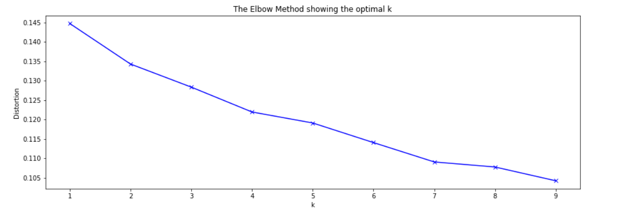
4.2 Find the optimal number of cluster
The elbow method shows us the optimal number of cluster k, in our study our optimal number is not obvious but we can show above that k = 4 for an optimal choice.

Slide 10
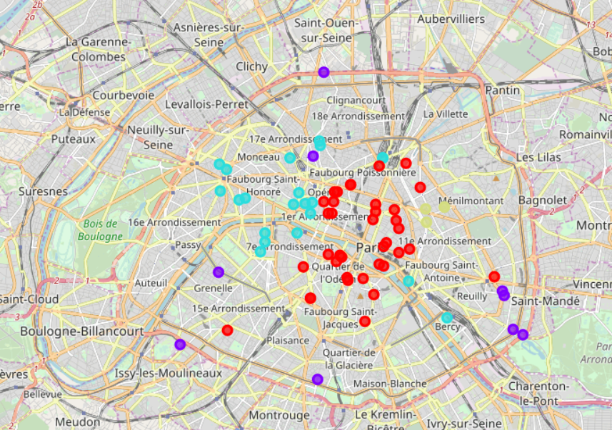
4.3 Map of clusters
First cluster in red;
Second cluster in purple;
Third cluster is blue;
Last cluster in yellow.

Slide 11
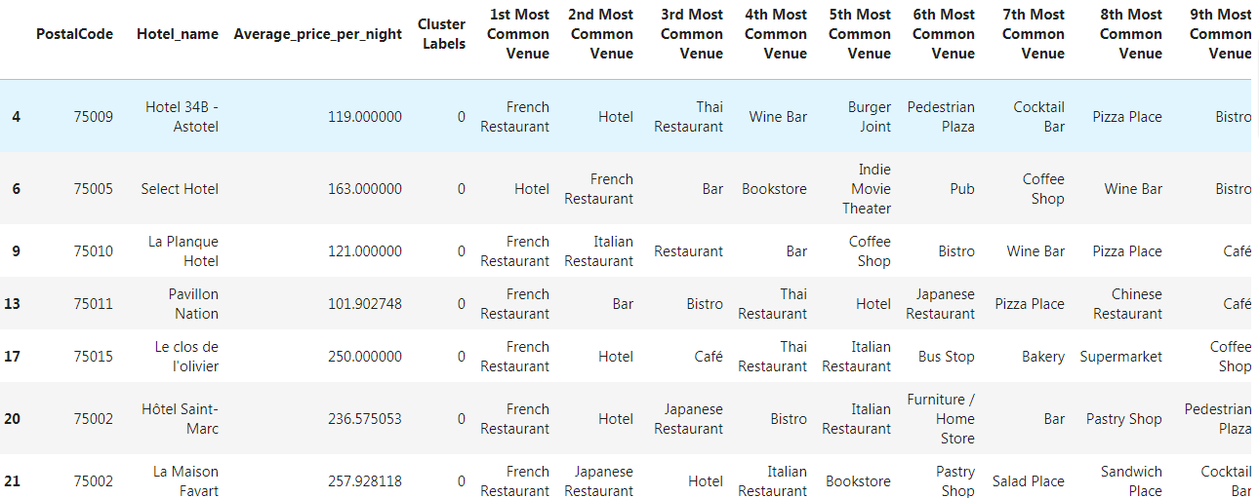
4.4 First cluster
It is only the head of the first cluster. It is the largest cluster regarding the number of hotels.

Slide 12
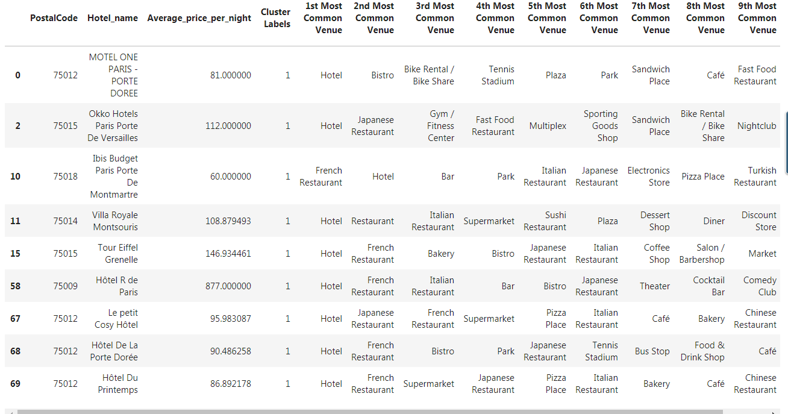
4.5 Second cluster

Slide 13
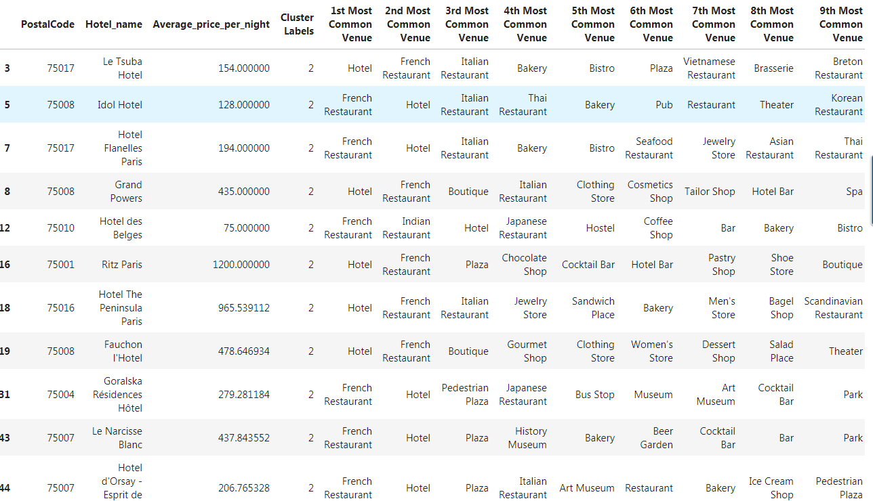
4.6 Third cluster
It is only the head of the first cluster. It is the largest cluster regarding the number of hotels.

Slide 14
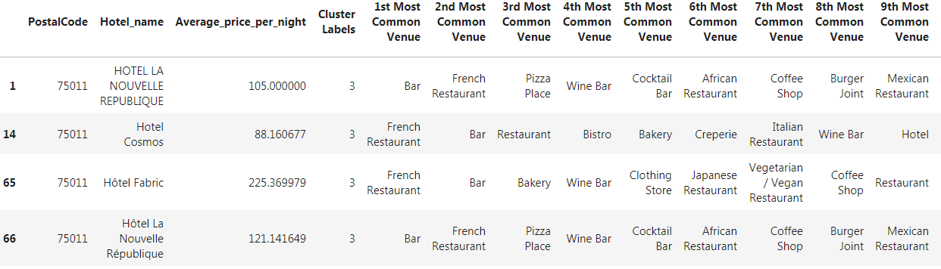
4.5 Fourth cluster

Slide 15
V. Discussion Section
The cost of accommodation varies according to region and type. While hotel rooms are inevitably more expensive in Paris, there are also many interesting hotels in Paris offering the same venues as the most expensive but at an acceptable price. It is interesting to note that, although the hotels in the center of Paris might be considered very expensive due to all the surrounding facilities there are also hotels with a lower price in each cluster which offer the same surrounding possibilities. Although all the clusters have an optimal range of facilities, I have found one main pattern.
The clustering is based on the proportion of each venue and each cluster groups the hotels with the same proportion of venues. In this case, if you are interested in a specific region of Paris but you have a limited budget you can take a look at the model and choose the hotel which offers the same surrounding facilities than the ones more expensive. Every cluster offers the same range of facilities but not in the same proportion.
We can extend this model and take in consideration the nearby region of Paris and try to see which area is the best in point of surrounding venues.

Slide 16
VI. Conclusion Section
To solve this business problem, we clustered hotels from Paris areas in order to recommend venues and to support people who are looking for the right hotel to take the best decisions.
In conclusion, Paris offers a wide range of tourist attractions: food, fashion, culture, nature, art and so on. If someone wants to travel there are many things to consider from choosing the right location, accommodation, flights, rental cars to attractions, restaurants, stores and other facilities. The price of accommodation depends on the number of venues and surrounding facilities. The closer the hotel is to the tourist attractions, the more expensive it will be but there is exceptions as you see because in each cluster there is more accessible hotel.

