Slide 1





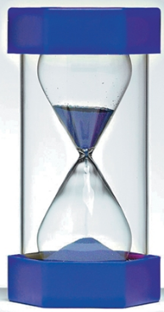
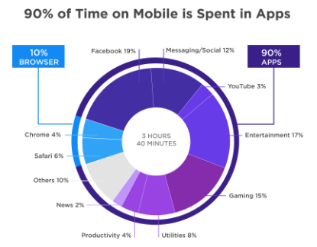


goIT App Project
Sebastian Hällman
How much time do we spend looking at our smartphones?
Sabina Mastafa
Ahmed Ahmed
The average time we spend on our mobile devices daily is 3 hours and 40 minutes and that amount of time does not include the time we spend doing actual phone calls.
What we want to address?
Avoid mental fatigue due to overuse
Fight back the addiction
Prevent Smartphone injuries (neck-arm-shoulder pain)
How do we address the problem?
Regulate usage &
How important is your smartphone?
91% say that their smartphone is very important and for 60% it is even more important than
For 96% of Millennial’s (people aged 18-24) the smartphone is very important and for 93% it is definitely more important than
Smartphone apps
References: https://saucelabs.com/blog/how-smartphones-and-mobile-internet-have-changed-our-lives

Slide 2
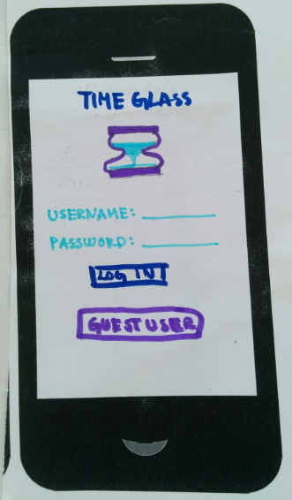
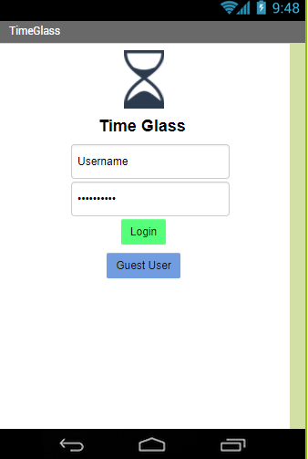
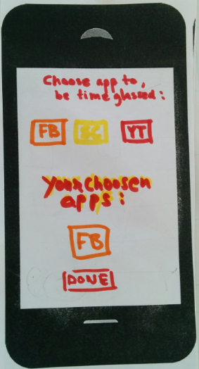
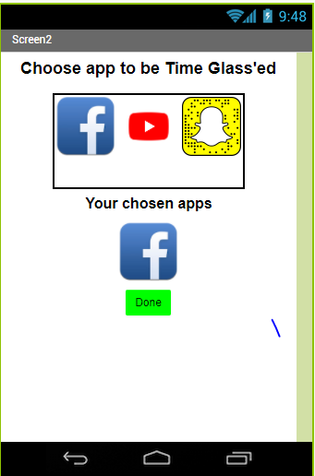
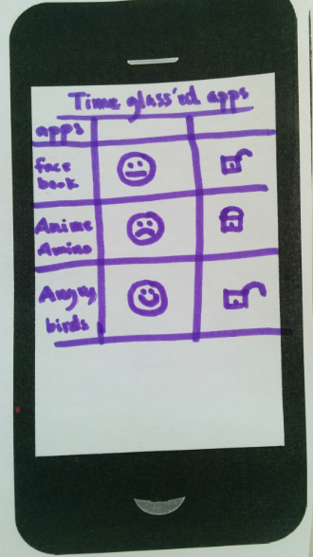
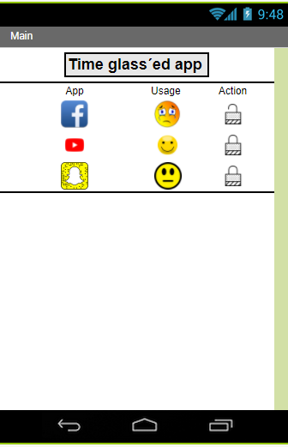
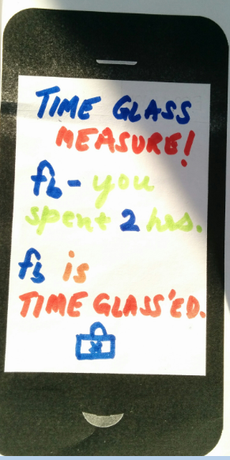
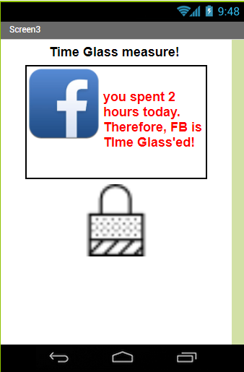
goIT App Project
1
Login to TimeGlass (Android App)
2
Select apps that you want to regulate
MIT APP Inventor Screen
(to be added)
MIT APP Inventor Screen
(to be added)
It’s time to
take back control
with
3
Monitor current usage and set upper limits
4
Receive notifications on apps when they are TimeGlass’ed
MIT APP Inventor Screen
(to be added)
MIT APP Inventor Screen
(to be added)
References: https://saucelabs.com/blog/how-smartphones-and-mobile-internet-have-changed-our-lives

