Slide 1


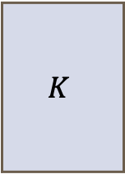

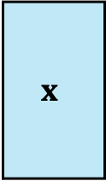
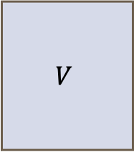

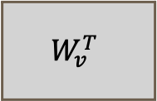




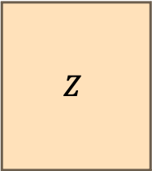
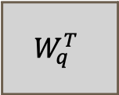



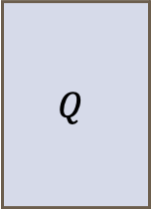






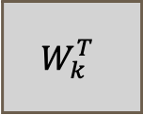


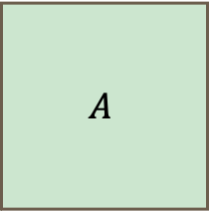

$$d_{k}$$
$$d_{q}=d_{k}$$
$$Q$$
$$W_{q}^{T}$$
$$d$$
$$n$$
$$n$$
$$QK^{T}$$
Embedding size
$$d$$
$$d_{k}$$
$$n$$
Softmax
$$d_{k}$$
$$x$$
$$K$$
Number of input tokens
$$W_{k}^{T}$$
$$n$$
$$n$$
$$d$$
$$n$$
$$A$$
$$d_{v}$$
$$n$$
$$d_{v}$$
$$V$$
$$W_{v}^{T}$$
$$d_{v}$$
$$d$$
$$n$$
$$Z$$
$$n$$
Notes:
Inspired from: https://sebastianraschka.com/blog/2023/self-attention-from-scratch.html

Slide 2

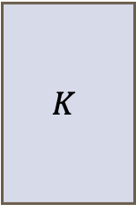
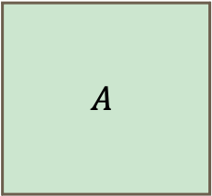
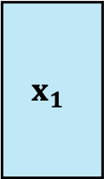
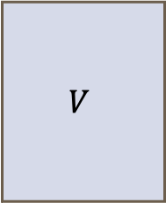
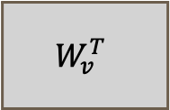



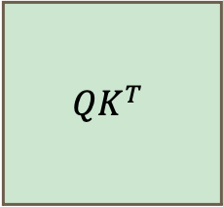


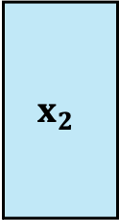



$$d_{k}$$
$$d_{q}=d_{k}$$
$$Q$$
Embedding size
$$W_{q}^{T}$$
$$d$$
$$d$$
$$n$$
$$m$$
$$x_{1}$$
$$QK^{T}$$
Number of tokens
$$n$$
$$d_{k}$$
Softmax
$$n$$
$$d_{k}$$
$$K$$
$$W_{k}^{T}$$
$$m$$
$$d$$
$$m$$
$$d$$
$$A$$
$$x_{2}$$
$$n$$
Number of tokens
$$m$$
$$d_{v}$$
$$d_{v}$$
$$d_{v}$$
$$V$$
$$W_{v}^{T}$$
$$Z$$
$$d$$
$$m$$
$$n$$
Notes:
Inspired from: https://sebastianraschka.com/blog/2023/self-attention-from-scratch.html

Slide 3
DDPM
DDPM
…
DDPM
Notes:
$x_T \sim \mathcal{N}(0,1)$
$x_{t-1} = \frac{1}{\sqrt{\alpha_t}} \left( x_t - \frac{1 - \alpha_t}{\sqrt{1 - \bar{\alpha}_t}} \epsilon_\theta(x_t, t) \right) + \sigma_t z$
$x_{T-1} = \frac{1}{\sqrt{\alpha_T}} \left( x_T - \frac{1 - \alpha_T}{\sqrt{1 - \bar{\alpha}_T}} \epsilon_\theta \right) + \sigma_T z$

Slide 4
…
Notes:
$x_T \sim \mathcal{N}(0,1)$
$x_{t-1} = \frac{1}{\sqrt{\alpha_t}} \left( x_t - \frac{1 - \alpha_t}{\sqrt{1 - \bar{\alpha}_t}} \epsilon_\theta(x_t, t) \right) + \sigma_t z$
$x_{T-1} = \frac{1}{\sqrt{\alpha_T}} \left( x_T - \frac{1 - \alpha_T}{\sqrt{1 - \bar{\alpha}_T}} \epsilon_\theta \right) + \sigma_T z$
$\mathbf{x}_T \sim \mathcal{N}(\mathbf{0},\mathbf{I})$
$\mathbf{x}_{T-1} = \frac{1}{\sqrt{\alpha_T}} \left( \mathbf{x}_T - \frac{1 - \alpha_T}{\sqrt{1 - \bar{\alpha}_T}} \boldsymbol {\epsilon}_\theta \right) + \sigma_T \mathbf{z}$

Slide 5
Notes:
$t \sim \mathcal{U}(1,T)$
$\mathbf{x}_0 \sim p_\text{data}(\mathbf{x}_0)$
$\mathbf{x_t} = \sqrt{\bar{\alpha}_t} \mathbf{x_0} + \sqrt{(1- \bar{\alpha}_t)} \boldsymbol{\epsilon}$
$\mathcal{L}_{\text{DDPM}} = \frac{1}{2\sigma^2_t} \frac{(1 - \alpha_t)^2}{\alpha_t(1 - \bar{\alpha}_t)} \cdot | \boldsymbol{\epsilon}_\theta(x_t, t) - \boldsymbol{\epsilon}_t |_2^2 $
$\boldsymbol{\epsilon} \sim \mathcal{N}(\mathbf{0}, \mathbf{1})$

Slide 6
Notes:
$t \sim \mathcal{U}(1,T)$
$\mathbf{x}_0 \sim p_\text{data}$
$\mathbf{x_t} = \sqrt{\bar{\alpha}_t} \mathbf{x_0} + \sqrt{(1- \bar{\alpha}_t)} \boldsymbol{\epsilon}$
$\mathcal{L}_{\text{DDPM}} =| \boldsymbol{\epsilon}_\theta(x_t, t) - \boldsymbol{\epsilon}_t |_2^2 $
$\boldsymbol{\epsilon} \sim \mathcal{N}(\mathbf{0}, \mathbf{1})$

Slide 7
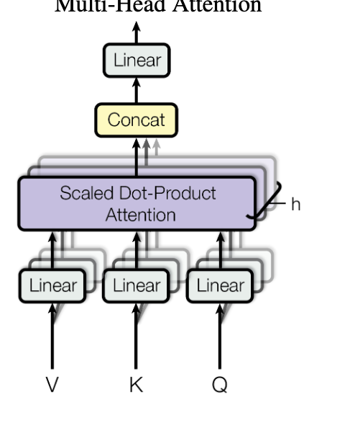


Slide 8
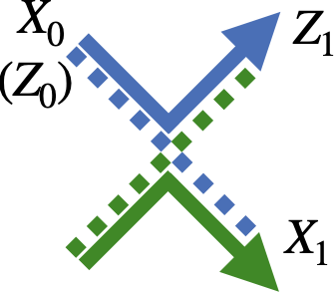

Slide 9


Slide 10


Slide 11
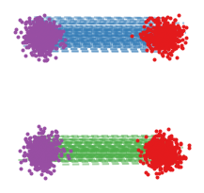

Slide 12


Slide 13
