Slide 1










$i^{th}$ block
🔥
$$×N$$
Text
+
Scale
$$g\left(E_{i},\overline{α_{2}} \right)$$
Pointwise
Feedforward
❄️
$$T5$$
Text
Encoder
Scale, Shift
$$g\left(E_{i},\overline{β_{2}},\overline{γ_{2}} \right)$$
+
Shared by
N blocks
🔥
Multi-Head
Cross-Attention
Time $t$
MLP
Image
+
Scale
$$g\left(E_{i},\overline{α_{1}} \right)$$
Multi-Head
Self-Attention
$$ε$$
❄️
Image
Encoder
Scale, Shift
$$g\left(E_{i},\overline{β_{1}},\overline{γ_{1}} \right)$$
+ noise
$$z_{t}$$
Noised latent
❄️
Frozen Parameters
🔥
Tunable Parameters
Notes:
18,29-2.6=15.69

Slide 2
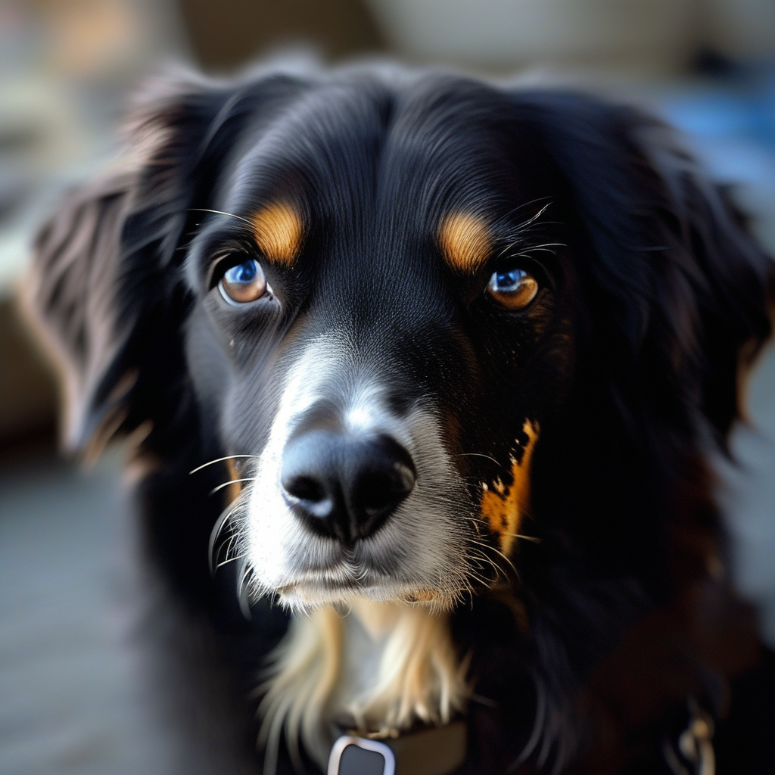
$i^{th}$ block
🔥
$$×N$$
Text
+
A dog
Scale
$$g\left(E_{i},\overline{α_{2}} \right)$$
MLP
❄️
$$T5$$
Text
Encoder
Scale, Shift
$$g\left(E_{i},\overline{β_{2}},\overline{γ_{2}} \right)$$
+
Shared by
N blocks
🔥
Multi-Head
Cross-Attention
Time $t$
MLP
Image
+
Scale
$$g\left(E_{i},\overline{α_{1}} \right)$$
Multi-Head
Self-Attention
$$ε$$
❄️
Image
Encoder
Scale, Shift
$$g\left(E_{i},\overline{β_{1}},\overline{γ_{1}} \right)$$
+ noise
$$z_{t}$$
Noised latent
❄️
Frozen Parameters
🔥
Tunable Parameters
Notes:
18,29-2.6=15.69

Slide 3
Timestep
Timestep Embedding
MLP
Prompt
T5 Encoder
Tokenizer
Image
Patch Embedding
Positional Embedding
Transformer Block 1
Transformer Block 2
…
Noise
Prediction
Transformer Block 28
Modulation
Encoder
Linear Layer
Notes:
18,29-2.6=15.69

Slide 4






Teacher
❄️
Noisy
Image
1
2
3
4
5
6
7
8
9
10
11
12
13
14
15
16
17
18
19
20
21
22
23
24
25
26
27
28
Less Noisy Image
Student
Learning signal
🔥
🔥
🔥
🔥
🔥
🔥
🔥
🔥
🔥
🔥
🔥
🔥
🔥
🔥
🔥
🔥
🔥
🔥
🔥
🔥
🔥
🔥
1
2
3
4
5
6
7
8
9
10
11
12
13
14
15
16
17
18
19
20
21
22
23
24
25
26
27
28
$$i$$
Removed block $i$
$$i$$
New removed block $i$
$$j$$
Tunable block $j$
Notes:
18,29-2.6=15.69

Slide 6
Teacher
❄️
1
2
3
4
5
6
7
8
9
10
11
12
13
14
15
16
17
18
19
20
21
22
23
24
25
26
27
28
Student
🔥
1
2
3
4
5
6
7
8
9
10
11
12
13
14
15
16
17
18
19
20
21
22
23
24
25
26
27
28
Notes:
18,29-2.6=15.69

Slide 7

Teacher
❄️
Noisy
Iamge
1
2
3
4
5
6
7
8
9
10
11
12
13
14
15
16
17
18
19
20
21
22
23
24
25
26
27
28
Less Noisy Image
Student
Learning signal
❄️
❄️
❄️
❄️
❄️
❄️
❄️
❄️
❄️
❄️
❄️
🔥
❄️
❄️
❄️
❄️
❄️
❄️
❄️
❄️
❄️
❄️
1
2
3
4
5
6
7
8
9
10
11
12
13
14
15
16
17
18
19
20
21
22
23
24
25
26
27
28
$$i$$
Removed block $i$
$$i$$
New removed block $i$
$$j$$
Tunable block $j$
Notes:
18,29-2.6=15.69

Slide 8
Teacher
❄️
Noisy
Iamge
1
2
3
4
5
6
7
8
9
10
11
12
13
14
15
16
17
18
19
20
21
22
23
24
25
26
27
28
Less Noisy Image
Student
Learning signal
1
2
3
4
5
6
7
8
9
10
11
12
13
🔥
❄️
14
15
16
17
18
19
20
21
22
23
24
25
26
27
28
$$i$$
Removed block $i$
$$i$$
New removed block $i$
$$j$$
Tunable block $j$
Notes:
18,29-2.6=15.69

Slide 9
Teacher
❄️
Noisy
Iamge
1
2
3
4
5
6
7
8
9
10
11
12
13
14
15
16
17
18
19
20
21
22
23
24
25
26
27
28
Less Noisy Image
Student
Learning signal
🔥
1
2
3
4
5
6
7
8
9
10
11
12
13
14
15
16
17
18
19
20
21
22
23
24
25
26
27
28
$$i$$
Removed block $i$
$$i$$
New removed block $i$
$$j$$
Tunable block $j$
Notes:
18,29-2.6=15.69

Slide 10
Controle Module
1
2
3
4
5
6
7
8
9
10
11
12
13
❄️
1
2
3
4
5
6
7
8
9
10
11
12
13
14
15
16
17
18
19
20
21
22
23
24
25
26
27
28

